Slide 1








Phillip T Slee (Ph.D) Grace Skrzypiec (Ph.D)
John Mannion Chris McDermott

Slide 2
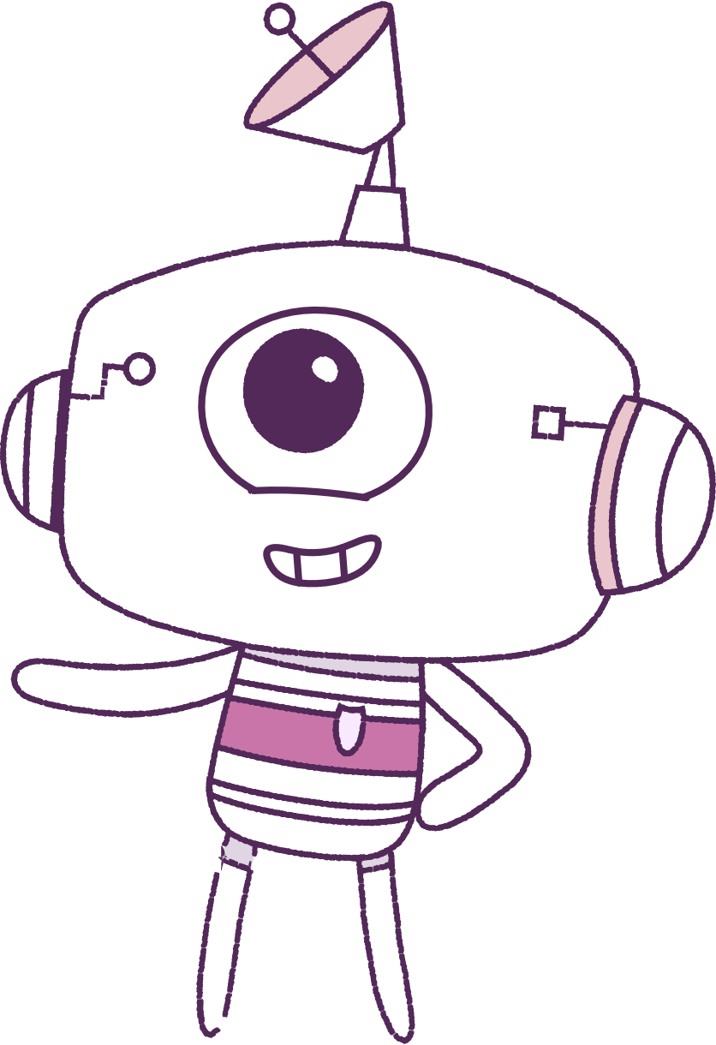




Lesson 4
Reslience
Lesson aims:
1.
Understand resilience.
2.
Learn coping strategies.
Notes:
EQUIPMENT REQUIRED – None
CORE CONTENT
PART 1: Student web search regarding resilience. (Appendix 1).
PART 2: Exercises on resilience.
COPING STRATEGY When I’m down I can pick myself up and move on.

Slide 3
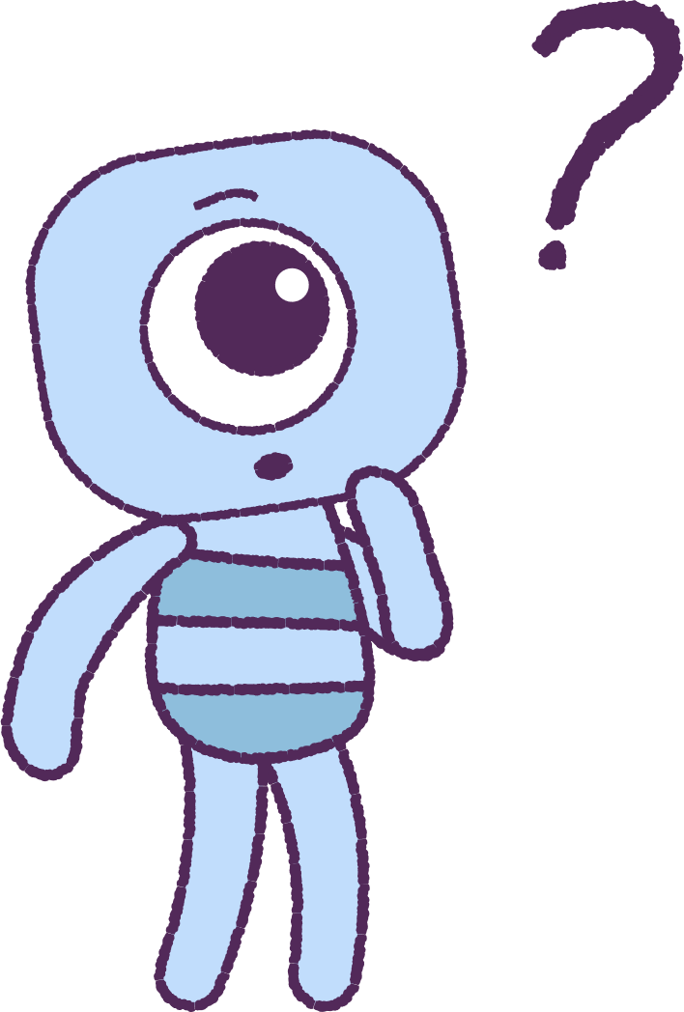

Part 1 – Review content from last week
Who can remember what we discussed last lesson?
In our session today, we will talk more about resilience.
Lets get ready to look at the animation!
3
Notes:
Begin by reviewing what students remember from last week about relationships, friendships, bullying and exclusion
Remind students of the discussion in Lesson 3.
Bullying is: • Typically repeated. • Deliberately harmful. • Involves the systematic abuse of power. Types of bullying include physical, verbal, social and cyber.
In the lesson today we will talk more about resilience.

Slide 4


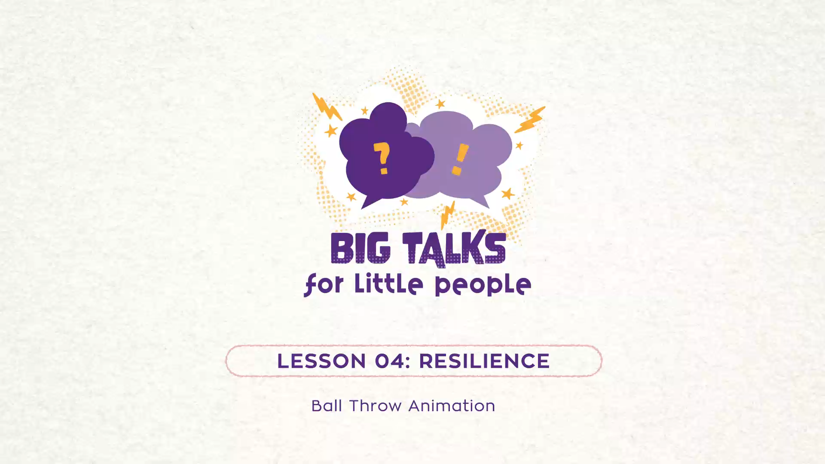

Part 2 – Watch the animation
Hover your mouse over the video to view play settings. Otherwise, download from the website.
4
Notes:
Use this lesson to revisit the concepts of “emotions” and “feelings”. For example: Emotions are relatively discrete reactions to events e.g. failing to score a goal in the ball throw and expressing anger Feelings are more diffuse inner responses that are not readily identified by others
Re-watch a few times – have students felt like Stem & Elk before?

Slide 5
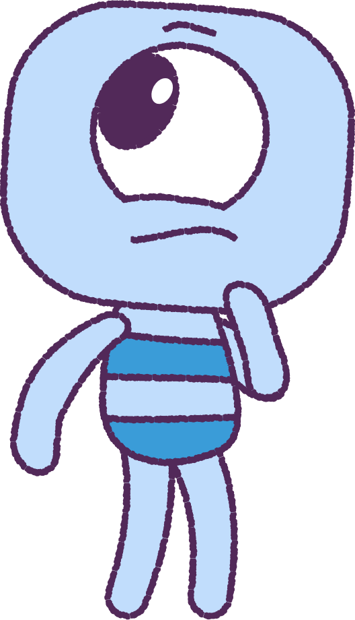
Now let’s discuss
What is happening in this game?
How might the “peeps” be feeling?
What might happen next?
How do you think the character got so good at their ball game?
When the ball was thrown away, how did the character feel? What could they do to be more resilient?
What could you do if that happened to one of your classmates?
5
Notes:
Begin by reviewing what students remember from last week about relationships, friendships, bullying and exclusion
Remind students of the discussion in Lesson 3.
Bullying is: • Typically repeated. • Deliberately harmful. • Involves the systematic abuse of power. Types of bullying include physical, verbal, social and cyber.
In the lesson today we will talk more about resilience.

Slide 6

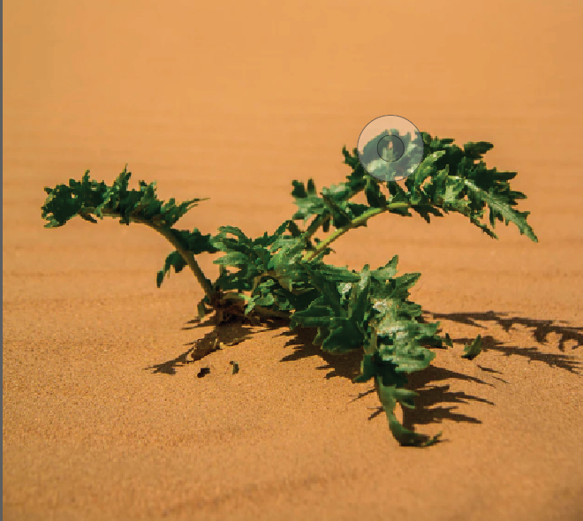




Part 3 – Student Web Search - What is resilience?
Look at images similar to these, and think about what resilience might mean.
“When I’m down,
I can pick myself up, and move on”.
6
Notes:
GROUP WORK Students will explore the concept of resilience by discussing the images in their groups.
The resilience of individuals can be described as their capacity to survive, adapt, and grow in the face of acute crises and chronic stresses. Most recently some researchers have conceptualized resilience as a dynamic process that draws from risk and protective factors that are internal (individual characteristics) and external (family, school and community) to the individual. In line with these factors, resilience can be built through a number of avenues. Firstly, through certain personal characteristics (individuals who are resilient have a good sense of self-worth, purpose, control, belonging and their future). Secondly, through external environments, such as schools, which contribute to personal competencies that help build resilience. Thirdly, through the interaction of these two factors.

Slide 7
Part 4 – (Optional) Alex’s Story
My name is Alex. I am 11 years old. I like sport and I hope to play my favorite sport on my school team next year.
I’ve had a lot of challenges at school and I often get into trouble with other kids and teachers. I have a hard time settling down to do my work and paying attention in class. Sometimes I come to school in the morning really tired, but I need to switch on and learn. Sometimes my switch gets stuck. Then I can get angry and upset and don’t always know how to stop these feelings. Sometimes some of the other kids see me getting upset and make fun of me. Other times I can take a deep breath and control my emotions and get back to the lesson.
What I most want to do is learn to manage my emotions and then I might switch on and start learning. When I switch on, my mind’s turned on, so I’m learning. I don’t want to get into trouble. What I most want to do is switch on and learn, and bounce back.
7
Notes:
Have the group read the story, and answer questions on the next slide.

Slide 8

Question Time
Based on Alex’s story…
• What is resilience?
• How is Alex being resilient?
• How could classmates help Alex?
• What gets in the way of being resilient?
Write on a sheet or in your work books,
and be prepared to share with the class.
8
Notes:
The group answers the following questions:
• What is resilience?
• How is Alex being resilient?
• How could classmates help Alex?
• What gets in the way of being resilient?

Slide 9

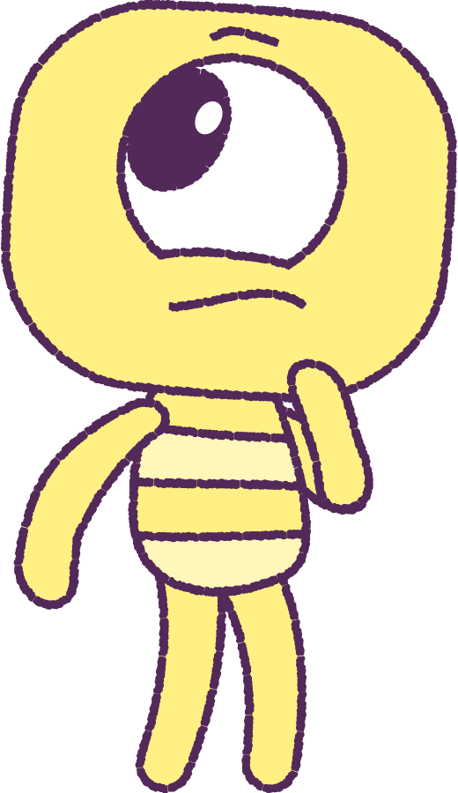
Can you think
of someone who
has been resilient?
What did they do?
9
Notes:
Have students write their answers in their work book or on a sheet and be prepared to share with the class.

Slide 10
Part 5 – Resilience exercises. (Optional)
What would you do?
1.
You’ve been waiting in the tuckshop line at recess and another student pushes in front of you.
3.
It’s recess and you see a group of your friends playing handball. When you ask to join in, someone calls you a “loser” and no-one invites you to play.
2.
Your teacher sets a group task to be completed in the lesson. The others in your group start fooling around and even though you try to get them to work together, when the lesson ends your group has nothing to hand in. Your teacher gives you all a lunchtime detention.
4.
Your parents have just read your report card. They are unhappy about some of your grades/marks and tell you that you’re banned from playing games online for 3 months.
10
Notes:
Class discusion.

Slide 11
This is the end of Lesson 4.
Great work!

