Slide 1








Phillip T Slee (Ph.D) Grace Skrzypiec (Ph.D)
John Mannion Chris McDermott

Slide 2
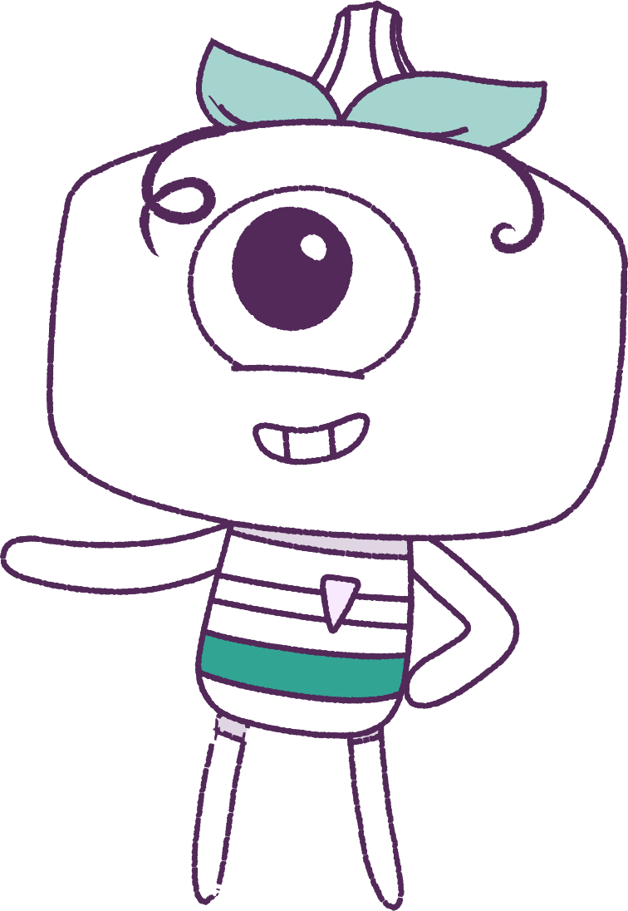




Lesson 5
Self Concept
Lesson aims:
1.
Understand self-concept.
2.
Learn about being proud, and responsible.
Notes:
EQUIPMENT REQUIRED “Self Concept” Work books for group work.
A number of different magazines, scissors, and glue and/or tape.
Handout: ”Awesome” adjective list.

Slide 3


Part 1 – Review content from last week
Who can remember what we discussed last lesson?
In our session today, we will talk more about self concept.
Lets get ready to look at the animation!
3
Notes:
Begin by reviewing what students remember from last week about resilience.
In the lesson today we will talk more about self-concept.

Slide 4


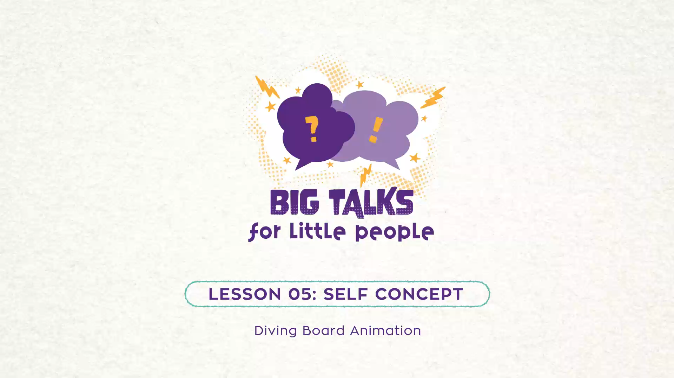

Part 2 – Watch the animation
Hover your mouse over the video to view play settings. Otherwise, download from the website.
4

Slide 5

Now, let’s discuss
What feelings are being shown by the feel?
What are the emotions being shown by
the peep?
How do emotions and feelings shape a person’s self-concept?
5

Slide 6
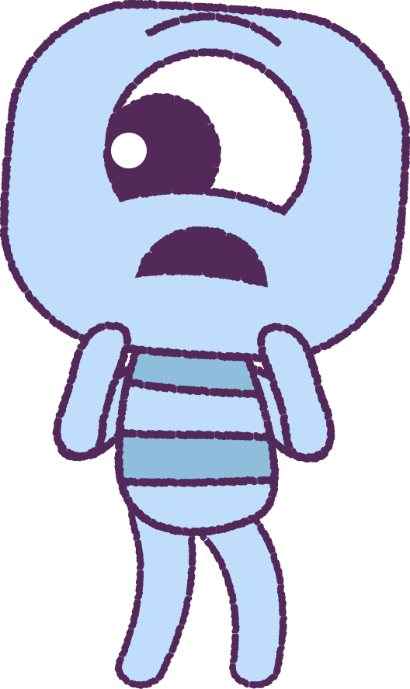
Can you think of a time when you felt scared to do something?
Can you think of a time when you felt scared to do something? How did you overcome your fear?
What emotions did you experience?
Did the experience change you?
6

Slide 7
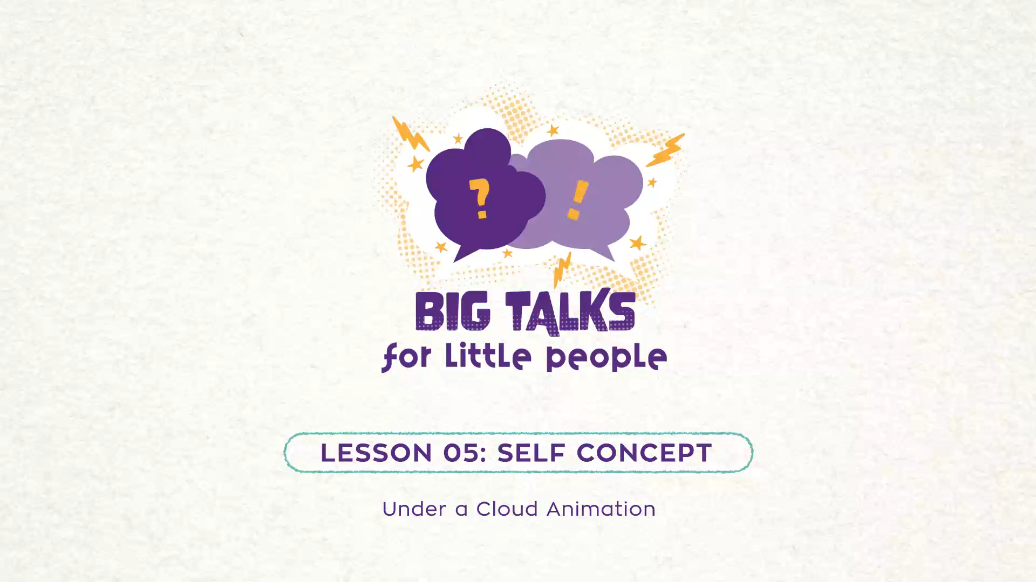
Part 3 – Watch the animation
Hover your mouse over the video to view play settings. Otherwise, download from the website.
7

Slide 8
Now, let’s discuss
• What do you think is happening here?
• How might the peep be feeling?
• What do you think happens next?
• What would you say to Pan?
8

Slide 9
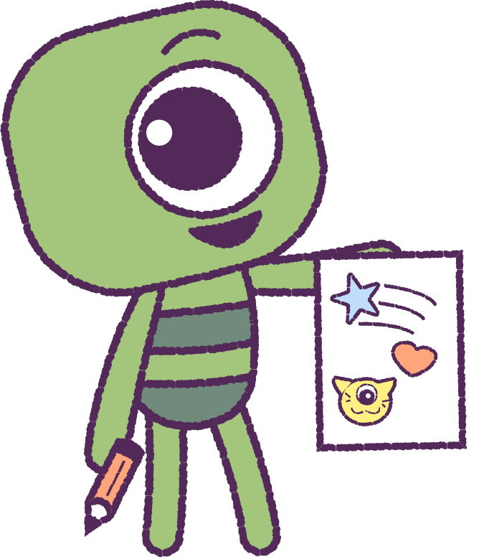
Part 4 - Activities
Next, we will explore more class activities relating to self-concept.
Choose any of the following activities on the next few slides…
9

Slide 10
Activity – “Me” Commercial
Work in groups.
Write a one minute television commercial about yourself.
The topic is why someone should hire you.
The commercial describes your special qualities.
Optional: Have the groups present their commercials to each other.
10
Notes:
Create a “Me” commercial Working in groups, have students help each other write / film a one minute television commercial about themselves. The topic is why someone should hire her/him. The commercial depicts the student’s special qualities. Optional: after they work on these, the students present their commercials in small groups.
• Design a self-brand You may introduce the idea of “self-brand” asking students to identify a “brand” such as Nike and the intention behind companies having a “brand name” (e.g. excellence, quality, reliability, competitiveness). Students could then be asked to quickly identify a “brand” that best represents them. Self brand collage (If time permits). Working in their groups, students will use pictures, words, or symbols clipped from magazines to represent their traits or things they enjoy doing, places they’ve been, people they admire, or careers they desire. With all these things students create a collage (See “Self Brand” below). If time permits they then present and explain their “brand” to their group

Slide 11
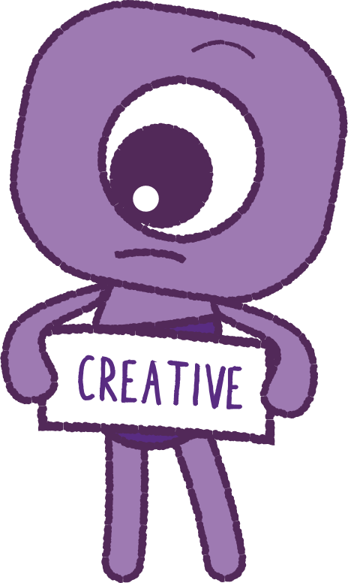
Activity – Design a “Self Brand”
Work in groups.
Can you name the intention of a brand?
Create a “Self-Brand” collage. Use pictures, words, or symbols clipped from magazines to represent your traits or things you enjoy doing, places you been, people you admire, or careers you desire.
If time permits, have students explain their “brand” to their group.
11

Slide 12

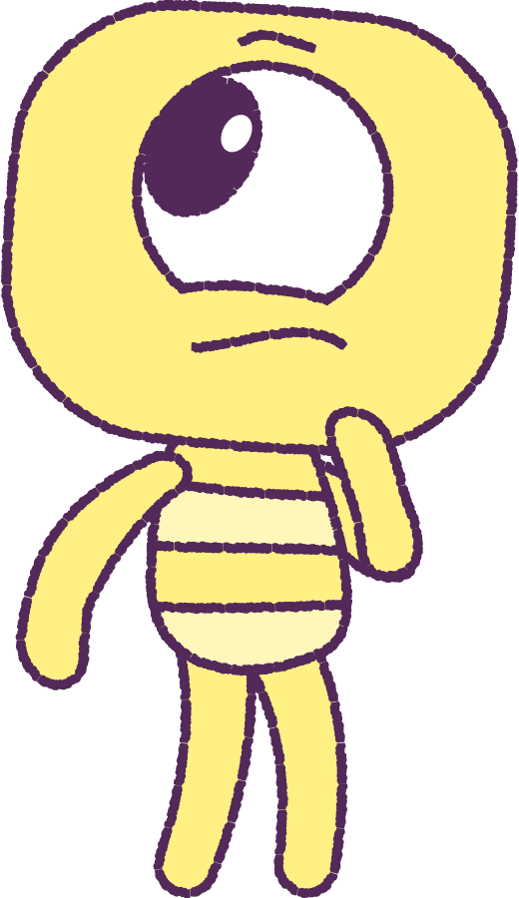
Activity - I am unique because…
List 5 things that make you, YOU!
12
Notes:
Sentence stem: Have students complete and illustrate: “I am unique because...”

Slide 13
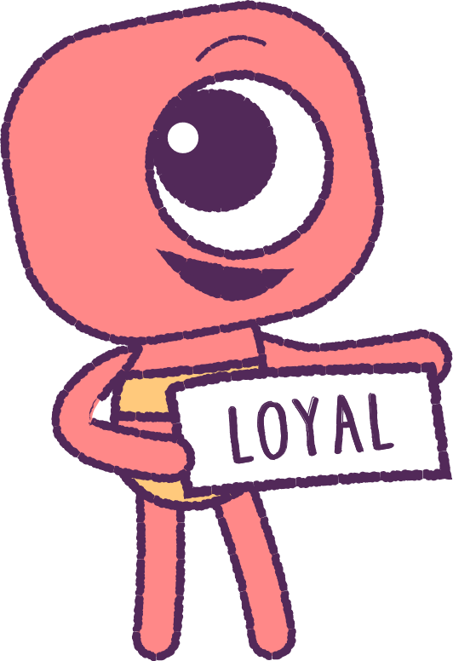
Activity - Ranking Traits
• Cut or rip a piece of paper into
ten strips.
• On each strip, write a word or phrase
that describes you. Refer to the “Awesome
Adjectives” handout.
• Arrange them in order from traits you
like best to least.
• Now give up 3 traits. What kind of person are
you now?
• Now write about what you kept in your
workbook, and what you learnt about yourself.
13
Notes:
Ranking traits (see “Awesome Adjective” list):
• Ask students to rip a piece of paper into ten strips.
• On each they write a word or phrase that describes themselves (use the “awesome adjective” list). Assure students that no one will see what they have written, so a student can be extremely honest.
• Then the student arranges the traits in order from what she/he most likes about her/himself to what is least liked.

Slide 14

Concluding Activity
Write out the major points from today’s lesson.
For example; self-concept, and
self-brand.
14

Slide 15
This is the end of Lesson 5.
Great work!

