Slide 1

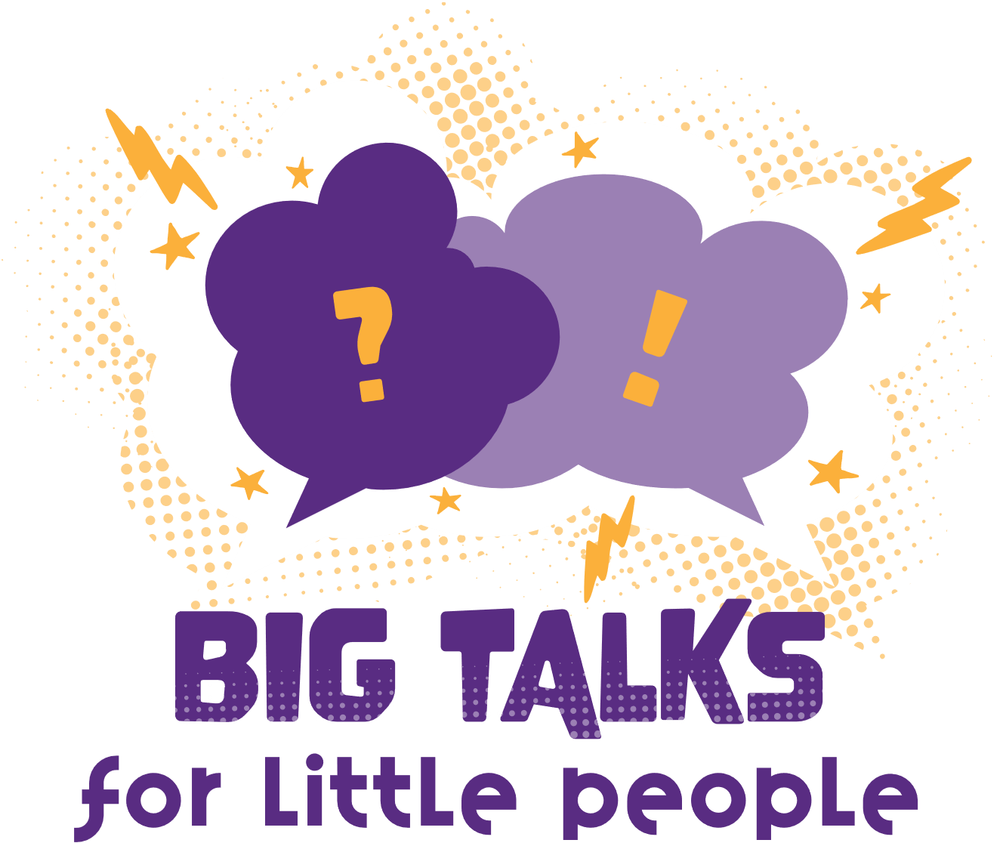






Phillip T Slee (Ph.D) Grace Skrzypiec (Ph.D)
John Mannion Chris McDermott

Slide 2
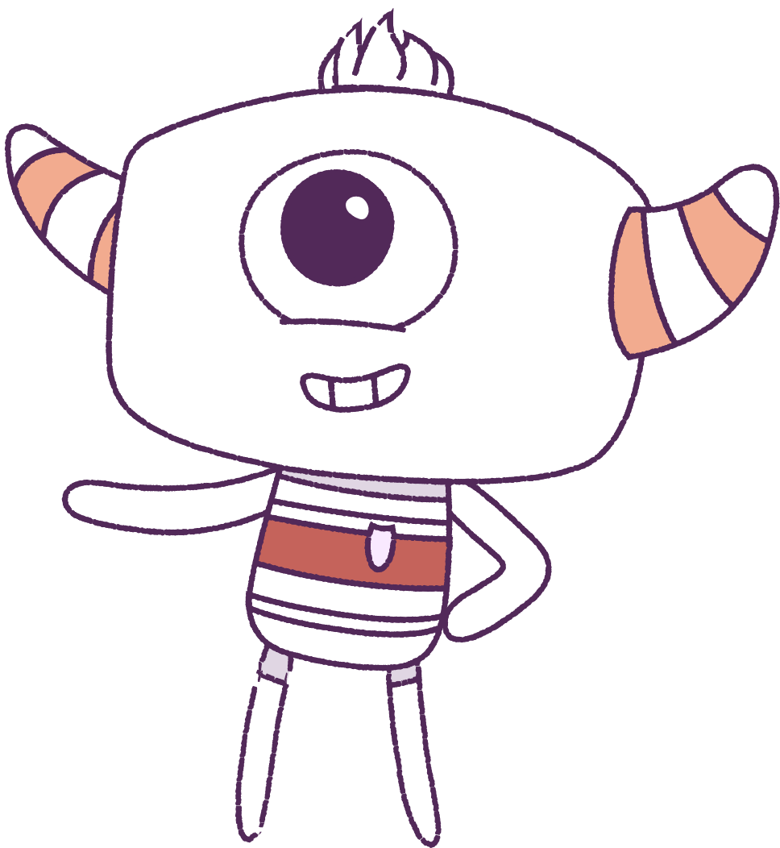




Lesson 6
Conflict Management
Lesson aims:
1.
Understand conflict management.
2.
Learn coping strategies related to conflict management.
3.
Complete a post-survey.

Slide 3
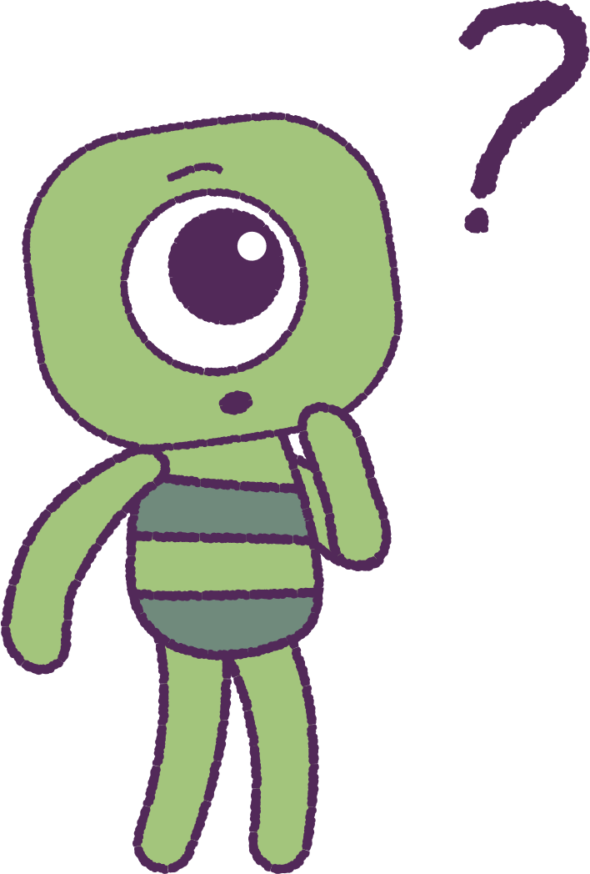

Part 1 – Review content from last week
Who can remember what we discussed last lesson?
In our session today, we will talk more about conflict management.
Lets get ready to look at the animation!
3
Notes:
Begin by reviewing what students remember from last week about resilience
In the lesson today we will talk more about conflict

Slide 4


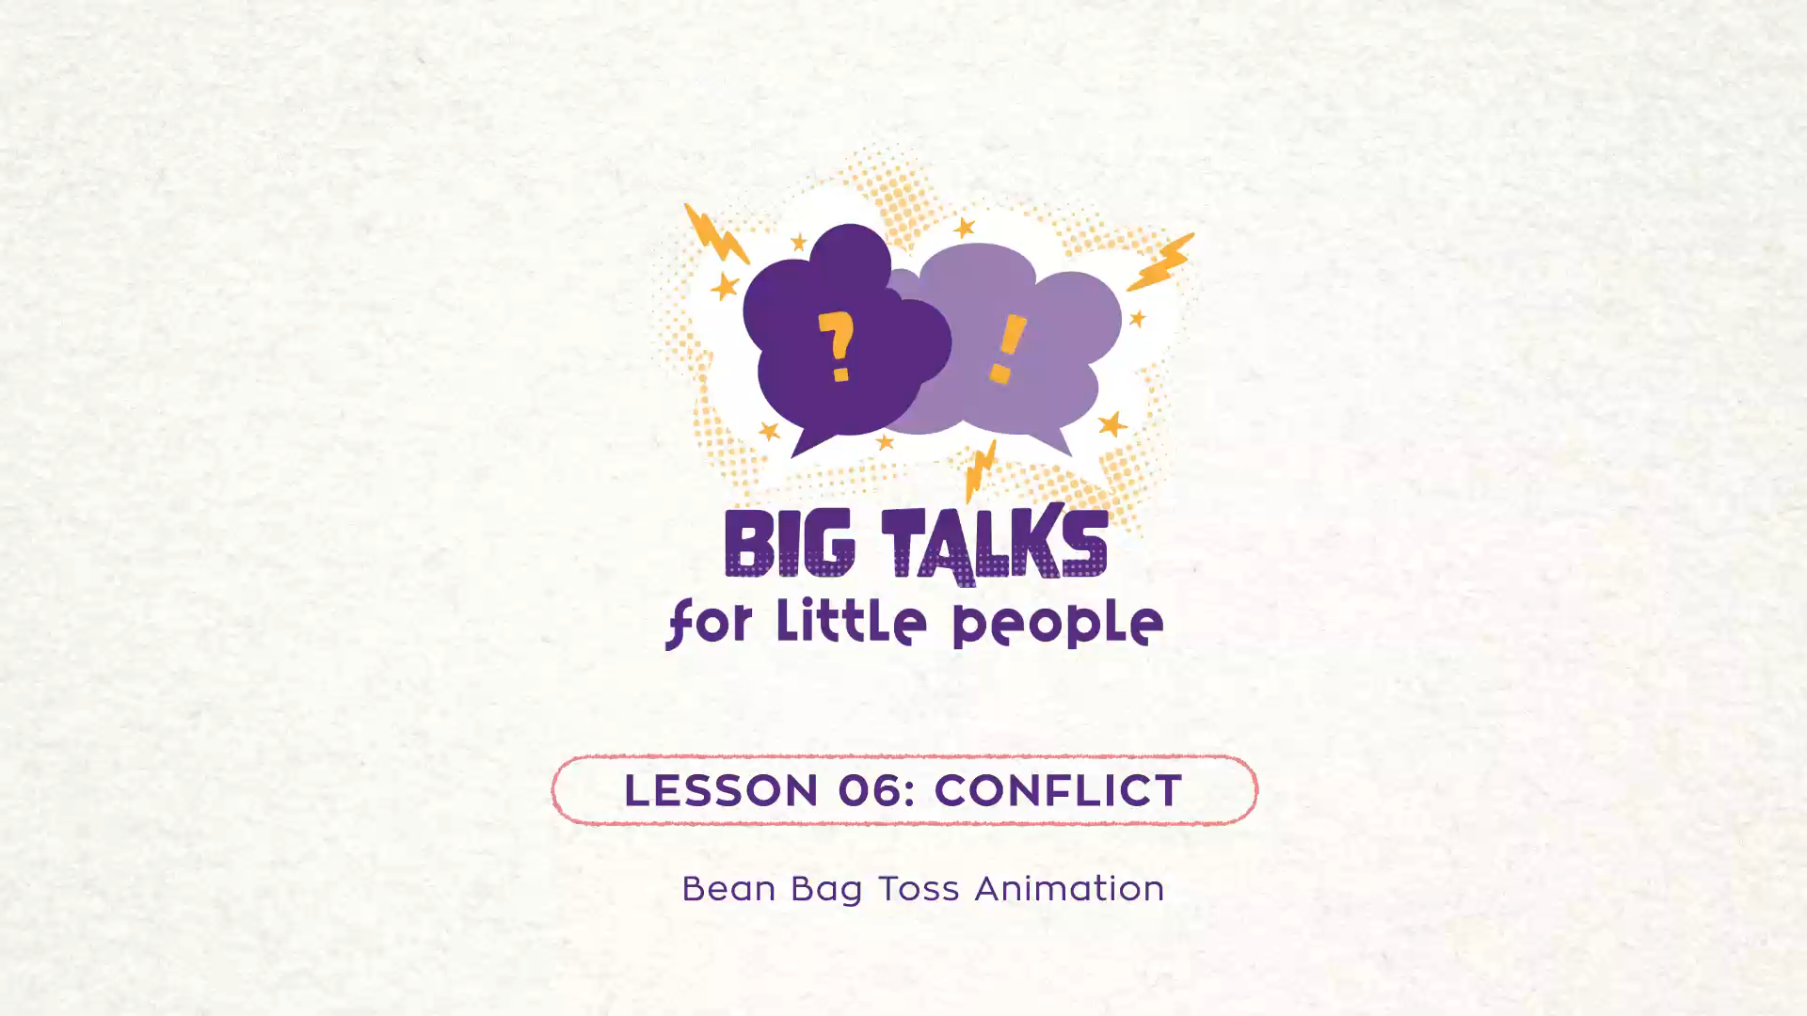

Part 2 – Watch the animation
Hover your mouse over the video to view play settings. Otherwise, download from the website.
4

Slide 5
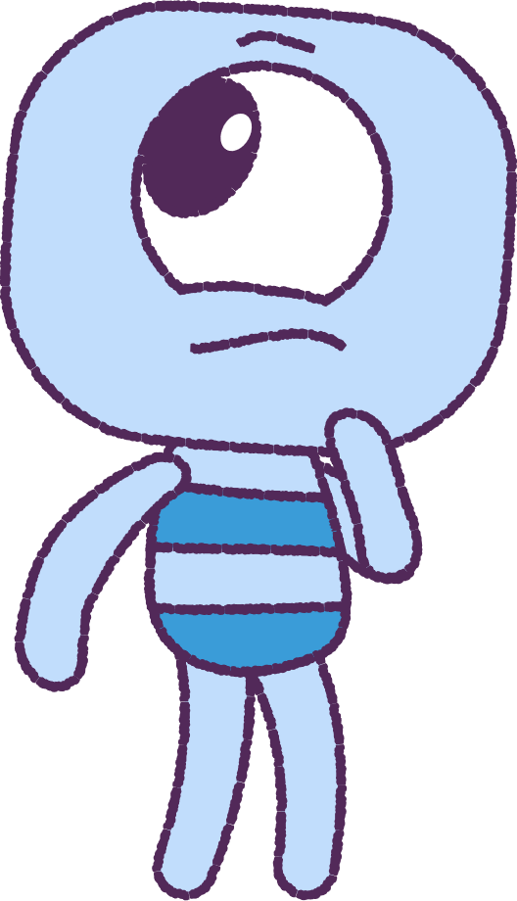
Now let’s discuss
• What do you think is happening here?
• How might the peeps be feeling?
• Is there a solution that makes
everyone happy?
• What is Crown feeling?
5
Notes:
Discuss the animation. What is happening in the game? How might the peeps be feeling? What might happen next?

Slide 6
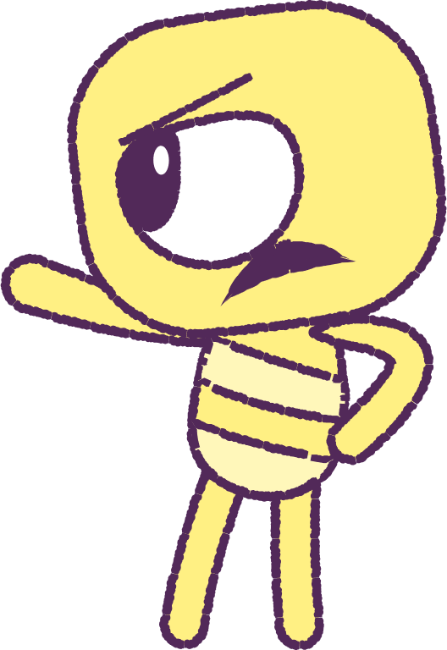
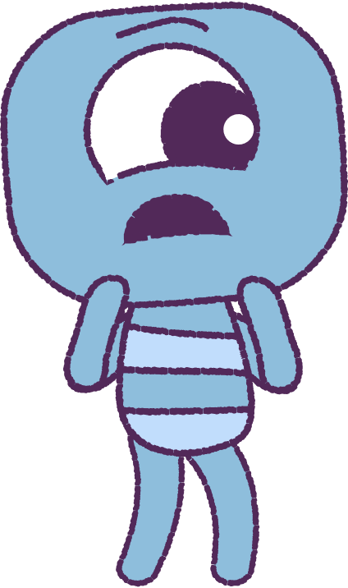
We can deal with conflict in 3 ways
1.
Avoid. We can pretend the problem does not exist.
2.
Attack. We can be confrontational by being aggressive and violent.
3.
Problem solve. We can talk and negotiate and find a solution that everyone is happy with.
When not handled well (i.e. aggressive) conflict can cause unhappiness and distress.
6
Notes:
The Macquarie Dictionary defines conflict as a “a battle or struggle, especially a prolonged struggle, strife controversy a quarrel.” Generally it denotes a disagreement between two individuals when one person does something to which a second person objects. While conflict is often seen as a “bad” thing this overlooks the possibility for conflict being able to lead to positive outcomes such as strengthening a relationship. Students need help with carrying out positive coping actions. Teachers should acknowledge that out the planned action is the real challenge. Sometimes what is required to carry out the action is courage and assertion.
Conflict is a natural part of human existence which no amount of positive thinking will eliminate.
• If not handled well, conflict can cause unhappiness and distress.
• By understanding the nature of conflict it is possible to shape it into a potentially positive force in relationships.
• Making sense of conflict and equipping students with the knowledge and skills to effectively deal with conflict when it arises contributes to student well-being.

Slide 7

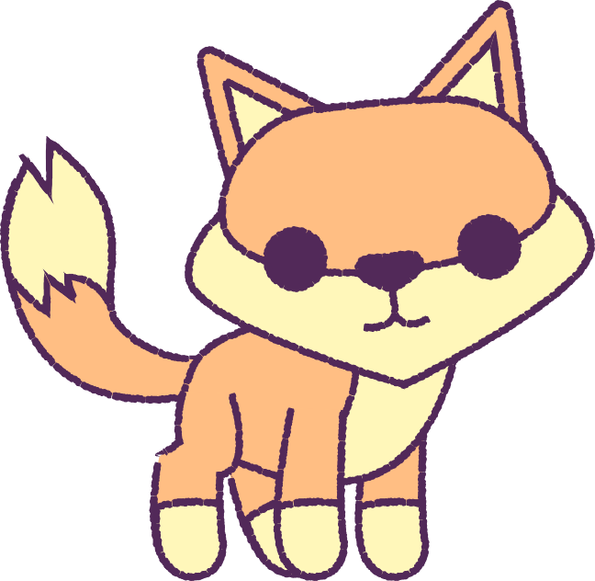
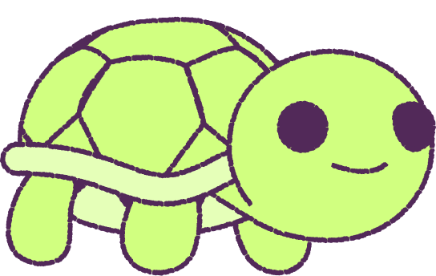
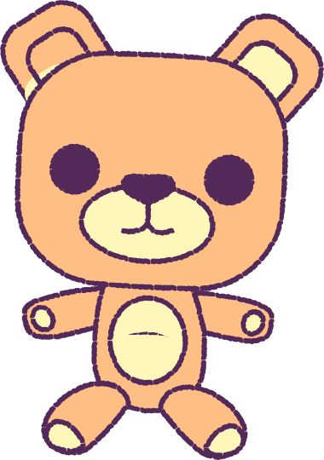
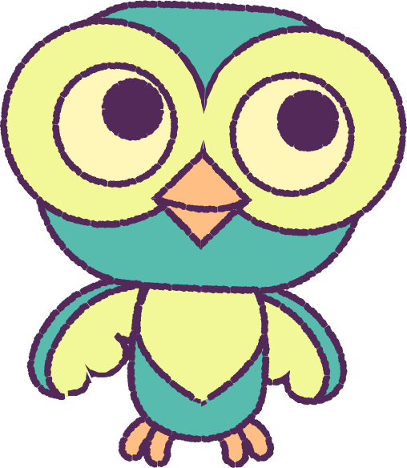

Part 3 – Pair Activity – Conflict Management
Work in pairs and think about a recent conflict situation you experienced. Use the handout to identify which conflict management style you used.
TURTLE
FOX
Low relationship goals.
Low personal goals.
Mid relationship goals.
Mid personal goals.
Teddy Bear
owl
SHARk
High relationship goals.
Low personal goals.
High relationship goals.
High personal goals.
Low relationship goals.
High personal goals.
7
Notes:
The strategies used for managing conflict vary between people. These strategies seem to be automatic responses although they are learned, usually in childhood. Most people are not aware of how they react in conflict situations and we seem to act by doing whatever comes naturally. However, because it was learned, it is possible to change the personal strategy we use by learning how to better manage conflict effectively.

Slide 8
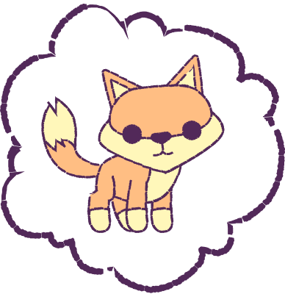
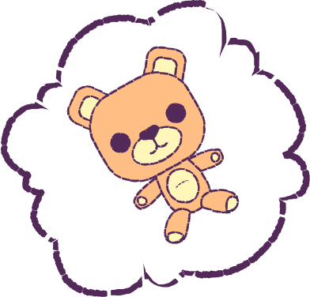

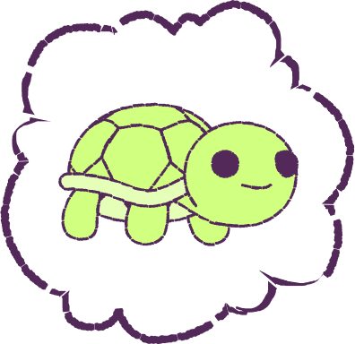
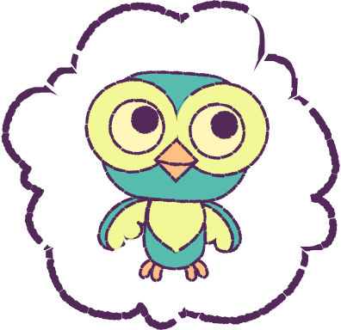
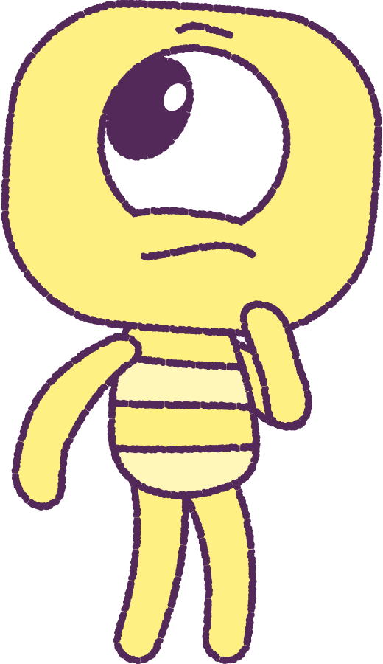
Group Discussion
What conflict management style do you commonly use?
What can you do to handle the conflict better next time?
8
Notes:
Conflict management style:
There are two main considerations that are taken into account in a conflict situation:
1. Achieving your personal goals – the reason there is a conflict is because your goal conflicts with someone else’s goal.
2. Maintaining your positive relationship with the other person – in the future you may need to interact with this person. Go hard on the issue soft on the people, we can all make mistakes, forgiveness is important.
When you are engaged in a conflict, the importance of each of these affects how you will act.

Slide 9
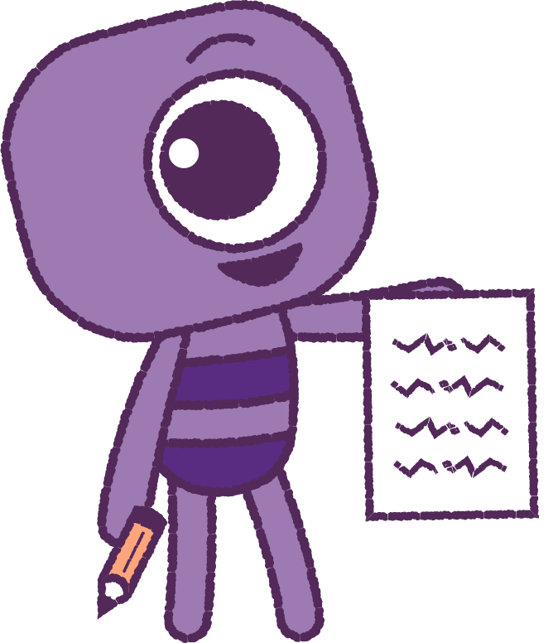
Part 4 - Activity - Communication Strategy
Tell someone about a situation involving physical bullying. And In groups, discuss how one of the below communication strategies could be used to address the bullying.
• Write a note to the adult asking for a time
to talk.
• Write a note which tells of the situation.
• Take a friend with you to help you get it said.
• Ask someone else to tell for you, like a friend,
sibling, or parent.
9
Notes:
To assist students in managing conflict they require guidance in listening and being respectful and in separating a difference of opinion from a personal attack. Learning how to have discussions without attacking others or becoming defensive will help students become less fearful of conflict situations. Acquiring skills of self-expression and accepting that others may not always agree with them, are important life-long relationship skills.

Slide 10
Win-win conflict resolution
1.
Stop, calm down, cool off. Turn attention inward. Notice the pain, body reaction.
Low relationship goals.
Low personal goals.
Mid relationship goals.
Mid personal goals.
2.
Say what’s bothering you. Communicate using “I” statements. Do not blame, attack, use put-downs or negative body language.
3.
Each re-iterates what the other person said. Brings clarity and empathy.
4.
Take responsibility. Responsibility is internal and present-future orientated.
What can each person do to improve things in the future?
High relationship goals.
Low personal goals.
Low relationship goals.
High personal goals.
5.
Brainstorm solution. Find one that satisfies all parties.
6.
Affirm, forgive or thank. Acknowledge the effort made to overcome the natural tendency to fight or withdraw.
10
Notes:
When teachers witness conflict between students it is important they:
• Do not ignore the conflict – the silence benefits the “more powerful” or advantaged.
• Do not act as a judge – students are not too immature to solve their own problems. Their maturity, social and moral growth may be impeded otherwise.
• Do not solely side with the victim – this can continue the cycle of victimization as it may lead to dependence by the target and label the bully as an aggressor. Be empathic.
• Do not encourage tattling – encourage students to solve their own problems using the “Conflict Resolution Model” on page 38 before coming to you. (Tattling is minimised if the above suggestions are followed)

Slide 11




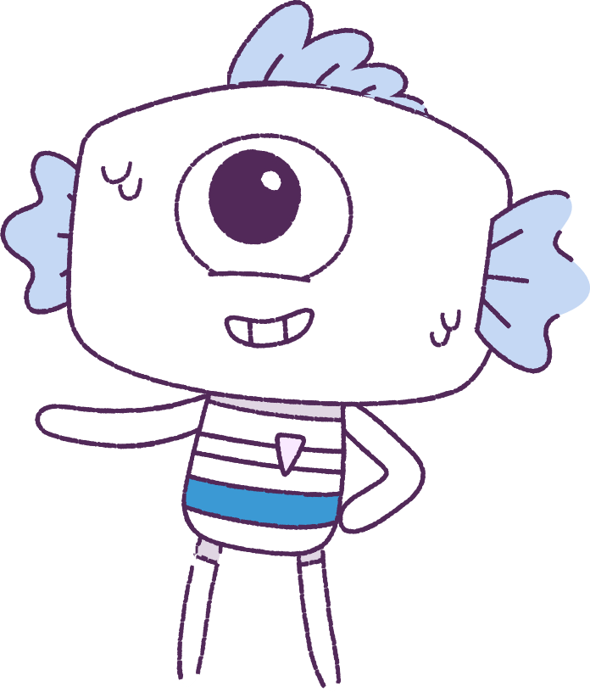
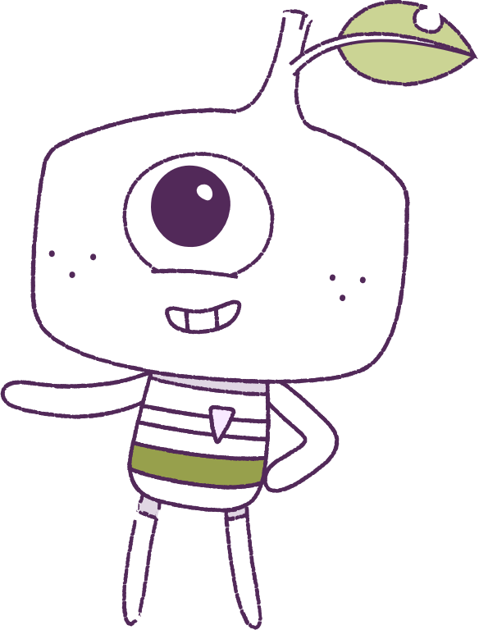
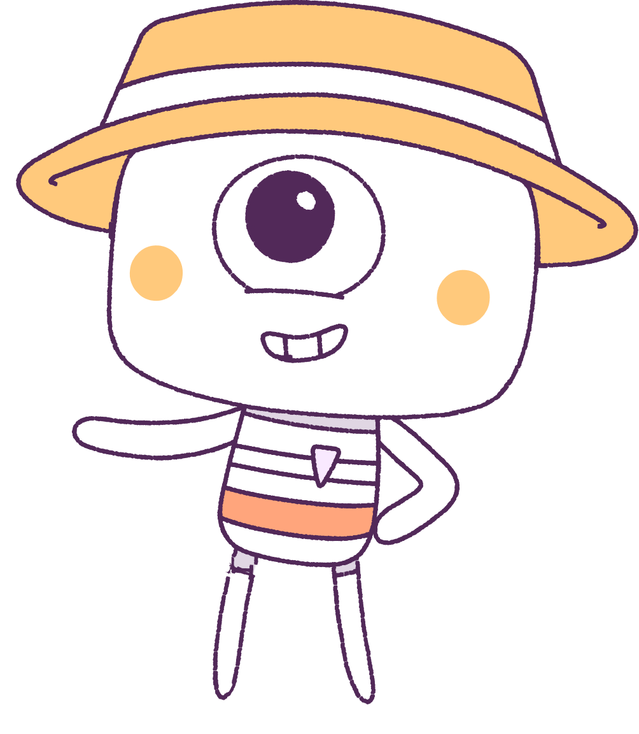
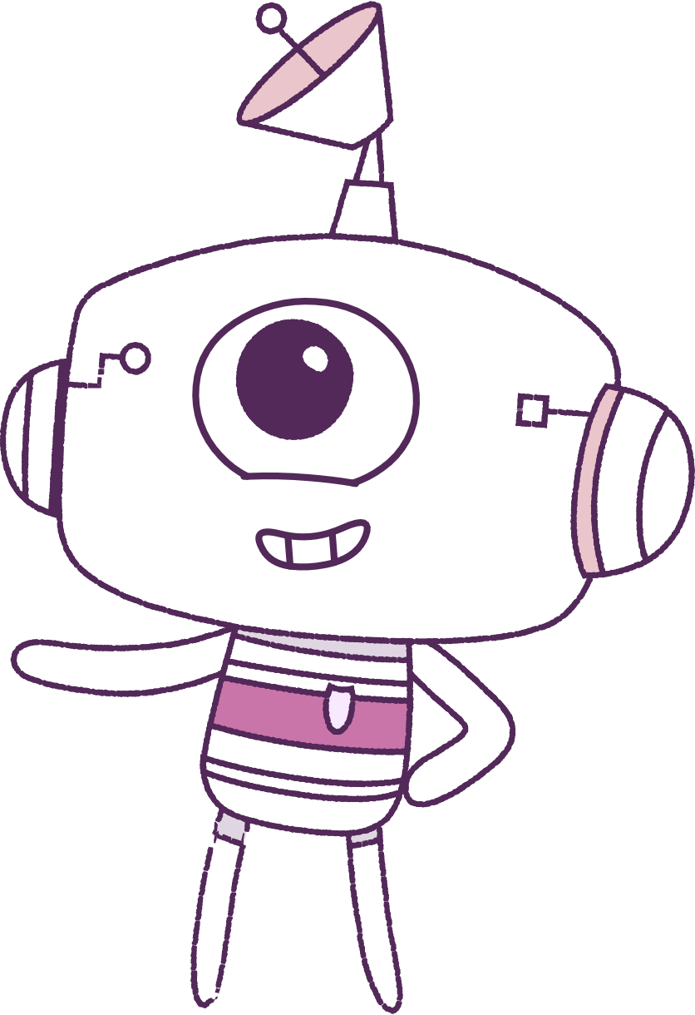


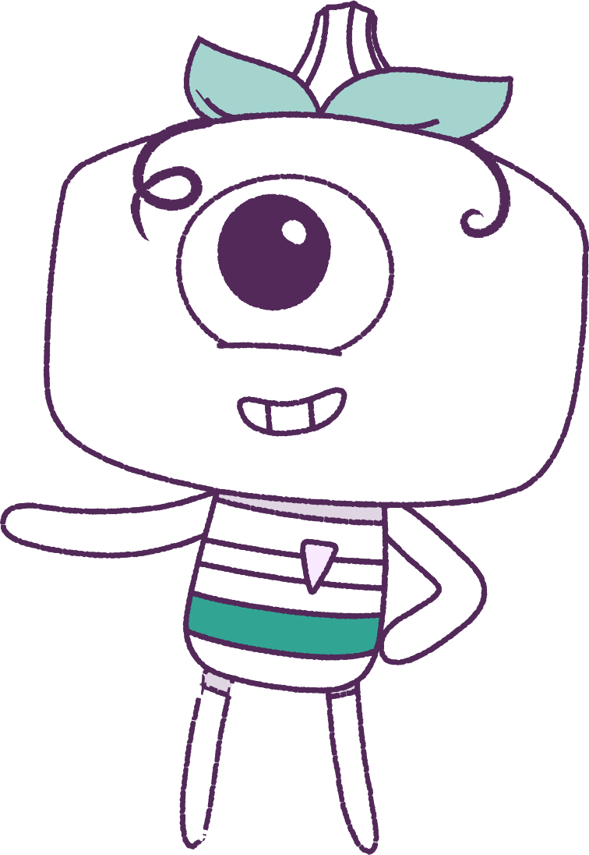
Part 5 – Big Talks Summary
lesson 1
lesson 2
lesson 3
Establishing
groups
Emotions
Exclusions & relationships
lesson 4
lesson 5
lesson 6
Resilience
Self Concept
Conflict Management
2021
Test
11
11
Notes:
Wrap up and review the topics of each lesson completed in the module before moving on to the post survey.

Slide 12

Part 6 – Student Post-Survey
This survery will ask questions about how you think and feel. It is important that you answer the questions as honestly as possible as the information will be used to help understand the well-being of young people.
Everyone should have the opportunity to answer the questions in a confidential manner, so please do not discuss the questions and your answers with anyone else. Please respect the privacy of other students.
This survey will take a minimum of 15 minutes
12

Slide 13
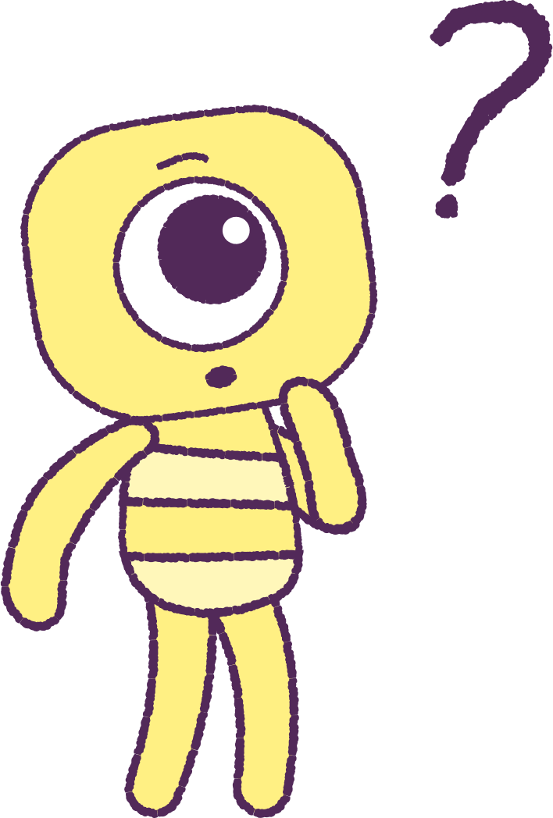
Student Post-Survey
Do not talk to anyone else as you are filling in the survey.
Once you have completed your survey a University researcher will look at the answers and analyse the data.
No one at this school will see your questionnaire answers.
We thank you for your participation in this important research.
13

Slide 14


Student Post-Survey
Please visit the below link.
Students must click on the button which says “Child Health Module”.
www.caper.com.au
14

Slide 15
Part 7 – Teacher Survey
The teacher should complete the online survey at the below website link.
Look for the “Implementation Index” button.
www.caper.com.au
15

Slide 16
This is the end of Lesson 6.
Great work!

