Slide 1






Professor Shane Pill (PhD) Professor Phillip Slee (PhD)
Associate Professor Deb Agnew (PhD) Dr Amy Wright (PhD)
Jessica Skuza (Research Assistant)

Slide 2
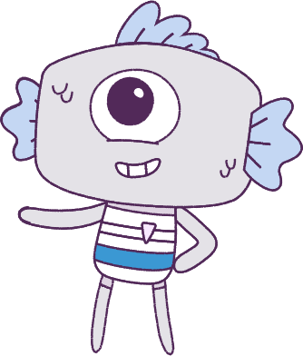




Lesson 1
Pre-Survey & Introduction
Pre-survey & Introduction
Lesson aims:
Lesson aims:
1.
1.
Optional: Complete a pre-survey.
Optional: Complete a pre-survey.
2.
2.
Learn about the Peeps and the Feels.
Learn about the Peeps and the Feels.
3.
Participate in different activities.
3.
Participate in class activities.

Slide 3

Part 1: Student pre-survey
(OPTIONAL)
This optional pre-survey will ask questions about how you think and feel.
Please have students visit the below website link:
www.caper.com.au
And click on:
“HPE Module – Student Surveys Years 1-2”.
It is important that you answer the questions as honestly as possible as the information will be used to help understand the well-being of young people.
This pre-survey will take a minimum of 15 minutes
3

Slide 4

Part 1: Continued
Everyone should have the opportunity to answer the questions in a confidential manner, so please do not discuss the questions and your answers with anyone else.
Please respect the privacy of other students.
Do not talk to anyone else as you are filling in the pre-survey. Once you have completed your pre-survey, a University researcher will look at the answers and analyse the data.
No one at this school will see your pre-survey answers. We thank you for your participation in this important research.
4

Slide 5
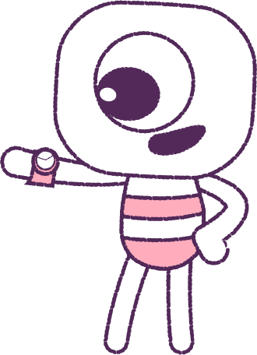


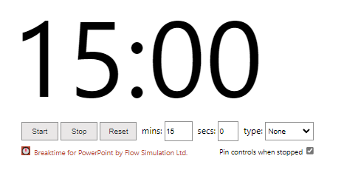
0
Part 1: Continued
How to use the timer: Click on “Trust this add-in” if this message pops-up. You might also need to click “Enable editing”. After, click into the white area and wiggle your mouse a bit. Adjust the settings to what you want, and start.
5

Slide 6
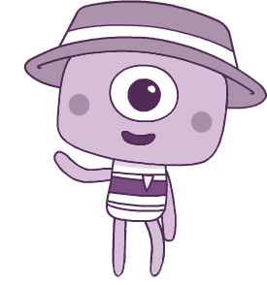
Part 2: Introduction to Big Talks
Over the next few weeks we will be learning about feelings and emotions together, and talking about tricky subjects like friendships, belonging and bullying.
Together we’ll watch a series of animations every week to help us talk about how to understand and build our skills around wellbeing.
You’ll get to know all about the Peeps!
6

Slide 7




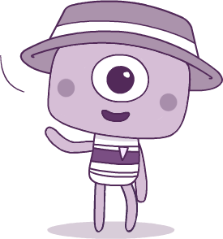
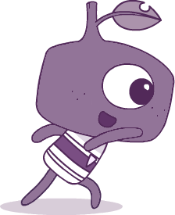
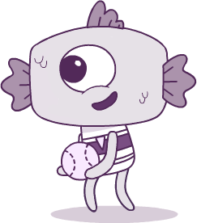
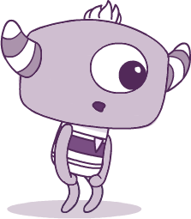
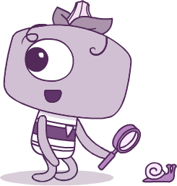
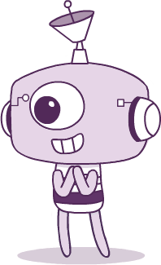
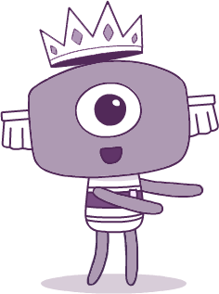
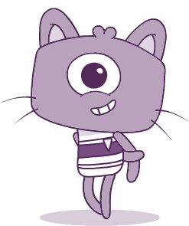
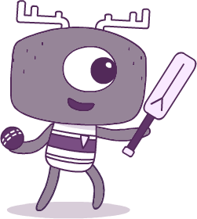
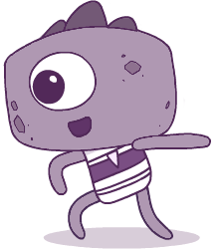
Meet the Peeps! Which one do you like best, and why?
BRIM
TWIG
FIN
PAN
STALK
ELK
STEG
TEK
CROWN
KIT

Slide 8
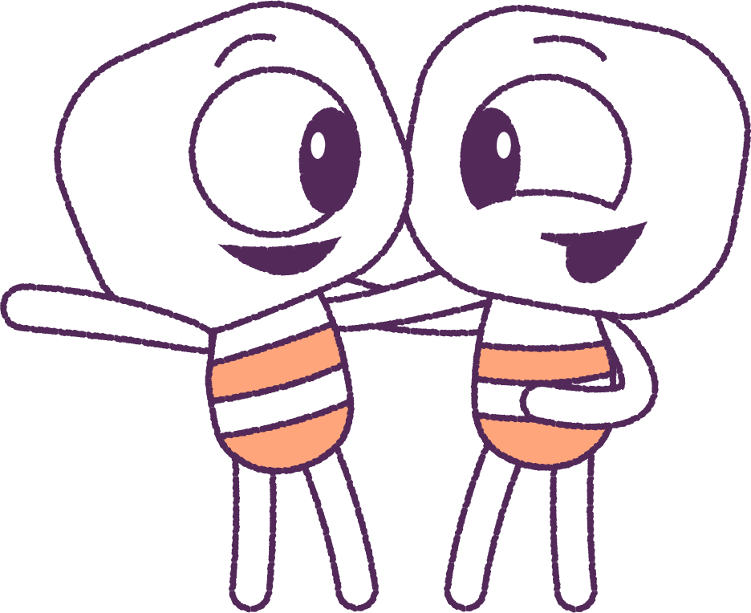
Part 3: Group Work
Divide students into groups. You have 10 minutes to decide and report back what your group roles will be and write down your group work rules.
Examples of Rules
• No put downs.
• Everyone gets a chance to speak.
• Everyone has a role in the group.
Examples of Roles
• Who will scribe answers to group questions.
• Who will speak for the group.
• Who will coordinate group work.
• Who will be in charge of supplies and timing.
8

Slide 9

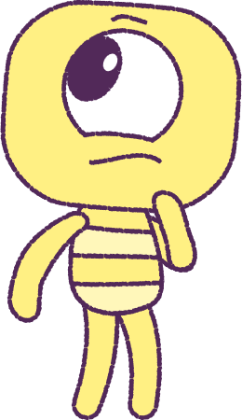
Report back
to class on
rules & roles
9

Slide 10
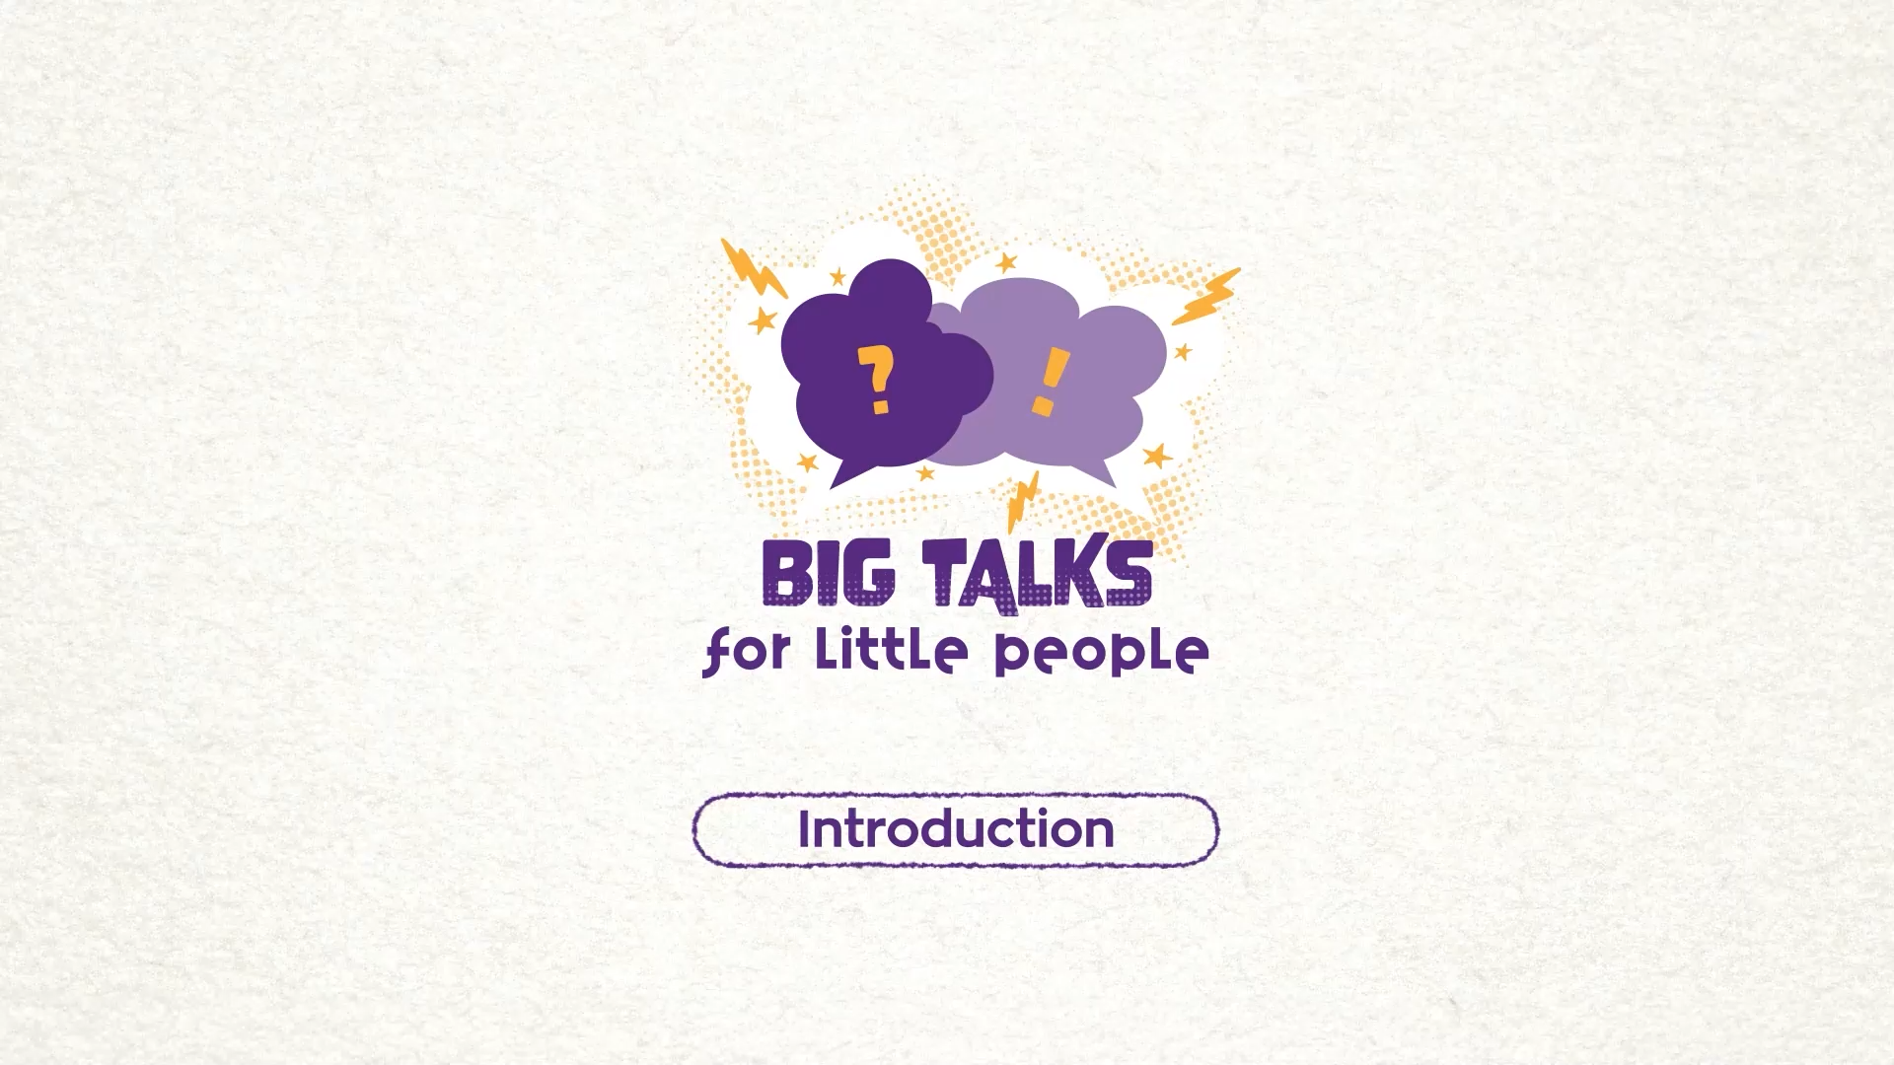
Part 4: Watch the animation
Hover your mouse over the video to view play settings. Otherwise, download from the website.
10

Slide 11

Part 4: Continued
First group work task is now to discuss the animation.
• What are some feelings/emotions you are
aware of?
• What feelings/ emotions are you aware of
others having?
• What sharing, helping and cooperative behaviour
among friends and classmates can you identify?
• What feelings are associated with helping and
being kind to others?
11

Slide 12
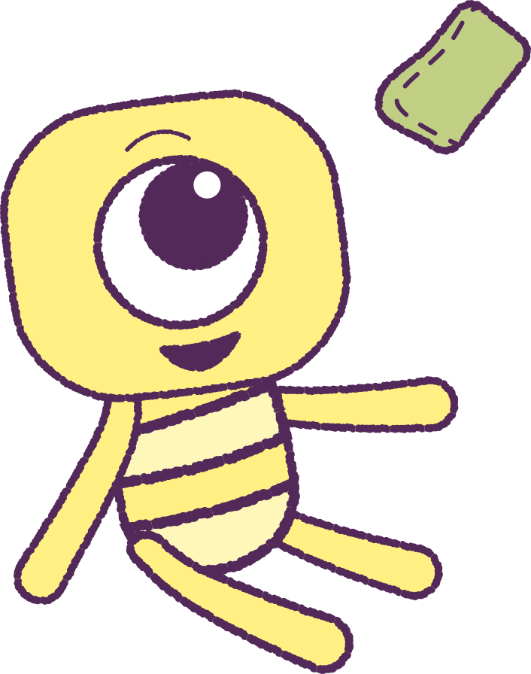
Part 5: Bean Bag Toss
It’s time to play Bean Bag Toss!
1. Sit on a circle on the floor.
2. Follow instructions from your teacher to
pass a bean bag around the circle.
3. Take turns to say a ‘feeling’.
Examples of Prompts
• How do you feel when you receive a gift?
• How do you feel when you stumble on your
feet?
12

Slide 13
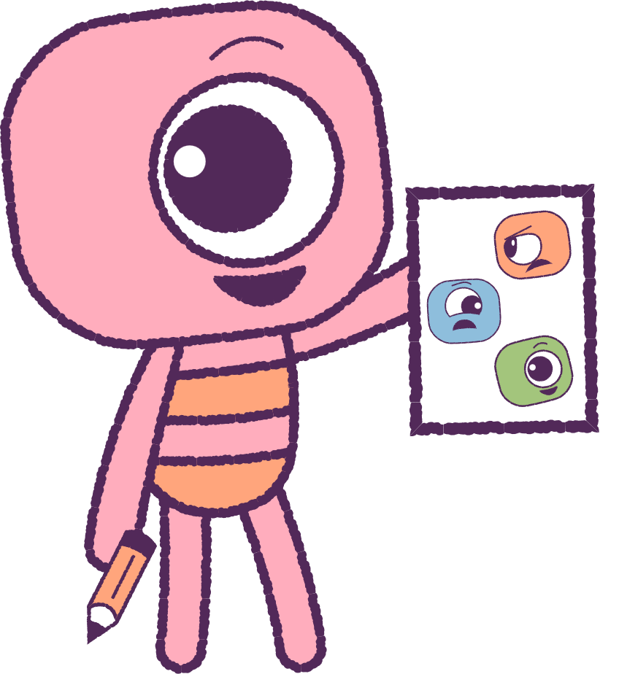
Part 6: Drawing Activity
Your teacher will let you know when it’s time
to go back to your chair.
Draw a picture that shows faces with
different feelings.
Add colours to your picture, that you think,
look like the feelings you have drawn.
13

Slide 14


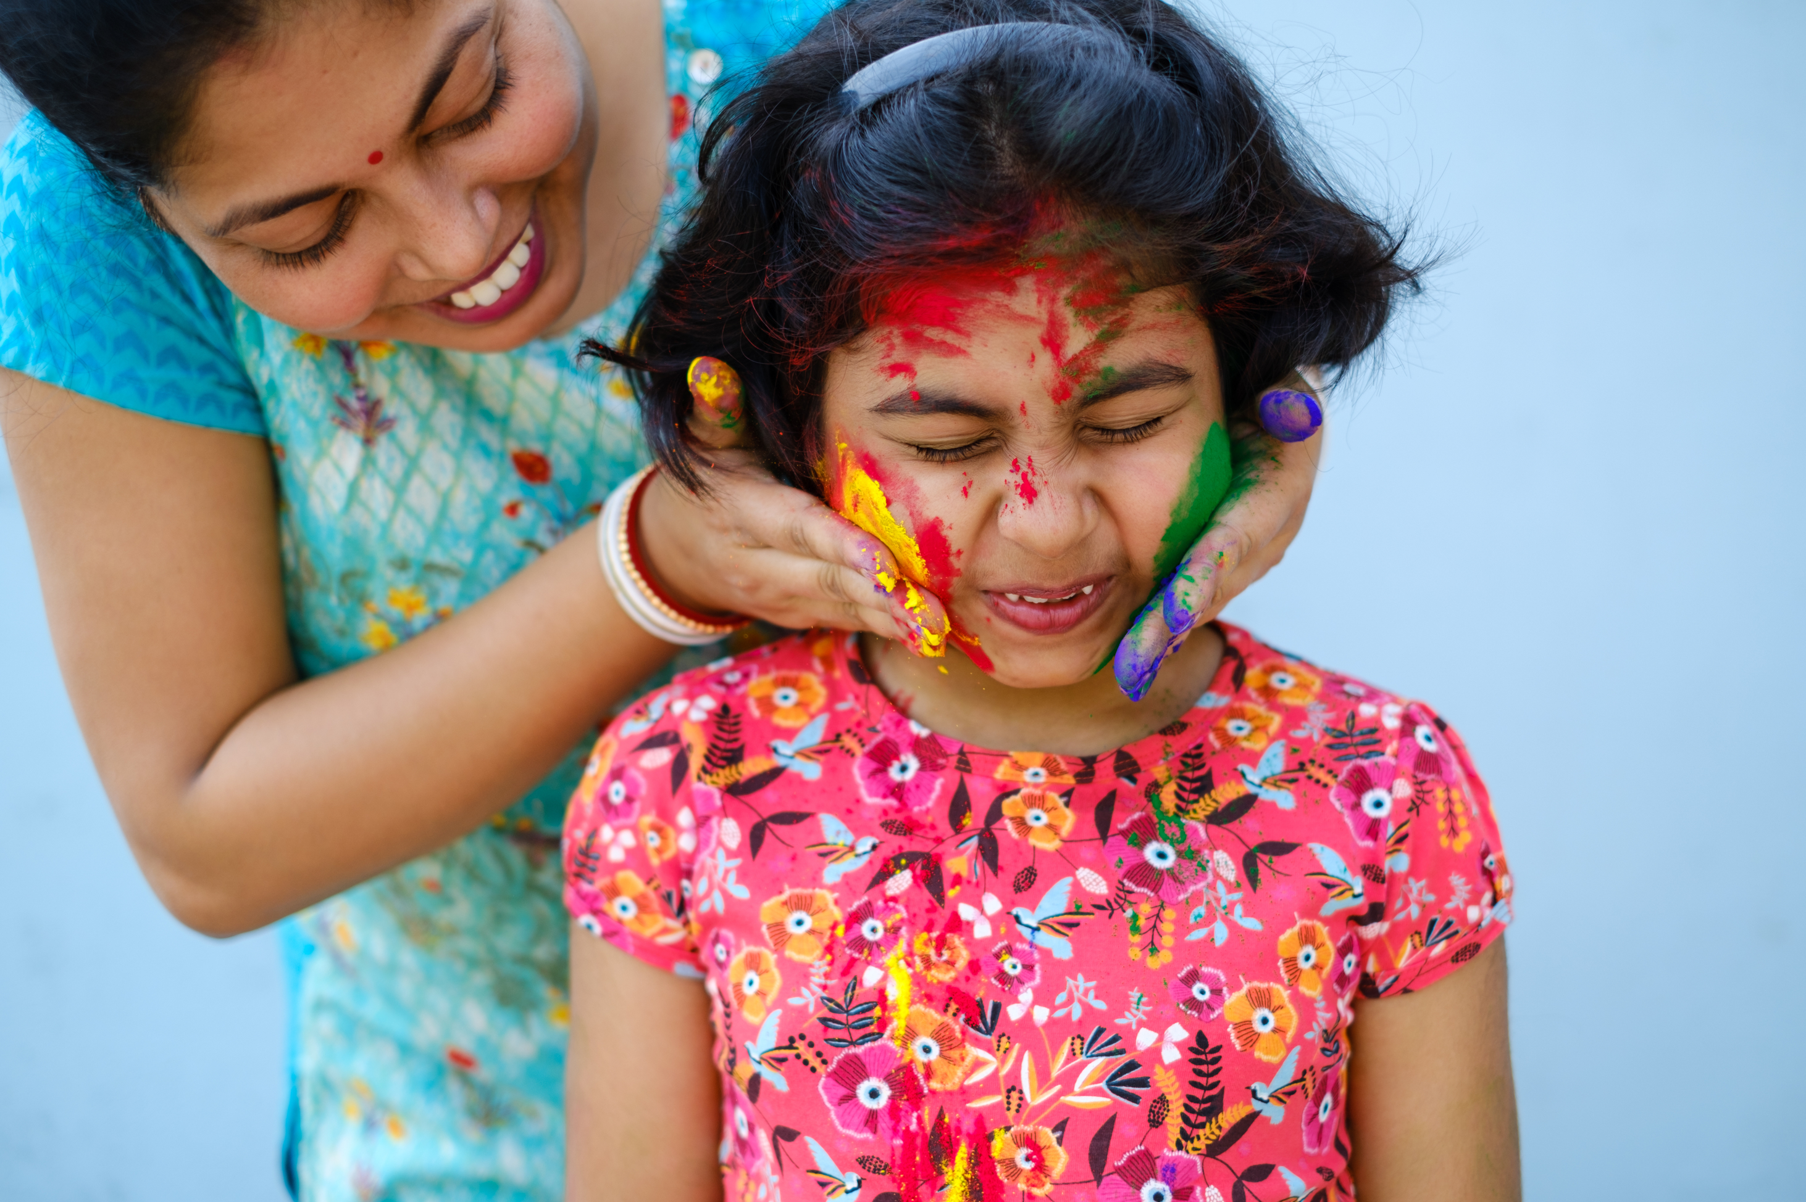
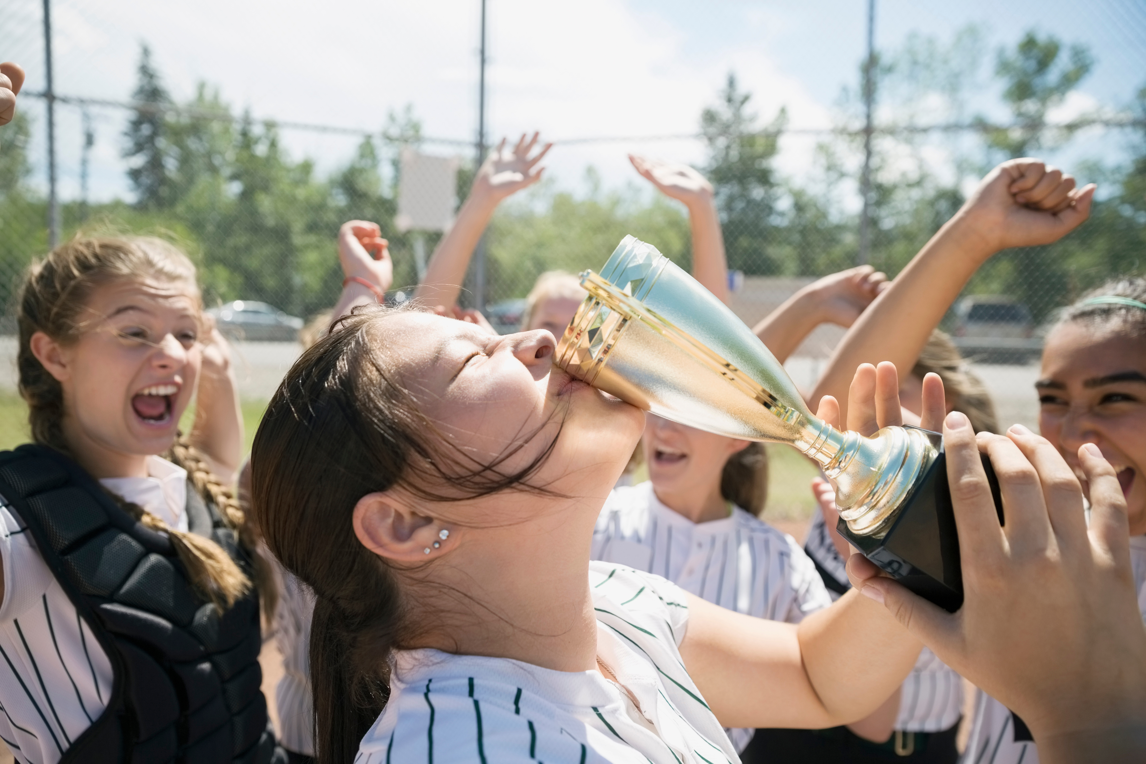
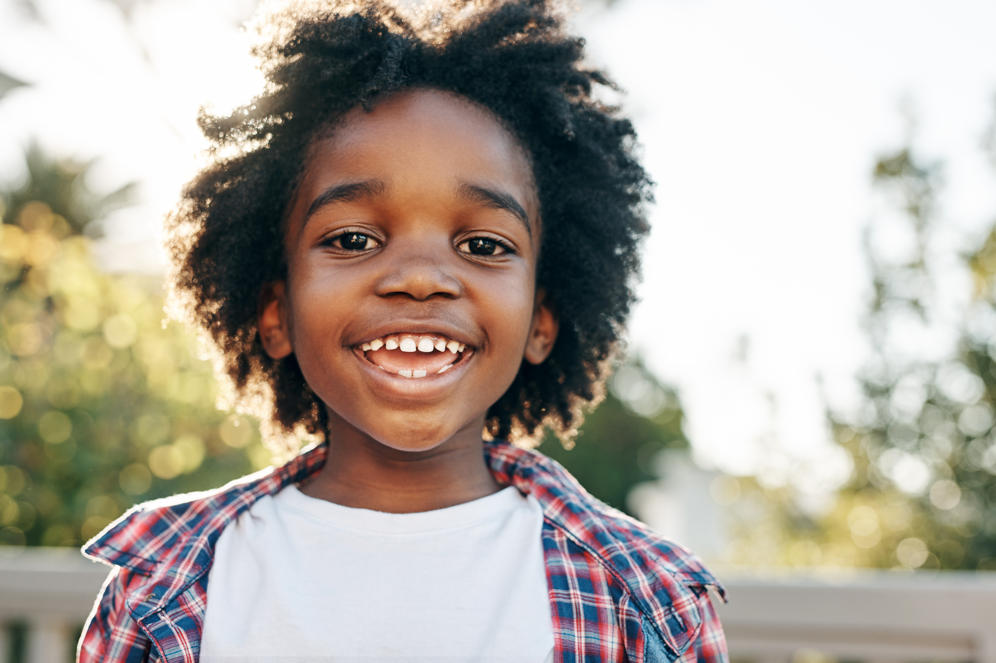
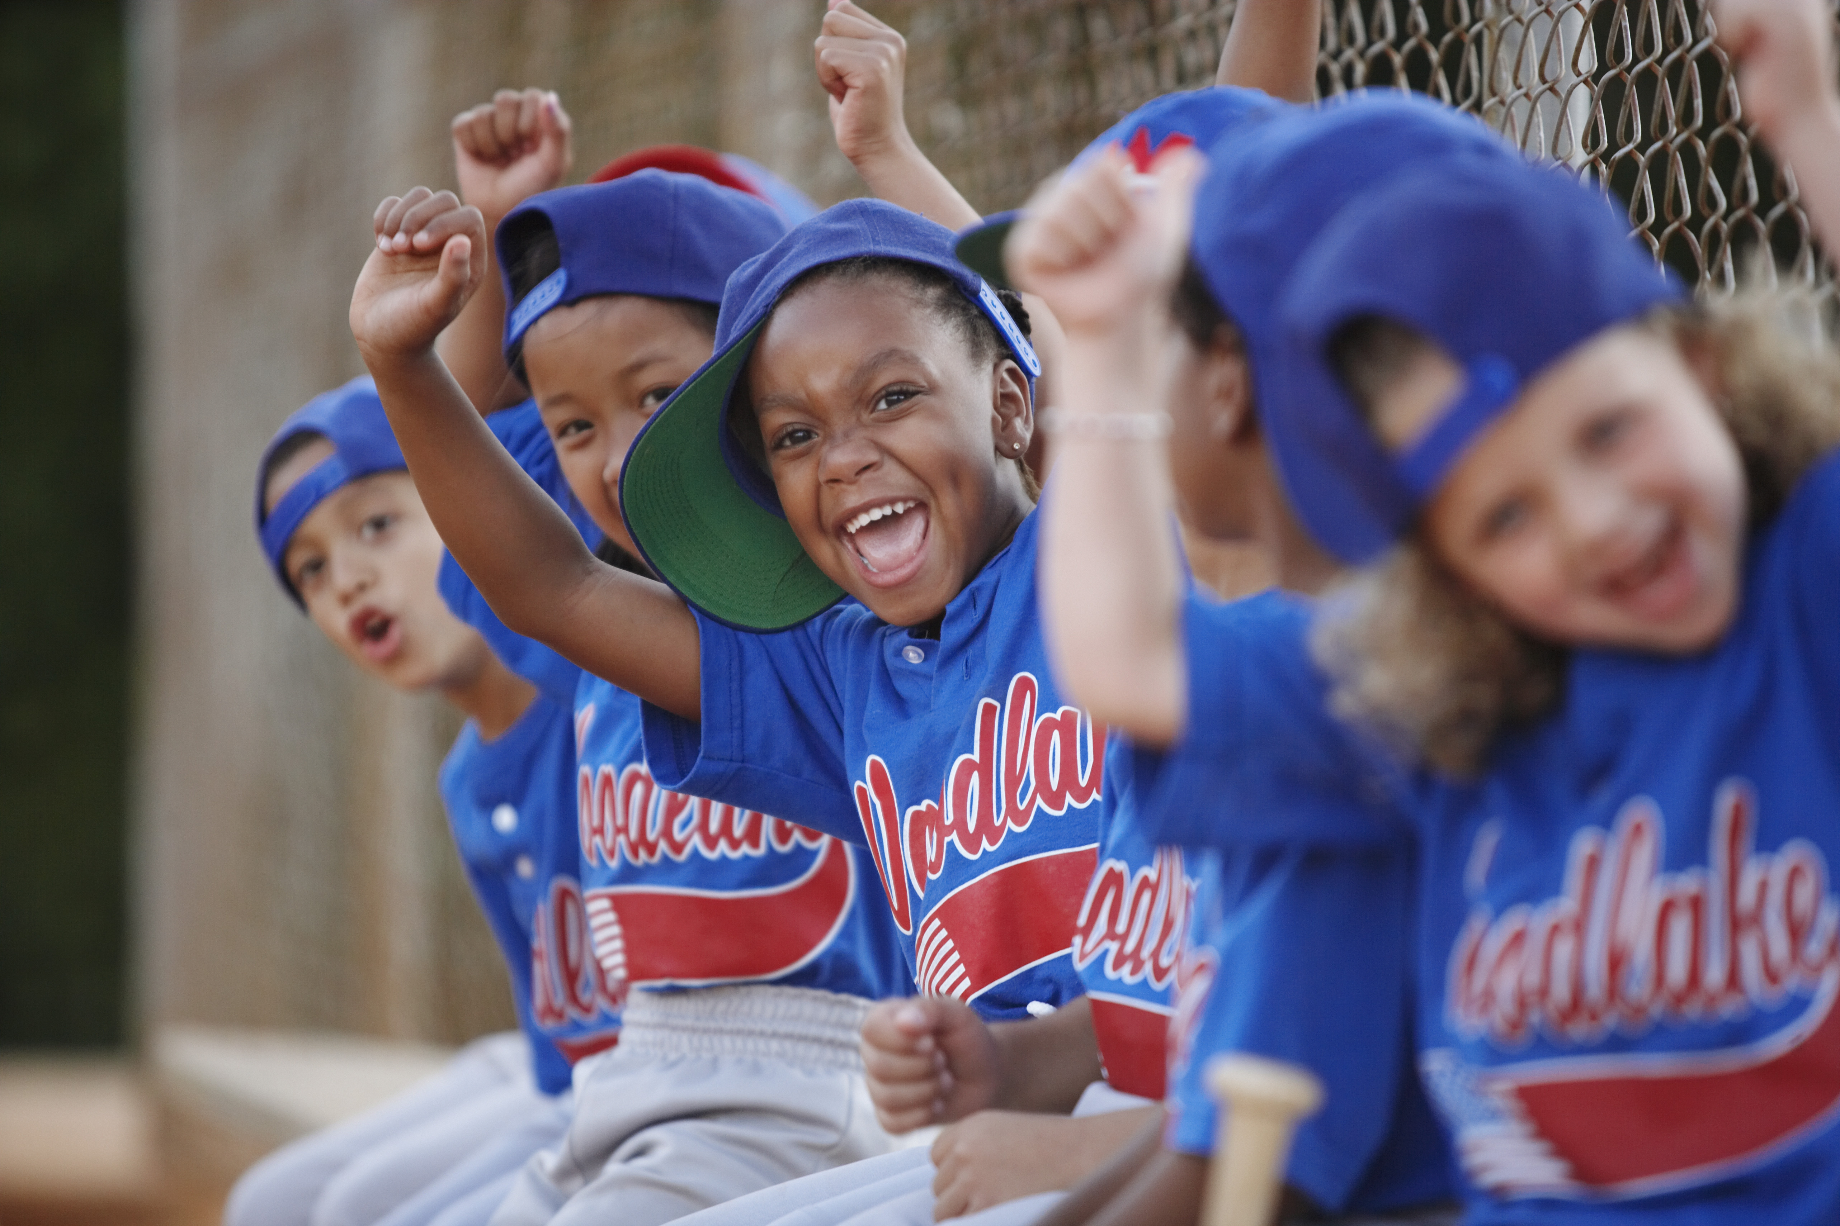

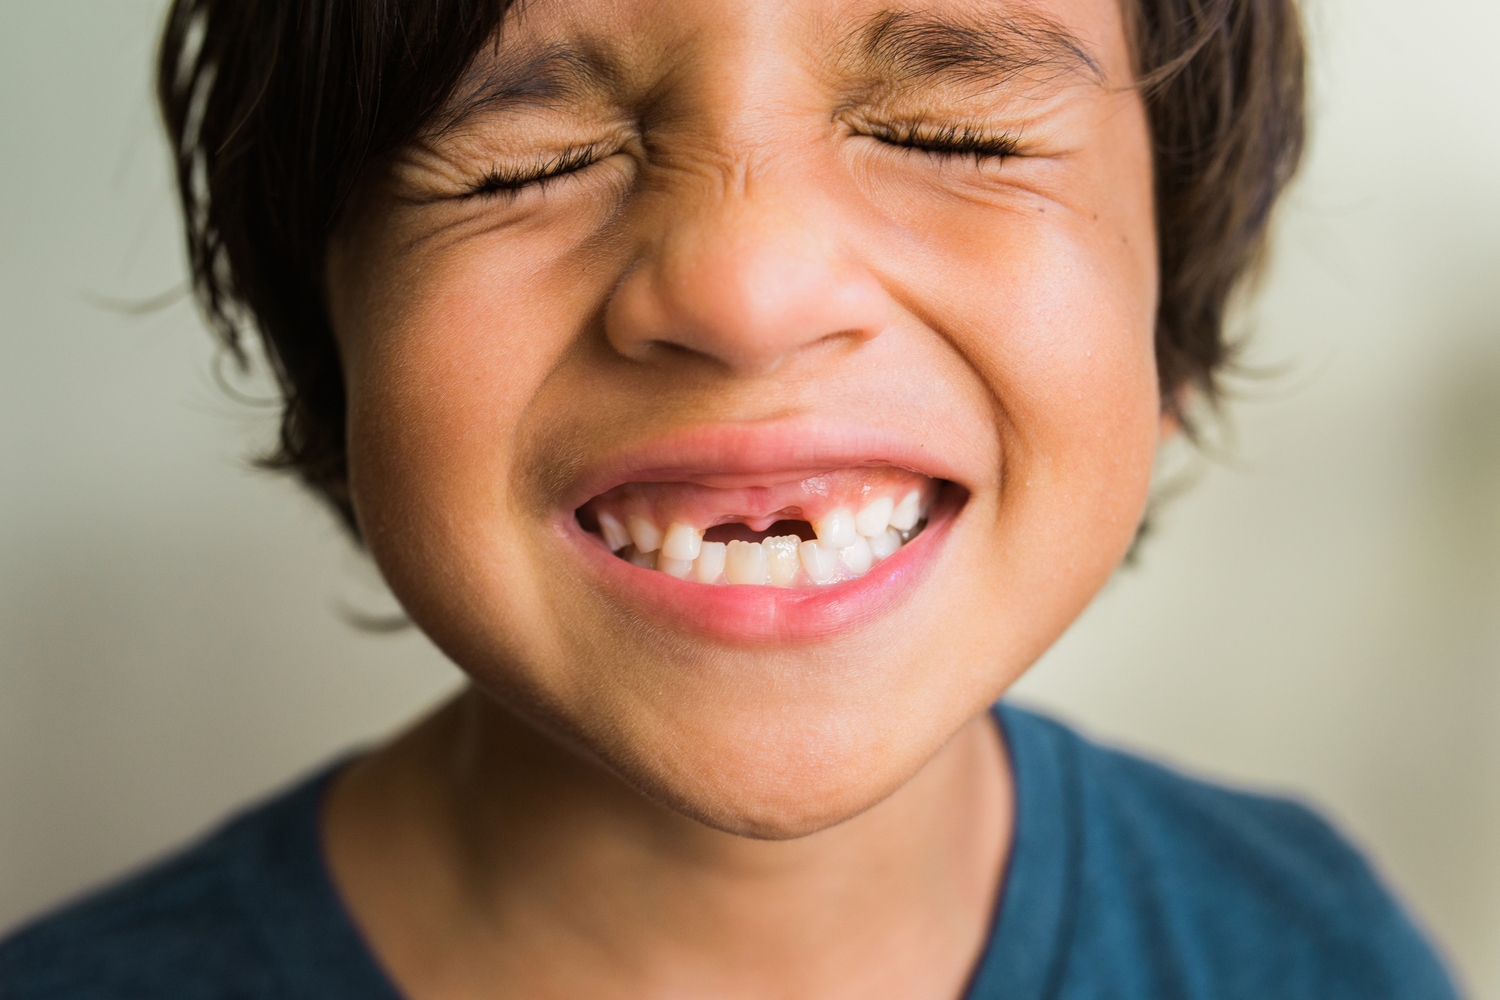
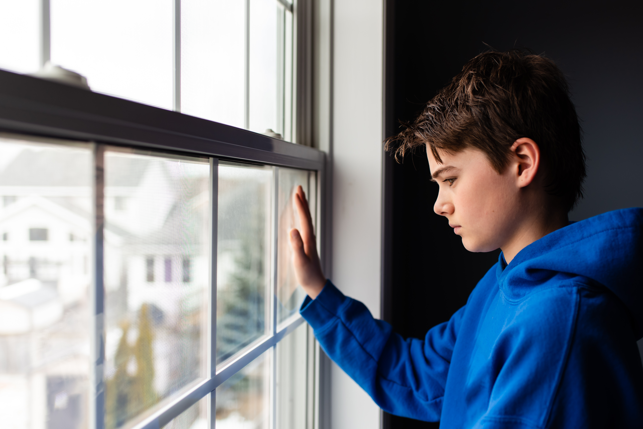
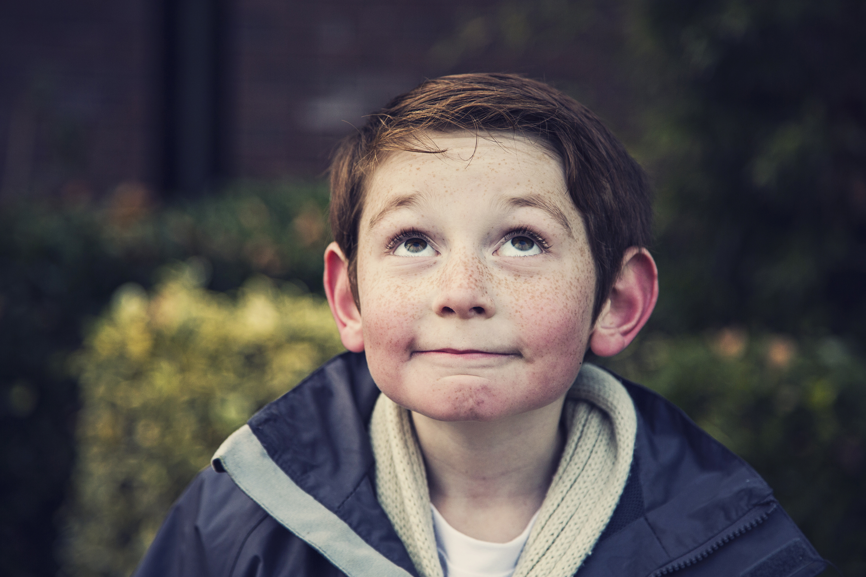
Part 7: Face Gallery Activity
Look at the examples of faces showing emotions.
Can you name some of them? Can you copy them?

Slide 15
This is the end of Lesson 1.
Great work!

