Slide 1






Professor Shane Pill (PhD) Professor Phillip Slee (PhD)
Associate Professor Deb Agnew (PhD) Dr Amy Wright (PhD)
Jessica Skuza (Research Assistant)

Slide 2
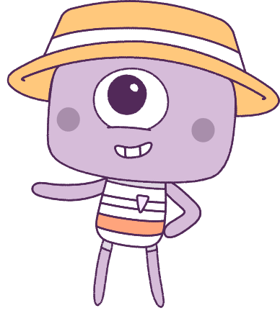




Lesson 2
Lesson 2
Emotions
Emotions
Lesson aims:
Lesson aims:
1.
Discover responsible decision making.
1.
Learn to recognise different emotions.
2.
Learn how different situations can
affect our emotions.
2.
Learn how different situations can
affect our emotions.
3.
Learn how to describe your own
feelings and the feelings of others.
3.
Learn how to describe your own
feelings and the feelings of others.

Slide 3
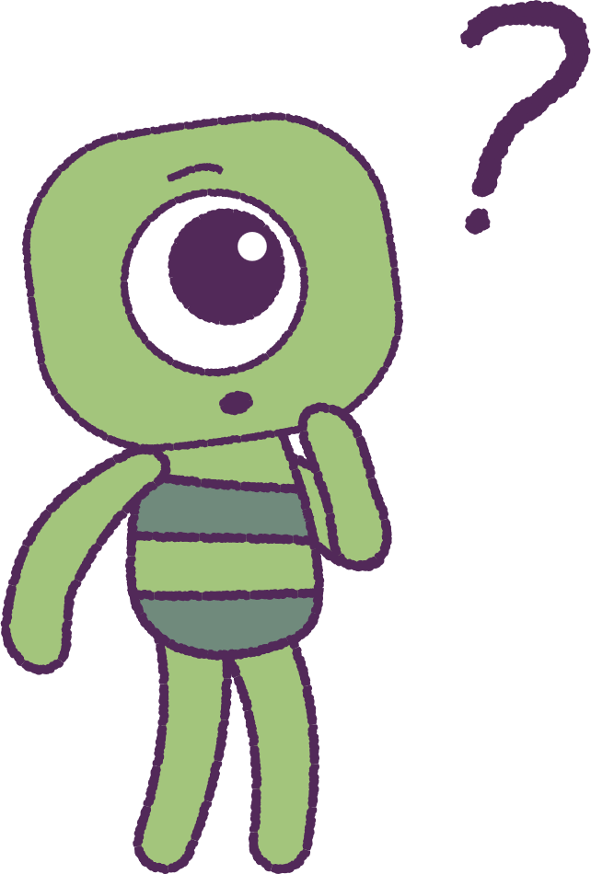

Part 1: Review content from last week
Who can remember what we discussed in Lesson 1?
In our lesson today, we will talk more about emotions.
Lets get ready to look at the animation!
3

Slide 4


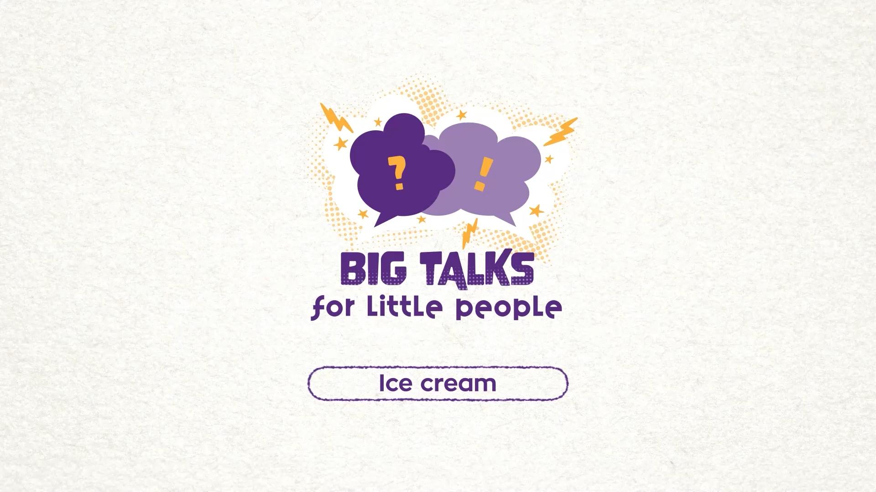

Part 2: Watch the animation
Hover your mouse over the video to view play settings. Otherwise, download from the website.
4

Slide 5
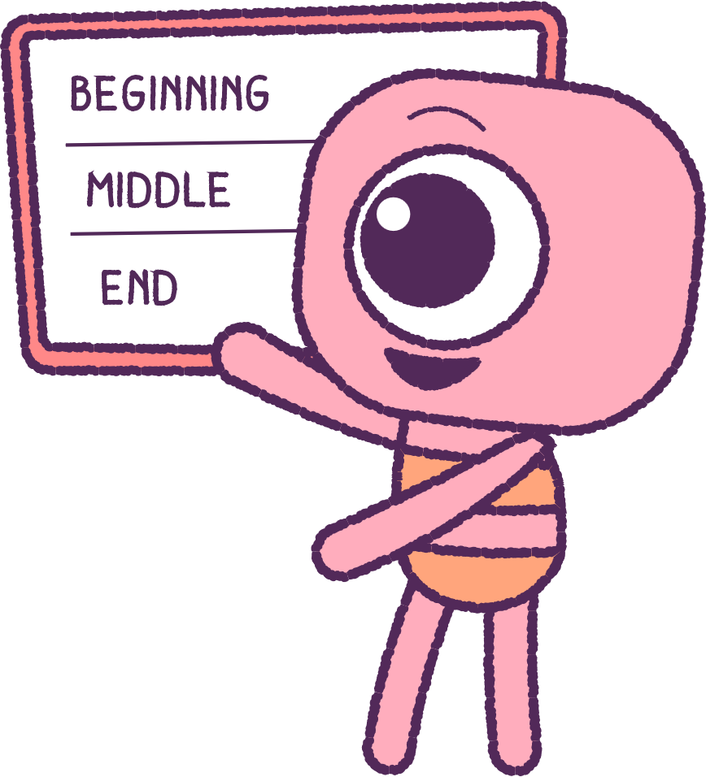
Part 2: Continued
What is happening in the animation?
What feelings did Twig’s ‘Feel’ have
after dropping the icecream?
Plot the story on a white board.
What happened at the beginning,
middle, and end?
Write down any emotions or feelings in
your wellbeing dictionaries.
5

Slide 6
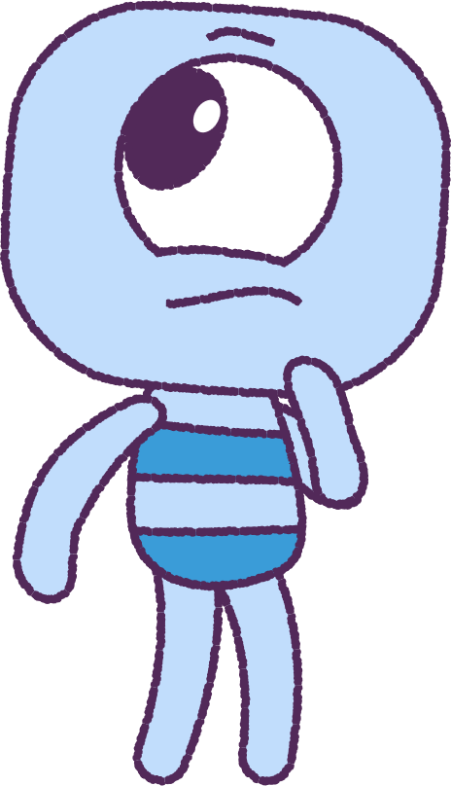
Part 2: Continued
Can you name some strong emotions or feelings?
Can you think of any situations that made you feel those strong emotions?
• Where were you?
• Who were you with?
• What were you doing at that time?
6

Slide 7
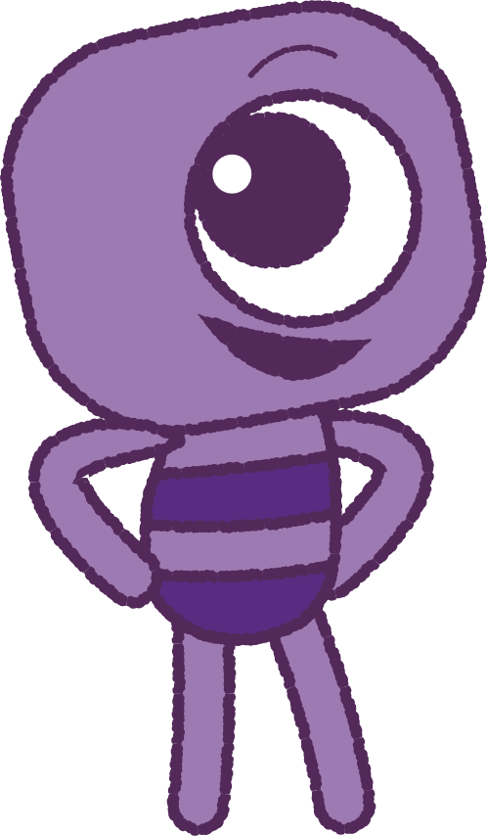
Part 2: Continued
Remember:
Everyone has different feelings at different times.
Some emotions can make you feel very happy and glad about things.
Some emotions can make you sad or unhappy about things.
7

Slide 8

Part 3: Drawing Activity
Follow instructions to go back to your workspace.
Draw your own emotions as ‘Feels’, in a
similar way, to how they are shown in the image on this slide.
As you are drawing, think about things that have happened recently to make you feel these emotions.
8

Slide 9
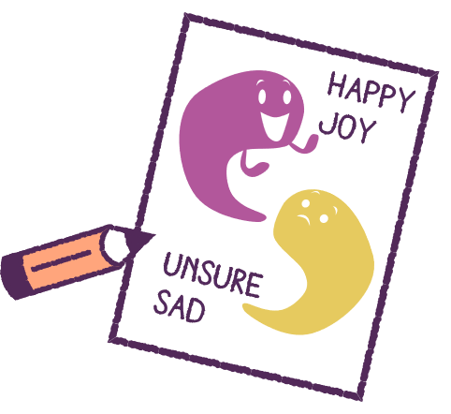
Part 4: Writing Activity
Can you name the feelings you have drawn?
Write the name of the feelings you have drawn next to your picture. Ask your teacher to help you if needed.
Add colours to your ‘Feels’, that you think, describe those feelings.
With a classmate, explain your picture.
9

Slide 10
This is the end of Lesson 2.
Great work!

