Slide 1






Professor Shane Pill (PhD) Professor Phillip Slee (PhD)
Associate Professor Deb Agnew (PhD) Dr Amy Wright (PhD)
Jessica Skuza (Research Assistant)

Slide 2
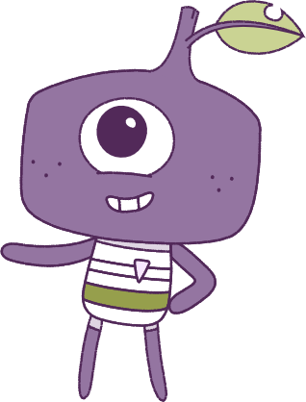




Lesson 3
Lesson 3
Emotions
Emotions
Lesson aims:
Lesson aims:
1.
Learn how to cope with uncomfortable or strong feelings.
1.
Learn how to cope with uncomfortable or strong feelings.
2.
Learn how different situations can
change our emotions.
2.
Learn how different situations can change our emotions.
3.
Learn how to recognise emotions.
4..
Learn ways to cope with
emotions in different situations.
3.
Learn to recognise emotions and how to cope in different situations.

Slide 3


Part 1: Review content from last week
Who can remember what we discussed last week?
In our session today, we will talk more about emotions.
Lets get ready to look at the animation!
3

Slide 4


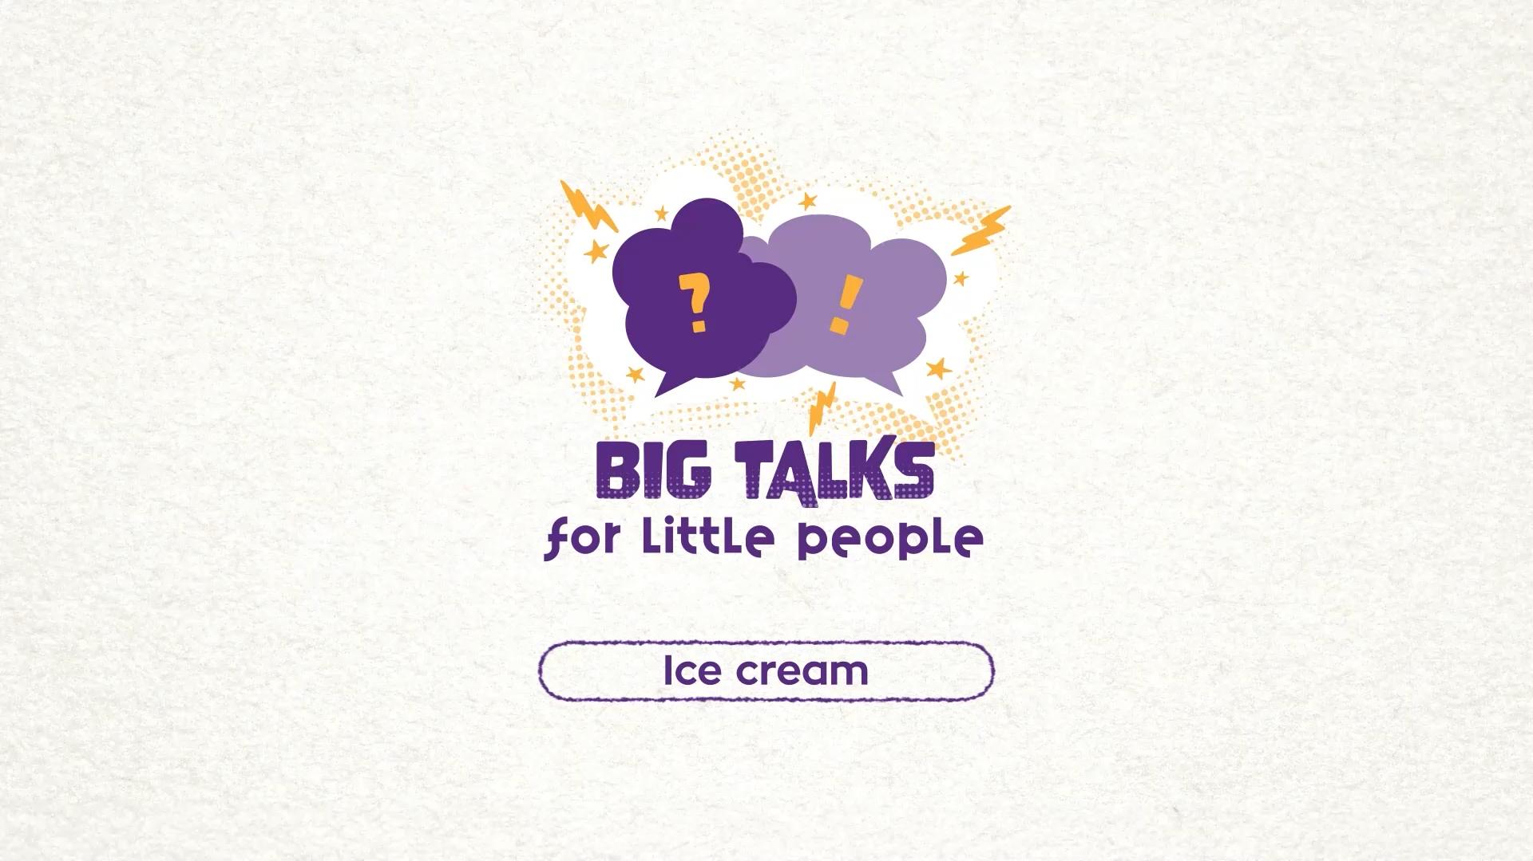

Part 2: Watch the animation
4
Hover your mouse over the video to view play settings. Otherwise, download from the website.

Slide 5
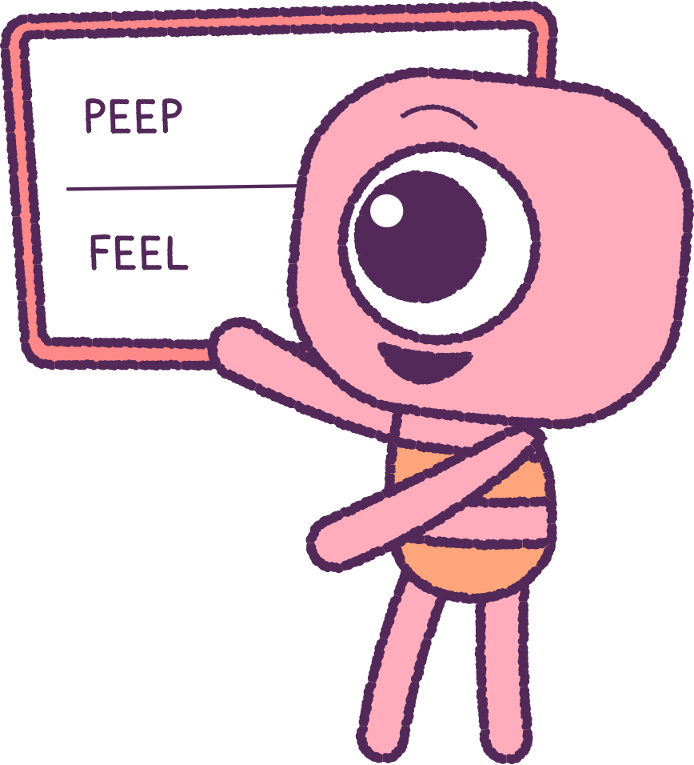
Part 2: Continued
As a class, let’s get ready to write on
the white board!
Watch the ‘Icecream’ video again and only watch the ‘Peep’s face and body movements.
How was the ‘Peep’ feeling?
Watch the video again carefully,
and this time only watch the ‘Feel’.
Was the ‘Feel’ showing the same emotions as the ‘Peep’ or different ones?
5

Slide 6
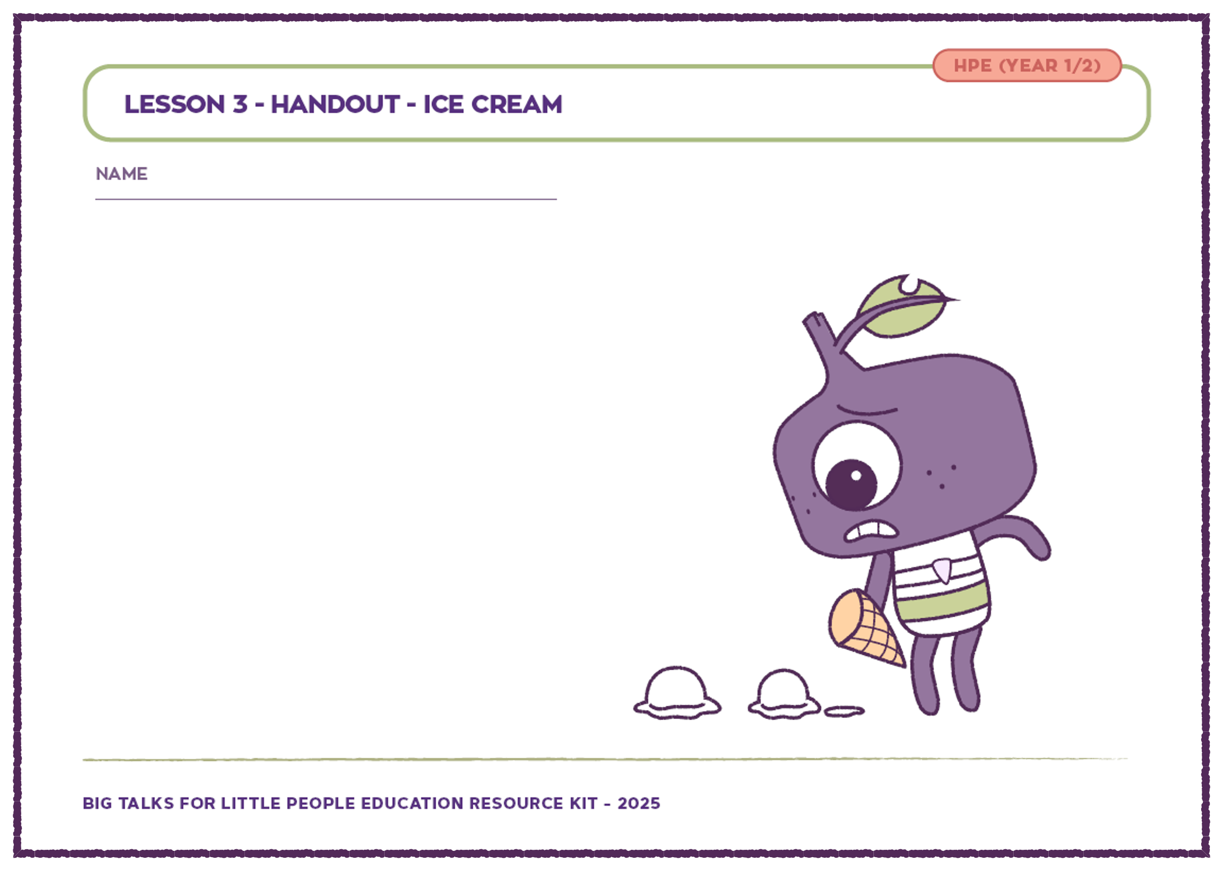
Part 3: Printout Activity
Follow instructions to return to your workspace. Your teacher will hand you
a sheet.
Draw yourself in the picture, showing how you would help the ‘Peep’ to feel better.
Question time
If you were the ‘Peep’ in the picture, how would you feel, and why would you feel that way?
What could you do or say to help the ‘Peep’ feel better?
6

Slide 7
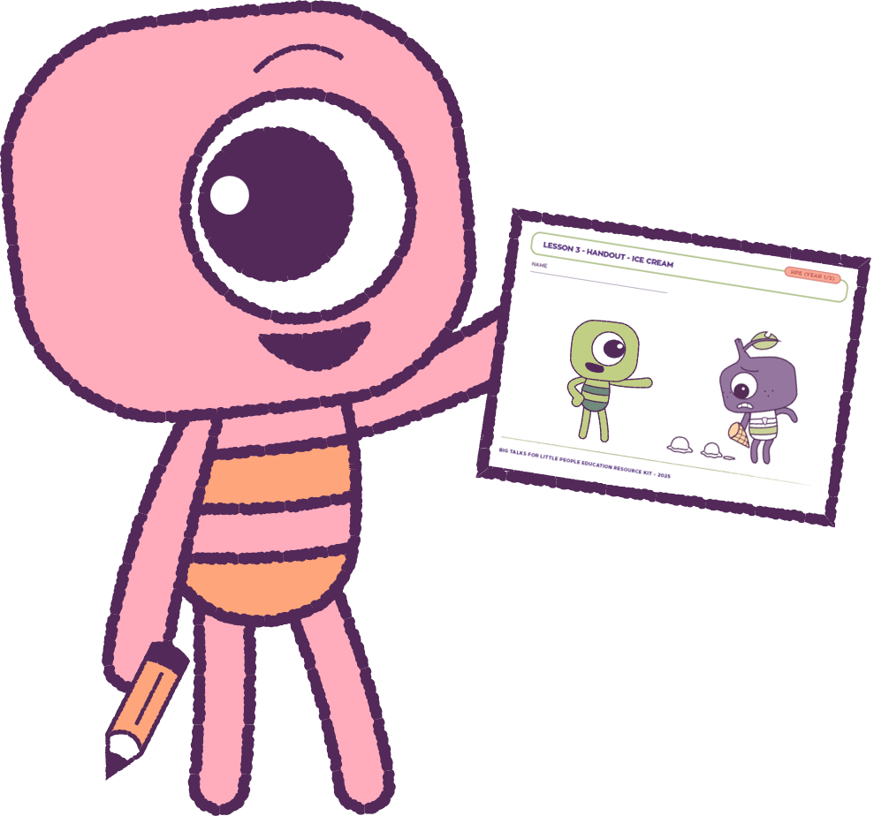
Part 4: Group Discussion
Share your pictures and ideas with the rest of class.
Talk about the different ways you were able to help the ‘Peep’ feel better.
The ‘Peep’ was very annoyed at themselves for dropping the icecream. This made the ‘Peep’ have other feelings.
7

Slide 8
This is the end of Lesson 3.
Great work!

