Slide 1






Professor Shane Pill (PhD) Professor Phillip Slee (PhD)
Associate Professor Deb Agnew (PhD) Dr Amy Wright (PhD)
Jessica Skuza (Research Assistant)

Slide 2
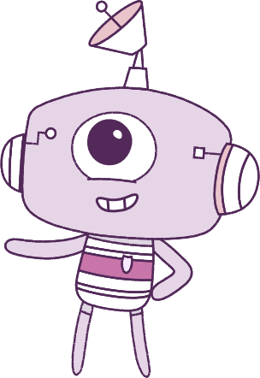




Lesson 4
Emotions
Lesson aims:
Lesson aims:
1.
Practise ways to know about your emotions before you act on them.
1.
Practise ways to know about your emotions before you act on them.
2.
Learn how different situations can
affect our emotions.
2.
Learn how different situations can
affect our emotions.
3.
Let’s think about ways to make kind and respectful friendships.
3.
Let’s think about ways to make kind and respectful friendships.

Slide 3
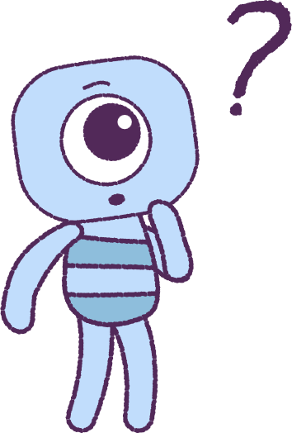

Part 1: Review content from last week
Who can remember what we discussed last lesson?
In our session today, we will talk more about emotions.
Let’s get ready to look at the animation!
3

Slide 4


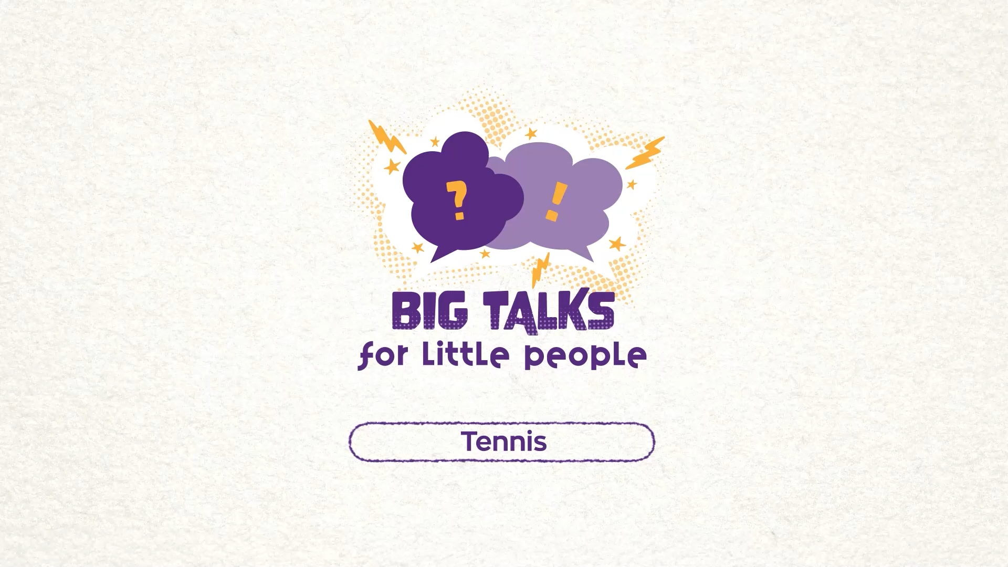

Part 2: Watch the animation
Hover your mouse over the video to view play settings. Otherwise, download from the website.
4

Slide 5
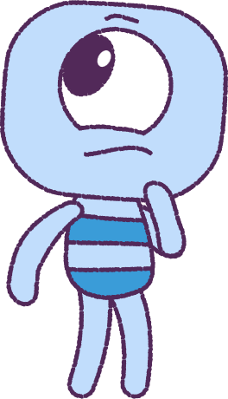
Part 2: Continued
What is happening in this animation?
Watch the ‘Tennis’ video again, watching how Bean acts.
Why did Bean act in that way?
Watch the video again and only watch
Beans ‘Feel’. How does the ‘Feel’ act?
What would Bean be doing if they acted like their ‘Feel’?
What do you think would happen to Bean if Bean really did act like their ‘Feel’?
5

Slide 6
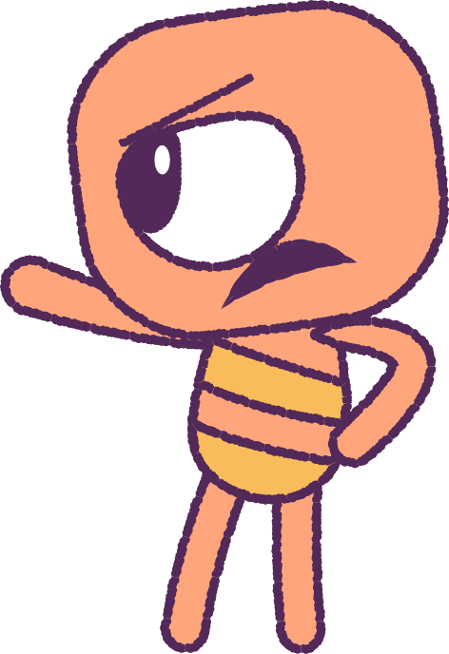
Part 2: Continued
Can you think of a time when you felt angry or frustrated after losing a game, like Bean did?
How long did the feeling last for?
Would you like to share your story with
the class?
Emotions are real and can be very strong,
but you can:
• Talk to someone about them.
• Learn to control them!
6

Slide 7
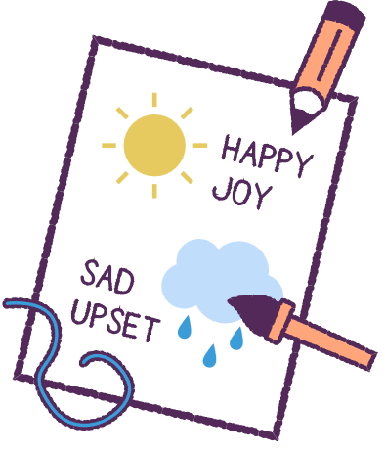
Part 3: Emotional Weather Forecast Board
Feelings come and go. They change like the weather!
Let’s start our next activity.
1. Find craft materials in your classroom.
2. Create weather symbols like ‘Sunny’ or ‘Stormy’ and try to match them to feelings.
Other examples could be:
• ‘Lightning’ for feeling angry
• ‘Whirlwind’ for feeling confused
• ‘Cloudy’ for feeling unhappy
7

Slide 8
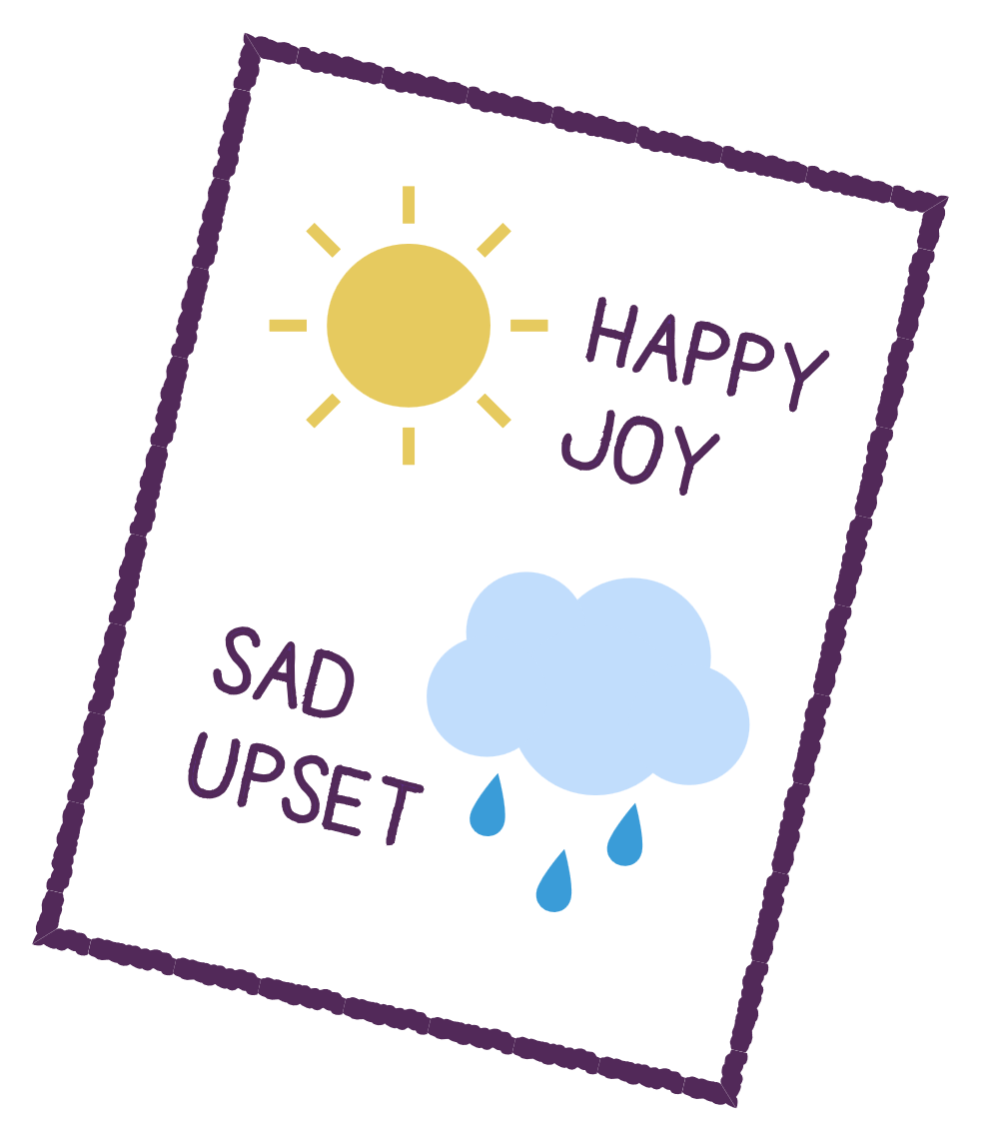
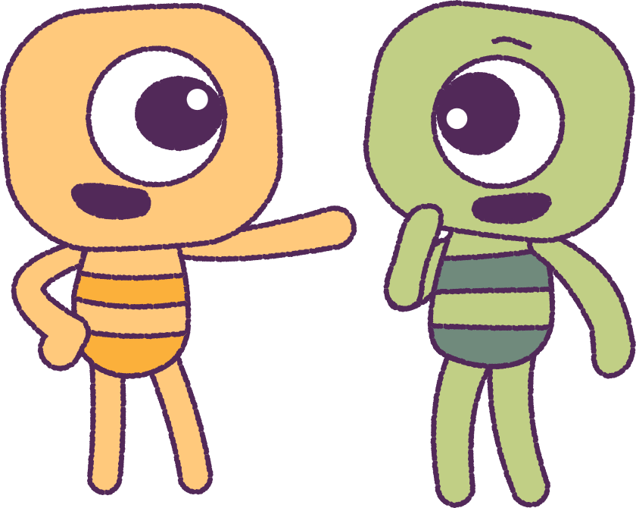
Part 4: Display and Discussion
Pin the weatherboards up in your class where you can see it.
Discuss how we can use the board every day to help you to remember the different feelings.
Remember that feelings are always changing… just like the weather!
8

Slide 9
This is the end of Lesson 4.
Great work!

