Slide 1






Professor Shane Pill (PhD) Professor Phillip Slee (PhD)
Associate Professor Deb Agnew (PhD) Dr Amy Wright (PhD)
Jessica Skuza (Research Assistant)

Slide 2
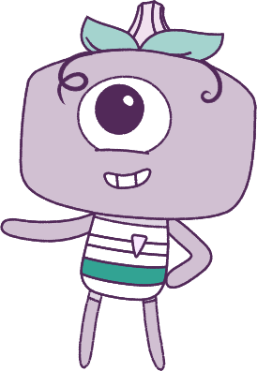




Lesson 5
Lesson 5
Emotions
Emotions
Lesson aims:
Lesson aims:
1.
Practise ways to know about your emotions before you act on them.
1.
Practice ways to know about your emotions before you act on them.
2.
Learn how different situations can affect our emotions.
2.
Learn how different situations can
affect our emotions.
3.
Learn how different situations can affect our emotions.
3.
Learn how to make friendships, and how to describe things about ourselves and other people.
4..
Learn to describe things about
ourselves and other people.

Slide 3
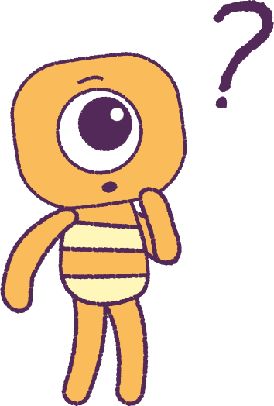

Part 1: Review content from last week
Who can remember what we discussed last lesson?
In our session today, we will talk more about emotions.
Let’s get ready to look at the animation!
3

Slide 4


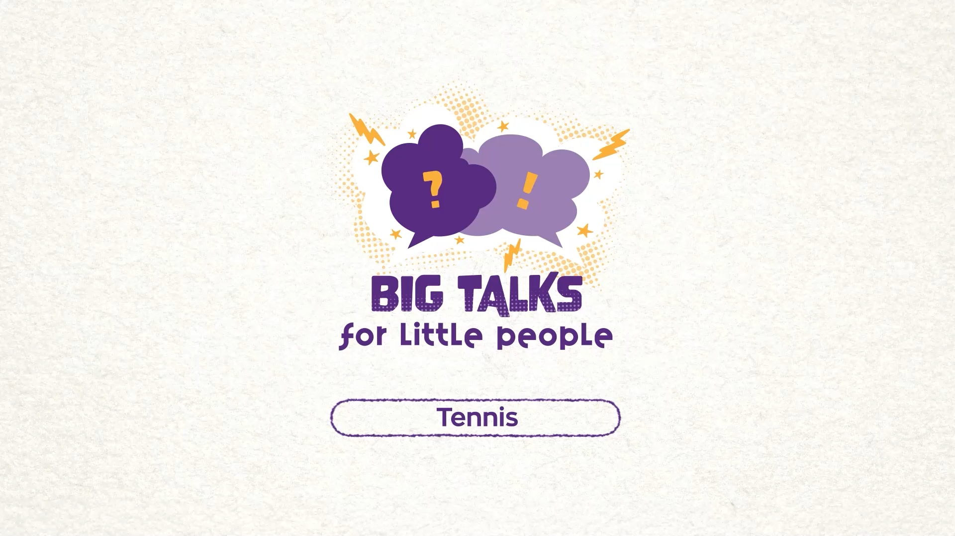

Part 2 – Watch the animation
4
Hover your mouse over the video to view play settings. Otherwise, download from the website.

Slide 5
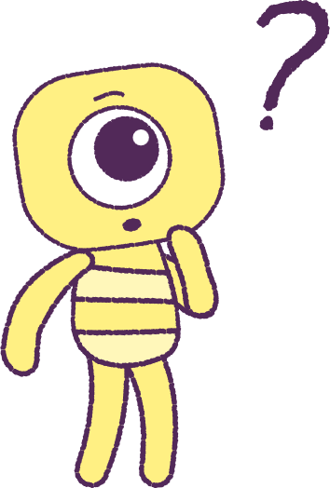
Part 2: Continued
Bean had strong feelings but didn’t act
on them.
You can have a strong feeling, but you can choose to ‘act opposite’ to your feeling.
Can you think of a time when you 'acted opposite’ to a strong feeling?
For example:
• You felt frightened but tried to look brave.
• You felt sad but tried your best to look happy.
5

Slide 6
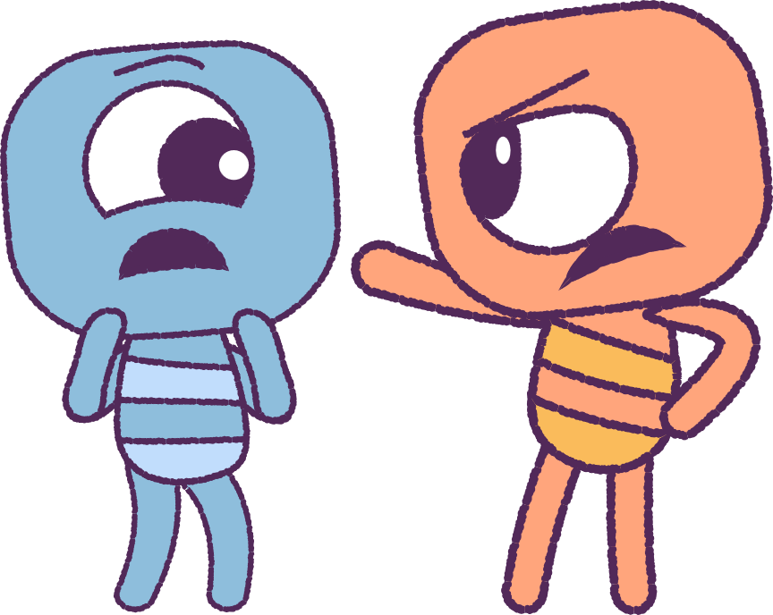
Part 3: Identify Emotions
Let’s practise showing feelings.
What is your body doing?
In groups, take turns to show some strong feelings.
Take notice of what your body is doing
when you are showing those strong feelings.
For example, if you are angry, you may…
• Clench your fists
• Stomp around loudly
• Use a louder voice
• Have an angry look on your face
• Talk over other people
6

Slide 7
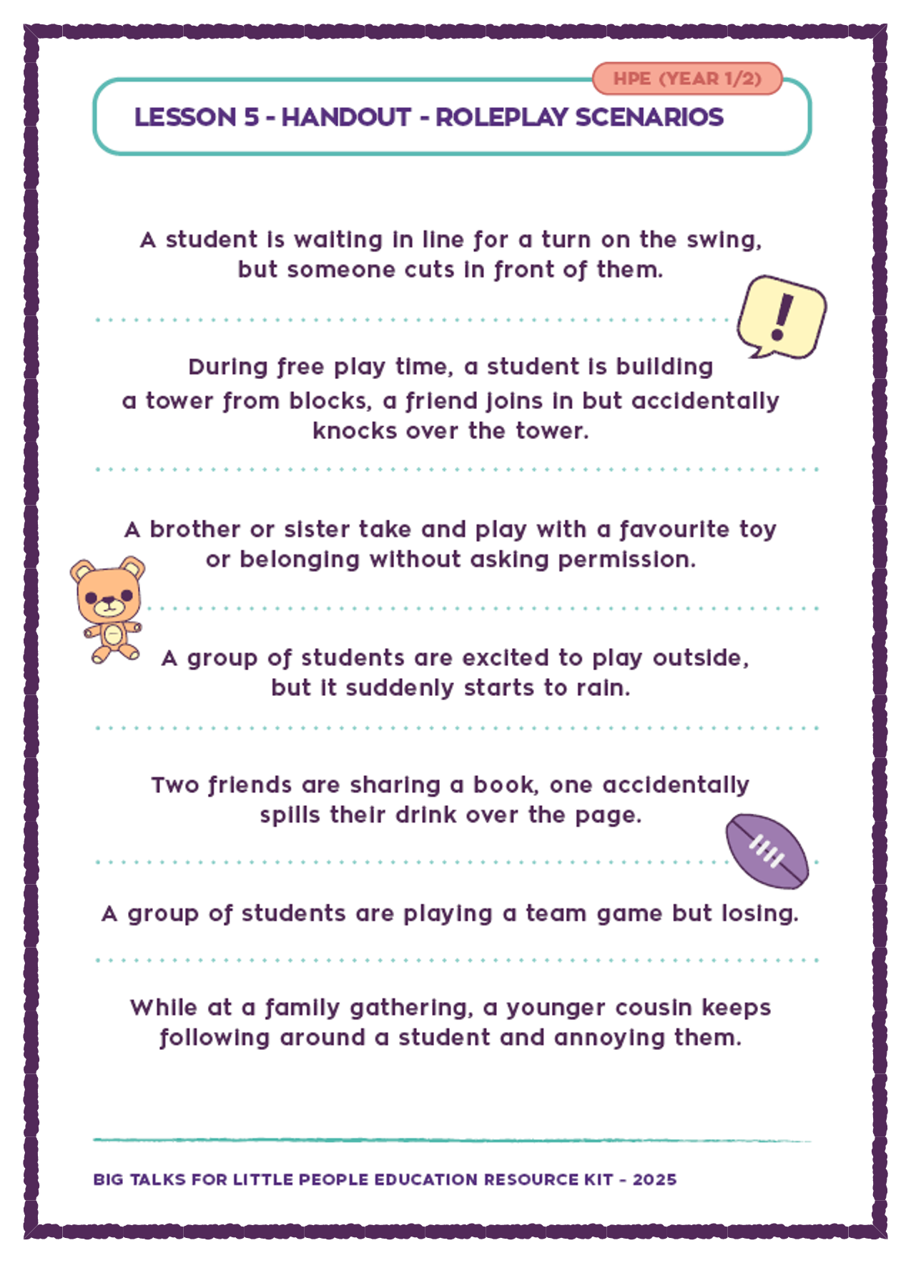
Part 4: Roleplay Scenarios
Your teacher will give you some pretend situations to ‘act out’ in groups.
Think about what would happen, if you react in a different way to those situations.
‘Replay’ the situation and try to ‘act opposite’. What happened this time?
Think about your actions. ‘Acting opposite’ can make a bad situation better.
For example, if you are angry, try to think about something that makes you happy!
7

Slide 8
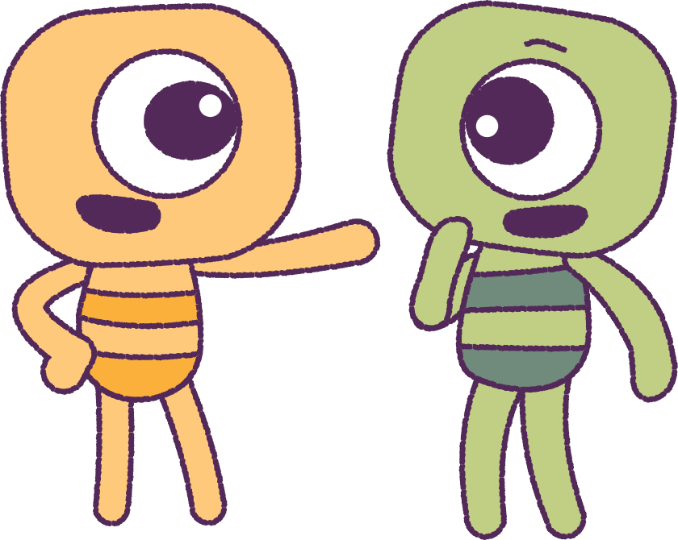
Part 5: Class Discussion
Let’s discuss what we learnt.
It’s important to take notice of your feelings.
Think about different ways you can act when uncomfortable things happen.
Think about what will happen if you act in those different ways.
Practise being calm and in control of
your feelings.
8

Slide 9
This is the end of Lesson 5.
Great work!

