Slide 1






Professor Shane Pill (PhD) Professor Phillip Slee (PhD)
Associate Professor Deb Agnew (PhD) Dr Amy Wright (PhD)
Jessica Skuza (Research Assistant)

Slide 2
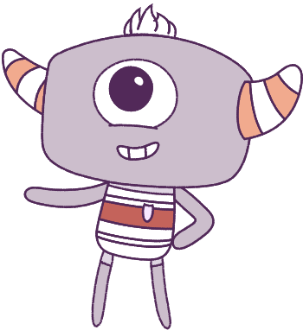




Lesson 6
Model Building Mindset
Lesson aims:
Lesson aims:
1.
Learn to recognise our emotions and what makes us all different and unique.
1.
Learn to recognise our emotions and identify what makes us unique.
2.
Learn how different situations can
affect our emotions.
2.
Describe things that make us
special and others special.
3.
Learn how different situations can affect our emotions.
4..
Find ways to work together,
especially in games and sports.
3.
Describe things that make us
special and others special.
Find ways to work together.

Slide 3
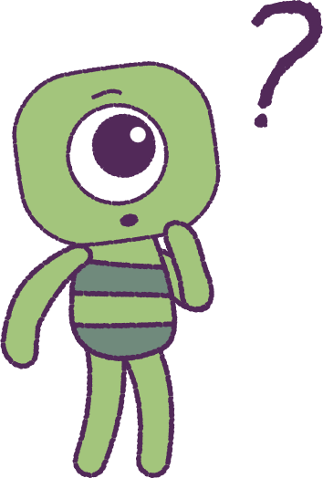

Part 1: Review content from last week
Who can remember what we discussed last lesson?
In our session today, we will talk more about model building mindset.
Let’s get ready to look at the animation!
3

Slide 4
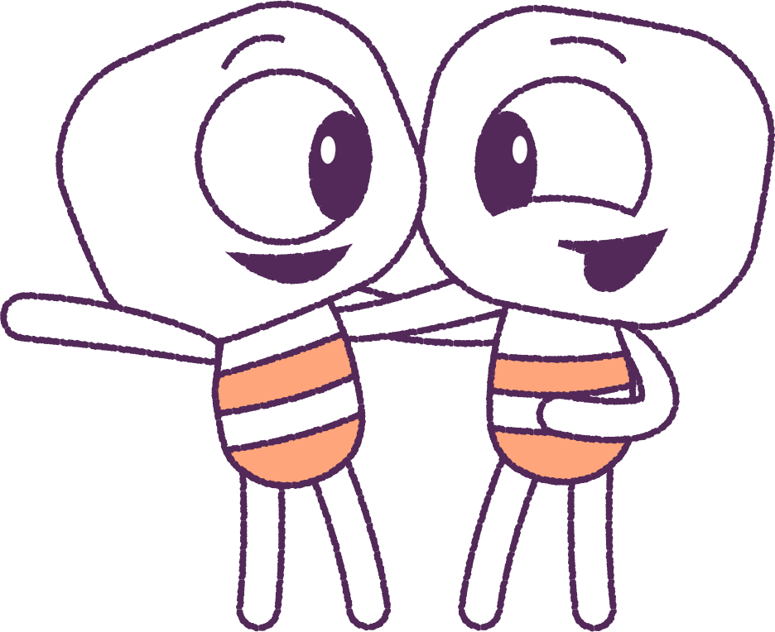
Part 2: Watch Animation
We’re about to watch an animation! But before
we do, let’s have a quick class discussion.
• What does ‘teamwork’ mean?
• Who can you work with in a team?
• How can you work well with them?
Can you think of some times when you might
need to work as a ‘team’? Can you think of some activities that you might want to work with someone else?
Special note: On first watch, pause the animation after the first scene when Elk and Stalk finish working on their model.
4

Slide 5


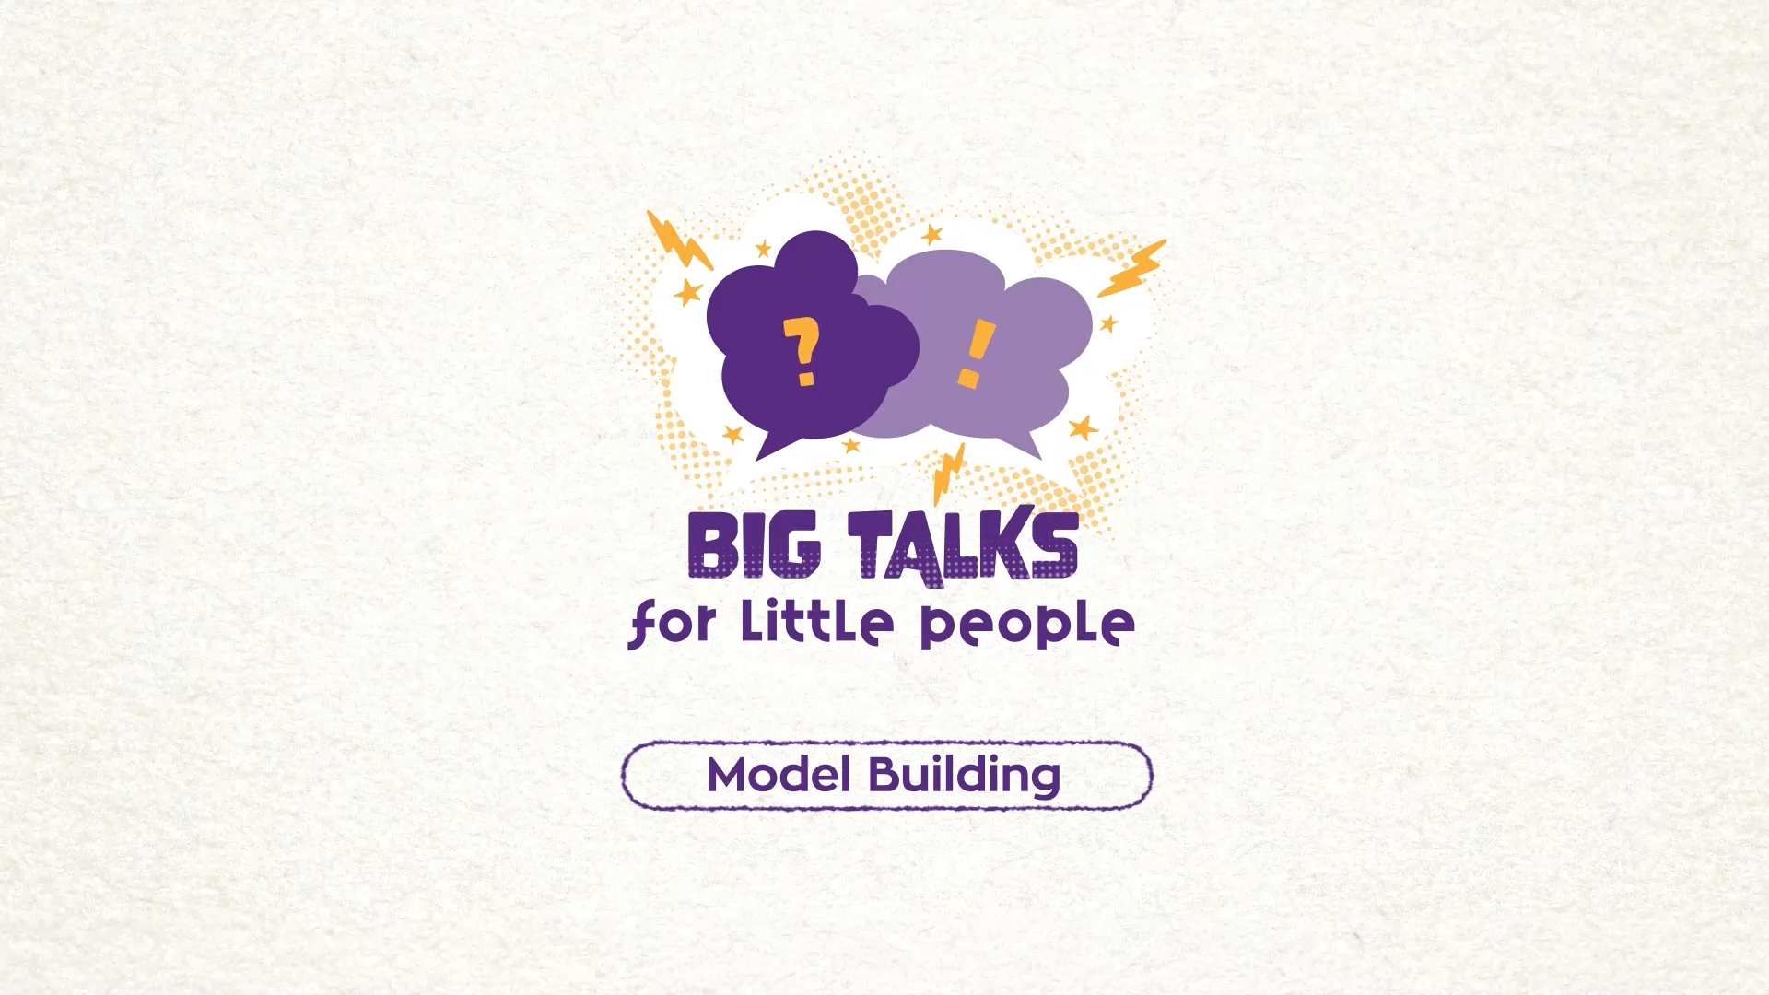

Part 2: Watch the animation
Hover your mouse over the video to view play settings. Otherwise, download from the website.
5

Slide 6
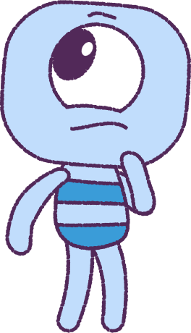
Part 2: Continued
What do you think the Peeps Elk and Stalk were both feeling while they were building the model?
Watch the video again: just watching Stalk.
Can you think of a time when you were working on something tricky or hard, and needed help?
How did you feel when you needed help?
Watch the video again: just watching Elk.
Have you helped someone with some thing hard or tricky? How did you feel when helping them?
6

Slide 7
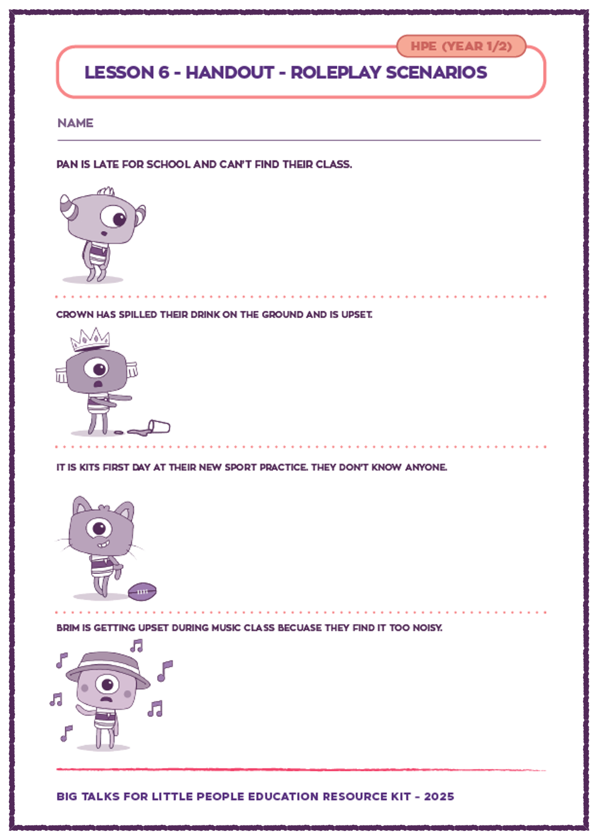
Part 3: Printout Activity
Your teacher will hand everyone an activity sheet and read out the stories.
How you would you feel if these things happened to you?
How are the Peeps feeling when these things happen?
What would you like a friend to do to help you, if these things happened to you?
Use words or pictures to show what you could do to help each Peep.
7

Slide 8
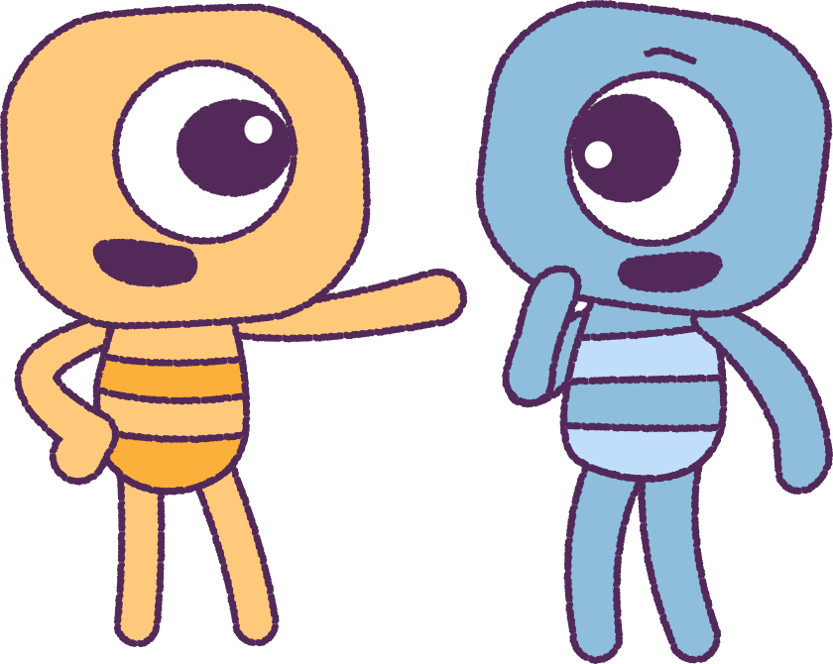
Part 4: Class Discussion
It’s class discussion time! Let’s share your great ideas with your classmates.
Remember:
• Everyone needs help sometimes.
• Offer to help people…Be part of a team!
• Learn to accept help from other people.
8

Slide 9
This is the end of Lesson 6.
Great work!

