Slide 1

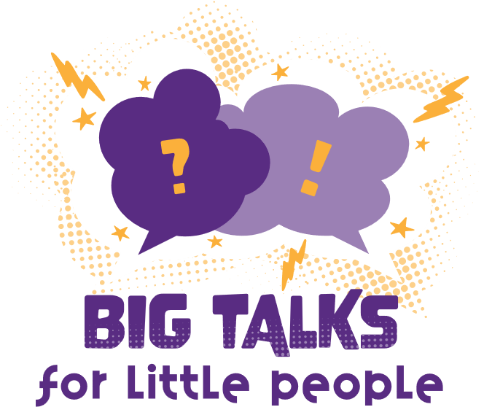



Professor Shane Pill (PhD) Professor Phillip Slee (PhD)
Associate Professor Deb Agnew (PhD) Dr Amy Wright (PhD)
Jessica Skuza (Research Assistant)

Slide 2
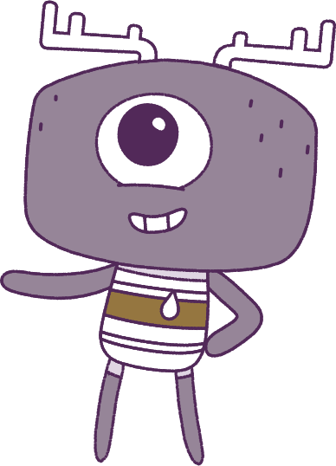




Lesson 7
Model Building Mindset
Lesson aims:
1.
Learn more about how our own emotions work and what makes us unique.
2.
Learn ways to make kind and
Respectful friendships.
3.
Describe things that make us
special and others special.
4..
Find ways to work together,
especially in games and sports.

Slide 3
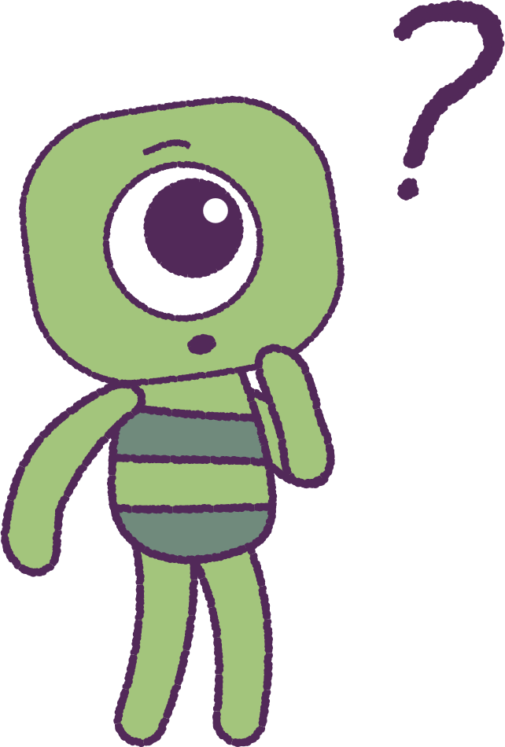

Part 1: Review content from last week
Who can remember what we discussed
last week?
In our session today, we will talk more about model building mindset.
Let’s get ready to look at the animation!
3

Slide 4


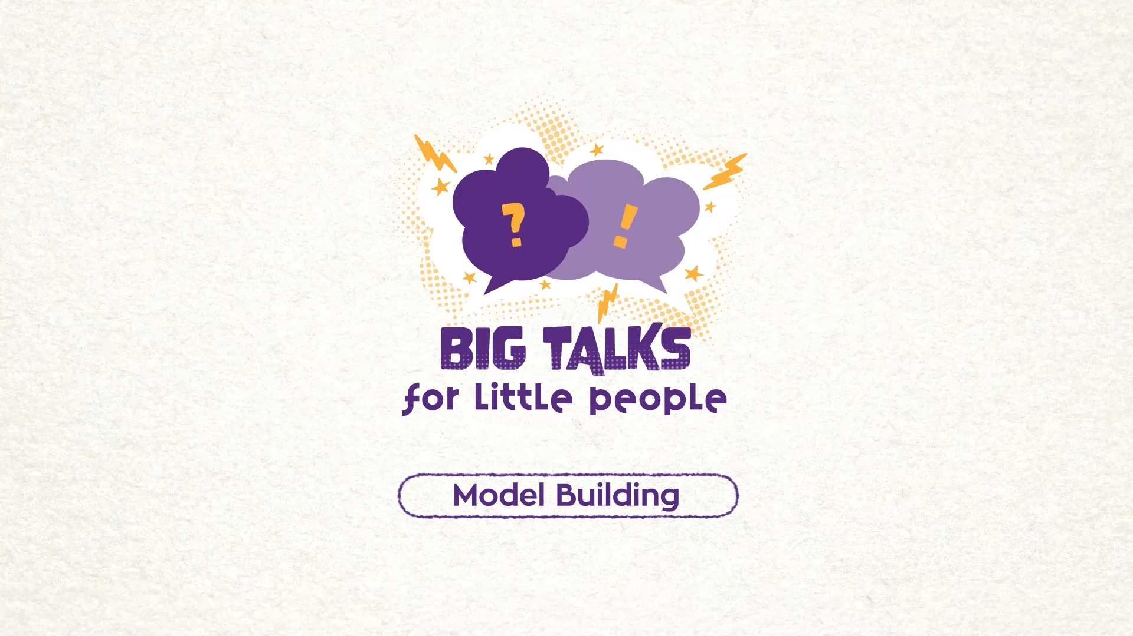

Part 2: Watch the animation
Hover your mouse over the video to view play settings. Otherwise, download from the website.
4

Slide 5
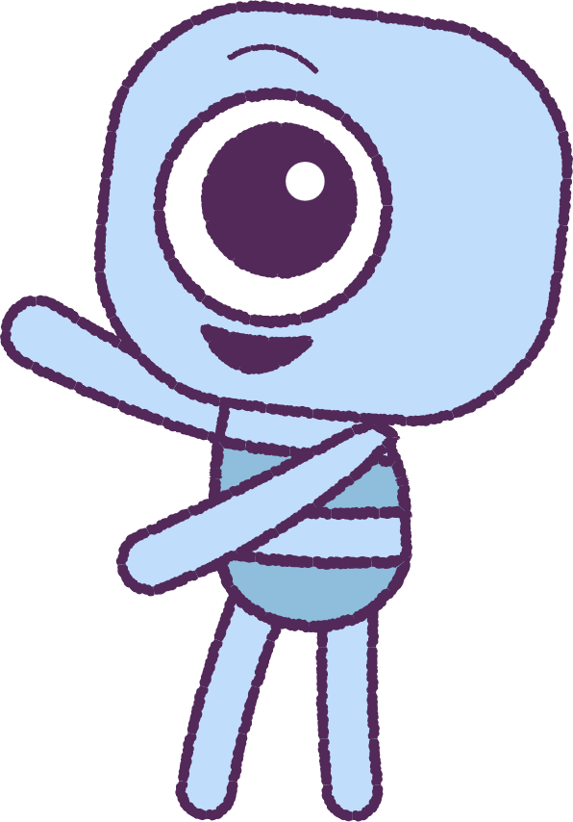
Part 2: Continued
Let’s discuss the animation!
When Elk and Stalk were collecting their prize:
• How is Elk acting?
• How is Elk feeling?
• Why do think Elk is feeling so strongly?
Make a list of all the feelings that Elk may be having and why Elk may be having those feelings.
• Is Elk being a good friend to act in that way?
5

Slide 6
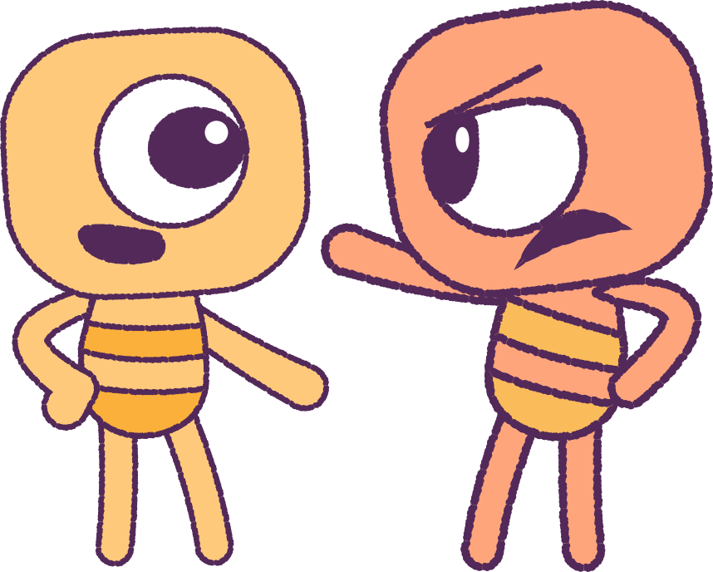
Part 3: Roleplay Activity 1
Your teacher will place you in pairs. In pairs, let’s pretend what would happen if:
• Elk feels angry but then acts angry.
• Elk shows anger and crosses their arms
and stares at Stalk.
• Stalks ignores Elk’s angry looks and cheers loudly.
After each story, talk about what things might happen if Elk stays angry.
• Will Stalk be safe? Will the prize table be safe?
As a class, talk about how our emotions could hurt other people and other things around us.
6

Slide 7
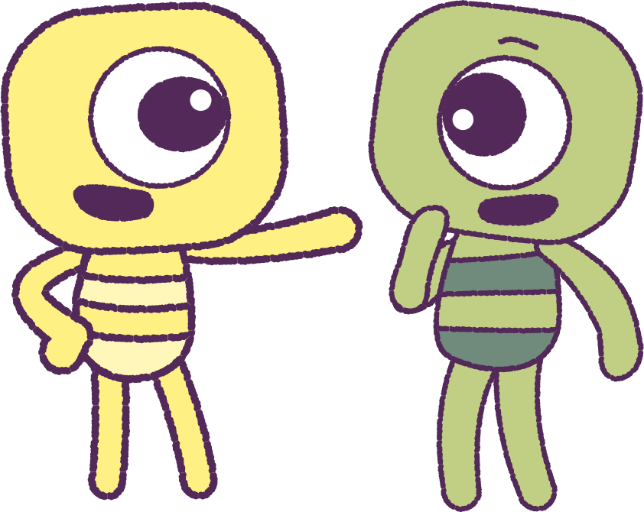
Part 4: Roleplay Activity 2
Before we start our next roleplay, let’s brainstorm how to act differently.
Your teacher will place you in the same pairs.
This time, ‘act opposite’ to how you did before.
Solve the problem:
Find ways to show kindness and that you
care for each other.
Being kind can keep us and others safe!
7

Slide 8
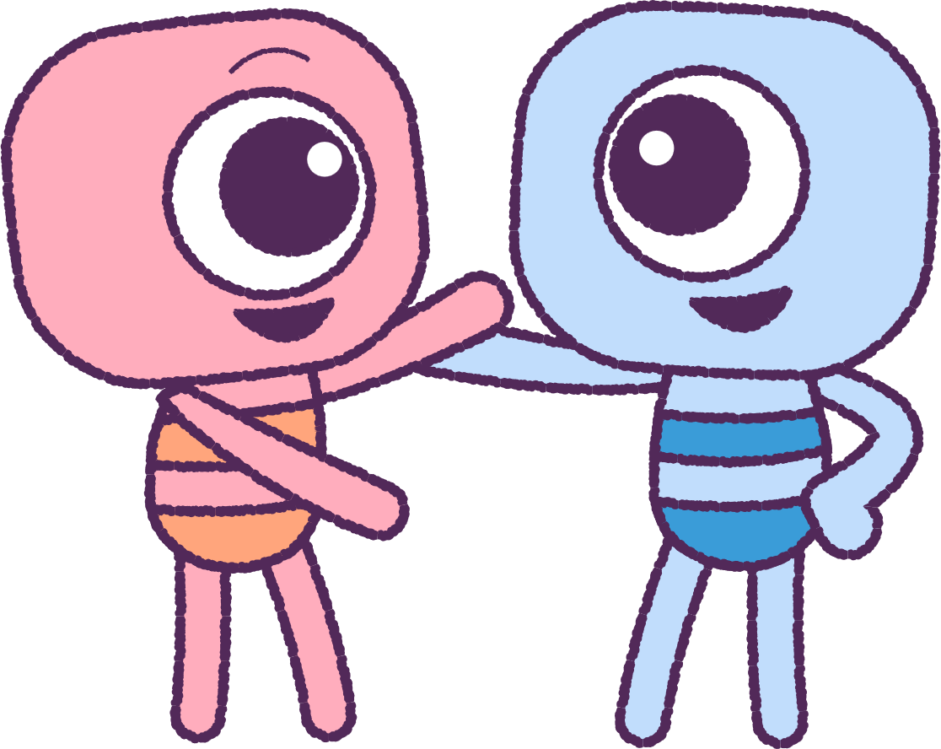
Part 5: Class Discussion
It’s important to communicate and notice the feelings of others.
What was different about the consequences and outcomes when you act ‘opposite to emotion’?
Why is it important to reflect before acting on strong emotions?
8

Slide 9
This is the end of Lesson 7.
Great work!

