Slide 1





Professor Shane Pill (PhD) Professor Phillip Slee (PhD)
Associate Professor Deb Agnew (PhD) Dr Amy Wright (PhD)
Jessica Skuza (Research Assistant)

Slide 2
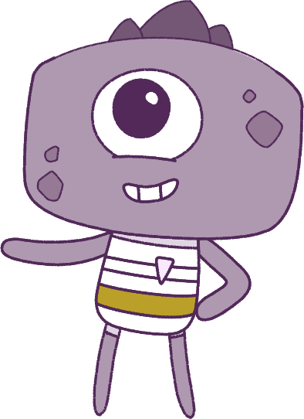




Lesson 8
Lesson 8
Resilience
Resilience
Lesson aims:
Lesson aims:
1.
Practise keeping calm in difficult
situations and making smart decisions.
1.
Practise keeping calm in difficult situations.
2.
Learn how different situations can change your emotions.
2.
Learn how to keep yourself and others safe and ways to look for help if you need it.
3.
Learn how situations can change your emotions.
4..
Describe the things that make us
special and others special.
3.
Learn about how to keep safe, look for help, and what makes others special.

Slide 3
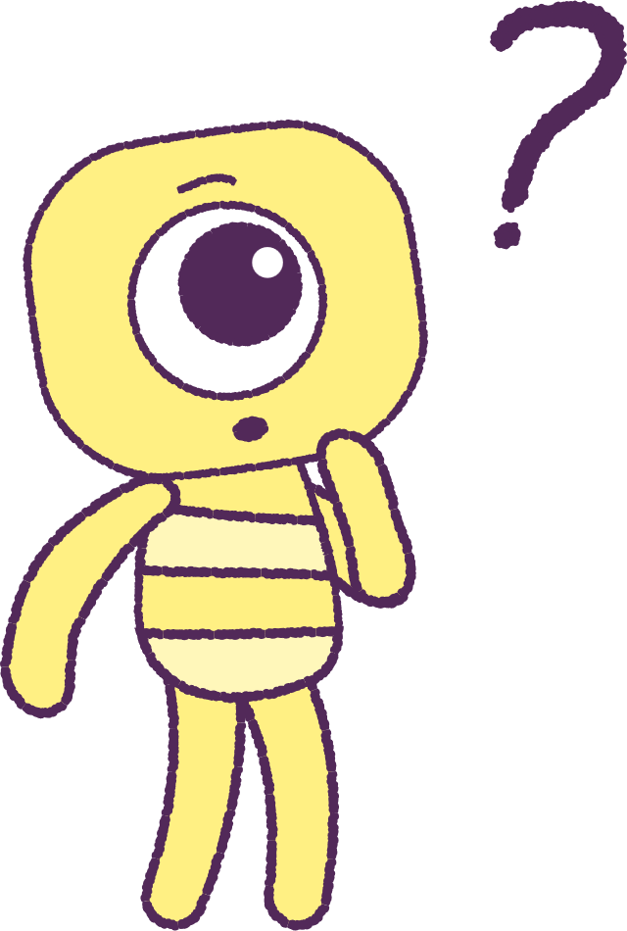

Part 1: Review content from last week
Who can remember what we discussed
last week?
In our session today, we will talk more about resilience.
Let’s get ready to look at the animation!
Special note: On first watch, pause the animation when the Peep Steg’s torch stops working.
3

Slide 4


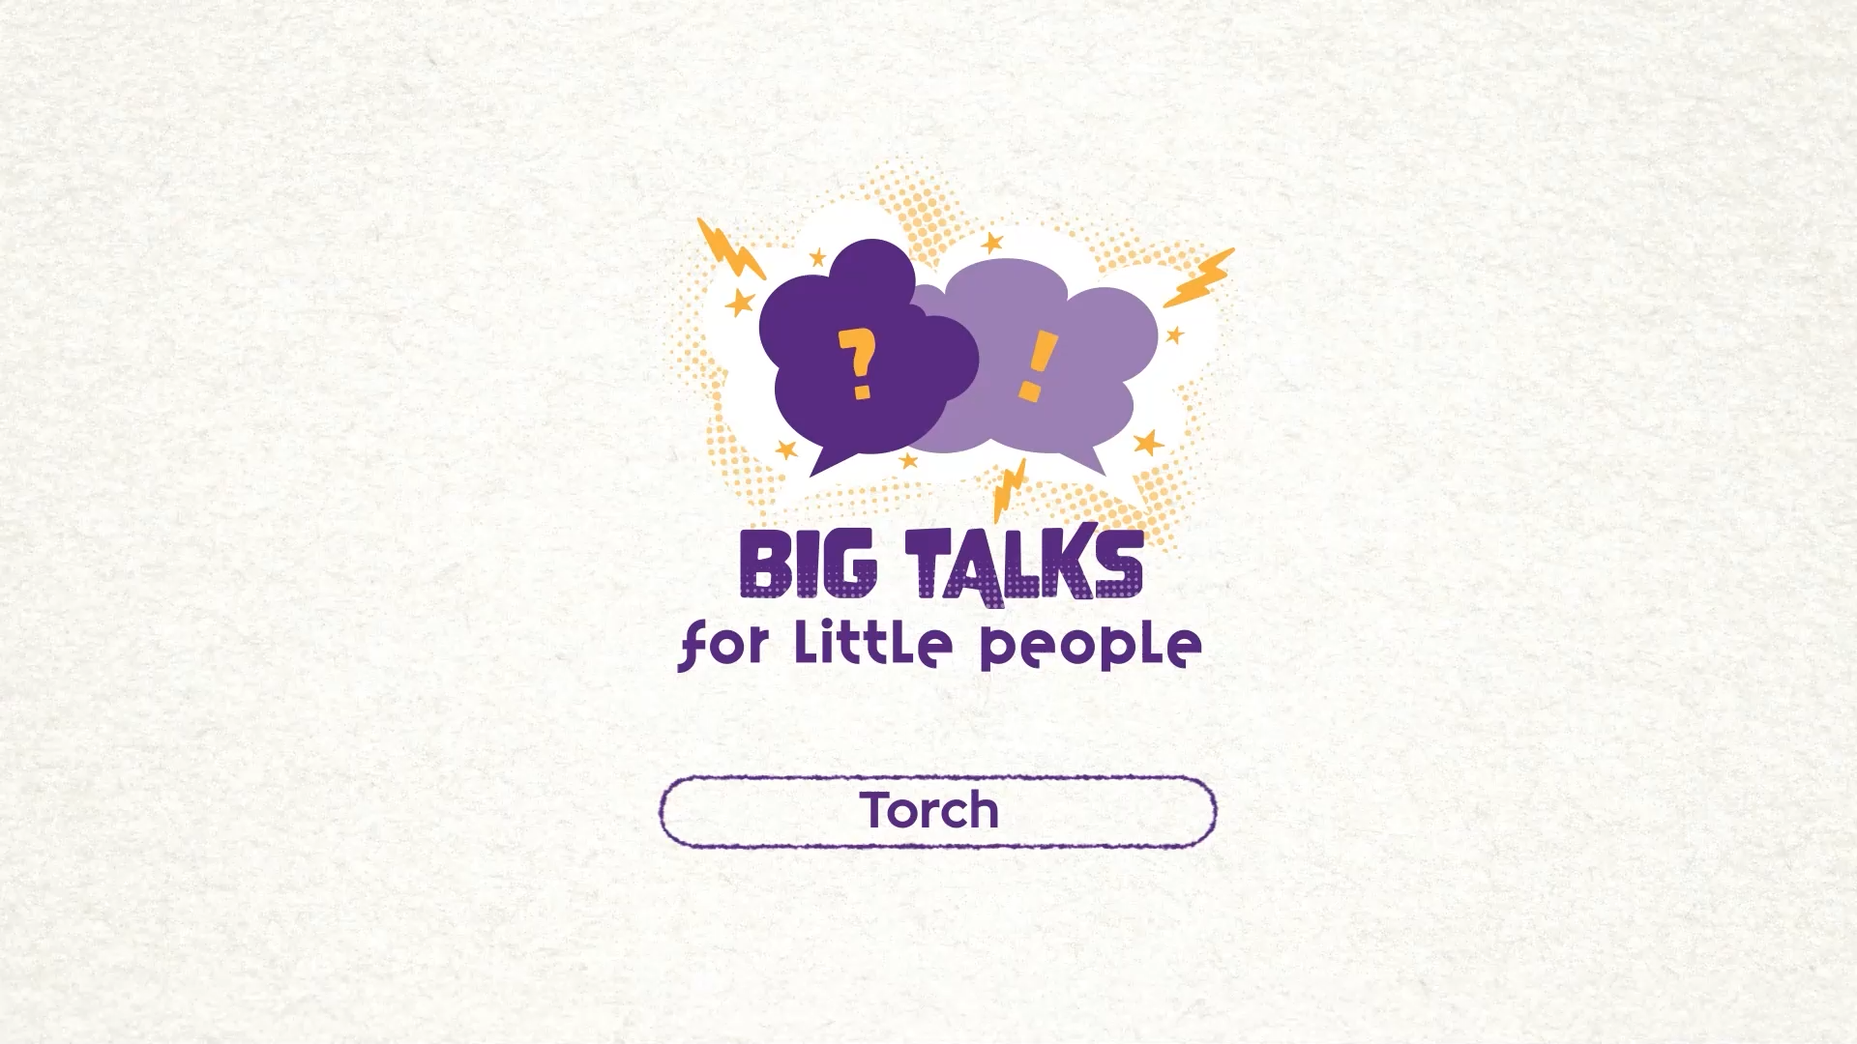

Part 2: Watch the animation
Hover your mouse over the video to view play settings. Otherwise, download from the website.
4

Slide 5
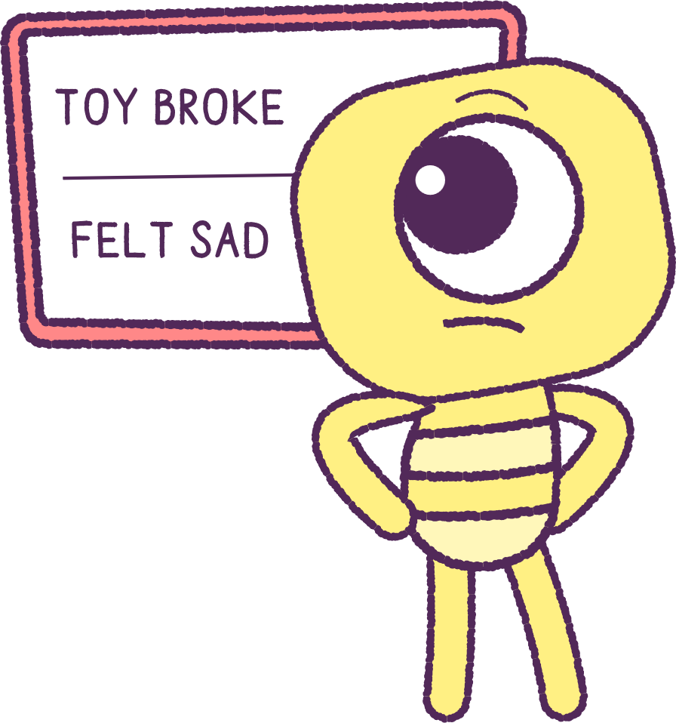
Part 2: Continued
Sometimes, things we like or enjoy playing with, can break or stop working.
Can you remember a time when this
happened to you?
How did you feel at the time when this happened?
Make a list on the whiteboard of the times
when something broke or stopped working.
Discuss how you felt at the time.
2021
5
2021
Test
Test
5
5

Slide 6
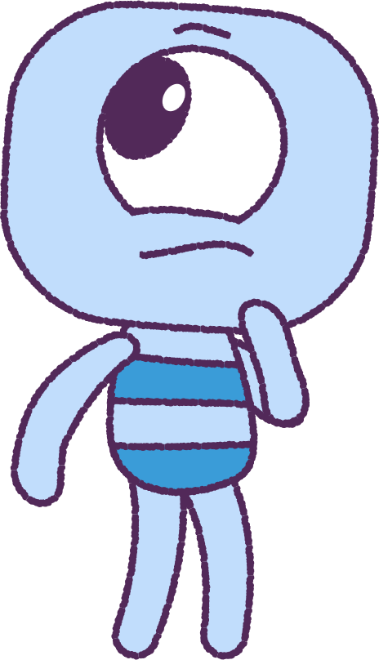
Part 3: Class Discussion
Watch the video again, right to the end.
As a class, try to spot the ‘Peep’ Steg’s different reactions to the broken torch?
Passive: Steg gave up trying to solve the problem.
Aggressive: Steg acted angrily instead of trying to solve the problem.
Assertive: Steg tried to solve the problem.
2021
6
2021
Test
Test
6
6

Slide 7
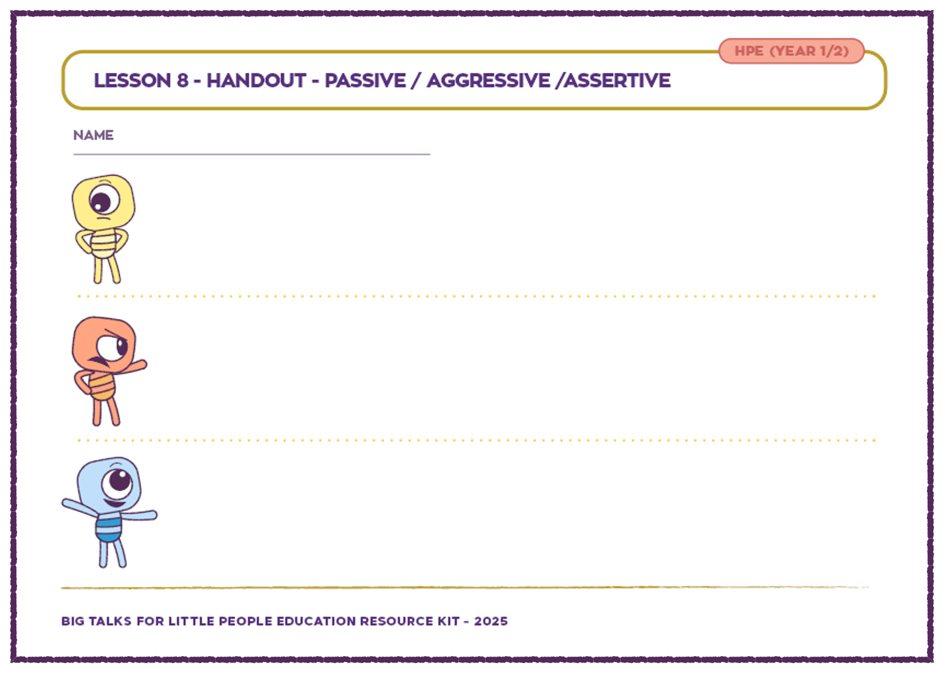
Part 4: Printout Activity
Your teacher will hand out an activity sheet.
You can work on your own or with a ‘brainstorming buddy’!
Write or draw ways that you have been:
• Passive: Give up
• Aggressive: Act angrily
• Assertive: Solve the Problem
Remember to use the list from the start of the lesson to help you remember a time that you had a problem to fix or solve.
2021
7
2021
Test
Test
7
7

Slide 8
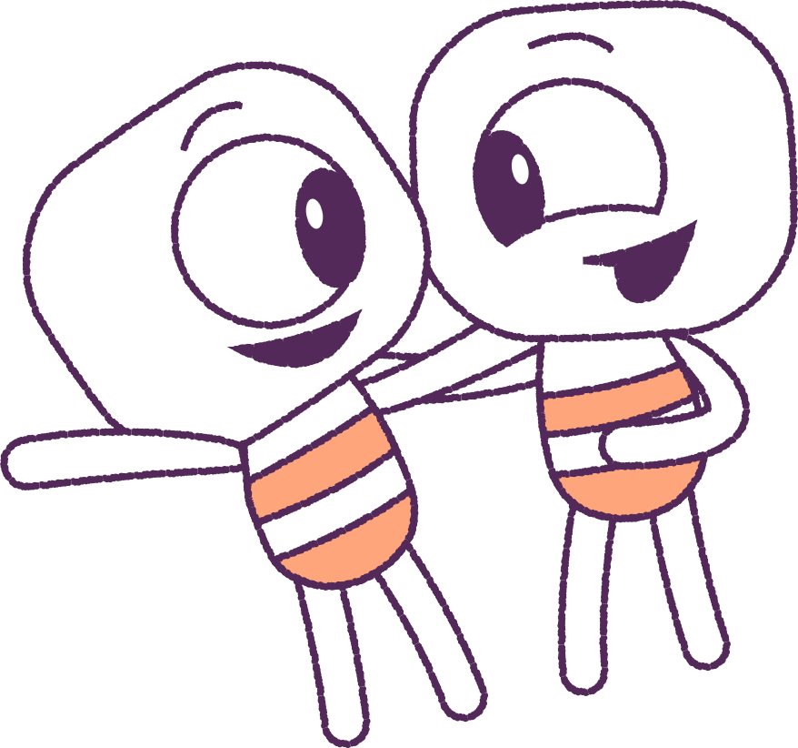
Part 5: Class Discussion
Share your drawings, notes and
Ideas with your classmates.
Talk about how your feelings can affect the choices that you make, and the actions that
you take.
By knowing and understanding our emotions, we can make better choices about how we react to our problems and to other people.
Let’s be a Problem Solver: be ‘Assertive’!
2021
8
2021
Test
Test
8
8

Slide 9
This is the end of Lesson 8.
Great work!

