Slide 1





Professor Shane Pill (PhD) Professor Phillip Slee (PhD)
Associate Professor Deb Agnew (PhD) Dr Amy Wright (PhD)
Jessica Skuza (Research Assistant)

Slide 2
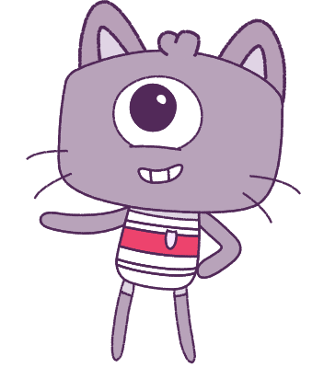




Lesson 9
Lesson 9
Resilience
Resilience
Lesson aims:
Lesson aims:
Practise learning to control our
emotions, making smart decisions and
making sure we treat others kindly.
1.
1.
Learn how to control our emotions, make smart decisions, and treat others kindly.
Learn about ways to keep yourself and others safe and ways to look for help
if you need it.
2.
2.
Learn about how to keep safe, look for help,
3.
Describe the things that make us
special and others special.
3.
Describe the things that make us and others special.

Slide 3
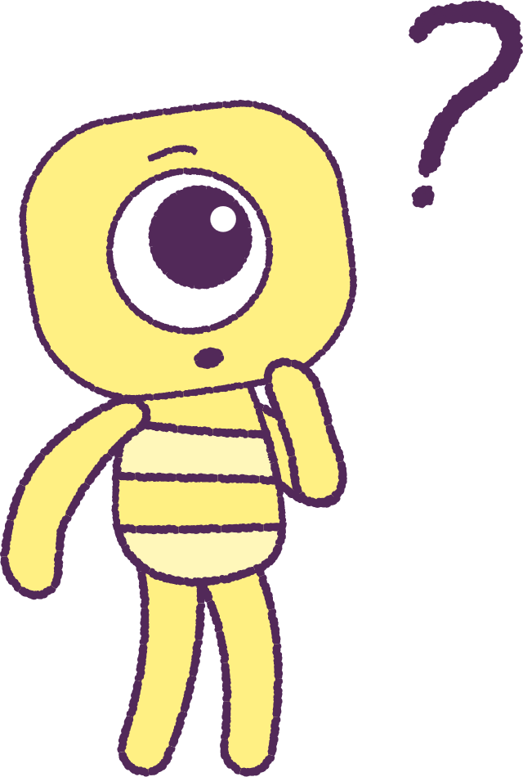

Part 1: Review content from last week
Who can remember what we discussed
last week?
In our session today, we will talk more about resilience.
Let’s get ready to look at the animation!
3

Slide 4


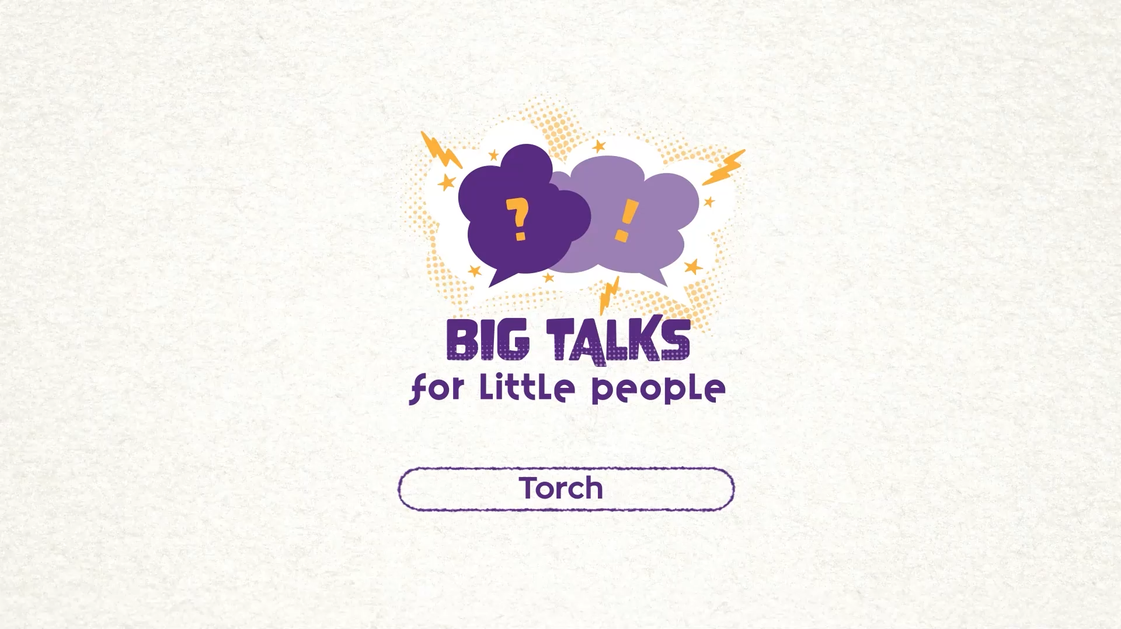

Part 2: Watch the animation
Hover your mouse over the video to view play settings. Otherwise, download from the website.
4

Slide 5
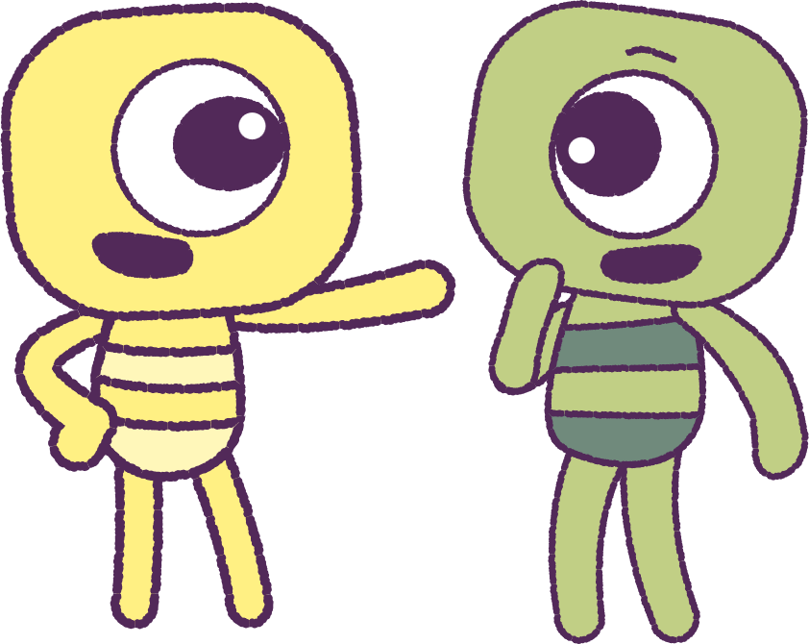
Part 2: Continued
It is important to control our emotions.
Not just because it keeps us safe, but it is also important to keeps others safe too.
Think about what could happen to ourselves
and others, if we did not control our emotions.
Can you think of some ways that can help you control your emotions? Perhaps you could:
• Count to 10
• Take some slow and deep breaths
• Talk to a friend
2021
5
2021
Test
Test
5
5

Slide 6
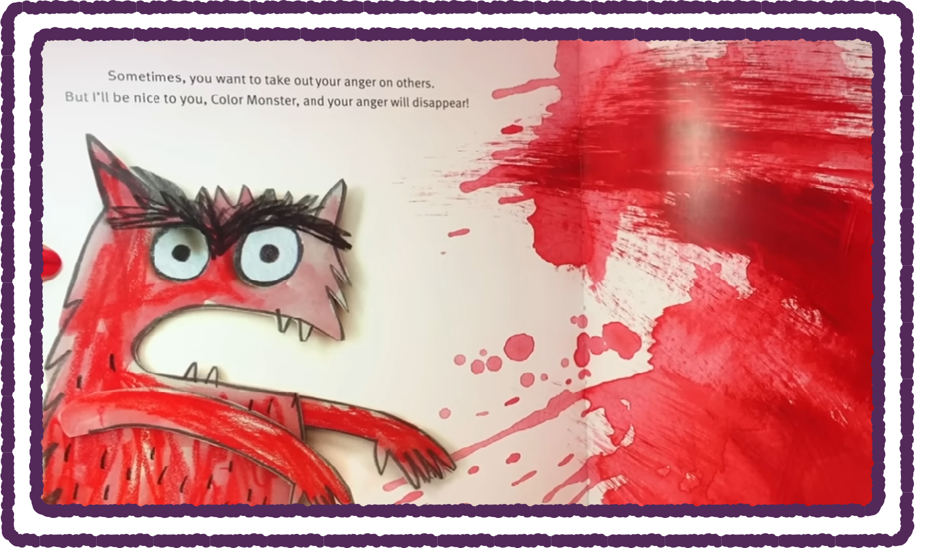
Part 3: Watch Youtube Video
Let’s watch a Youtube video.
https://www.youtube.com/watch?v=PWujGPb6mgo
This story has a character that has a lot of different feelings and emotions.
Listen carefully as the book is read to you.
Which emotions or versions of the ‘Color Monster’ would you like to spend time with?
Would you like to spend time with the
‘Color Monster’ when it is feeling strong emotions?
2021
6
2021
Test
Test
6
6

Slide 7
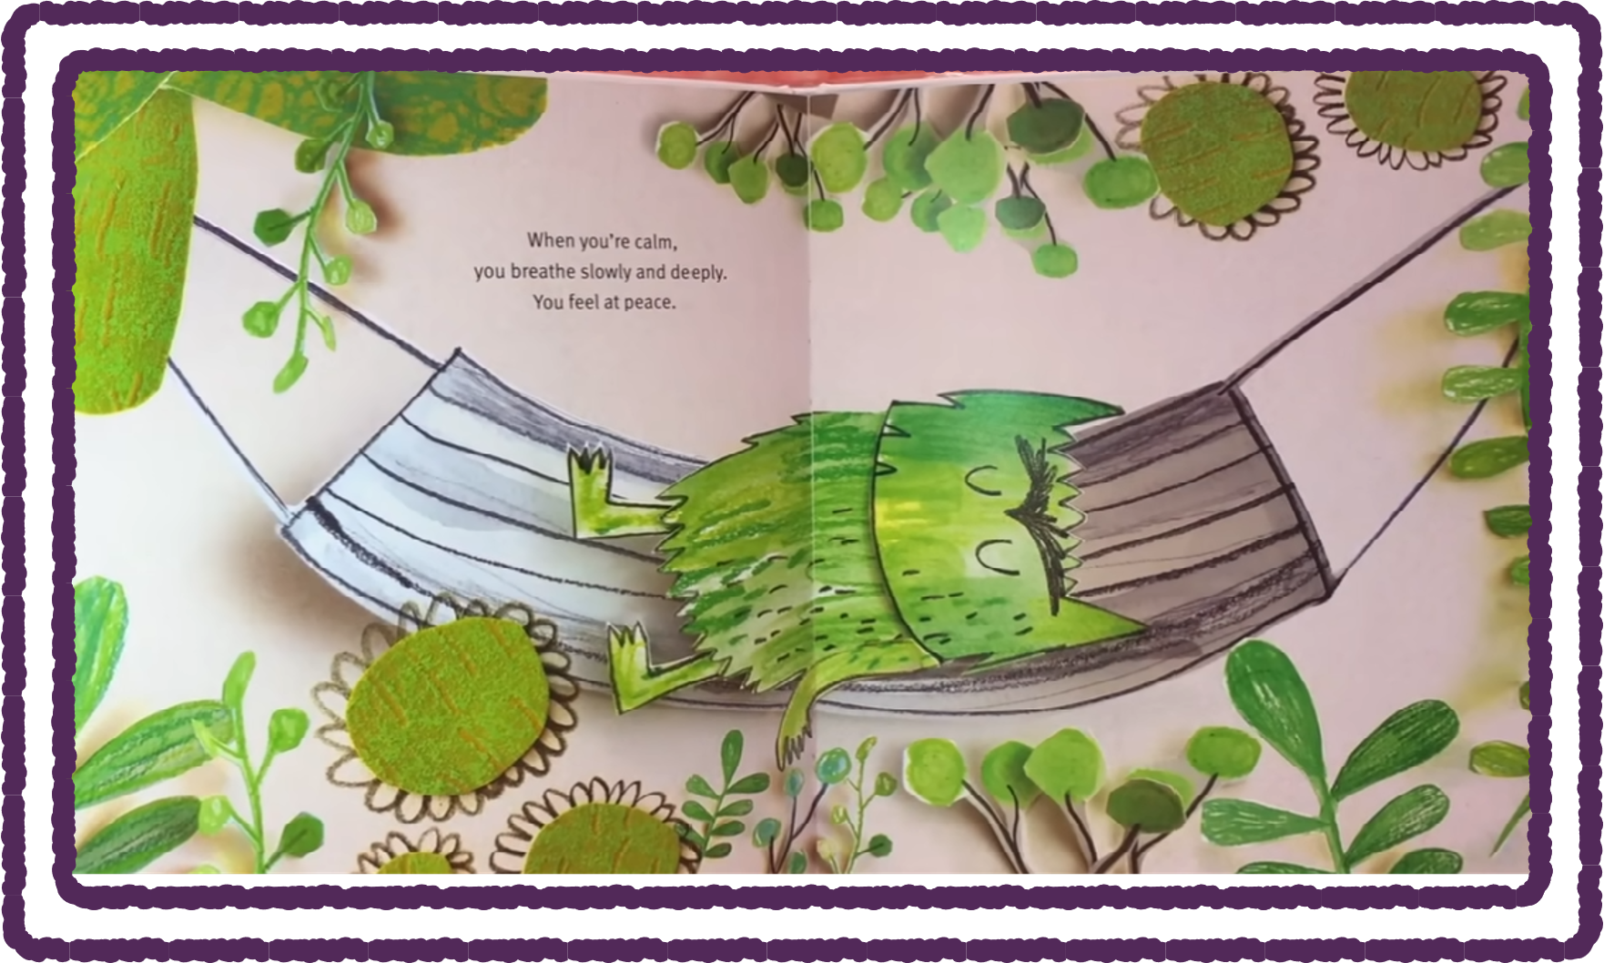
Part 4: Discuss Youtube Video
When the ‘Colour Monster’ is angry, would you like to be around it?
When the ‘Colour Monster’ is sad, how would
you try to talk to it? What would you say?
Which page and which colour would you feel more comfortable with?
Everyone has different feelings at times!
Strong feelings are not bad.
You need to make good decisions so that you don’t hurt yourself or others.
2021
7
2021
Test
Test
7
7

Slide 8

Part 5: Feelings Landscape
Use materials in your classroom, such as paints, wool, felt or cardboard to make a
‘Feelings Landscape’ picture.
Use the colours in your picture to show some of the emotions that you are feeling.
How would your ‘Feelings Landscape’ change if you were feeling different emotions on a different day?
2021
8
2021
Test
Test
8
8

Slide 9

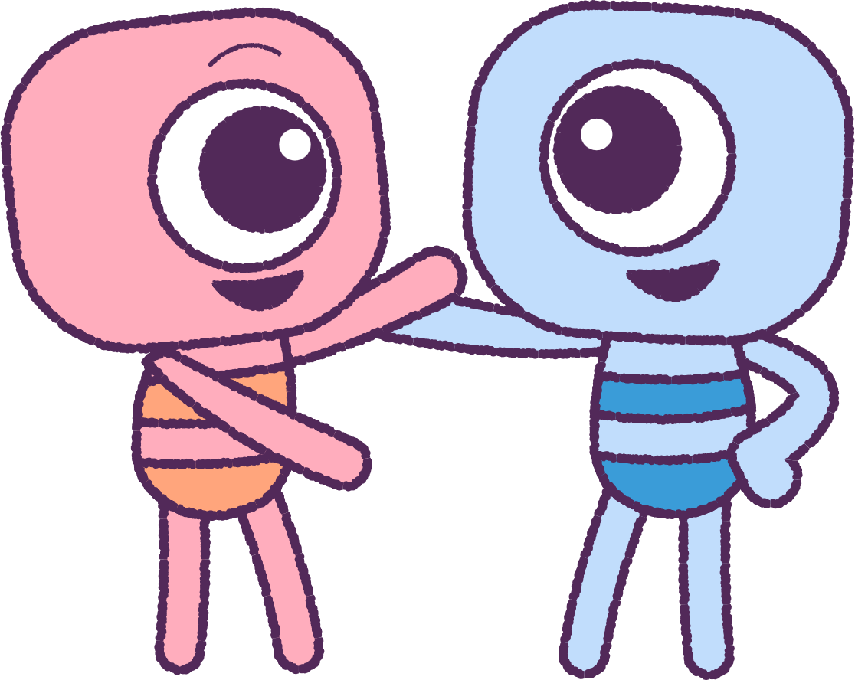
Part 6: Share and Display
Time to display your “Emotional Masterpieces”
in the class!
Use these to remind you that different emotions are a great part of everyday life!
Remember to use these as reference points when experience feelings.
These will help you with identifying feelings and emotions over time!
2021
9
2021
Test
Test
9
9

Slide 10
This is the end of Lesson 9.
Great work!

