Slide 1





Professor Shane Pill (PhD) Professor Phillip Slee (PhD)
Associate Professor Deb Agnew (PhD) Dr Amy Wright (PhD)
Jessica Skuza (Research Assistant)

Slide 2
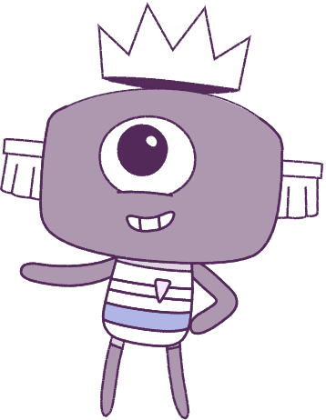




Lesson 10
Assessment & Conclusion
Lesson aims:
1.
Remember the types of feelings and emotions we all feel.
2.
Remember the ways to cope with the emotions we have.
3.
Optional: Complete a post-survey.

Slide 3
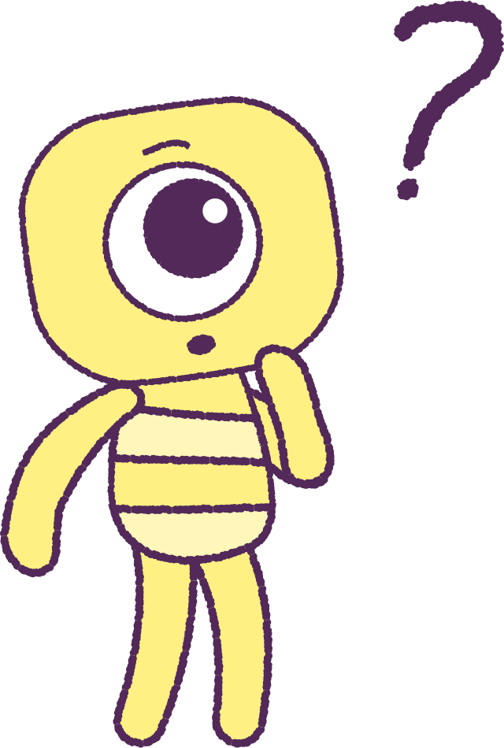

Part 1: Review content from last week
Who can remember what we discussed
last week?
In our session today, we will talk more about what we have learnt in general.
3

Slide 4
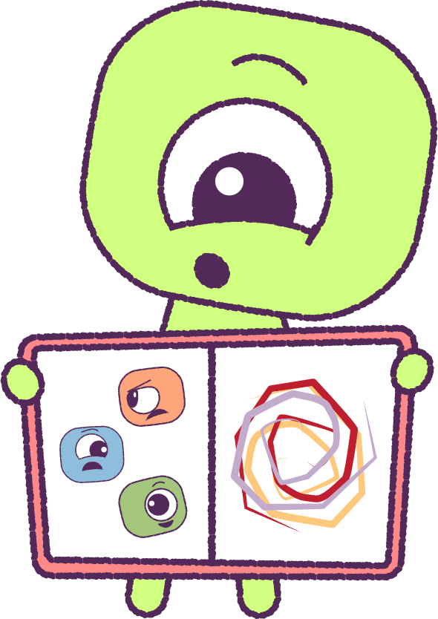
Part 2: Feelings Journal
Let’s make a feelings journal.
On each page, create a picture of yourself feeling different emotions. Make them colourful!
Using your imagination, you could also design a colourful ‘Abstract picture’ (a picture that does not show a real thing) that might show your feelings.
2021
4
2021
Test
Test
4
4

Slide 5

Part 3: Student Post-Survey
(OPTIONAL)
This optional post-survey will ask questions about how you think and feel.
Please have students visit the below website link:
www.caper.com.au
And click on:
“HPE Module – Student Surveys Years 1-2”.
It is important that you answer the questions as honestly as possible as the information will be used to help understand the well-being of young people.
This pre-survey will take a minimum of 15 minutes
2021
5
2021
Test
Test
5
5

Slide 6
Part 4: Teacher Post-Survey
(OPTIONAL)
This optional post-survey will ask questions about how the HPE program went.
Please visit the below website link:
www.caper.com.au
And click on:
“Teacher Implementation Index”.
It is important that you answer the questions as honestly as possible as the information will be used to help understand the well-being of young people.
This pre-survey will take a minimum of 15 minutes
2021
6
2021
Test
Test
6
6

Slide 7
This is the end of Lesson 10.
Great work!

