Slide 1






Professor Shane Pill (PhD) Professor Phillip Slee (PhD)
Associate Professor Deb Agnew (PhD) Dr Amy Wright (PhD)
Jessica Skuza (Research Assistant)

Slide 2
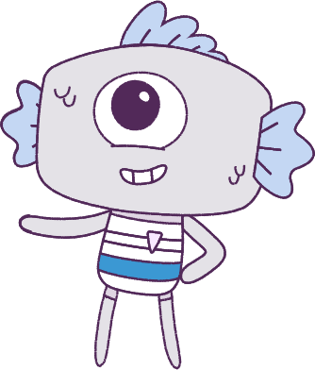




Lesson 1
Lesson 1
Pre-Survey & Introduction
Pre-Survey & Introduction
Lesson aims:
Lesson aims:
1.
Optional: Complete a pre-survey.
2.
Learn about the Peeps and the Feels.
3.
Participate in class activities.

Slide 3

Part 1: Student pre-survey
(OPTIONAL)
This optional pre-survey will ask questions about how you think and feel.
Please have students visit the below website link:
www.caper.com.au
And click on:
“HPE Module – Student Surveys Years 3-4”.
It is important that you answer the questions as honestly as possible as the information will be used to help understand the well-being of young people.
This pre-survey will take a minimum of 15 minutes
3

Slide 4

Part 1: Continued
Everyone should have the opportunity to answer the questions in a confidential manner, so please do not discuss the questions and your answers with anyone else.
Please respect the privacy of other students.
Do not talk to anyone else as you are filling in the pre-survey. Once you have completed your pre-survey, a University researcher will look at the answers and analyse the data.
No one at this school will see your pre-survey answers. We thank you for your participation in this important research.
4

Slide 5
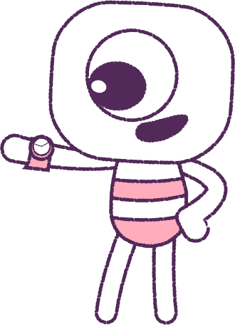


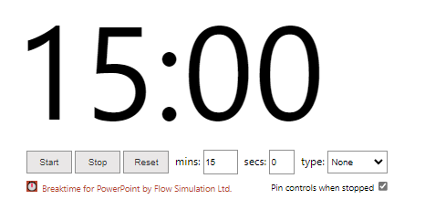
0
Part 1: Continued
How to use the timer: Click on “Trust this add-in” if this message pops-up. You might also need to click “Enable editing”. After, click into the white area and wiggle your mouse a bit. Adjust the settings to what you want, and start.
5

Slide 6
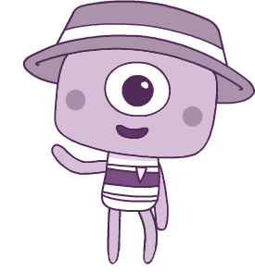
Part 2: Introduction to Big Talks
Over the next few weeks we will be learning about feelings and emotions together, and talking about tricky subjects like friendships, belonging and bullying.
Together we’ll watch a series of animations every week to help us talk about how to understand and build our skills around wellbeing.
You’ll get to know all about the Peeps!
6

Slide 7




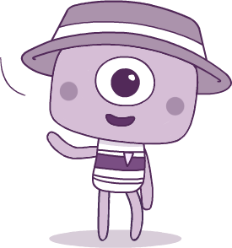
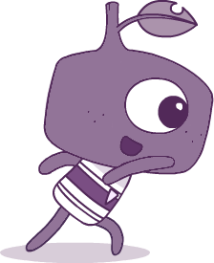
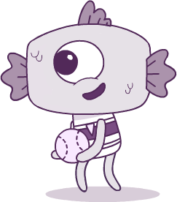
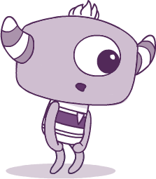
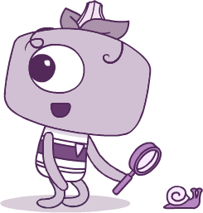
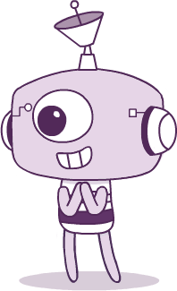
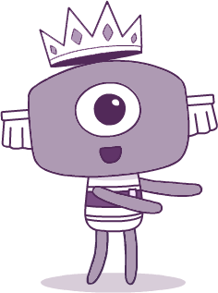
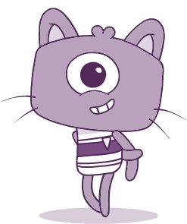
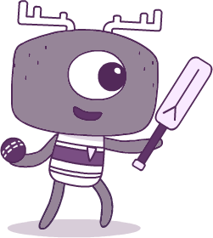
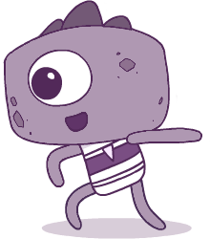
Meet the Peeps! Which one do you like best, and why?
BRIM
TWIG
FIN
PAN
STALK
ELK
STEG
TEK
CROWN
KIT

Slide 8
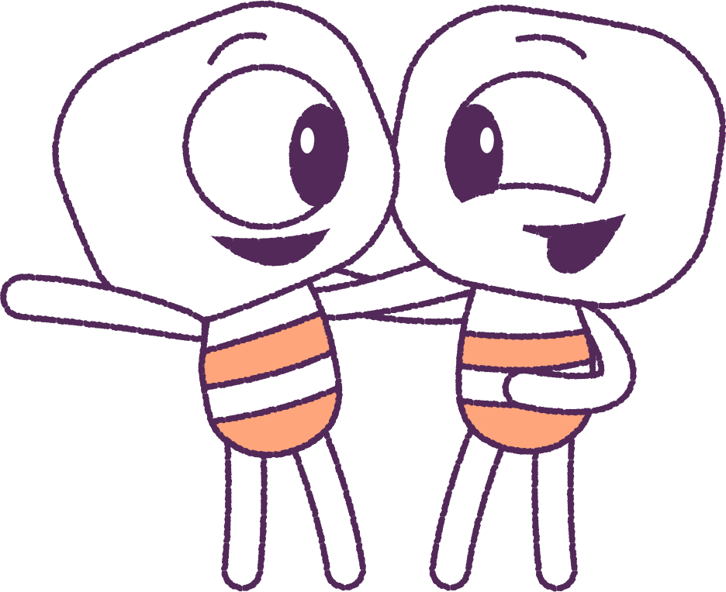
Part 3: Group Work
Divide students into groups. You have 10 minutes to decide and report back what your group roles will be and write down your group work rules.
Examples of Rules
• No put downs.
• Everyone gets a chance to speak.
• Everyone has a role in the group.
Examples of Roles
• Who will scribe answers to group questions.
• Who will speak for the group.
• Who will coordinate group work.
• Who will be in charge of supplies and timing.
8

Slide 9

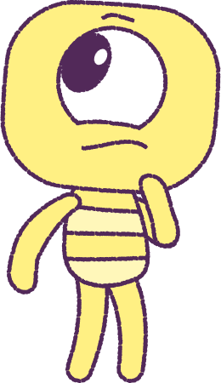
Report back
to class on
rules & roles
9

Slide 10
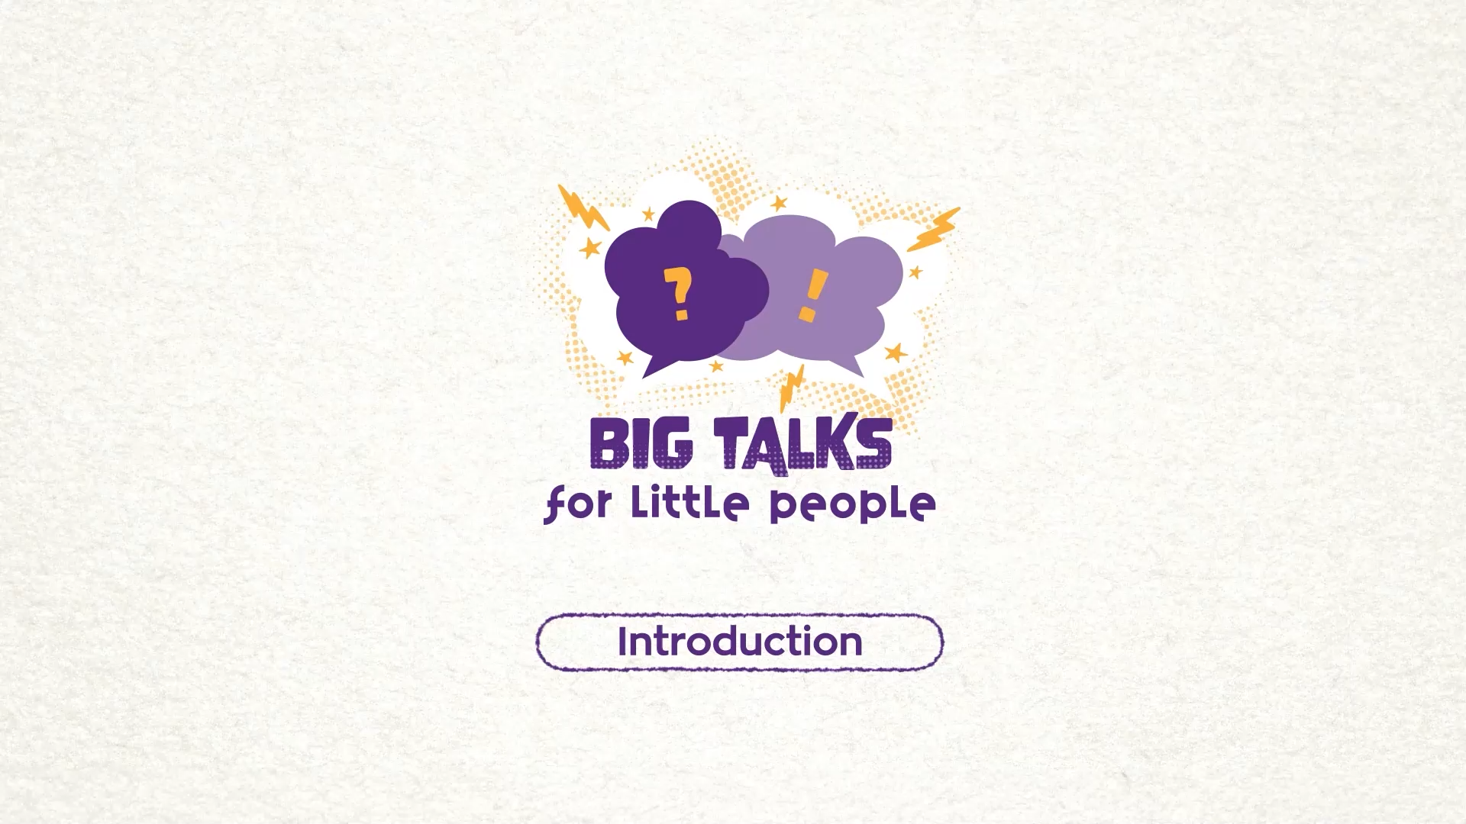
Part 4: Watch an Animation
Hover your mouse over the video to view play settings. Otherwise, download from the website.
10

Slide 11

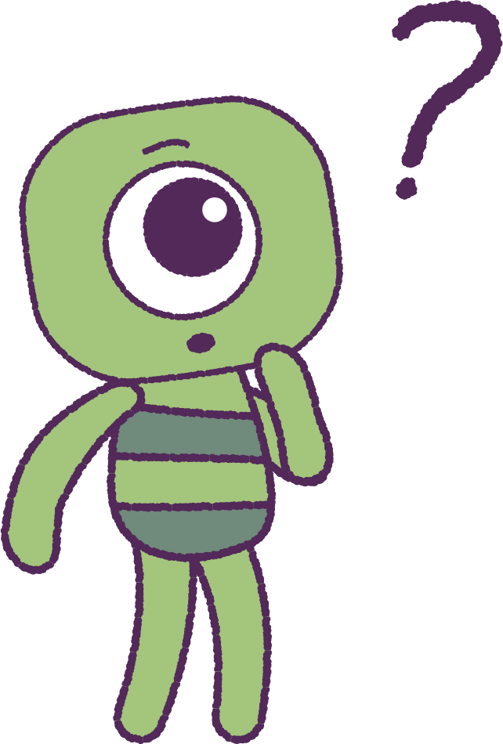
Part 4: Continued
Let’s now discuss the animation.
• As a class talk about how the ‘Feels’ are
changing.
• As a class, talk about why you think the ‘Feels’
may be changing?
• Try to spot some scenes where the ‘Feels’ may
look the same as their ‘Peep’.
• Try to spot some scenes where the ‘Feels’ may
look different from their ‘Peep’
11

Slide 12
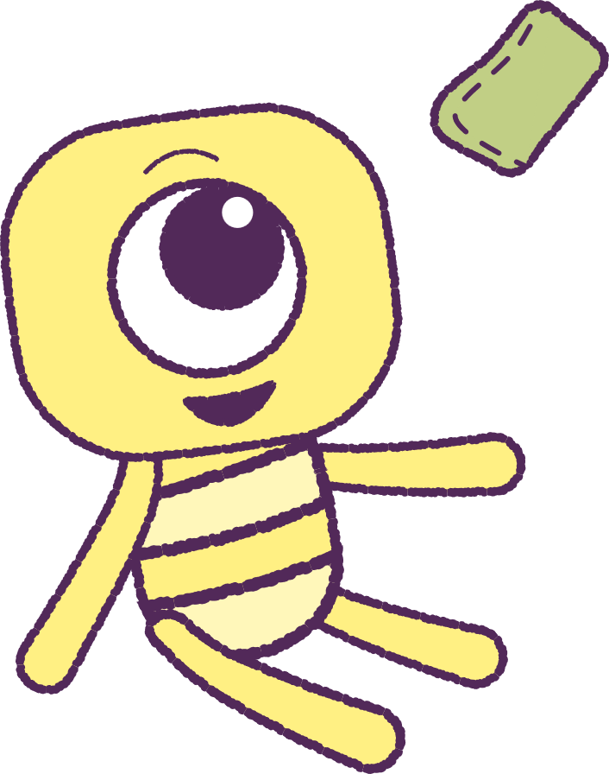
Part 5: Bean Bag Toss
It’s time to play Bean Bag Toss!
1. Sit in a circle on the floor.
2. Follow instructions from your teacher to pass
a bean bag around the circle.
3. Take turns to say a ‘feeling’. Your teacher will
write this on a board.
Examples of Prompts
• How do you feel when you receive a gift?
• How do you feel when you stumble on your feet?
12

Slide 13
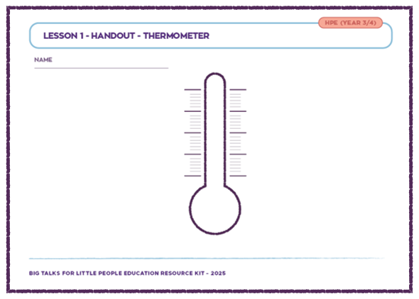
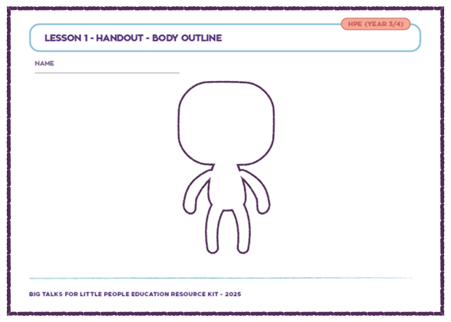
Part 6: Print Handout Activity
Your teacher will let you know when it’s time to go back to your chair. You will be given two print handout activities.
Thermometer Activity
Write your feelings on your ‘Thermometer’, sorting them from ‘Cool’ (Green) to ‘Hot’ (Red).
E.g. 'Excited' may be low on the scale as green.
‘Anger’ may be high on the scale as red.
Body Outline Activity
Use you your ‘Body Outline’ to label where and how you think these feelings are felt in different parts of your body.
13

Slide 14
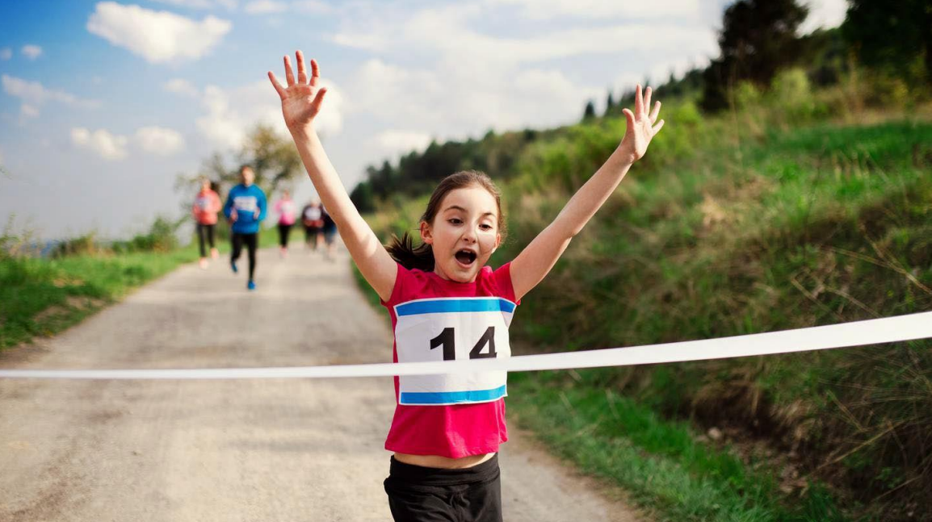
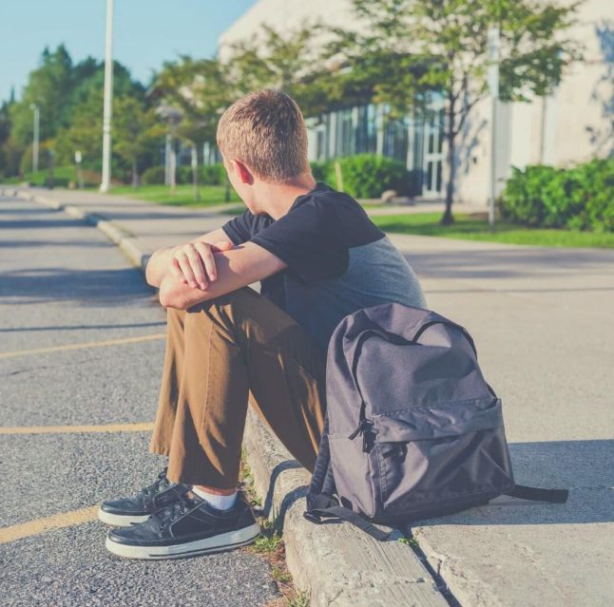
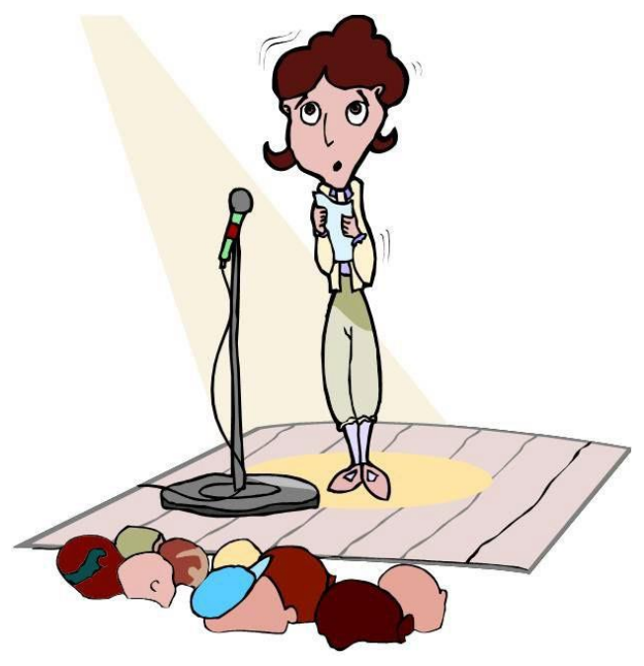
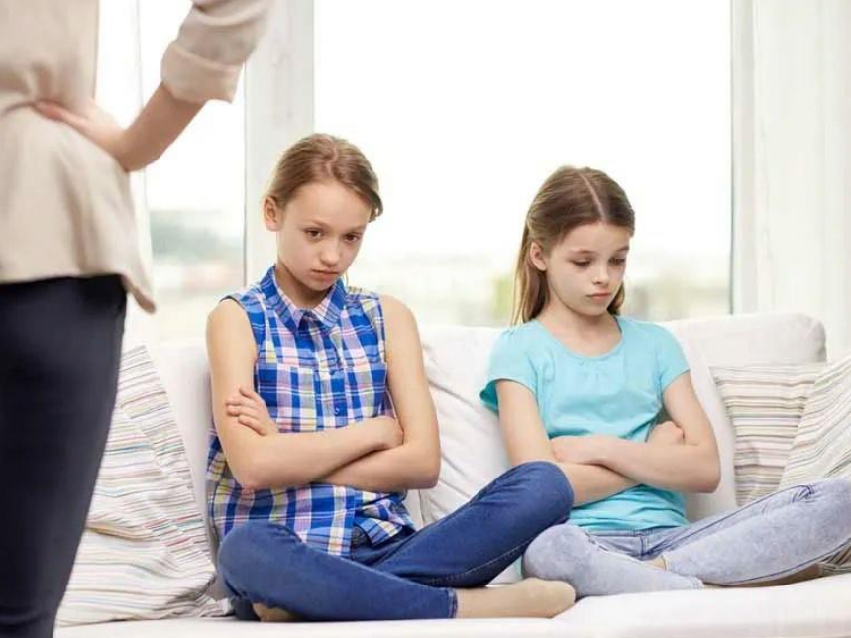
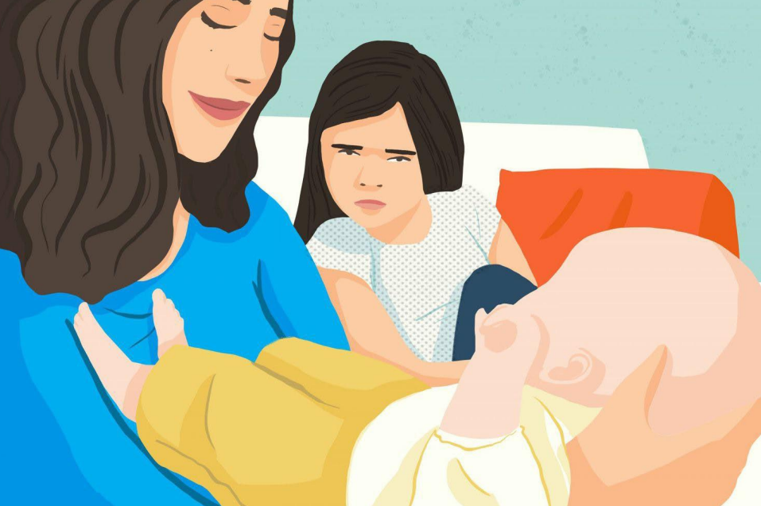
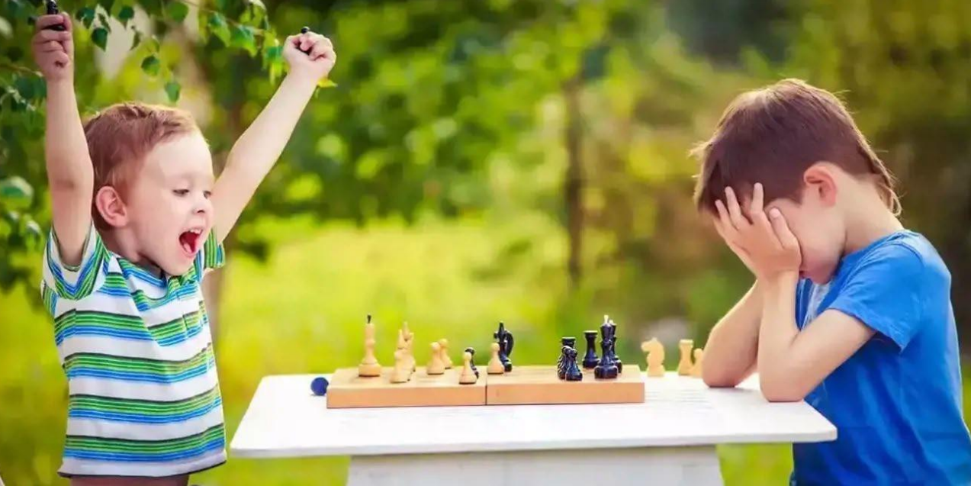
Part 7: Image Activity
Can you describe the feelings that these people may be having?
What tells you that these people may be feeling this way?
Do you do the same thing, or look similar when you feel this way?

Slide 15
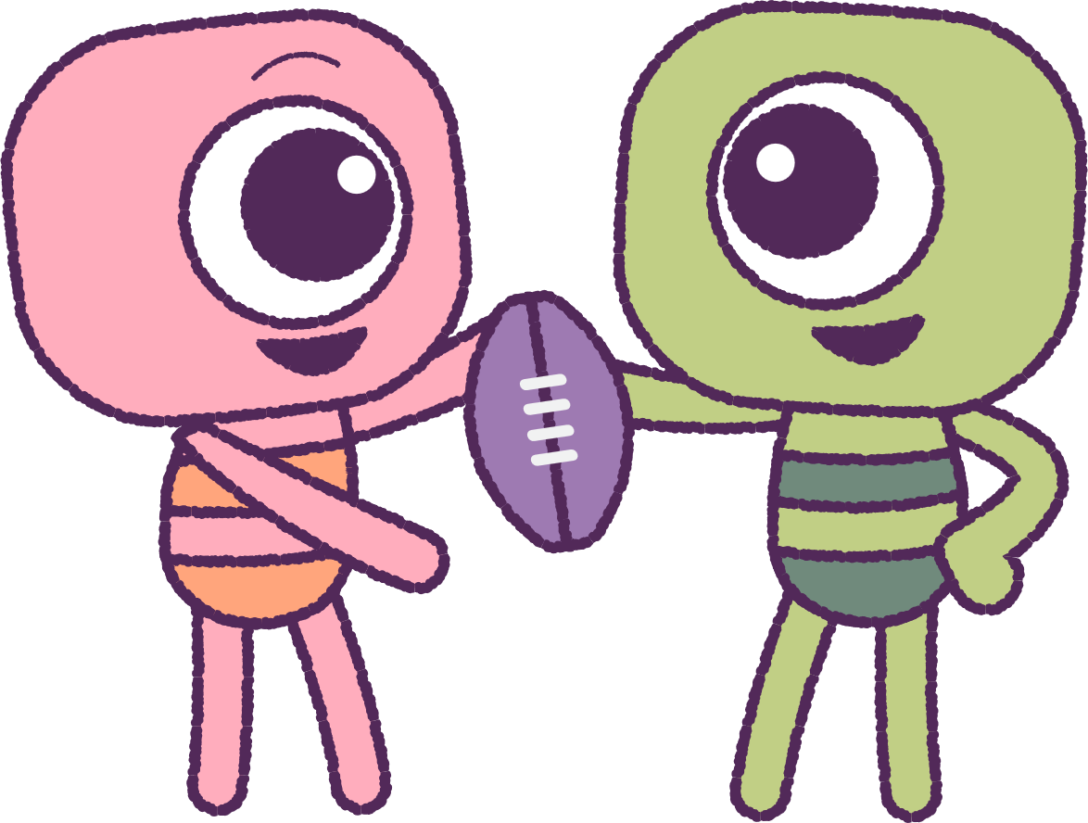
Part 8: Indoor/Outdoor Activity
Your teacher will pick a simple game that you have played before. After, let’s discuss:
Can you remember some feelings that you felt while playing the game?
Can you remember what movements your face and body were making during the game?
Could you see the feelings that other classmates were having, when you were playing the game?
Could you see what movements their face and body were making during the game?
15

Slide 16
This is the end of Lesson 1.
Great work!

