Slide 1






Professor Shane Pill (PhD) Professor Phillip Slee (PhD)
Associate Professor Deb Agnew (PhD) Dr Amy Wright (PhD)
Jessica Skuza (Research Assistant)

Slide 2
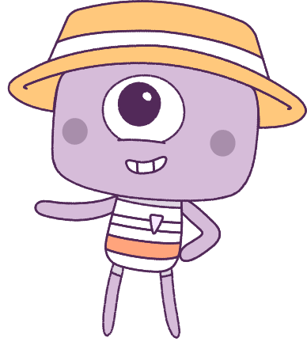




Lesson 2
Lesson 2
Exclusion & Relationships
Exclusion & Relationships
Lesson aims:
1.
Build personal and social skills to make and strengthen friendships
2.
Learn how success and challenges strengthen resilience and personal identity.
3.
Build on abilities and achievements using feedback and self-assessment.
4..
Discuss the importance of other people’s needs, emotions, cultures, and backgrounds.

Slide 3
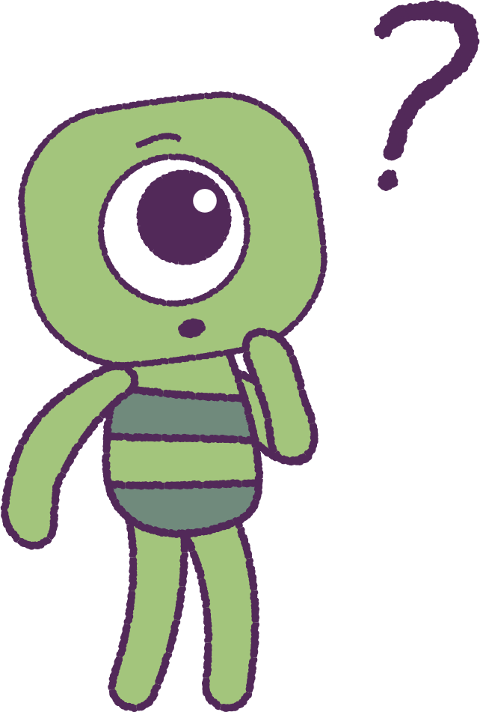

Part 1: Review content from last week
Who can remember what we discussed in Lesson 1?
In our lesson today, we will talk more about exclusion and relationships.
Lets get ready to look at the animation!
Special Note: On first watch, focus on the “Peep” characters.
3

Slide 4


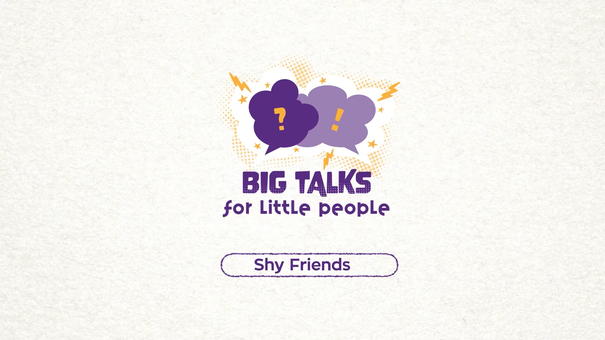

Part 2: Watch the animation
4
Hover your mouse over the video to view play settings. Otherwise, download from the website.

Slide 5
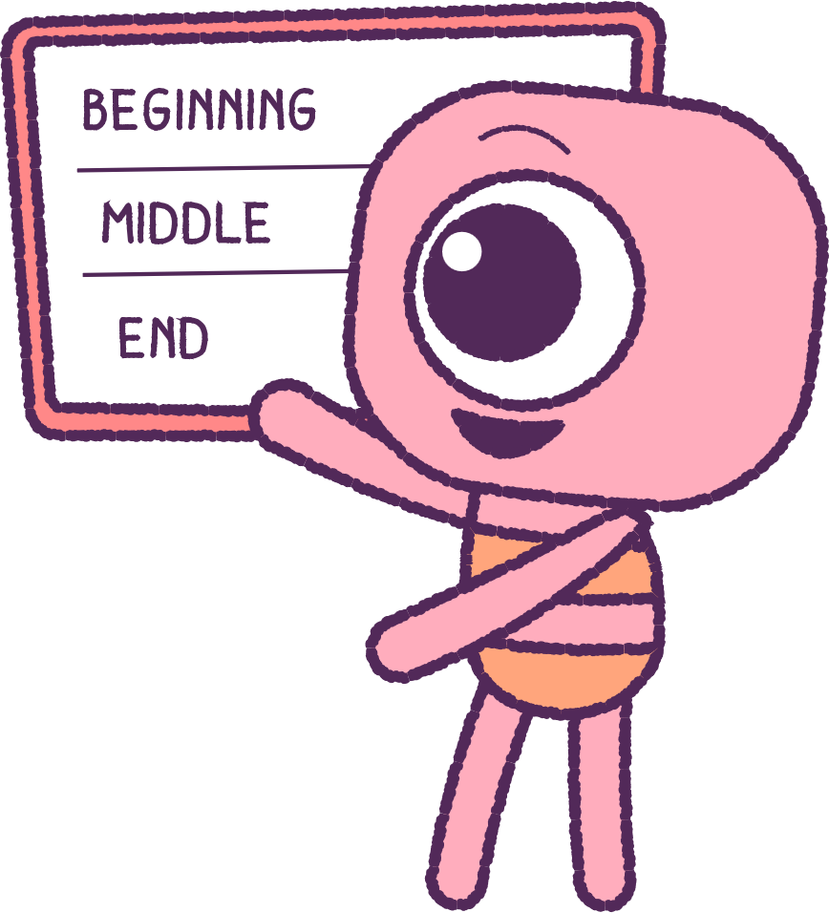
Part 2: Continued
Now, watch it again and focus on the ‘Feels’.
What is happening in the animation?
What feelings did the Peeps experience?
Plot the story on a white board.
Peeps storyboard:
What happened at the beginning, middle,
and end?
Feels storyboard:
What happened at the beginning,
middle, and end?
5

Slide 6
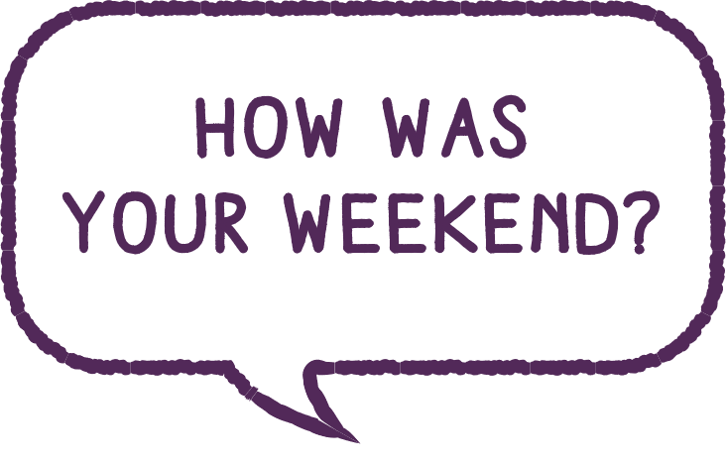

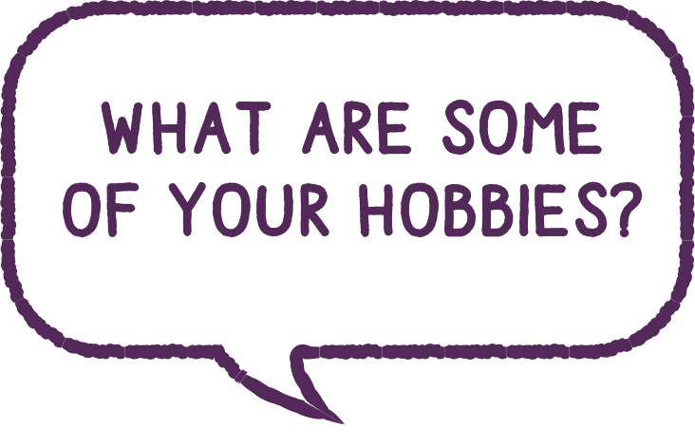
Part 3: Speech Bubble Activity
Next we’re going to start a Speech Bubble activity.
First, using both drawings and words,
depict when you:
• Felt shy
• Lacked confidence
• Felt unsure of what to say in a social group
After, work in small groups or pairs.
In big speech bubbles, write out ways
you can start a conversation.
6

Slide 7
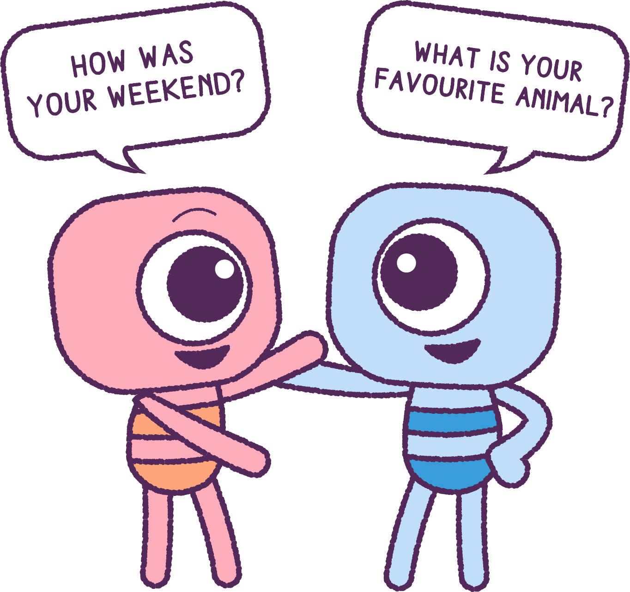
Part 3: Continued
Next, your teacher will find a partner for
each student.
Share and compare your speech bubbles.
If your partner shares speech bubble that
you didn’t have, add this to your own speech bubble list.
Stick your speech bubbles in your book or diary.
7

Slide 8
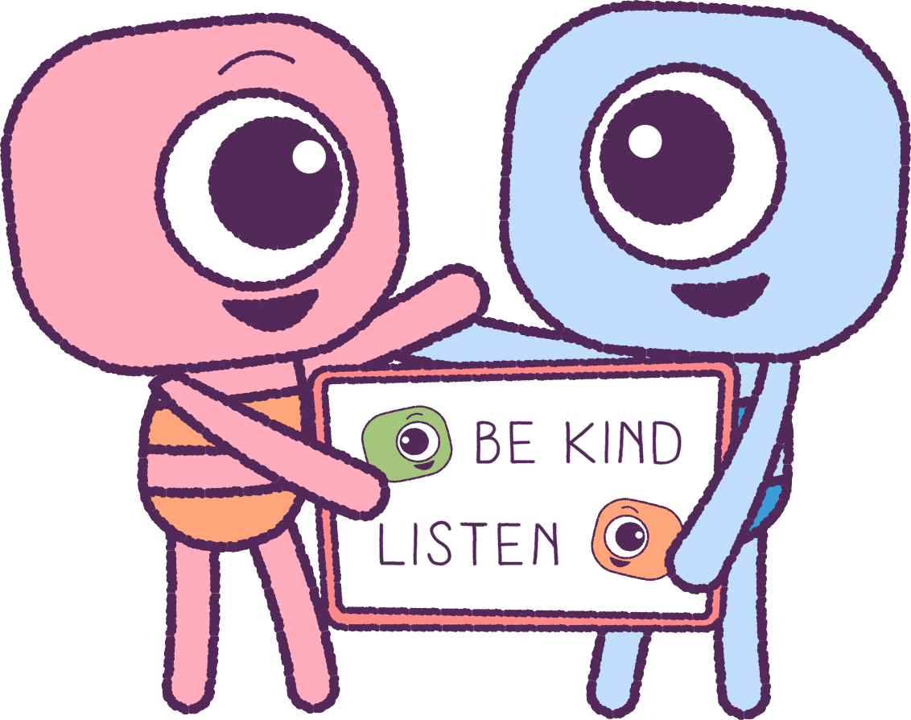
Part 4: Ideas Board
As a group, create an ‘Ideas Board’.
List the personal and social skills that you use now or can use in the future to:
• Start a Friendship
• Keep a Friendship
• Strengthen a Friendship
Some examples are:
Listen Show that you care
Share Be patient
Cooperate Be positive
Use manners Ask politely for help
8

Slide 9

Part 5: Class Art Activity
OPTIONAL:
The class could make a hanging mobile or a colourful collage of ‘Speech Bubbles’ to display in the class, to help everyone to learn and remember these helpful phrases.
9

Slide 10
This is the end of Lesson 2.
Great work!

