Slide 1






Professor Shane Pill (PhD) Professor Phillip Slee (PhD)
Associate Professor Deb Agnew (PhD) Dr Amy Wright (PhD)
Jessica Skuza (Research Assistant)

Slide 2
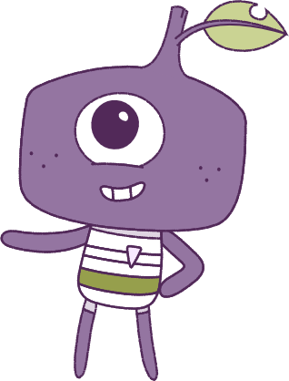




Lesson 3
Exclusion & Relationships
Lesson aims:
Lesson aims:
1.
Build personal and social skills to make and strengthen friendships
Build social skills to make and strengthen relationships.
1.
Learn how success and challenges strengthen resilience and personal identity.
2.
Learn how success and challenges
can strengthen resilience. Learn how
to build up personal abilities.
3.
Build on abilities and achievements using feedback and self-assessment.
2.
4..
Discuss the importance of other people’s needs, emotions, cultures, and backgrounds.
3.
Discuss the importance of other people, their needs, emotions,
and more.

Slide 3
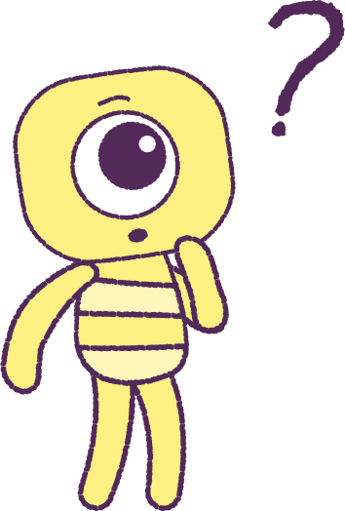

Part 1: Review content from last week
Who can remember what we discussed last week?
In our session today, we will talk more about exclusion and relationships.
Lets get ready to look at the animation!
Special Note: On your first watch, focus on the ‘Peeps’ characters.
3

Slide 4


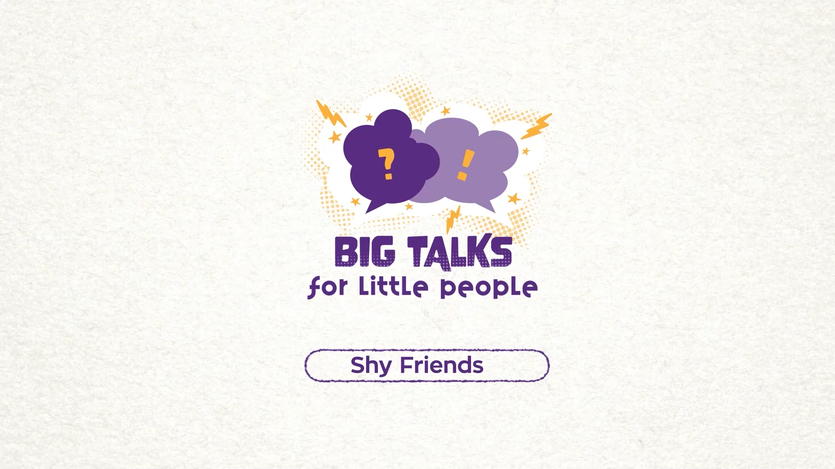

Watch the animation
4
Hover your mouse over the video to view play settings. Otherwise, download from the website.

Slide 5
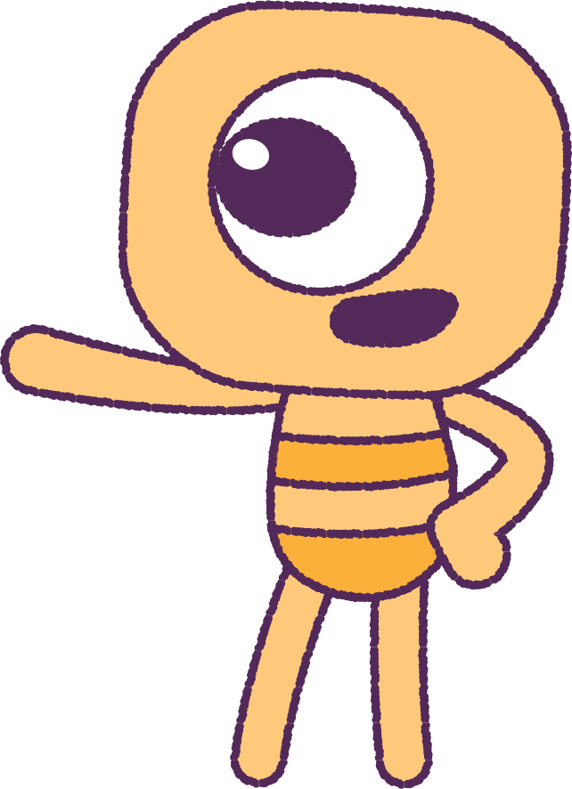
Part 2: Friendship discussion
+ Ideas Wall
Now let’s watch the animation again,
this time looking at the ‘Feels’.
How do the feels change? Are the ‘Feels’ the
same or different from the character’s actions?
As a class, list all the things that makes someone a ‘great friend’. What do you look for in a friend?
Share with class: activities, events and situations that you like or would prefer to do:
• Alone: Give reasons why.
• With a friend/friends: Give reasons why.
5

Slide 6
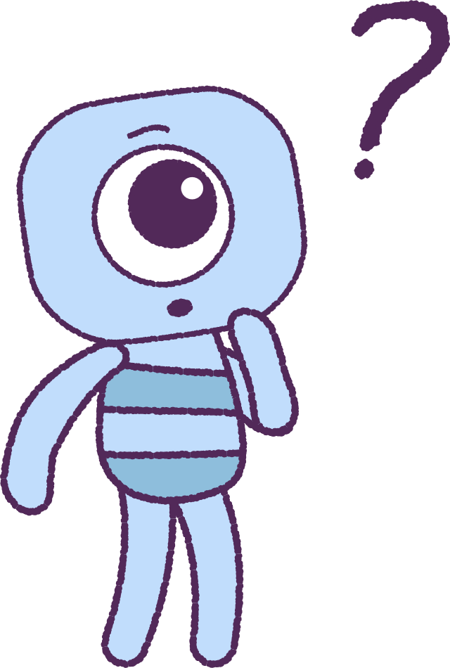
Part 3: Skit Activity
We’re going to do a Skit activity1
First, we need to brainstorm. Can you think of any activities, events or situations where you can only have a small number of people joining in?
E.g.
• Inviting only one person to play after school.
• Having only one other game controller
to share.
• Being asked to form a class group but having
too many friends to choose from.
6

Slide 7
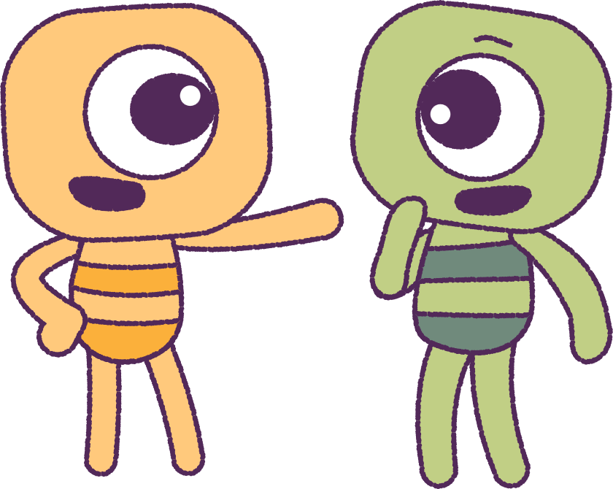
Part 3: Continued
Now it’s time to plan your skit.
Use your list of ‘Great friend’ descriptions to help you to create a very short skit (play).
Show how you can do one of the activities in very small groups, but not hurt anyone else’s feelings, when you are unable to include others at that time.
After, share your skits with the whole class!
7

Slide 8
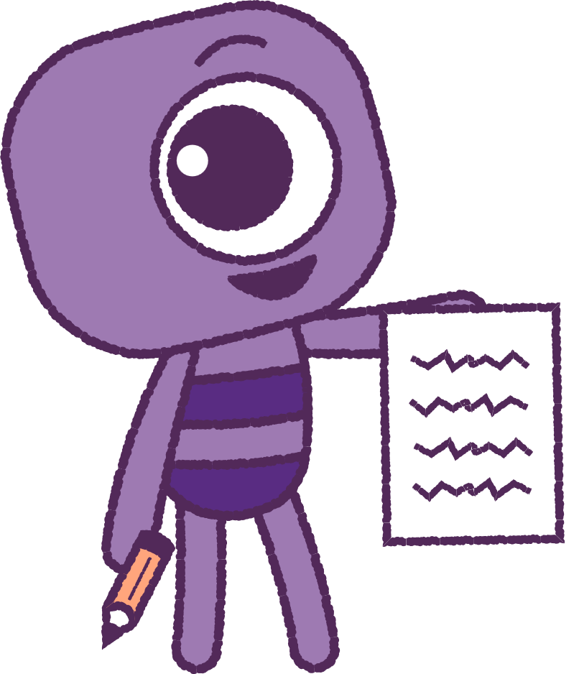
Part 4: Friendship Goals
+ Ideas Board
Create your own list of your own ‘friendship goals’.
What are the things that make you a ‘great friend’?
• What do you do for others?
• What do you say to others?
• How do you help others?
What are the things that make others a ‘great friend’?
• What do others do for you?
• What do others say to you?
• How do others help you?
If you have time, share these goals with a partner.
8

Slide 9
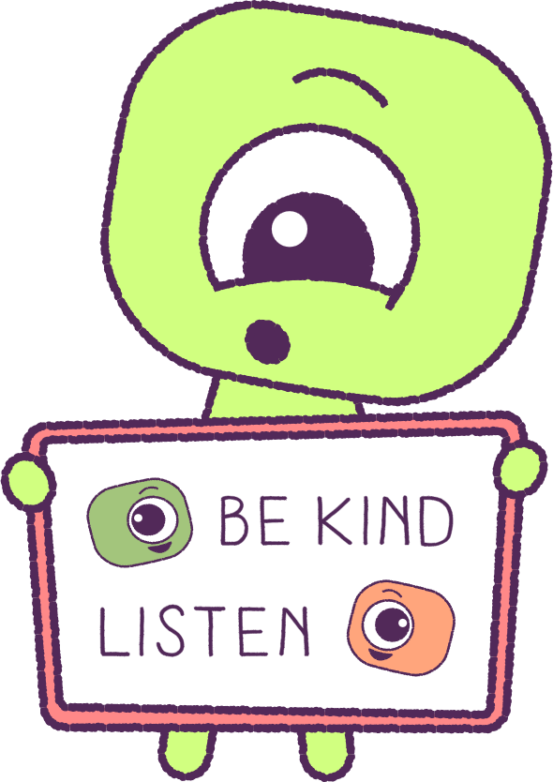
Part 4: Friendship Goals
+ Ideas Board
Next, it’s time to make an Ideas board.
On the ideas board, make a list of the good and special things about you and others, that help to:
• Start a friendship
• Keep a friendship
• Strengthen a friendship
Write this in your workbook too.
9

Slide 10
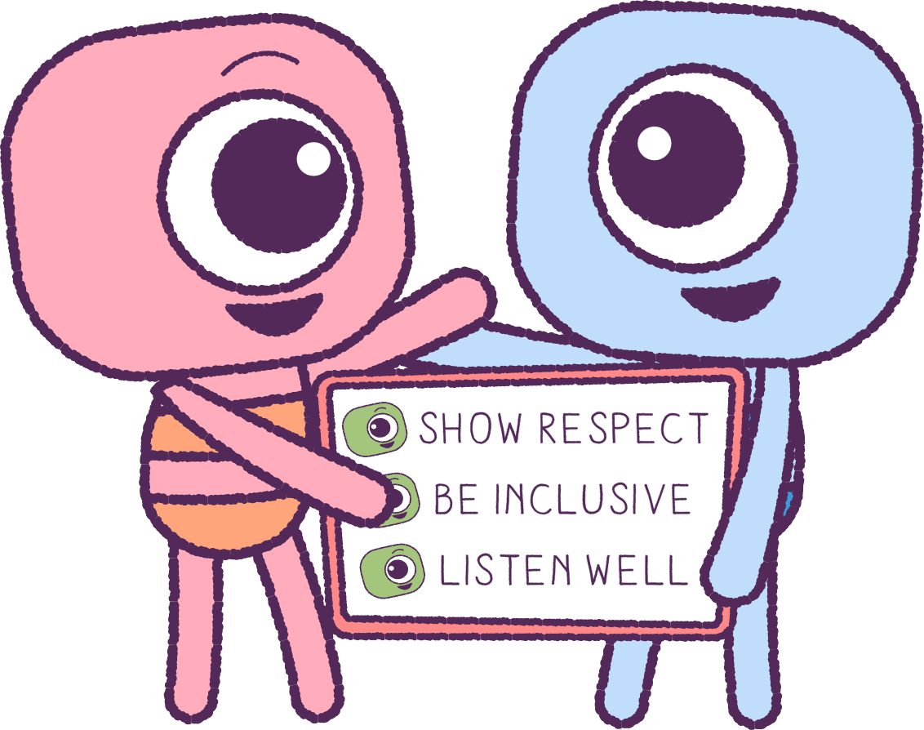
Part 5: Class Activity
(OPTIONAL)
As a class, create a colourful mobile, collage or poster of these things on the list.
This will remind you when you are needing help with a friendship at any time.
10

Slide 11
This is the end of Lesson 3.
Great work!

