Slide 1






Professor Shane Pill (PhD) Professor Phillip Slee (PhD)
Associate Professor Deb Agnew (PhD) Dr Amy Wright (PhD)
Jessica Skuza (Research Assistant)

Slide 2
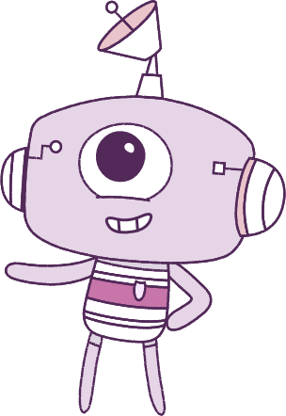




Lesson 4
Lesson 4
Self-Concept
Self-Concept
Lesson aims:
Lesson aims:
1.
Explore factors that help to build identities and help to cope with emotional responses
1.
Practise ways to know about your emotions before you act on them.
2.
Learn how success and challenges strengthen resilience and personal identity.
2.
Learn how different situations can
affect our emotions.
3.
Explain how things or people can help to change your personal qualities and growth.
3.
Let’s think about ways to make kind and respectful friendships.
4..
Build skills in self-awareness and
self-management.

Slide 3
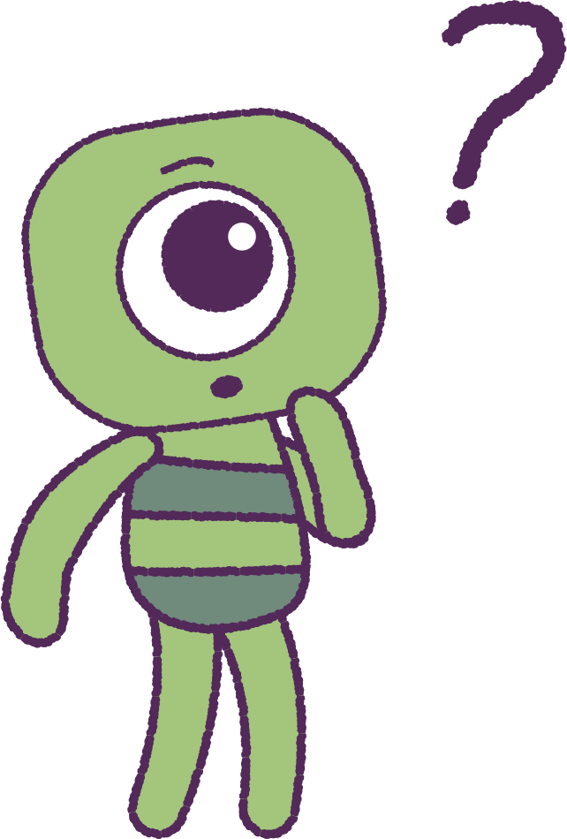

Part 1: Review content from last week
Who can remember what we discussed last lesson?
In our session today, we will talk more about self-concept.
3

Slide 4
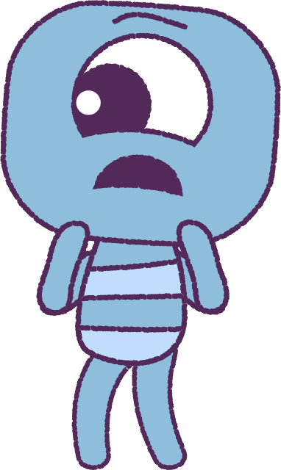
Part 2: Discuss Fear
As a class group, talk about what ‘Fear’ means.
• What do you think it means?
• How do you feel fear?
• Where do you feel fear?
• What do you say when you feel fear?
• What does your body do when you feel fear?
4

Slide 5
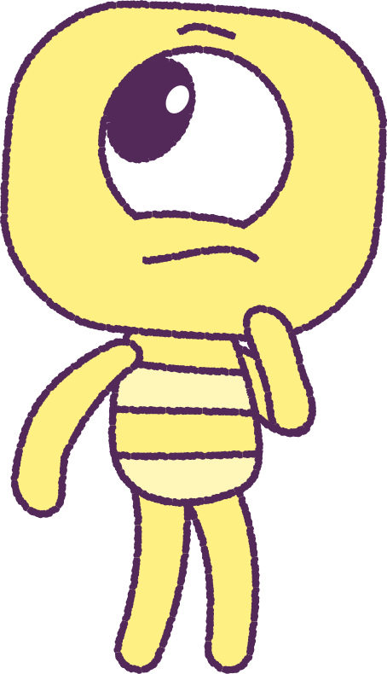
Part 2: Continued
Think of some times or places when you have felt a bit frightened.
If you would like to, share your story with the class.
It takes courage (being brave) to share your stories, but with practice you will get better!
Now, lets get ready to look at the animation!
Special Note: On first watch, focus on the
“Peep” characters.
5

Slide 6


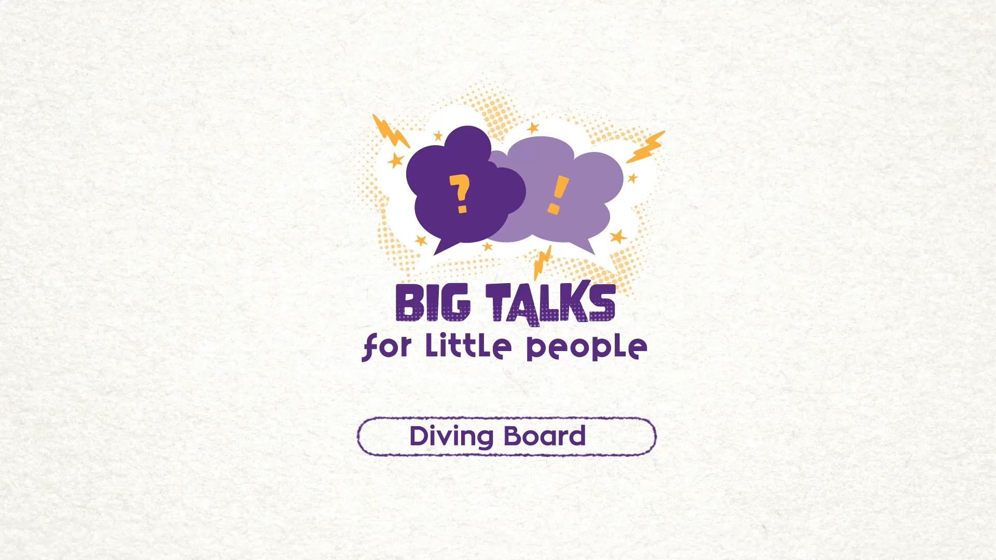

Part 3: Watch the animation
6
Hover your mouse over the video to view play settings. Otherwise, download from the website.

Slide 7
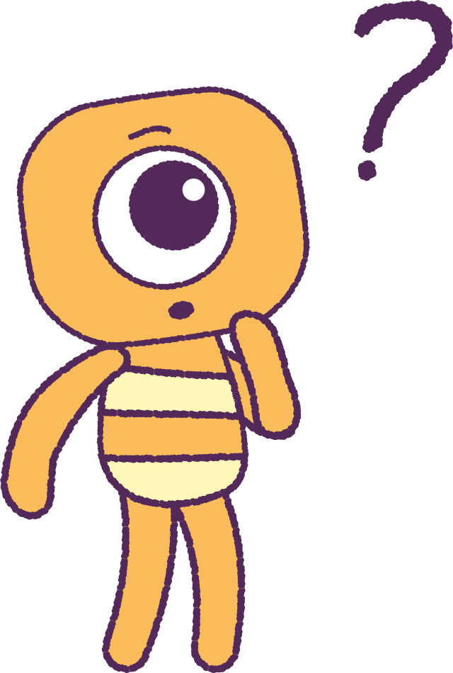
Part 3: Continued
Now watch the animation again,
looking at the ‘Feels’.
Try to spot some places when the ‘Peep’ Kit and their ‘Feel’ look similar.
Try to spot places where the ‘Peep’ Kit and their ‘Feel’ look different.
After jumping, how do you think Kit felt? Relieved? Excited? Proud? Brave enough to do it again?
Why do you think Kit may feel this way?
7

Slide 8
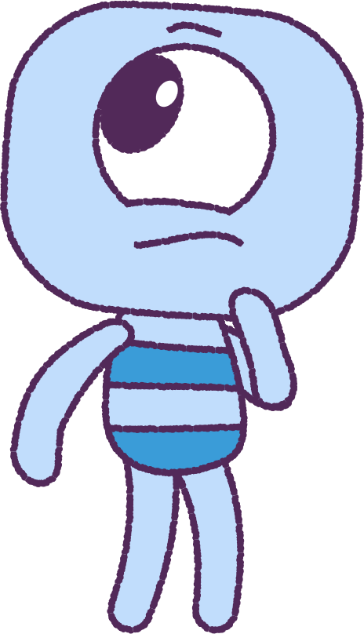
Part 3: Continued
Watch the animation again and look for the part where Kit’s ‘Feel’ tries very hard to stop Kit from jumping.
What might have happened if Kit’s ‘Feel’ stopped Kit from jumping?
How would Kit have felt if they were stopped from jumping?
Do you think Kit would have been brave enough
to try again?
Could Steg and Crown have said or done anything to help Kit have more confidence?
8

Slide 9
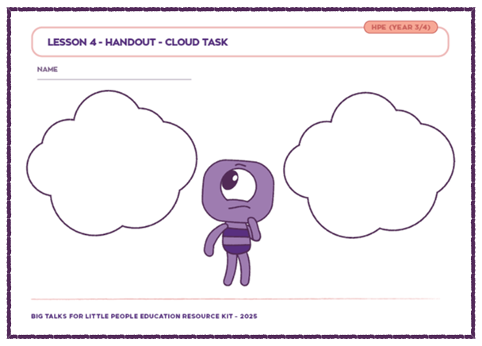
Part 4: Cloud Printout
Your teacher will hand out a ‘Cloud’ worksheet.
On one cloud, write about a time when you felt afraid but were able to ‘face your fear’.
On another cloud, write about a time when you felt afraid, but didn’t feel brave enough to find a solution to the problem.
Draw a picture next to your stories and draw your own feels that match your stories.
9

Slide 10
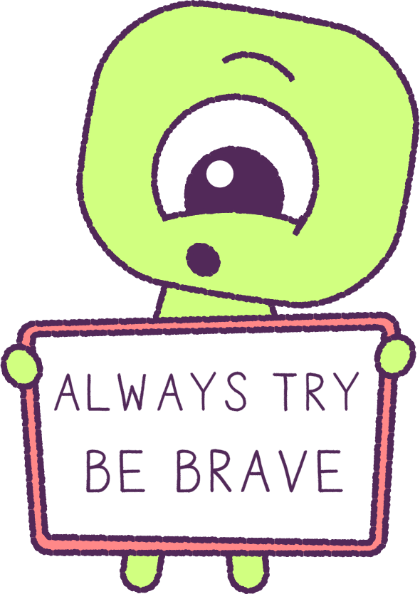
Part 4: Ideas Board
Discuss ideas that the class have used to help to control ‘fearful’ emotions.
Write these on an ‘Ideas board’.
Set some ‘goals’ for yourself, about facing a fear or fears, next time you come across them.
10

Slide 11
This is the end of Lesson 4.
Great work!

