Slide 1






Professor Shane Pill (PhD) Professor Phillip Slee (PhD)
Associate Professor Deb Agnew (PhD) Dr Amy Wright (PhD)
Jessica Skuza (Research Assistant)

Slide 2
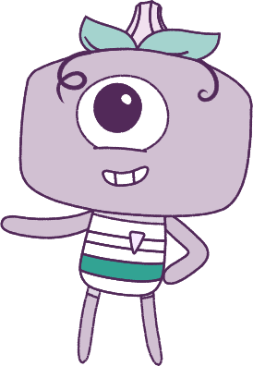




Lesson 5
Lesson 5
Lesson 5
Self-Concept
Self-Concept
Lesson aims:
Lesson aims:
Lesson aims:
1.
1.
Explore factors that help to build identities and help to cope with emotional responses.
1.
Explore how to build identity,
and cope with various situations.
2.
Learn how success and challenges strengthen resilience and personal identity.
2.
2.
Learn how to strengthen resilience.
3.
Discuss emotional responses and practise strategies to manage emotions.
3.
3.
Learn how to practice good behaviours that contribute to positive outcomes.
4.
Learn and practise behaviours that relate to health, safety, friendships and wellbeing.
4.

Slide 3
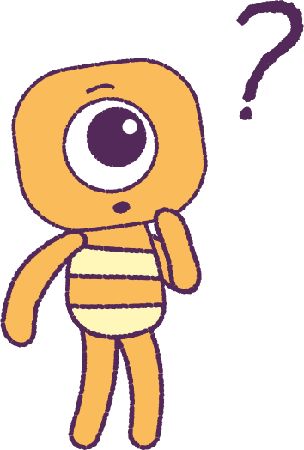

Part 1: Review content from last week
Who can remember what we discussed last lesson?
In our session today, we will talk more about self-concept.
Lets get ready to look at the animation!
3

Slide 4


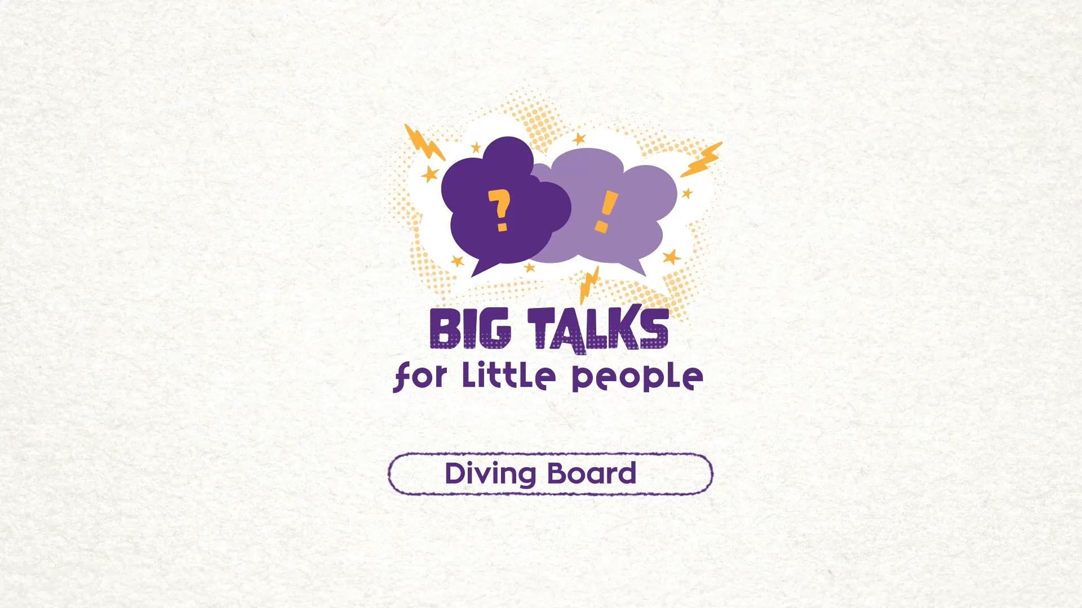

Part 1: Watch the animation
4
Hover your mouse over the video to view play settings. Otherwise, download from the website.

Slide 5
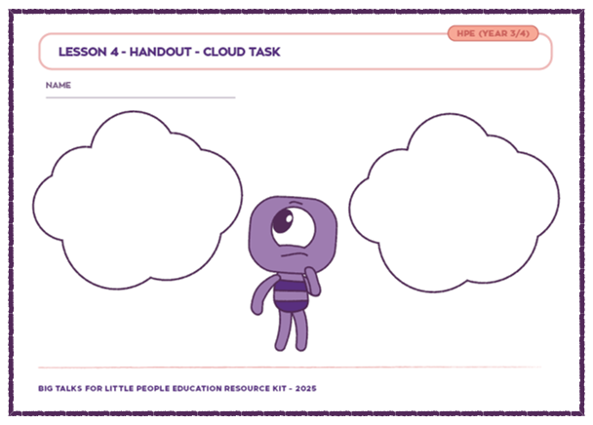
Part 2: Cloud Printout Review
Your teacher will pass your ‘Cloud activity’ sheets from the previous lesson back to you.
Think about the goals that you set for yourself.
• What was the ‘fear’ that you wanted to face?
• How are you going to ‘face that fear’?
• Do you want to add more goals?
Share with classmates, ways to make goals,
and ways to help make them happen!
It takes courage to share your stories, but with
practice you will get better…YOU’VE GOT THIS!
5

Slide 6
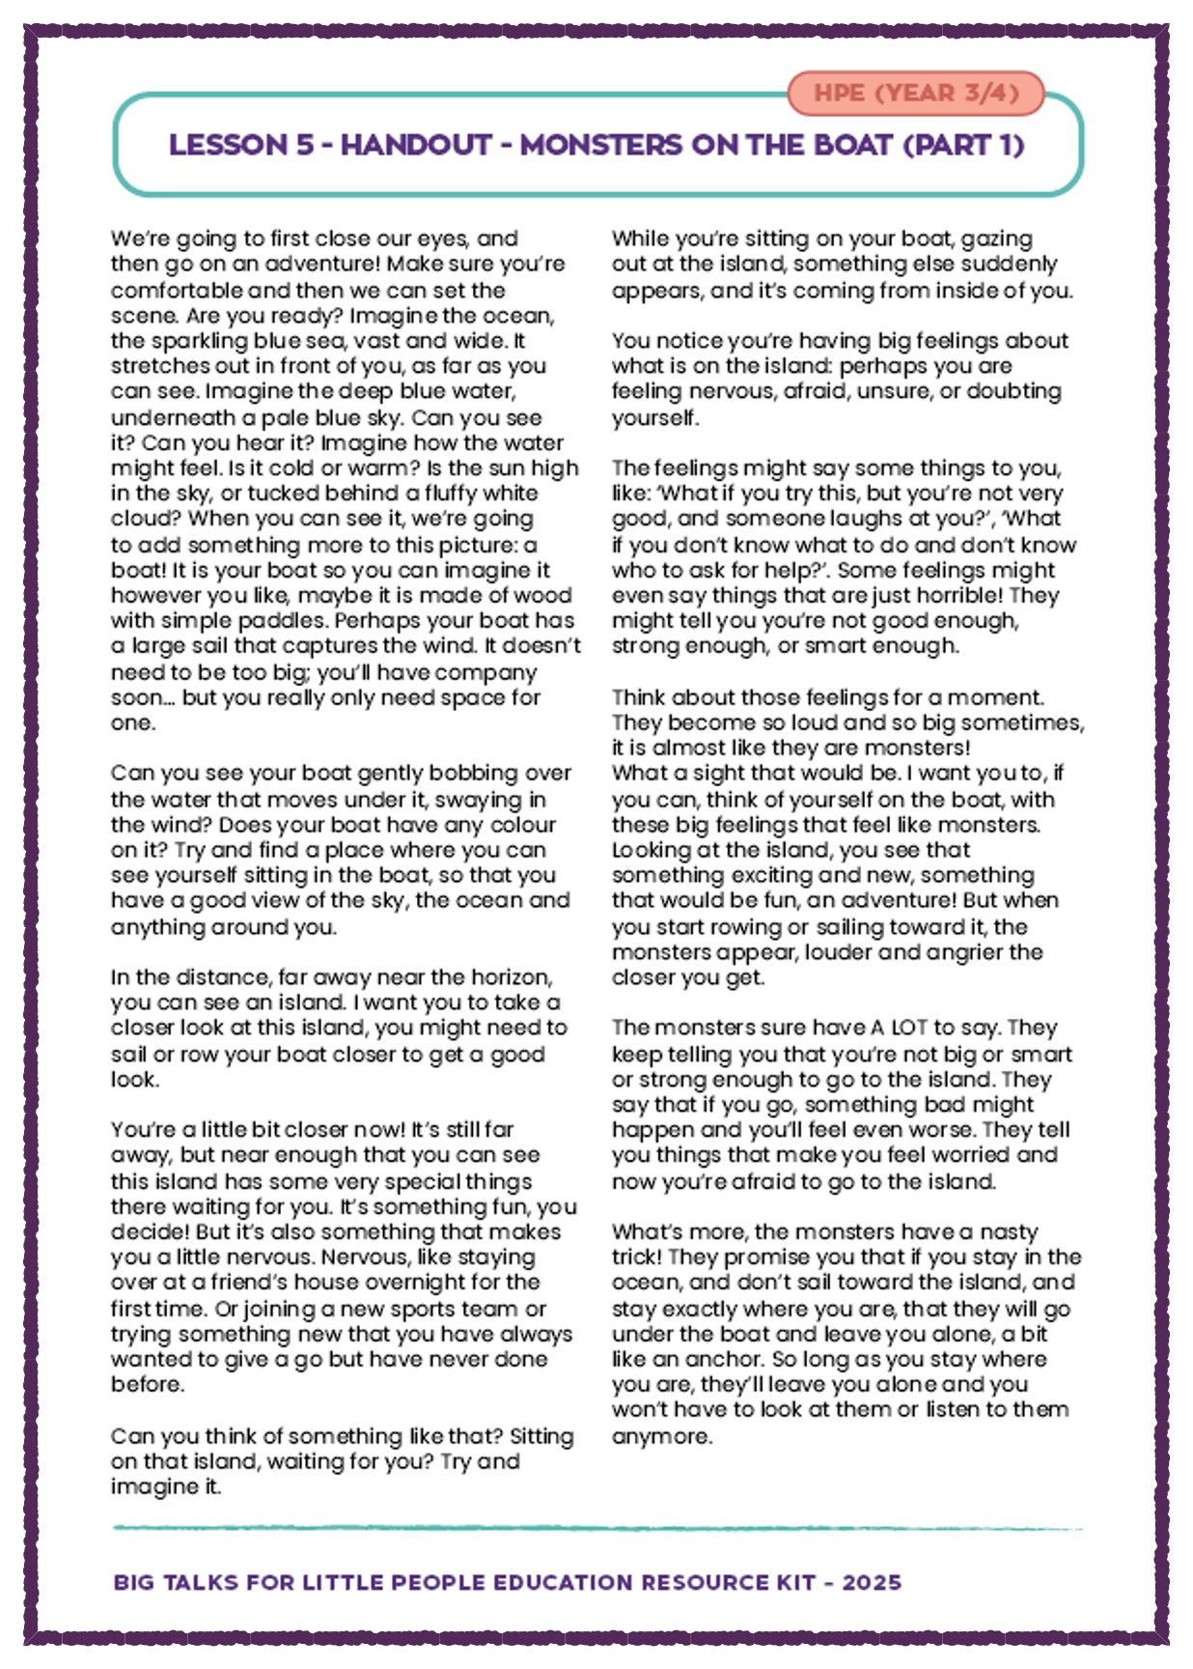
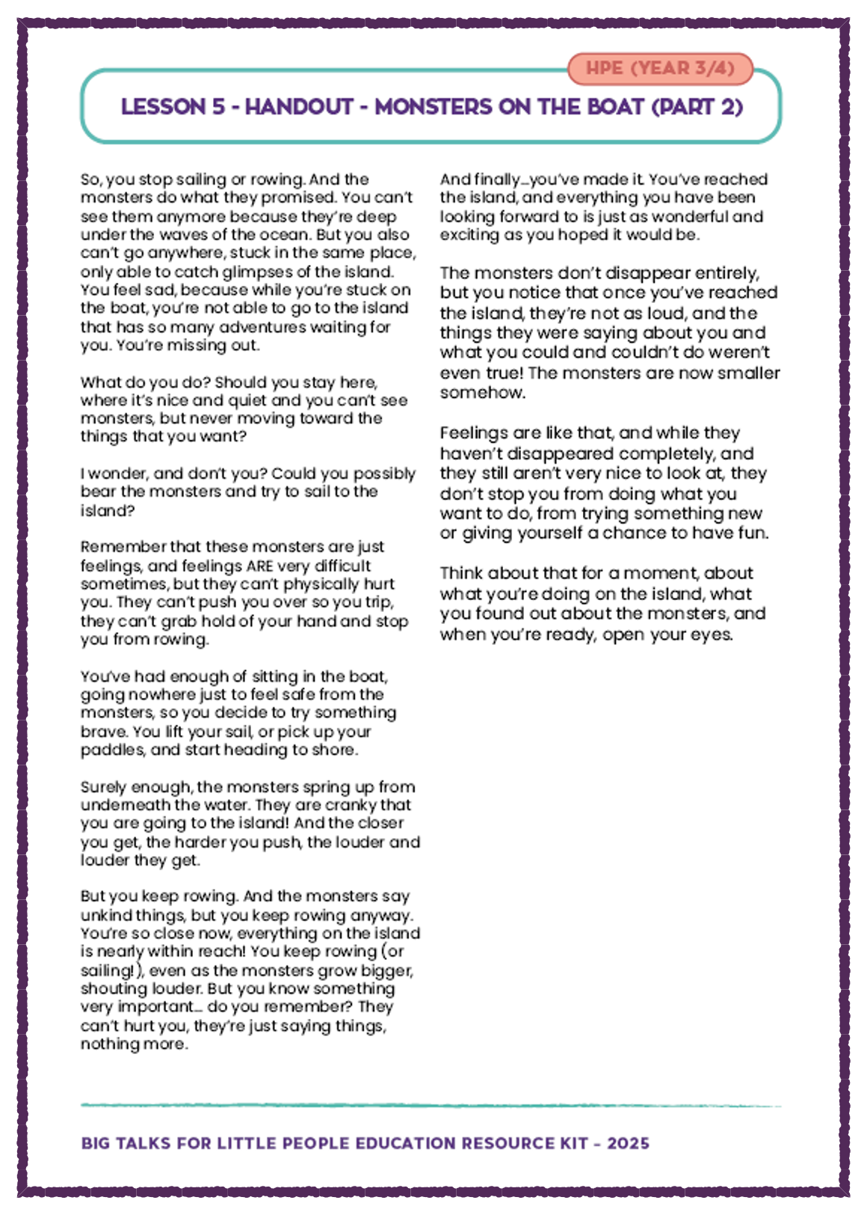
Part 3: Monsters on the
Boat Printout
It’s time to listen to ‘Monsters on a Boat’.
In small groups or with the class, share what you imagined when the story was being read out.
After, watch the ‘Diving Board’ animation again.
In your mind, were the Feels in the animation
similar to the ‘Monsters’ in the story?
What feelings or strengths did Kit need to have,
to be able to be able to finally jump off the board?
After seeing the animation, can you think of some
names to describe Kit's actions?
6

Slide 7
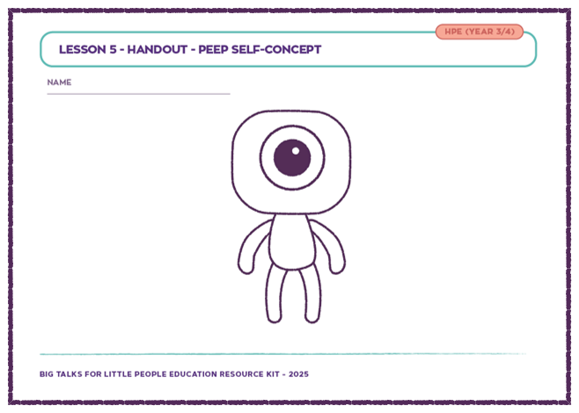
Part 4: Self-Concept Printout
Refer back to ‘Cloud activity’ sheet and look at the second cloud with the challenge you faced.
Your teacher will hand out a new ‘Peep’
Self-Concept task sheet.
Add designs to the blank ‘Peep’ to show things about your outer self that describe you.
Use the blank spaces on the sheet to describe the things that other people can’t see about you.
Can you describe things about your personality?
Can you describe things about your thoughts?
Can you describe things about your likes or fears?
7

Slide 8
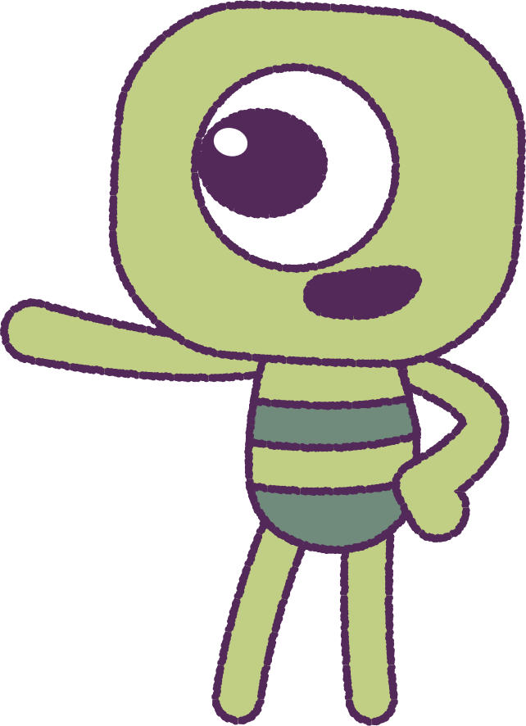
Part 5: Class Discussion
As a class, discuss what stops us from using ‘helping strategies’ to overcome our fears.
Can you find a way to be brave?
On the back of your ‘Self-Concept’ drawing, write a note about a challenge that you want to overcome.
Think about how your ‘qualities’ that can help you to achieve that goal.
When we control our emotions, we can help
to keep ourselves safe; and others safe too.
8

Slide 9
This is the end of Lesson 5.
Great work!

