Slide 1






Professor Shane Pill (PhD) Professor Phillip Slee (PhD)
Associate Professor Deb Agnew (PhD) Dr Amy Wright (PhD)
Jessica Skuza (Research Assistant)

Slide 2
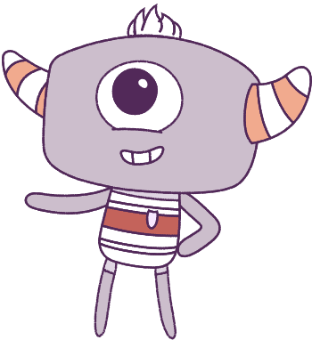




Lesson 6
Conflict Management
Lesson aims:
1.
Practise using personal and social skills to make and build friendships.
2.
Explain how and why emotional responses can change.
3.
Practise ways to manage emotions.
4.
Discuss how people might feel in a range of challenging situations and discuss what others can do to support them.

Slide 3
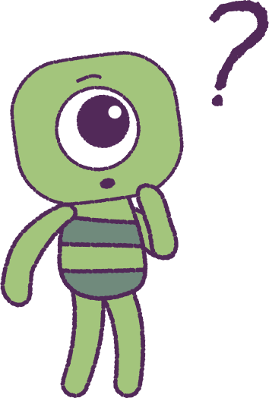

Part 1: Review content from last week
Who can remember what we discussed last lesson?
In our session today, we will talk more about conflict management.
3

Slide 4
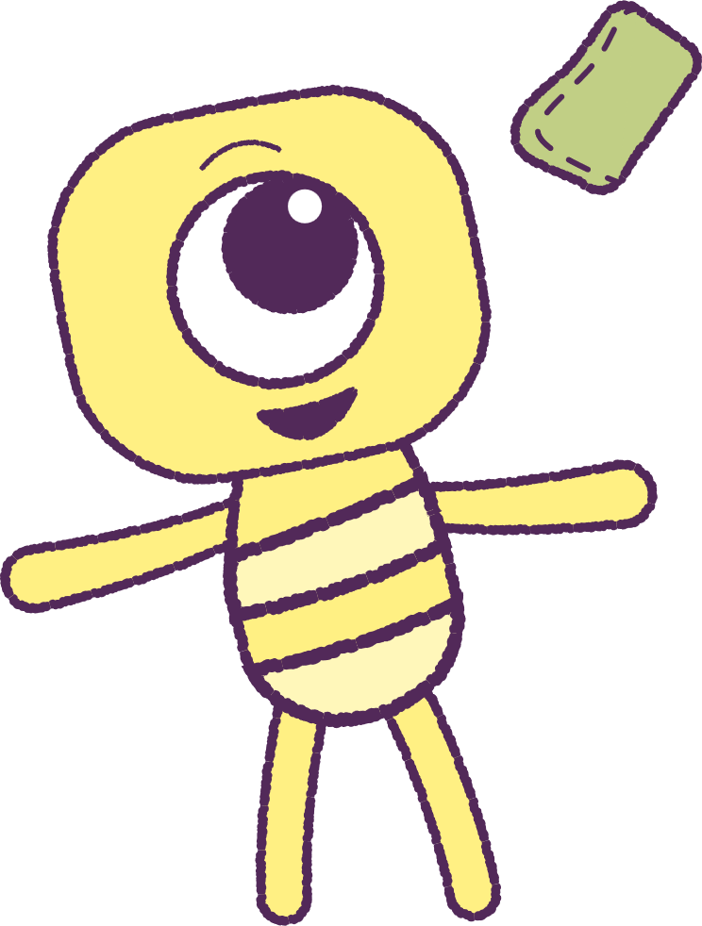
Part 2: Play Bean Bag Toss
Before we watch the animation, we will play
‘Bean Bag Toss’. You will need players and
one referee for each small group.
Take turns to throw bean bags into a bucket.
After a few shots, take a step back to make it more difficult. The referee will keep the score.
Switch roles so others get a turn at being the referee.
Return to your workspace to discuss the scores,
and how each person feels about their score.
Share these feelings so that a list can be made.
E.g. Excited? Disappointed? Proud?
4

Slide 5


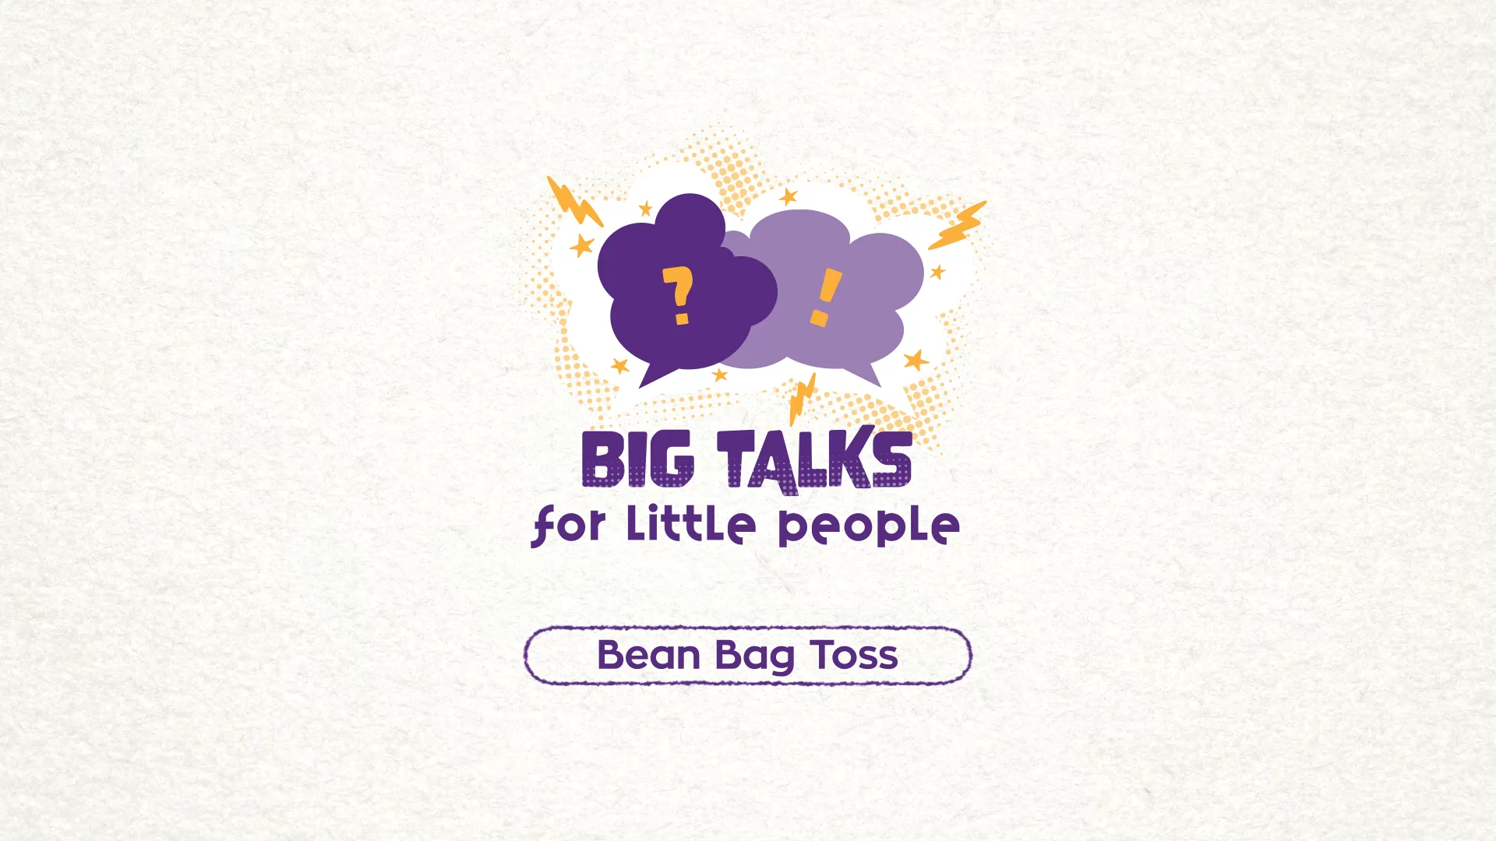

Part 3: Watch the animation
Hover your mouse over the video to view play settings. Otherwise, download from the website.
5

Slide 6
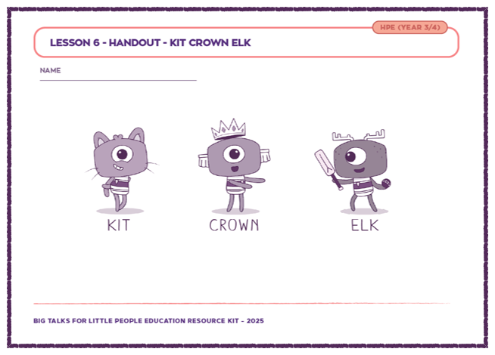
Part 3: Continued
Your teacher will organise you into small groups.
Your teacher will also provide a printout.
Rewatch the animation, and note:
• How each character in the story is feeling?
• What their needs are in this scenario?
• How they might be able to express their needs?
Record and share ideas on the printout.
After, groups will discuss and share their ideas
to the whole class.
6

Slide 7
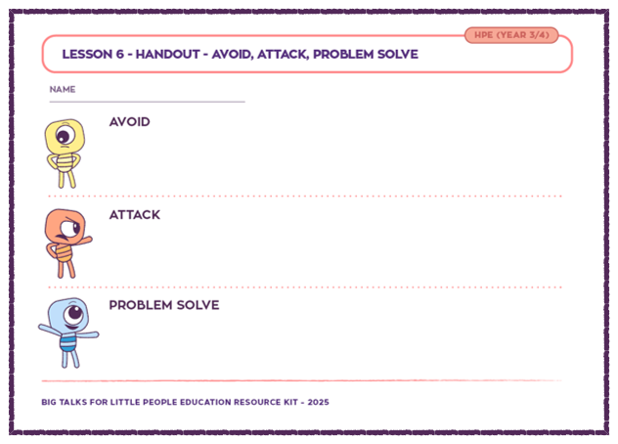
Part 4: Attribute Box Printout
& Roleplay Scenarios
Your teacher will give you a printout sheet with
verbs (doing words).
• AVOID
Hide away from a problem.
• ATTACK
Make a problem worse.
• PROBLEM SOLVE
Try to make things work.
Remember these verbs; we will use them in a
roleplaying activity next.
7

Slide 8
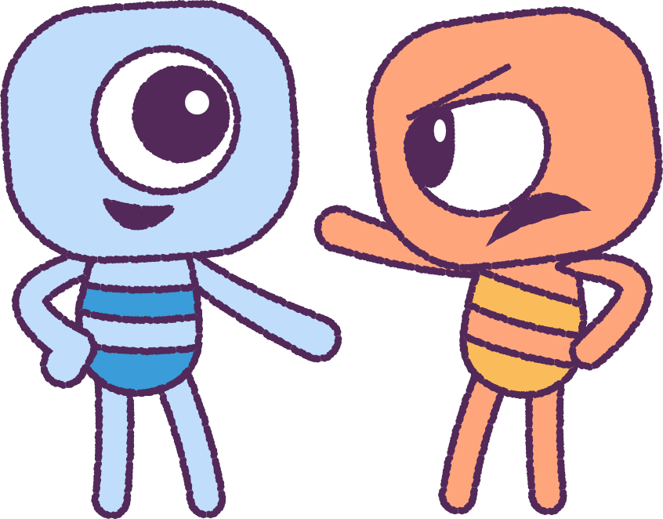
Part 4: Attribute Box Printout
& Roleplay Scenarios
Volunteers will act out the scene in the animation.
Another volunteer will be a bystander who:
• Avoids the situation.
• Speaks angrily to the players and umpire.
• Problem solves, to help the game to continue.
Take turns to rotate the actors in the play.
Use a ‘director’ to call out ‘Action!’ and ‘Cut!’.
If you are in the audience, offer suggestions for
other things the characters might do to show the
3 ways of reacting.
8

Slide 9
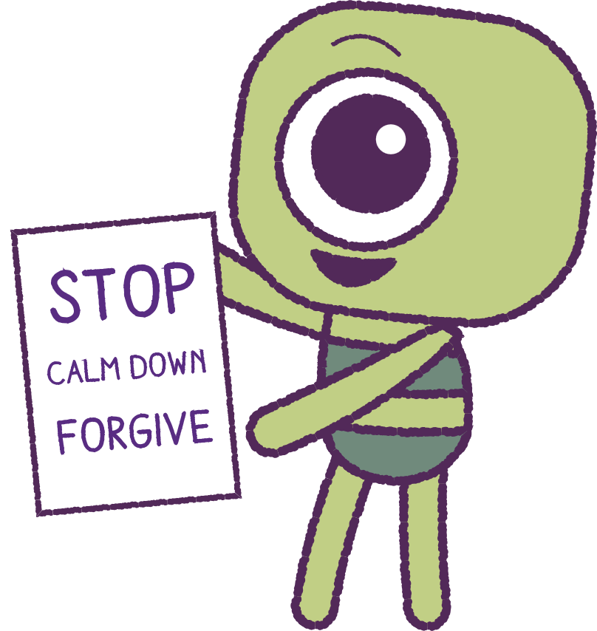
Part 5: Classroom Strategy Poster
Create a poster showing ways to solve arguments.
• Stop, Calm Down, Cool Off
Tell the other person what is bothering you.
• Repeat what the other person has said.
“You are feeling upset/afraid/confused.”
• Take responsibility.
What can each person do to improve things?
• Brainstorm a Solution
Find a solution that pleases all people involved.
• Affirm, forgive, thank
Show the other person that you are grateful that
the situation was sorted out.
9

Slide 10
This is the end of Lesson 6.
Great work!

