Slide 1





Professor Shane Pill (PhD) Professor Phillip Slee (PhD)
Associate Professor Deb Agnew (PhD) Dr Amy Wright (PhD)
Jessica Skuza (Research Assistant)

Slide 2
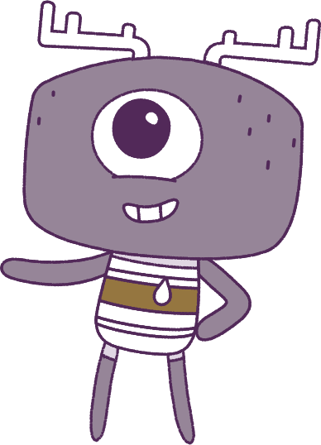




Lesson 7
Conflict Management
Lesson aims:
1.
Practise using personal and social skills to make and build friendships.
2.
Explain how and why emotional responses can change.
3.
Practise ways to manage emotions.
4.
Discuss how people might feel in a range of challenging situations and discuss what others can do to support them.

Slide 3
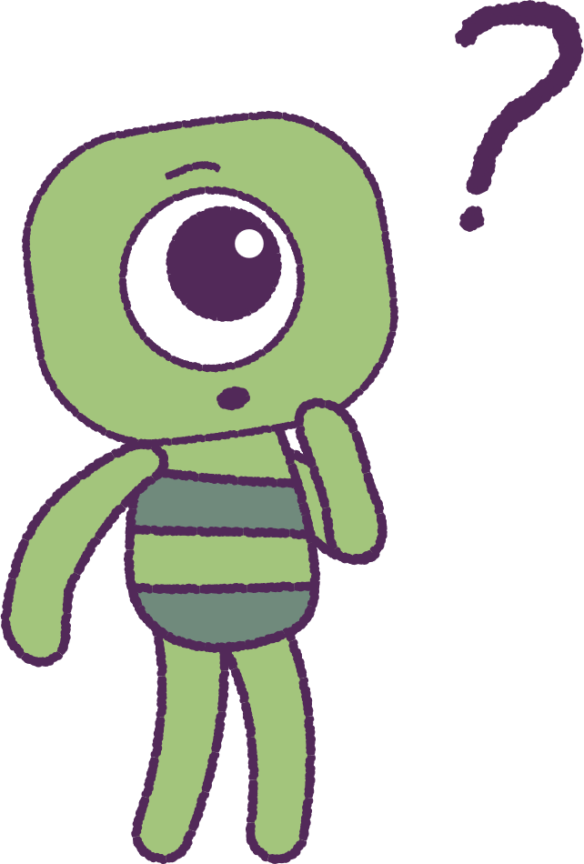

Part 1: Review content from last week
Who can remember what we discussed
last week?
In our session today, we will talk more about conflict management.
We have many fun activities coming up.
To help us complete these activities,
let’s get ready to look at the animation!
3

Slide 4


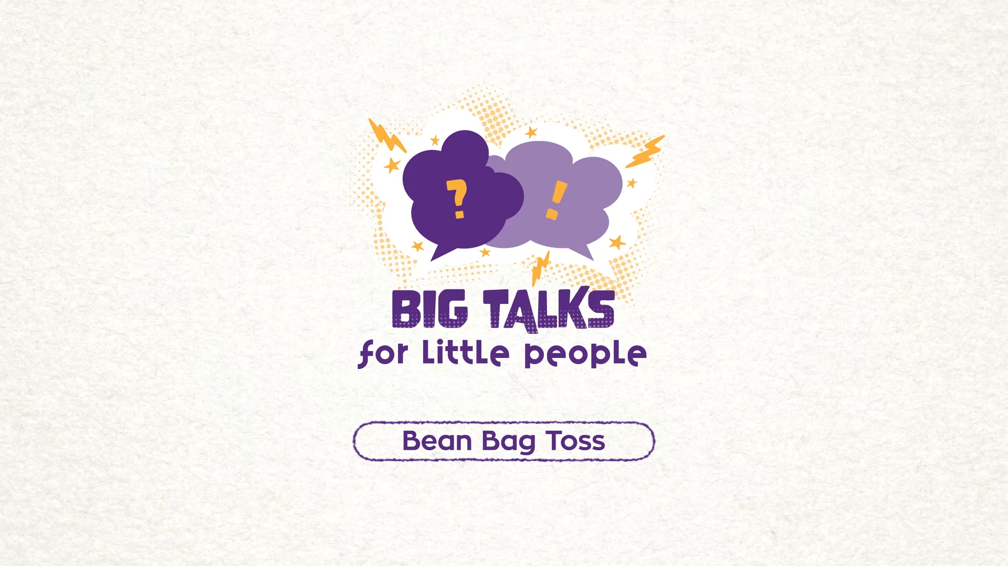

Part 1: Continued
Hover your mouse over the video to view play settings. Otherwise, download from the website.
4

Slide 5
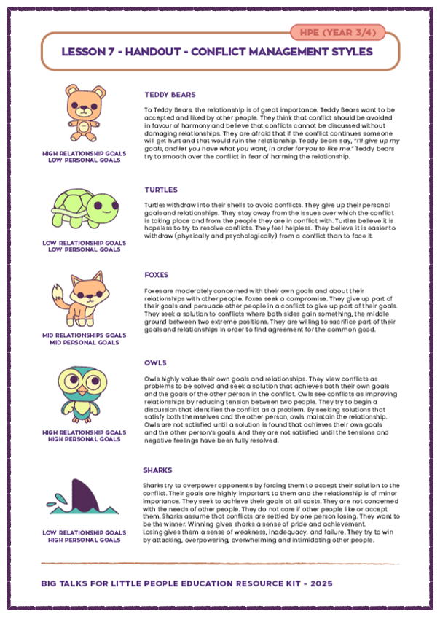
Part 2: Conflict Management Poster
Your teacher will provide you with an animal ‘Character’ sheet.
Each animal in the sheet has a different way of dealing with tricky problems and arguments.
Have a look at each one, while your teacher reads out the description of each animal.
Think about a movie you have seen recently.
Did any of the characters act or behave like one of these animal characters?
Which animal character would prefer to be
most like?
5

Slide 6
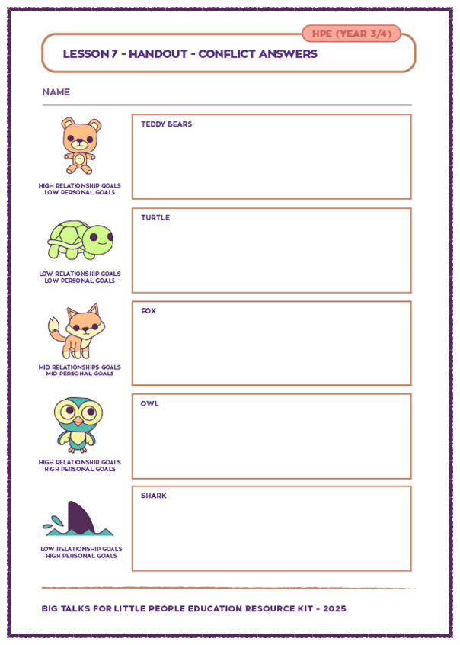
Part 2: Continued
Your teacher will give you another handout.
Watch the ‘Bean Bag Toss’ video again, looking carefully at the actions of each Peep.
Try to match each ‘Peep’ with an animal.
• Which ‘Peep’ is most like the Teddy Bear?
• Which ‘Peep’ is most like the Turtle?
• Which ‘Peep’ is most like the Fox?
• Which ‘Peep’ is most like the Owl?
• Which ‘Peep’ is most like the Shark?
Do any of the ‘Peeps’ change to match
more than one animal character?
6

Slide 7
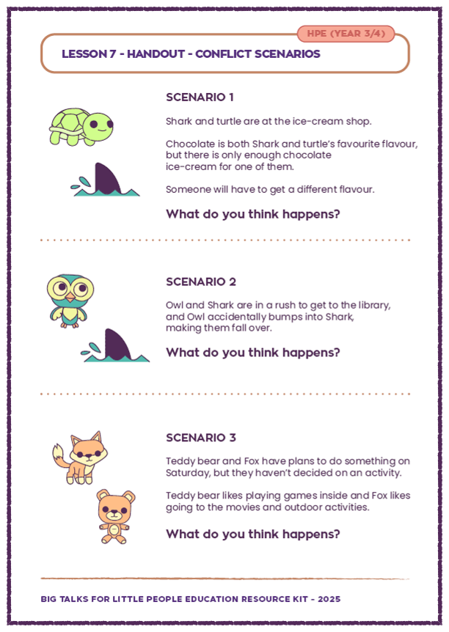
Part 3: Conflict Scenario Activity
Your teacher will hand out another sheet with some examples of some problems to solve.
Your teacher will read out each problem.
Use the ‘Character sheets’ to remember what each character is like and how they would act.
How may the characters talk to each other
about the situations?
Do you think they can find a solution to each problem?
Can you think of some ways that you could help them to find a solution, so that everyone is happy?
7

Slide 8
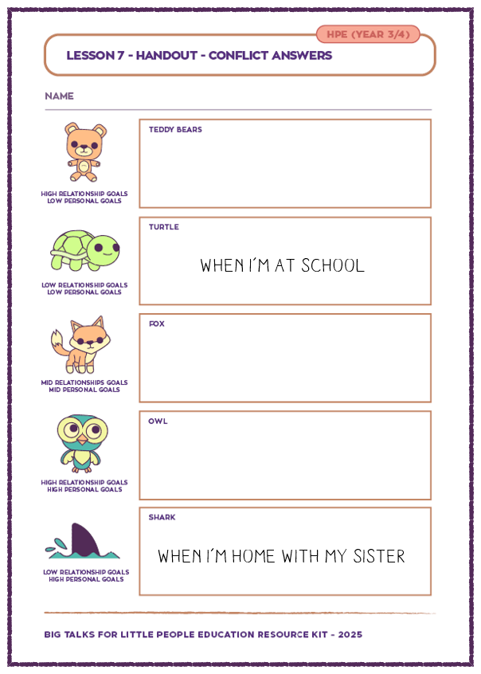
Part 4: Conflict Activity
Your teacher will give you with another sheet
with animals and blank boxes. Here, write which of
the animals that you feel most like. When you are with different people you may feel like you are more like a different animal.
When you are in different places you may feel
like you more like a different animal. E.g.
• When I am at school, I feel like a ‘Turtle’.
• When I am at home with my sister, I feel like
a ‘Shark’.
8

Slide 9
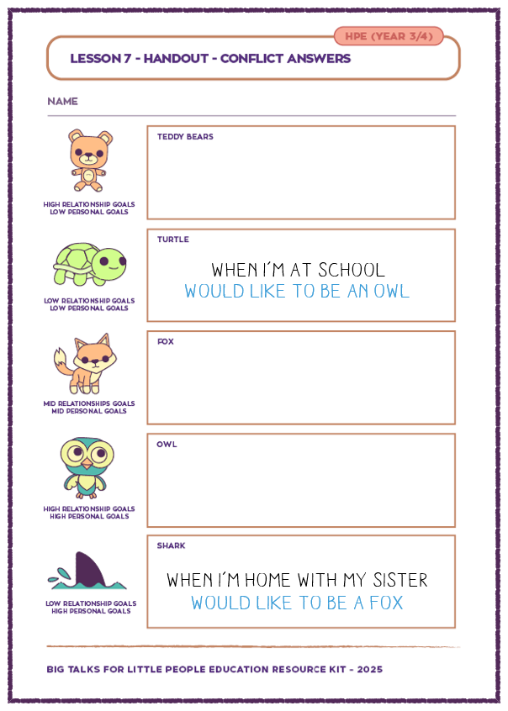
Part 4: Conflict Activity
Using the same sheet, think about the things
that you would like to improve about yourself.
In a different coloured pencil, write some things
next to your other comments about yourself,
that you would really like improve.
If felt like a ‘Turtle’ at school, would you like to be more like an ‘Owl’?
If felt like a ‘Shark’ at home with your sister,
would you like to be more like a ‘Fox’?
Think about what is most important to YOU.
Remember; there are no right or wrong answers!
9

Slide 10
This is the end of Lesson 7.
Great work!

