Slide 1





Professor Shane Pill (PhD) Professor Phillip Slee (PhD)
Associate Professor Deb Agnew (PhD) Dr Amy Wright (PhD)
Jessica Skuza (Research Assistant)

Slide 2
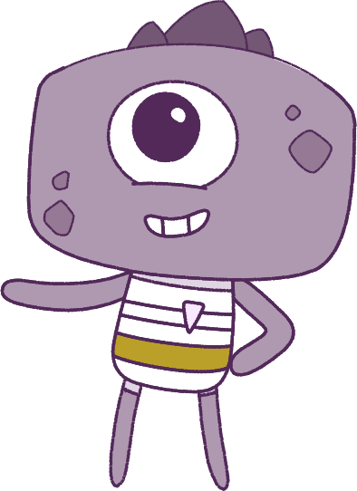




Lesson 8
Lesson 8
Exclusion & Bullying
Resilience
Lesson aims:
Lesson aims:
1.
Practise using personal and social skills to make and build friendships.
1.
Practise keeping calm in difficult situations.
Discuss how other people might
feel in a range of challenging situations
and discuss how you can support them.
2.
2.
Learn how situations can change your emotions.
3.
Recognise that there are many ways to bully someone, including online, and find ways to limit bullying in and out of school.
3.
Learn about how to keep safe, look for help, and what makes others special.

Slide 3
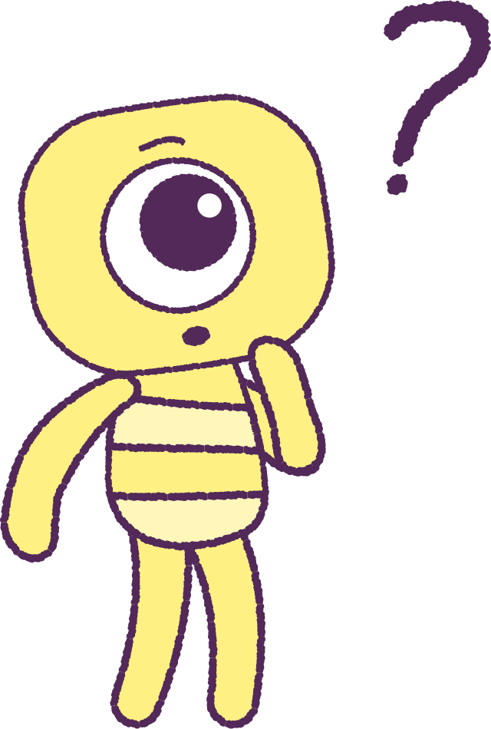

Part 1: Review content from last week
Who can remember what we discussed
last week?
In our session today, we will talk more about exclusion & bullying.
3

Slide 4
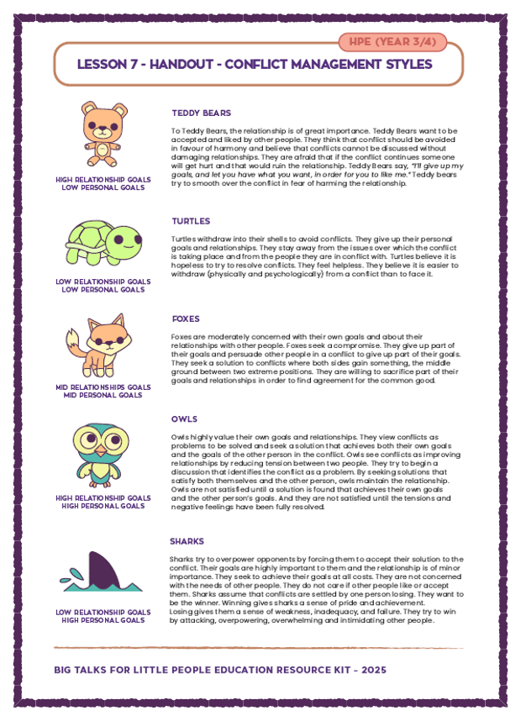
Part 2: Review Conflict
Management Sheets
Your teacher give will you the ‘Animal Character’ sheet that you used last lesson.
Each animal has a different personality and ways of dealing with tricky problems and arguments.
Can you remember what was special about
each animal?
While watching our next animation; ‘Handball’;
keep in mind the different types of animals.
Can you spot any particular ‘animal characters’
in the animation?
2021
4
2021
Test
Test
4
4

Slide 5


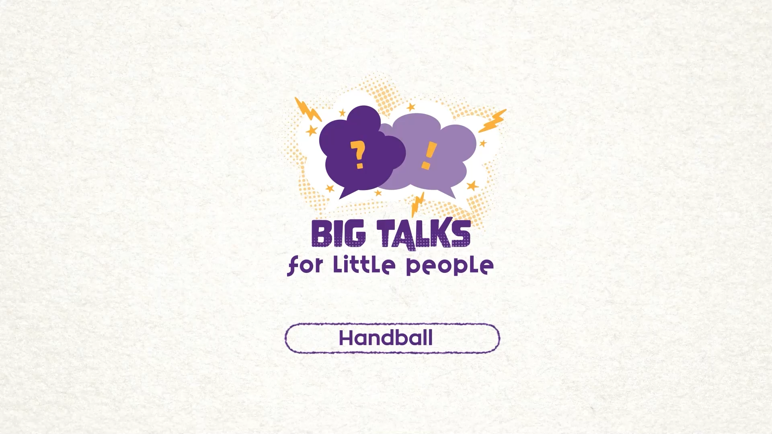

Part 3: Watch the animation
5
Hover your mouse over the video to view play settings. Otherwise, download from the website.

Slide 6
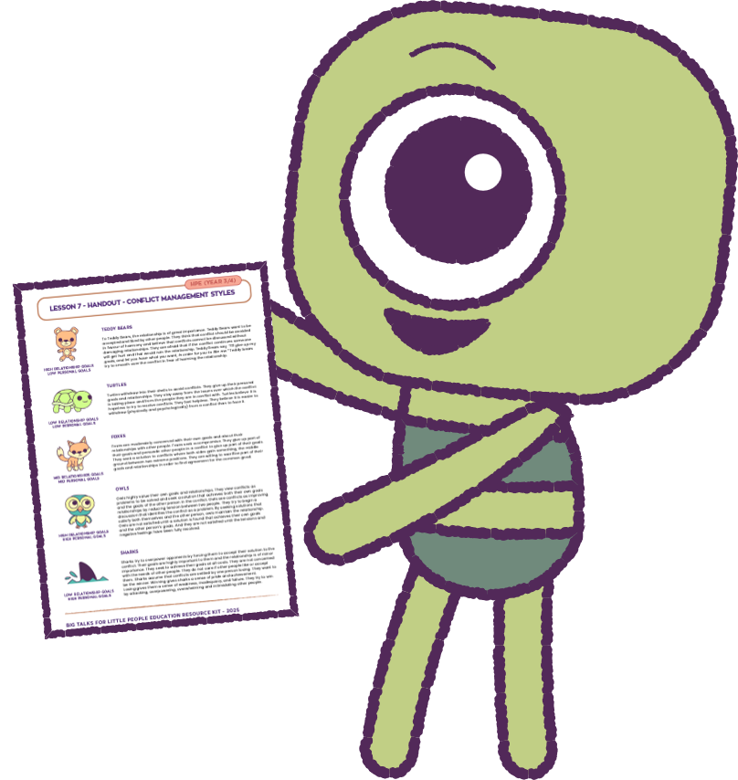
Part 3: Continued
As a class, match up the characters in the
animation (Steg, Fin and Twig), to the animals.
• Who is avoiding getting involved?
• Who is attacking?
• What do think Twig was thinking?
• Why did Twig act and feel that way?
Look at the 15 sec mark of the video where Twig
looks to Fin: What is happening here?
Would Twig have acted differently if Fin did something different?
Have you ‘had to do something’ so that you didn’t upset another friend? Can you explain this?
2021
6
2021
Test
Test
6
6

Slide 7
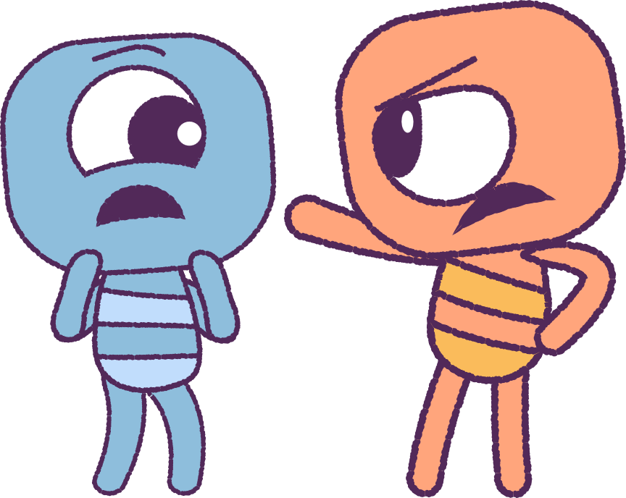
Part 3: Continued
Rewatch the ‘Handball’ animation.
Do you think any of the characters is being ‘a bully‘?
If so, how are they being a bully?
Do you think it’s fair to leave someone out
because there aren’t enough spots or equipment?
What could you do to make this situation fair for everyone who wants to be involved?
Steg was being ‘excluded’ – left out of the game.
If you were playing the game, or being another
bystander watching the game, what would you do,
to make Steg feel better?
2021
7
2021
Test
Test
7
7

Slide 8
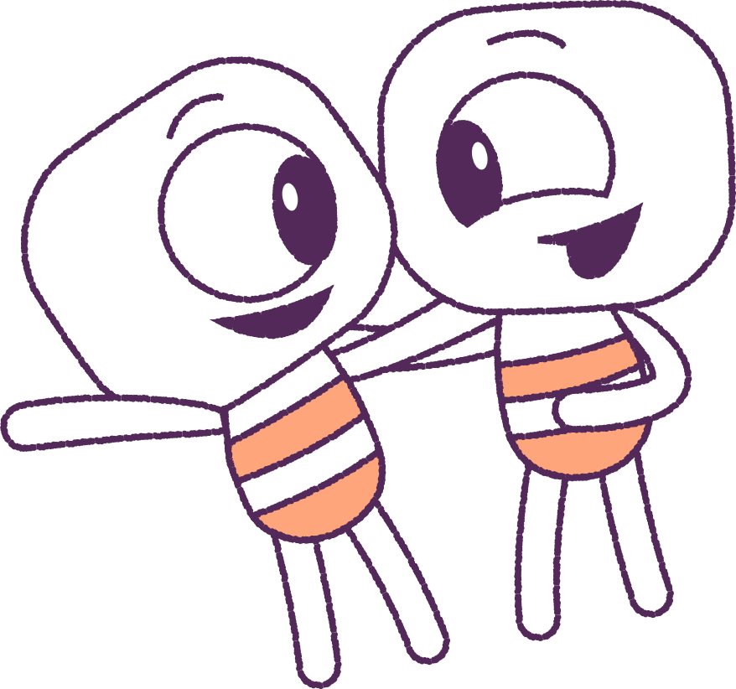
Part 4: Group Activity
Think about a different scenario, where Steg,
Fin and Twig, get along well and the game is fun.
In groups, pretend you’re ‘re-writing’ the animation.
Work out some new actions, so that the situation turns out better for all, and all the ‘Feels’ are happy.
In your groups, take turns to ‘act out’ your script.
Think about what it means to be ‘a bully’.
Can you think of ways to be kind to other people?
REMEMBER...TREAT OTHERS AS YOU WOULD TREAT A GOOD FRIEND!
2021
8
2021
Test
Test
8
8

Slide 9
This is the end of Lesson 8.
Great work!

