Slide 1





Professor Shane Pill (PhD) Professor Phillip Slee (PhD)
Associate Professor Deb Agnew (PhD) Dr Amy Wright (PhD)
Jessica Skuza (Research Assistant)

Slide 2
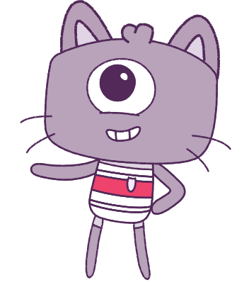




Lesson 9
Lesson 9
Exclusion & Bullying
Resilience
Lesson aims:
Lesson aims:
1.
Practise using personal and social skills to make and build friendships.
1.
Learn how to control our emotions, make smart decisions, and treat others kindly.
Discuss how other people might
feel in a range of challenging situations and discuss what you can do to support them.
2.
2.
Learn about how to keep safe, look for help,
Recognise that there are many ways to bully someone, including online, and find ways to limit bullying in and out of school.
3.
3.
Describe the things that make us and others special.

Slide 3
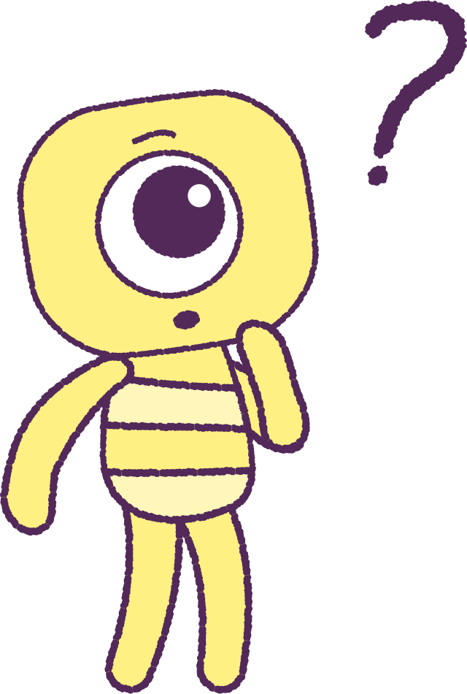

Part 1: Review content from last week
Who can remember what we discussed
last week?
In our session today, we will talk more about exclusion & bullying.
Let’s get ready to look at the animation!
3

Slide 4


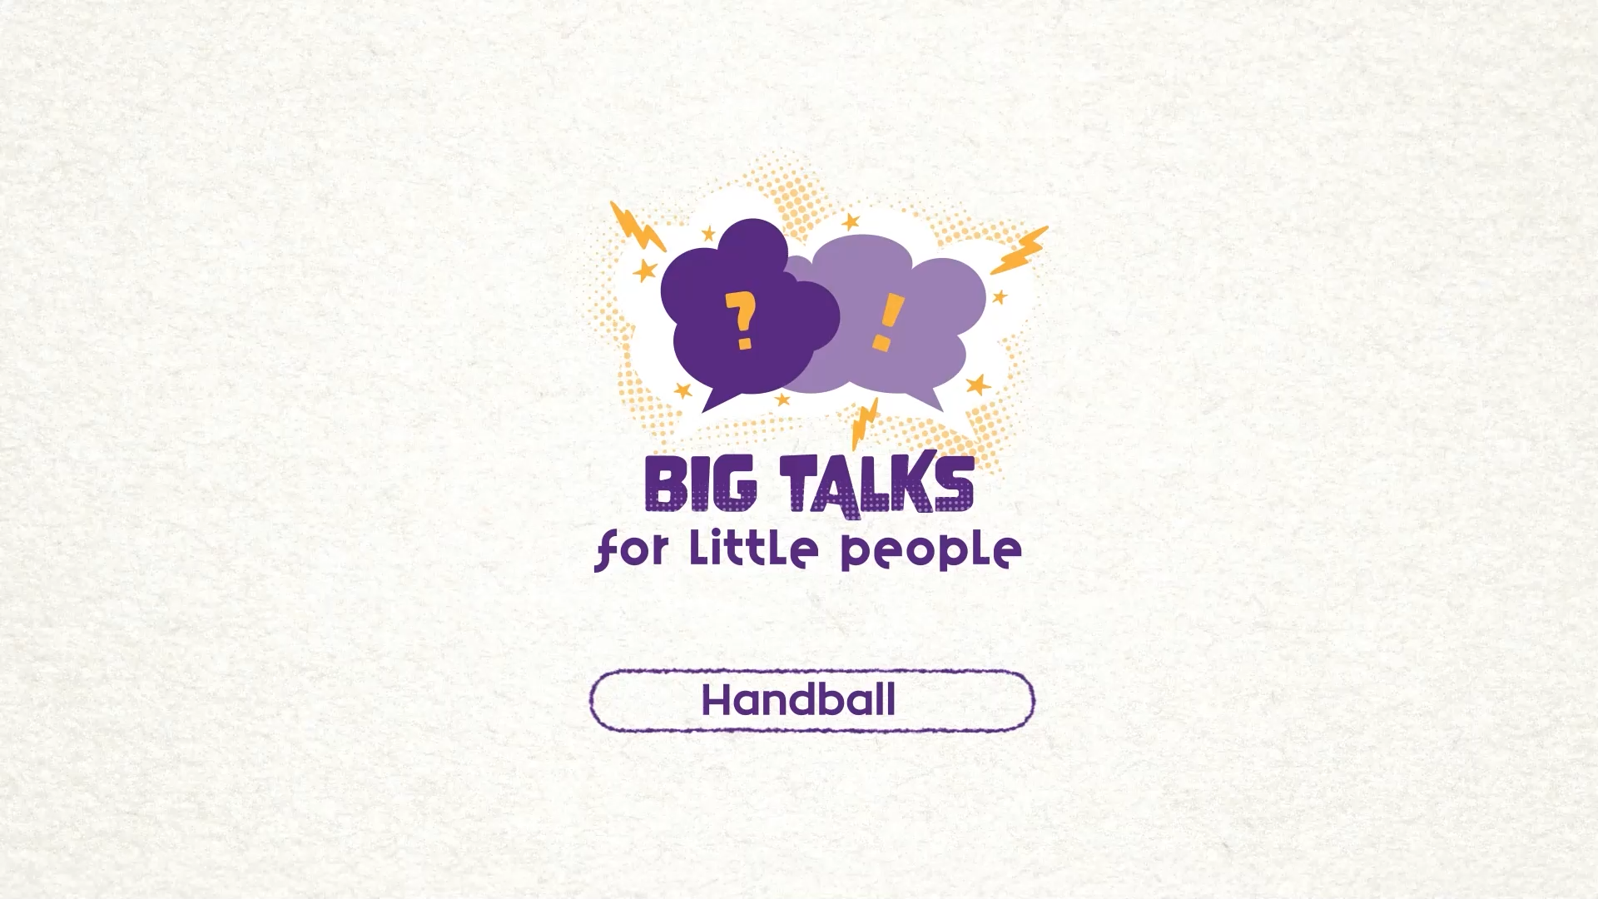

Part 2: Watch the animation
Hover your mouse over the video to view play settings. Otherwise, download from the website.
4

Slide 5

Part 2: Continued
Watch the ‘Handball’ animation again.
Can you remember the characters in the video, and how they were acting?
Were they being kind, and including each other?
Let’s keep this in mind before we move on to
our next activity.
2021
5
2021
Test
Test
5
5

Slide 6
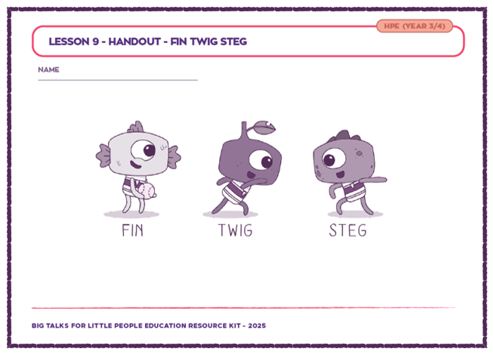
Part 3: Character Printout Activity
Your teacher will hand you out a worksheet, with the animation characters, Twig, Steg and Fin.
Think about your ‘plays’ from the last lesson, that showed how things could turn out differently for all.
Next to each character, list some good qualities and feelings that each character could practise,
to improve themselves and ‘be a better friend’
to each other.
E.g.
• Fin might need to be braver to support Steg.
• Twig needs to be kinder to include Steg.
2021
6
2021
Test
Test
6
6

Slide 7
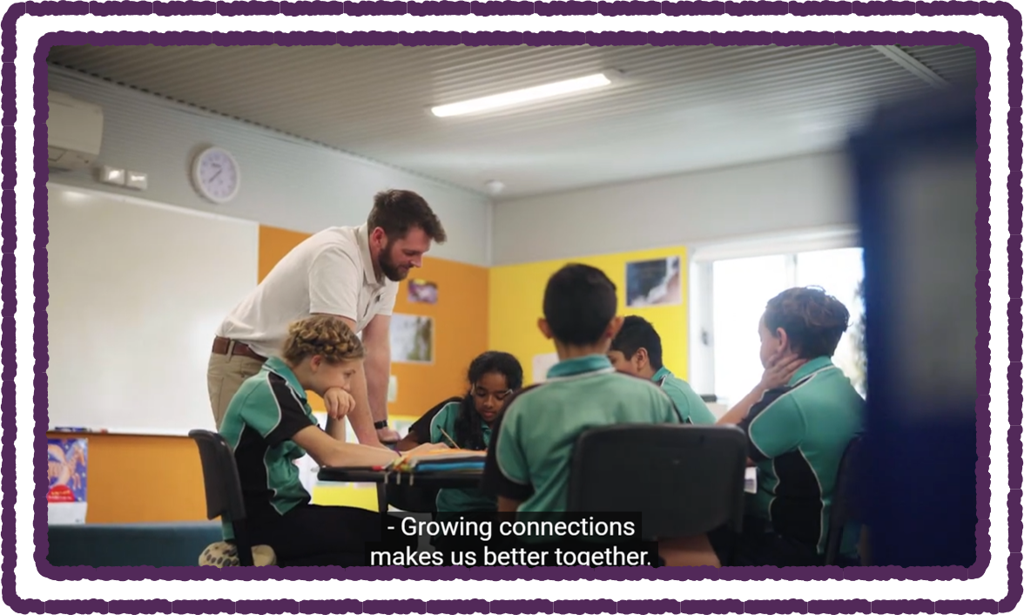
Part 4: Watch Youtube Video
Watch the following video ‘Bullying. No Way!’:
https://youtube/3gK1BsKarek
What is a bully?
Write examples you have seen of ‘bullying’ in:
• The classroom
• The school yard
• Outside of the school
• The internet
2021
7
2021
Test
Test
7
7

Slide 8
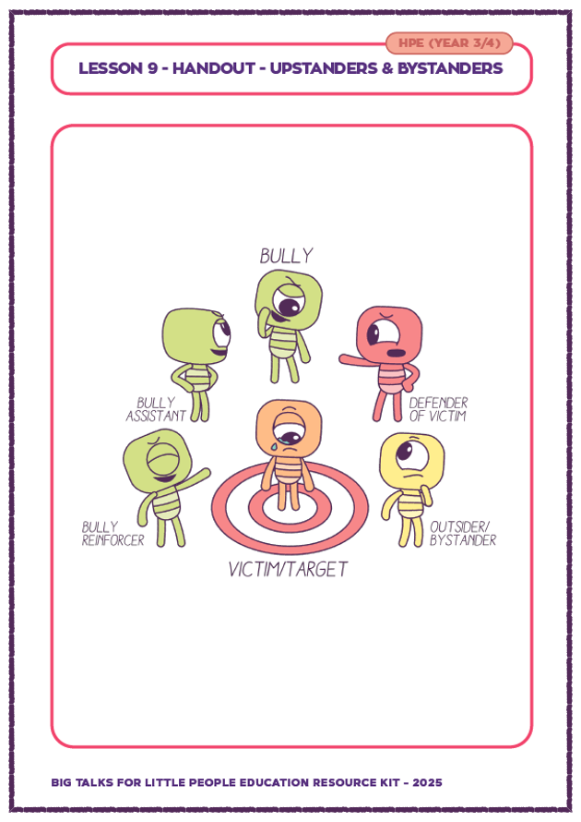
Part 5: Bystander or Upstander
Go through each of your examples of bullying
Carefully. Share them with the class.
Use the words ‘Upstanders and ‘Bystanders’
to describe what happened.
Upstander: A person that helps to stop bad behaviour and helps to sort the situation out in a good way.
An upstander helps to defend the victim.
Bystander: Someone that doesn’t get involved in the situation.
Your teacher will give you a printout.
Which role would you take? Explain why?
2021
8
2021
Test
Test
8
8

Slide 9
This is the end of Lesson 9.
Great work!

