Slide 1





Professor Shane Pill (PhD) Professor Phillip Slee (PhD)
Associate Professor Deb Agnew (PhD) Dr Amy Wright (PhD)
Jessica Skuza (Research Assistant)

Slide 2
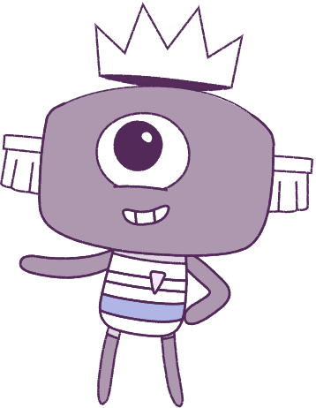




Lesson 10
Assessment & Conclusion
Lesson aims:
1.
Review the various types
of feelings and emotions.
Make a journal, showing an understanding of ways to help to cope with feelings and emotions.
2.
3.
Optional: Post-surveys.

Slide 3
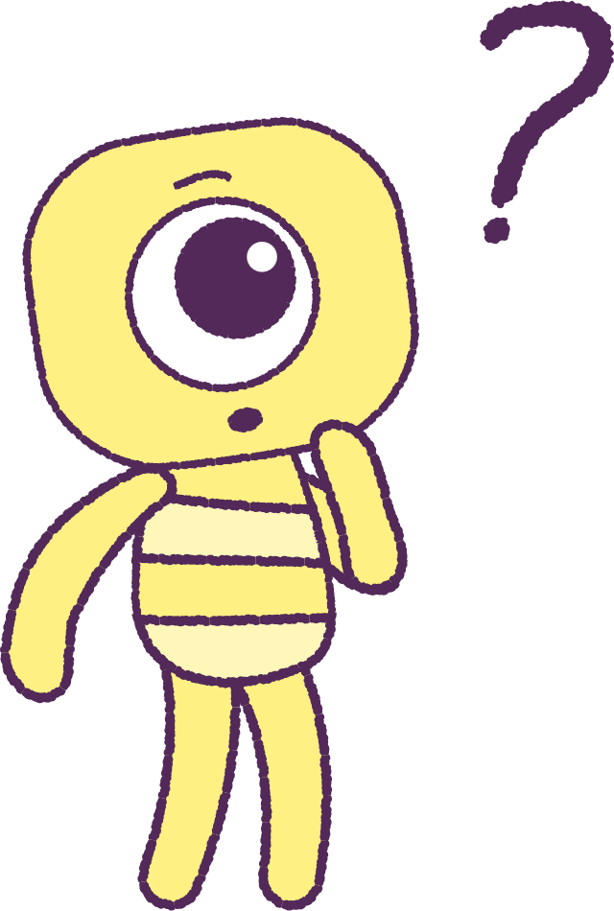

Part 1: Review content from last week
Who can remember what we discussed
last week?
In our session today, we will talk more about what we have learnt in general.
3

Slide 4
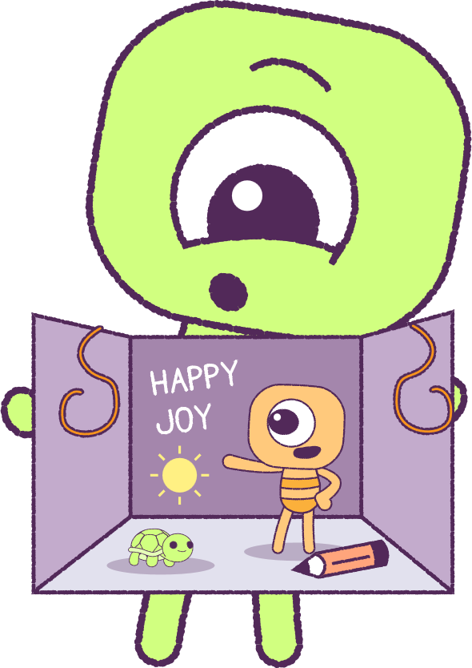
Part 2: 3D Peep Diorama
Create a 3-dimensional (3D) model of a ‘Peep’,
that you think, represents yourself.
You may choose where and how the ‘Peep’ is presented.
You may like to create a ‘Diorama’ (displayed in
a box with scenery), showing likes, dislikes, hobbies, pets, friends, feelings, emojis etc.
You can use recycled materials available in your classroom - be creative!
You may like to create a hand drawing, or use a drawing app on a digital device, to create a digital picture of a ‘Peep’ with decorations and text.
2021
4
2021
Test
Test
4
4

Slide 5
Part 2: 3D Peep Diorama
Build your ‘Peep’ from the 'inside out’. If you want your ‘Peep’ to look 'happy', think about all the things that help to improve your wellbeing.
Make small objects to show what you think are the important and special things about yourself, and the that things that boost your wellbeing.
Place these inside the ‘Peep’. Keep a list of the
important things that are inside of your ‘Peep’!
Choose an environment for your ‘Peep’ to live in. Show what you value, and what relationships or friendships that you think are important.
What are the things that make me...ME?
2021
5
2021
Test
Test
5
5

Slide 6

Part 3: Student post-survey
(OPTIONAL)
This optional post-survey will ask questions about how you think and feel.
Please have students visit the below website link:
www.caper.com.au
And click on:
“HPE Module – Student Surveys Years 3-4”.
It is important that you answer the questions as honestly as possible as the information will be used to help understand the well-being of
young people.
This pre-survey will take a minimum of 15 minutes
2021
6
2021
Test
Test
6
6

Slide 7
Part 4: Teacher post-survey
(OPTIONAL)
This optional post-survey will ask questions about how the HPE program went.
Please visit the below website link:
www.caper.com.au
And click on:
“Teacher Implementation Index”.
It is important that you answer the questions as honestly as possible as the information will be used to help understand the well-being of
young people.
This pre-survey will take a minimum of 15 minutes
2021
7
2021
Test
Test
7
7

Slide 8
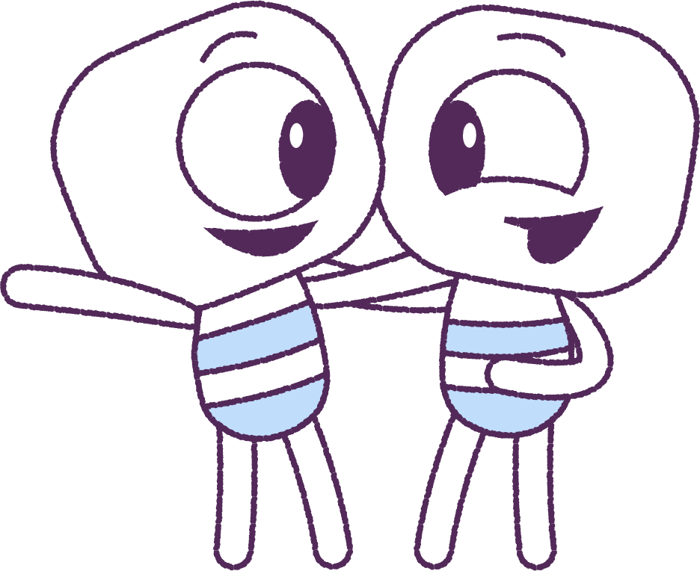
Conclusion
Recognise the good and bad things that other
people do and feel, which makes you a stronger,
more confident person.
Remember strategies (good plans) to help you
manage your feelings and emotions.
You can STOP. CALM DOWN. COOL OFF.
Be respectful to others by:
• ‘Talking with kindness’
• ‘Acting with kindness’
• ‘Playing with kindness’
TREAT OTHERS AS YOU WOULD TREAT A GOOD FRIEND!
2021
8
2021
Test
Test
8
8

Slide 9
This is the end of Lesson 10.
Great work!

