Slide 1






Professor Shane Pill (PhD) Professor Phillip Slee (PhD)
Associate Professor Deb Agnew (PhD) Dr Amy Wright (PhD)
Jessica Skuza (Research Assistant)

Slide 2
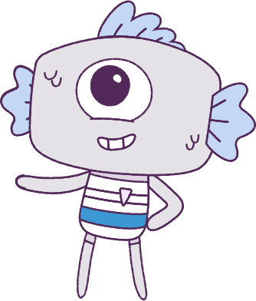




Lesson 1
Lesson 1
Pre-Survey & Introduction
Pre-Survey & Introduction
Lesson aims:
Lesson aims:
1.
Optional: Complete a pre-survey.
2.
Learn about the Peeps and the Feels.
3.
Participate in class activities.

Slide 3

Part 1: Student pre-survey
(OPTIONAL)
This optional pre-survey will ask questions about how you think and feel.
Please have students visit the below website link:
www.caper.com.au
And click on:
“HPE Module – Student Surveys Years 5-6”.
It is important that you answer the questions as honestly as possible as the information will be used to help understand the well-being of young people.
This pre-survey will take a minimum of 15 minutes
3

Slide 4

Part 1: Continued
Everyone should have the opportunity to answer the questions in a confidential manner, so please do not discuss the questions and your answers with anyone else.
Please respect the privacy of other students.
Do not talk to anyone else as you are filling in the pre-survey. Once you have completed your pre-survey, a University researcher will look at the answers and analyse the data.
No one at this school will see your pre-survey answers. We thank you for your participation in this important research.
4

Slide 5
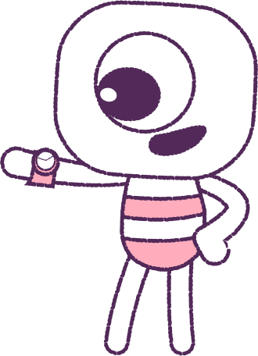


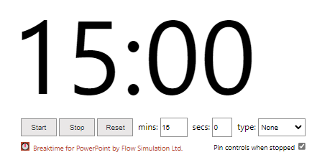
0
Part 1: Continued
How to use the timer: Click on “Trust this add-in” if this message pops-up. You might also need to click “Enable editing”. After, click into the white area and wiggle your mouse a bit. Adjust the settings to what you want, and start.
5

Slide 6
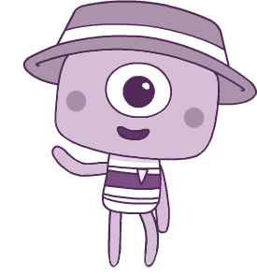
Part 2: Introduction to Big Talks
Over the next few weeks we will be learning about feelings and emotions together, and talking about tricky subjects like friendships, belonging and bullying.
Together we’ll watch a series of animations every week to help us talk about how to understand and build our skills around wellbeing.
You’ll get to know all about the Peeps!
6

Slide 7




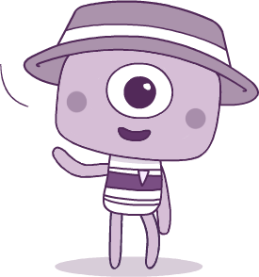
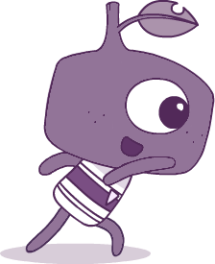
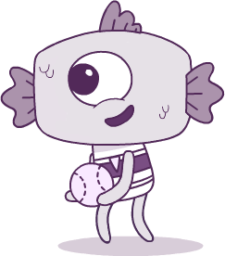
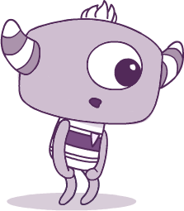
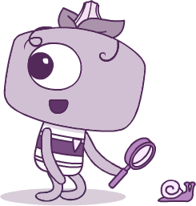
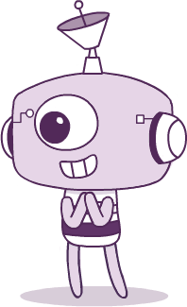
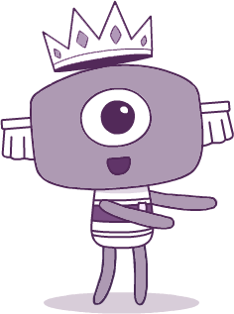
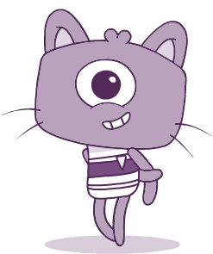
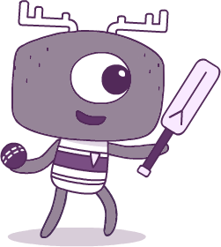
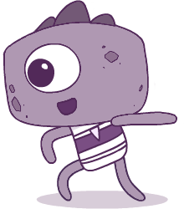
Meet the Peeps! Which one do you like best, and why?
BRIM
TWIG
FIN
PAN
STALK
ELK
STEG
TEK
CROWN
KIT

Slide 8
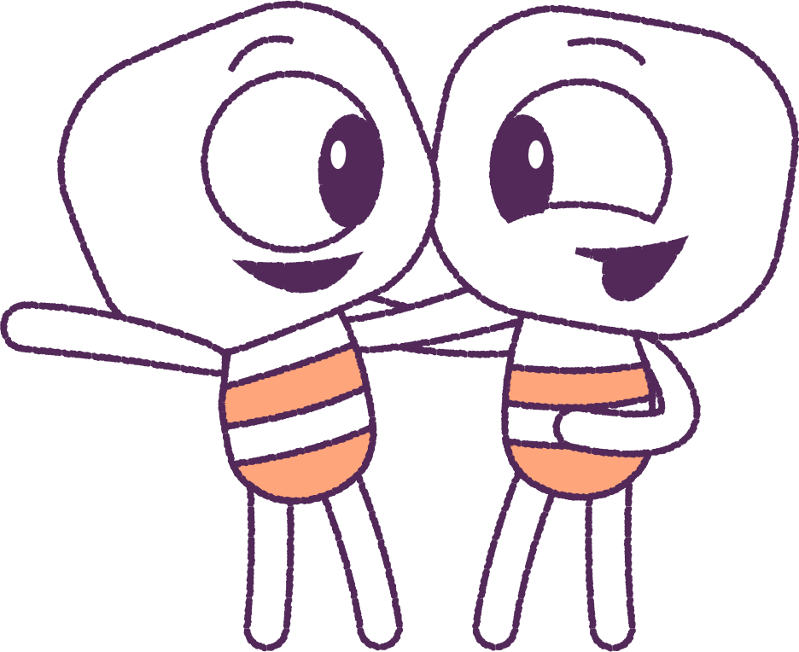
Part 3: Group Work
Divide students into groups. You have 10 minutes to decide and report back what your group roles will be and write down your group work rules.
Examples of Rules
• No put downs.
• Everyone gets a chance to speak.
• Everyone has a role in the group.
Examples of Roles
• Who will scribe answers to group questions.
• Who will speak for the group.
• Who will coordinate group work.
• Who will be in charge of supplies and timing.
8

Slide 9

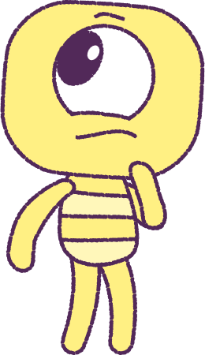
Report back
to class on
rules & roles
9

Slide 10
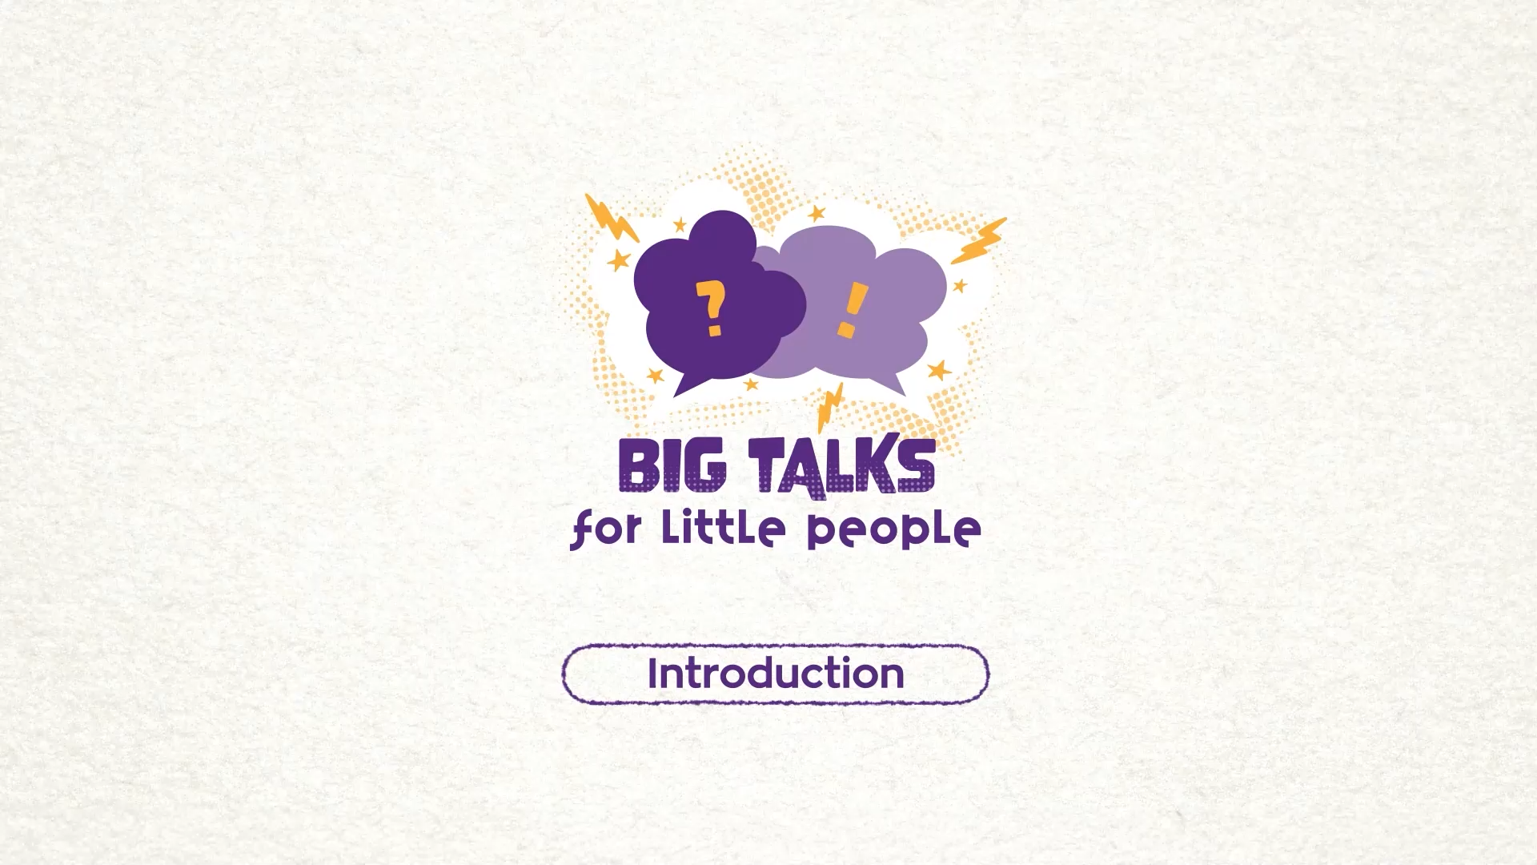
Part 4: Watch an Animation
Hover your mouse over the video to view play settings. Otherwise, download from the website.
10

Slide 11
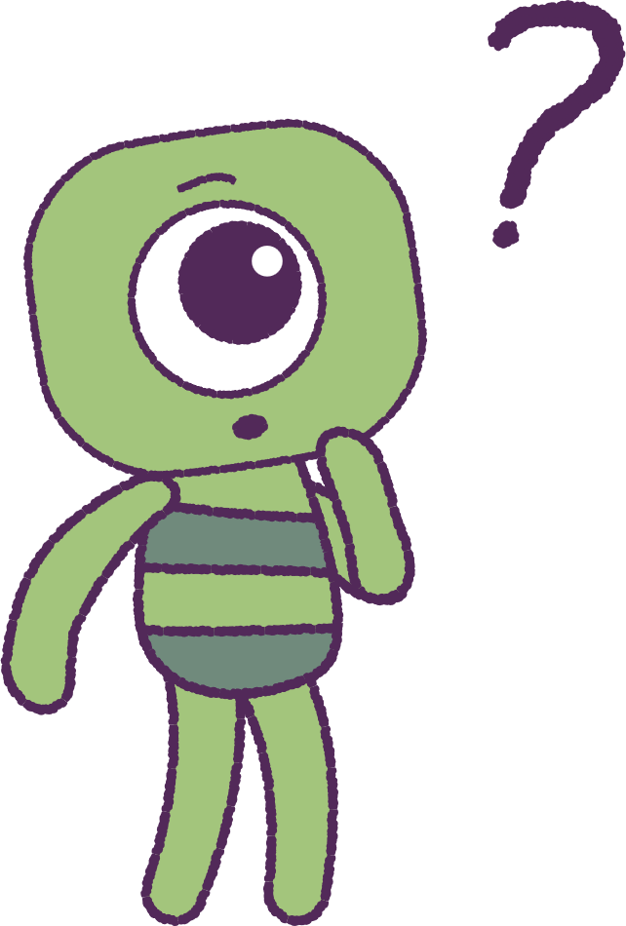
Part 4: Continued
Let’s now discuss the animation and what we currently know.
• What are some feelings/emotions you are
aware of?
• What feelings/emotions are you aware of
others having?
• What sharing, helping and cooperative
behaviours among friends and classmates
can you identify?
• What feelings are associated with helping and
being kind to others?
11

Slide 12
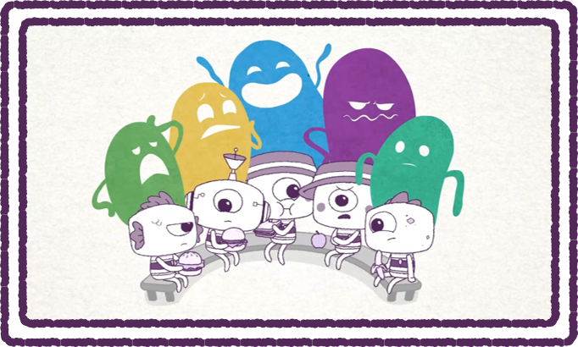
Part 5: Wellbeing Dictionary
In your notebook, set up a table to be used to
record the names of emotions and feelings,
and a description of what they mean.
Watch the ‘Introductory Video’ again and note
all the feelings and emotions that you can see. Include the reactions of the ‘Peeps’ and the ‘Feels’.
(The ‘Feels’ are the bubbles that appear over the top of the ‘Peeps’.)
Write down as many different emotions as you can see in the images on this slide. Think about what the ‘Peeps’ faces 'look like' before you interpret the feeling of the ‘Feel’.
12

Slide 13
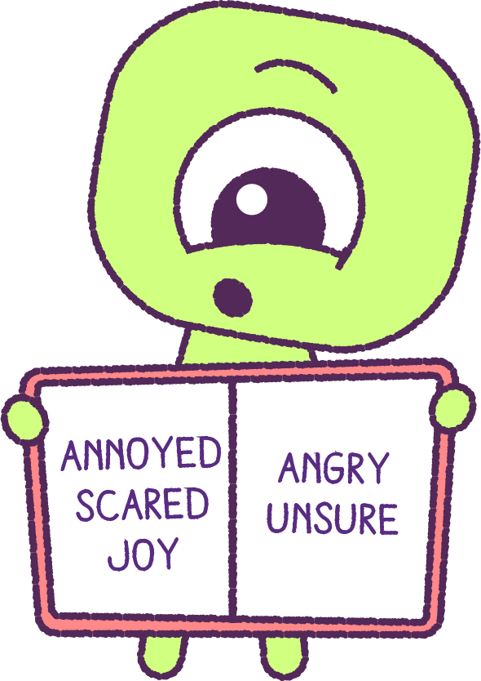
Part 6: Share Wellbeing Dictionary
It’s time to share your work!
Share the list of emotions you’ve made
amongst the class.
If someone has listed an emotion you didn’t have in your own wellbeing dictionary, write it down.
13

Slide 14
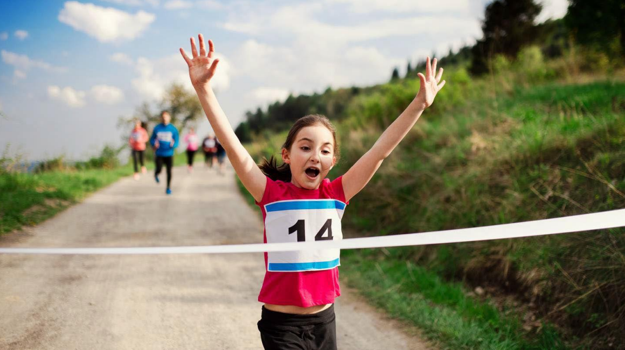
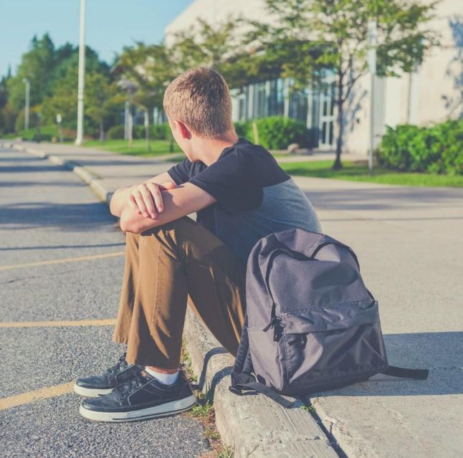
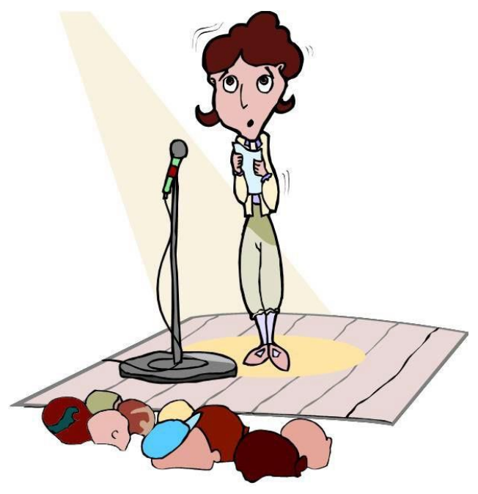
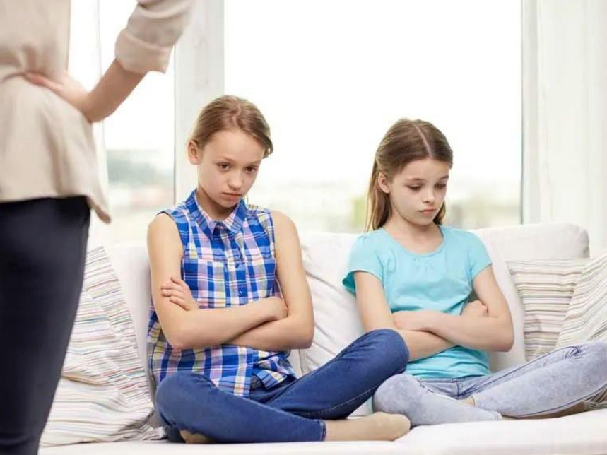
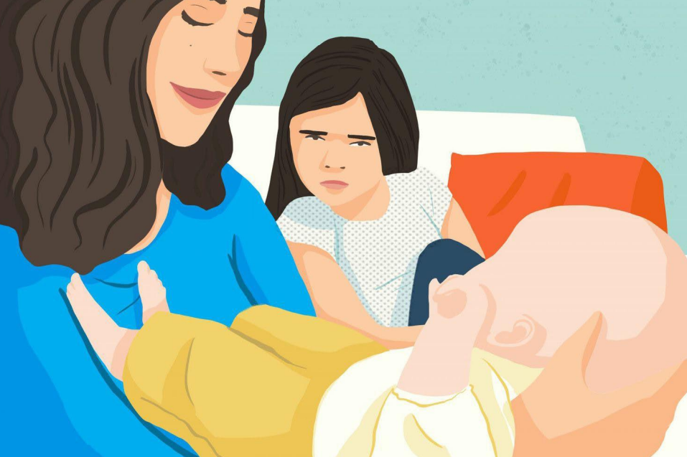
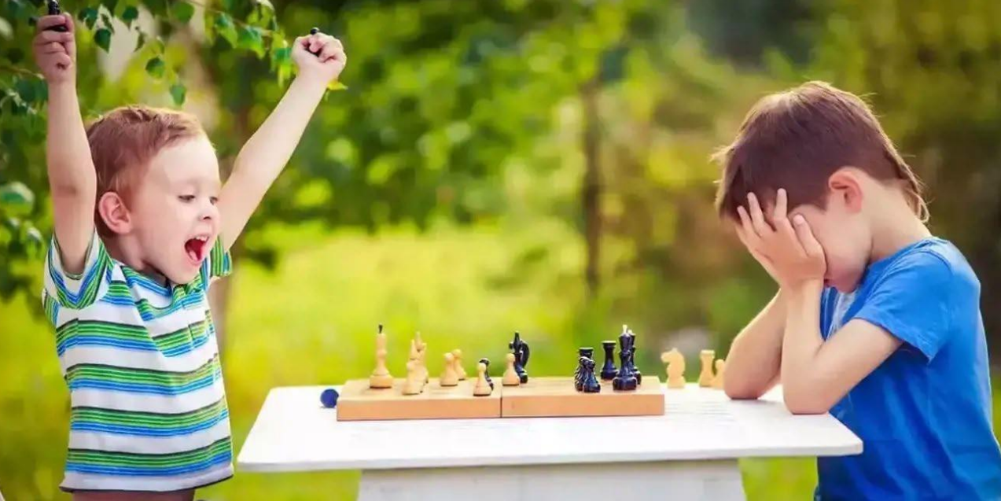
Part 7: Image Activity
Can you describe the feelings that these people may be having?
What tells you that these people may be feeling this way?
Do you do the same thing when you feel this way?

Slide 15
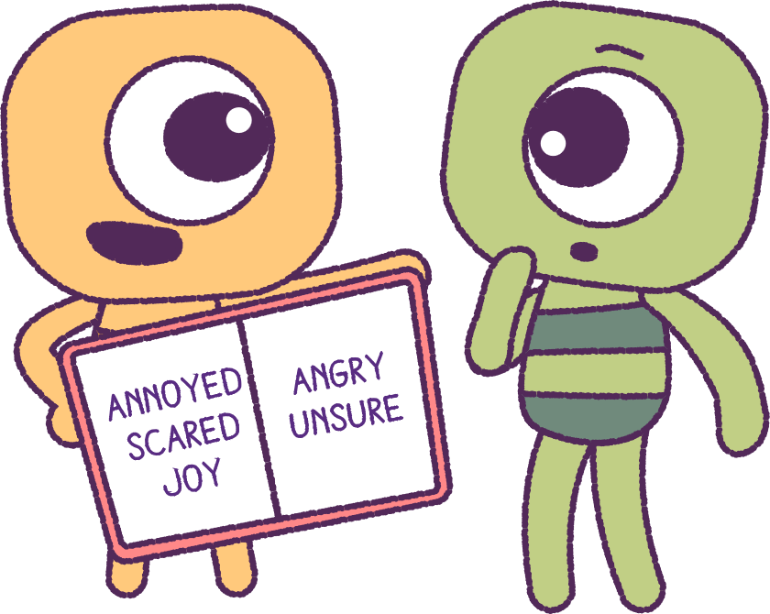
Part 8: Finalise Wellbeing Dictionary
In your discussions about the pictures, record
any new feelings in your ‘Wellbeing dictionary’.
Discussion: Do you think that different genders
are expected to act in different ways to situations?
Do you think, that in certain situations, different people are expected to act in different ways?
Think about how you respond to certain situations. E.g. When might you cross your arms, tap your feet, look down to the floor or smile?
Use an online THESAURUS to find words that mean something similar and add them to your list.
15

Slide 16
This is the end of Lesson 1.
Great work!

