Slide 1






Professor Shane Pill (PhD) Professor Phillip Slee (PhD)
Associate Professor Deb Agnew (PhD) Dr Amy Wright (PhD)
Jessica Skuza (Research Assistant)

Slide 2
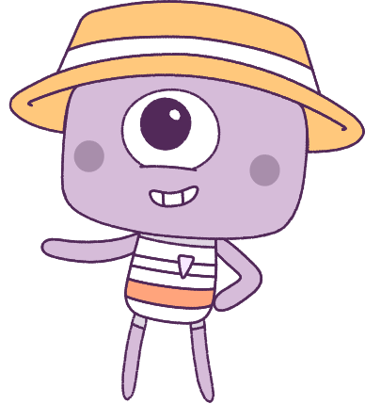




Lesson 2
Lesson 2
Emotions
Exclusion & Relationships
Lesson aims:
1.
Explore the value of social connection offline and online, while developing strategies to manage emotions in online conflicts.
Learn strategies to manage emotions and analyse how emotional responses influence social interactions.
2.
Analyse the influence of different factors and situations in relation to
emotional responses.
3.

Slide 3
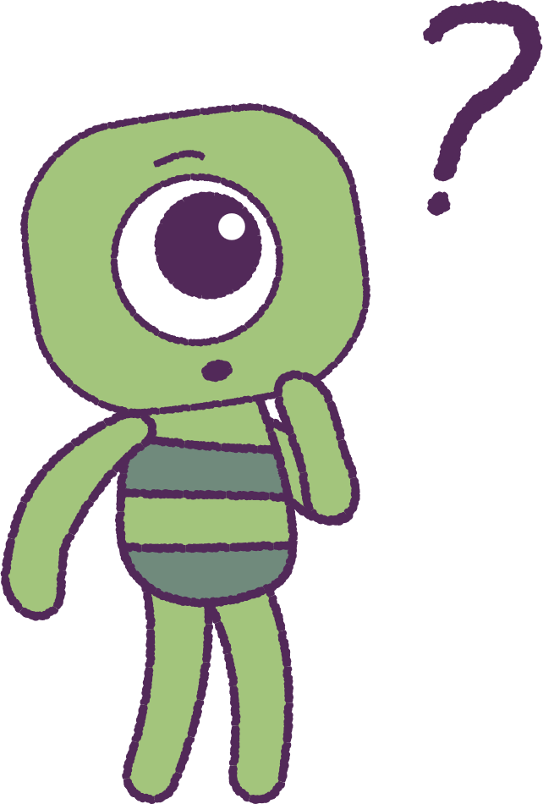

Part 1: Review content from last week
Who can remember what we discussed
in Lesson 1?
In our lesson today, we will talk more about emotions.
Lets get ready to look at the animation!
Special Note: On first watch, focus on the “Peep” characters.
3

Slide 4


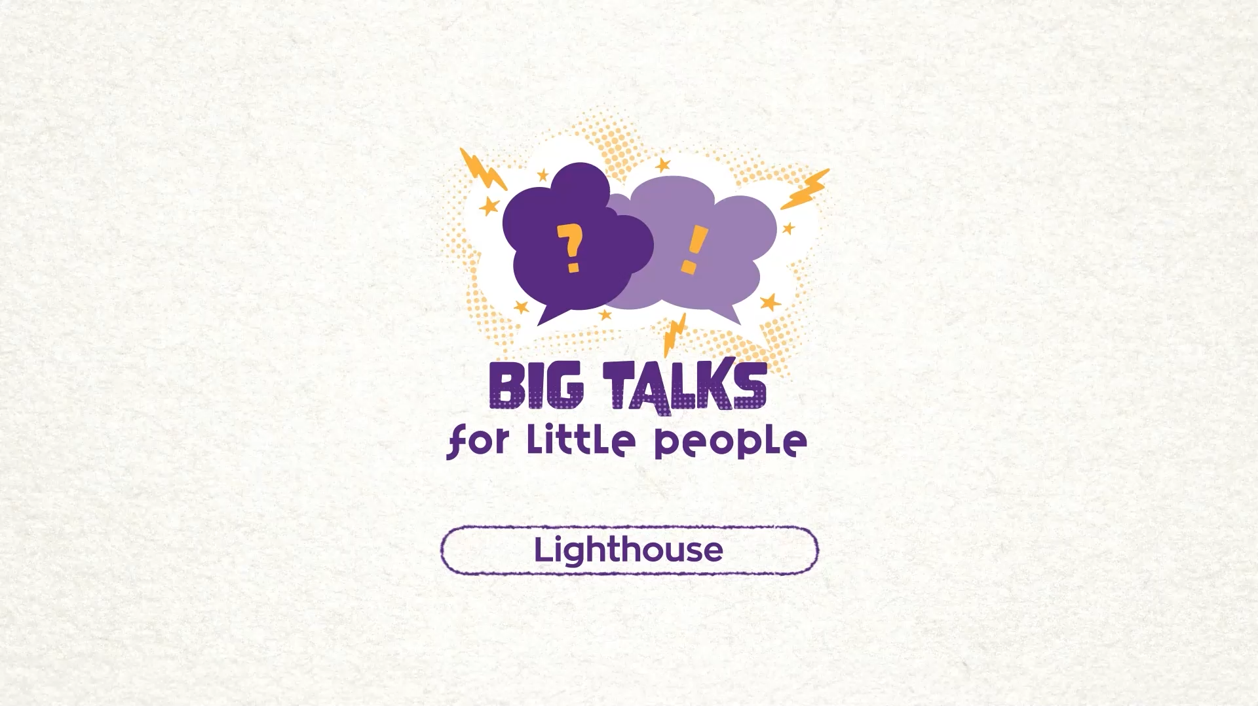

Part 2: Watch the animation
4
Hover your mouse over the video to view play settings. Otherwise, download from the website.

Slide 5
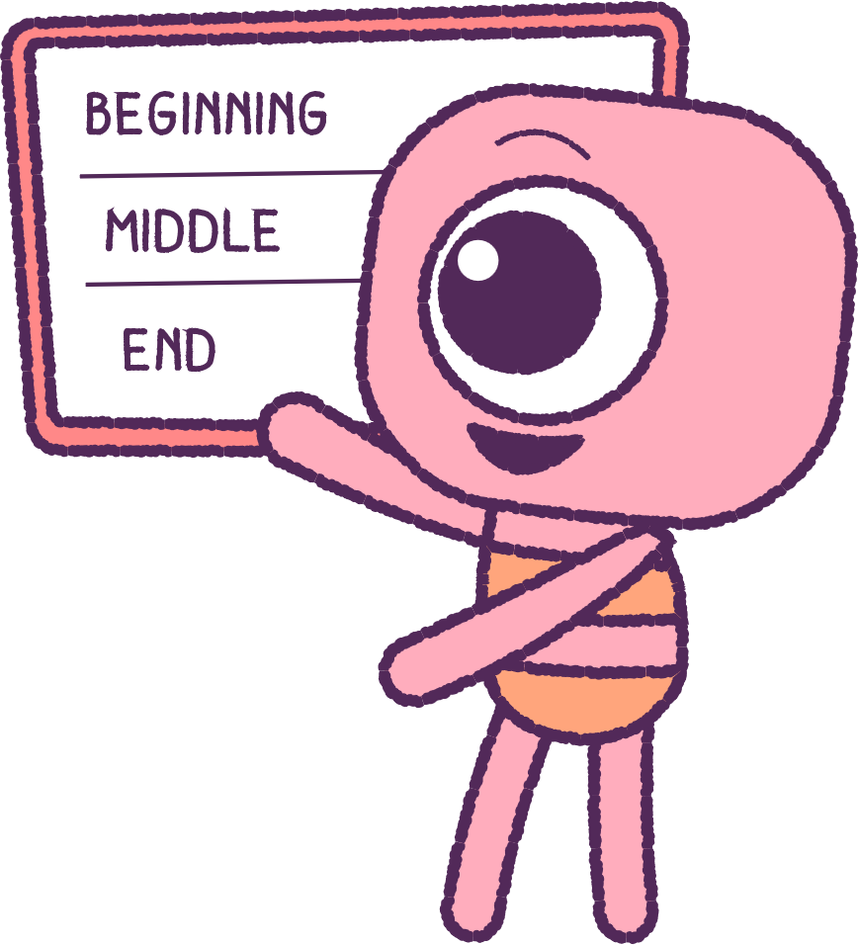
Part 2: Continued
Watch the ‘Lighthouse' animation carefully.
As a class group, create a ‘story board.’
Peeps storyboard:
What happened at the beginning, middle,
and end?
Feels storyboard:
What happened at the beginning,
middle, and end?
Add those feelings to your story board and write them in your ‘Wellbeing dictionary’.
5

Slide 6

Part 3: Discuss Online Experiences
Think about the time that you spend online,
whether it is for school or for your own enjoyment.
Can you remember the emotions and feelings that
you have experienced, while you were online?
Try to think about the types of these emotions
and feelings.
Were they strong emotions?
Were they good/bad/confusing etc.?
Write a list of all these emotions and feelings as a
table or list.
6

Slide 7
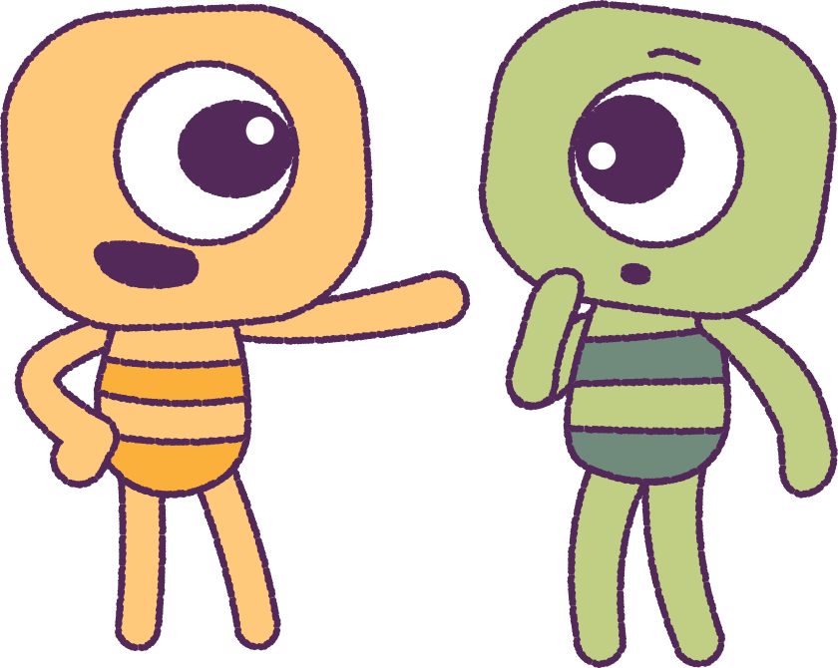
Part 3: Continued
Think about time that you spend online and the things that you choose to do online.
What are some of the things that you do online
or see online that cause you to experience bad emotions or feelings?
Talk with your classmates about these emotion
‘triggers’ and see if you have any in common with others in the class.
• Is it a comment/post about your online content?
• Is it a hurtful meme?
• Is it a hurtful picture?
• Is it being ghosted/excluded from a group
game or chat room?
7

Slide 8
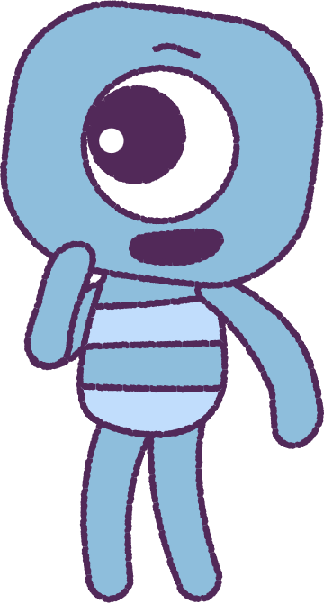
Part 4: Emotional Strategies
1. Take a large breath and count to ten.
2. Breathing slowly and breath out on even
numbers until you have reached ten. You can do
this so that you do not immediately respond to
comments while experiencing strong emotions.
3. Think ‘outside the square’. Ask yourself what was
intended and the meaning behind the comment
or message sent. Ask yourself if you know the
person or their intention.
4. Ask for help and support from your parents or
a trusted adult.
5. Get ‘offline’ and do something with a friend or
family member, to remove yourself.
8

Slide 9
This is the end of Lesson 2.
Great work!

