Slide 1

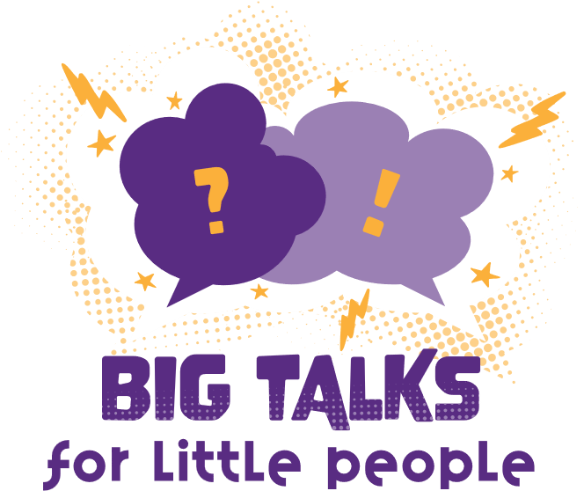




Professor Shane Pill (PhD) Professor Phillip Slee (PhD)
Associate Professor Deb Agnew (PhD) Dr Amy Wright (PhD)
Jessica Skuza (Research Assistant)

Slide 2
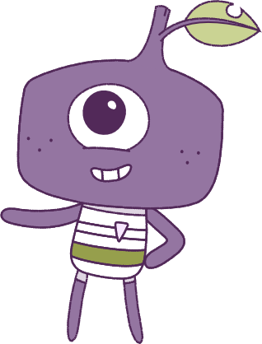




Lesson 3
Emotions
Lesson aims:
1.
Explore the value of social connection by building the concept of what ‘health’ entails
and the importance of social connection.
Lesson aims:
Apply strategies to manage emotions
and analyse how emotional responses influence interactions.
2.
Build social skills to make and strengthen relationships.
1.
Learn how success and challenges
can strengthen resilience. Learn how
to build up personal abilities.
3.
Analyse how behaviours influence the
health, safety, relationships and wellbeing
of individuals and communities.
2.
Discuss the importance of other people, their needs, emotions,
and more.
3.
Analyse the influence that choices have
on developing personal qualities and
identify areas for growth.
4..

Slide 3
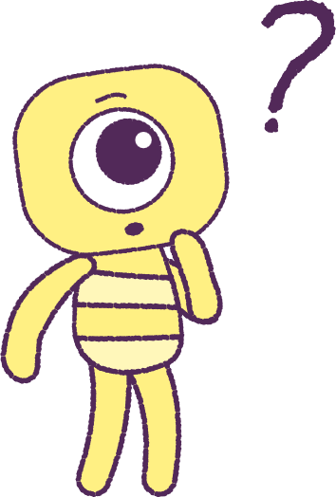

Part 1: Review content from last week
Who can remember what we discussed last week?
In our session today, we will talk more about emotions.
Lets get ready to look at the animation!
3

Slide 4


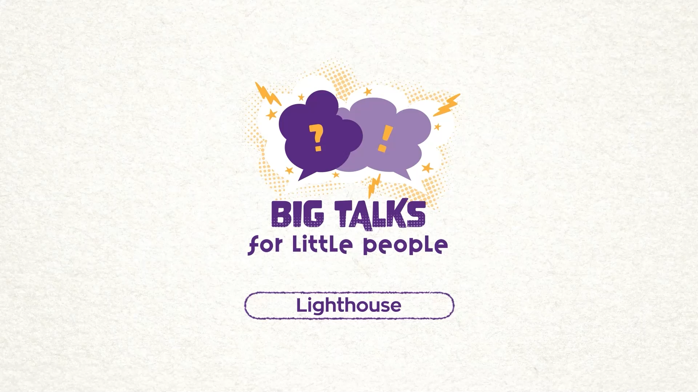

Part 2: Watch the animation
4
Hover your mouse over the video to view play settings. Otherwise, download from the website.

Slide 5
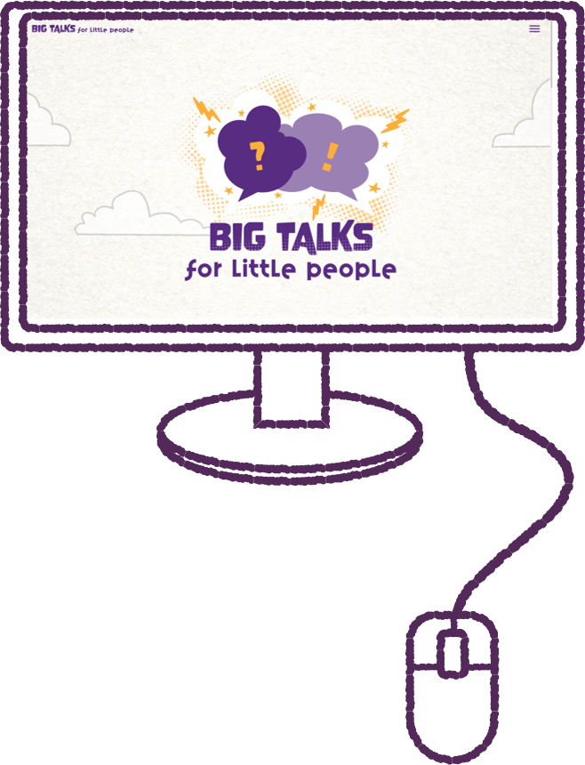
Part 2: Continued
Think about the time that you spend on devices,
whether it be a mobile phone, tablet or laptop.
How much time, do you think, is a ‘healthy’ and acceptable amount of time to be spending online
a day?
Record these times, so that you can compare your answers with your classmates.
5

Slide 6
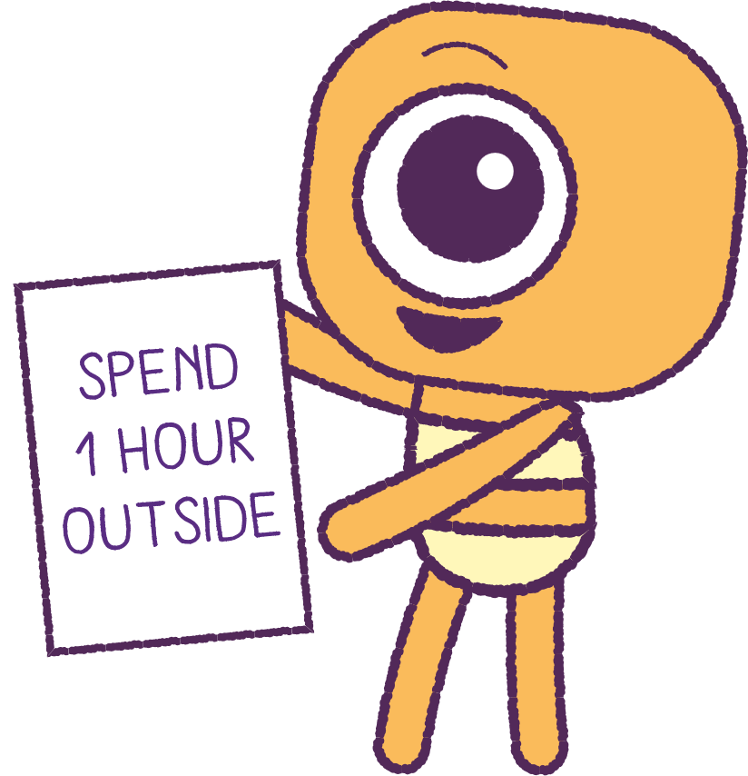
Part 2: Continued
You can access the Australian E-safety website which has some great tips for managing your time online.
https://www.esafety.gov.au/young-people/balancing-your-time-online
Make a list of rules for yourself when online,
that you think, are important to manage and care for your ‘health’ and ‘wellbeing’.
How should you behave online?
6

Slide 7
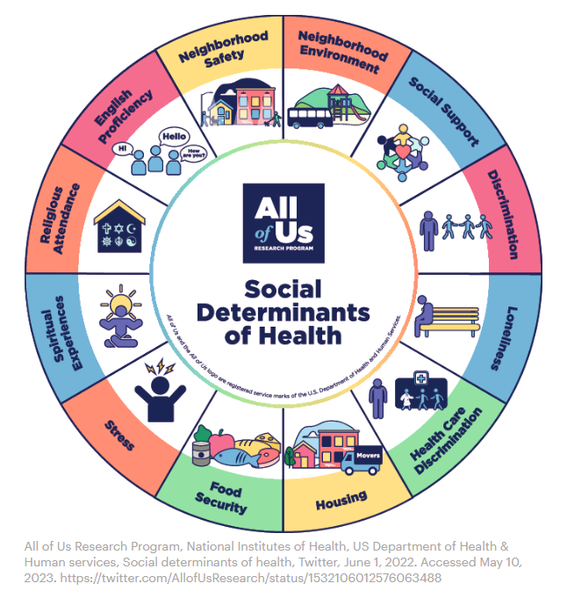
Part 3: Infographic Discussion
The wheel diagram shows some important things
that help us to maintain our overall ‘Health’.
There are physical things our body needs. And there
are social things we need, like connections/friendships.
Some things that can improve our ‘Health’ are:
• Social support (having people around us to help)
• Neighbourhood safety
• Food security (having enough to eat)
Some things that can harm our ‘Health’ are stress
and loneliness.
Make a list for yourself of things that are important to
you, to keep yourself healthy. (physically and socially.)
7

Slide 8
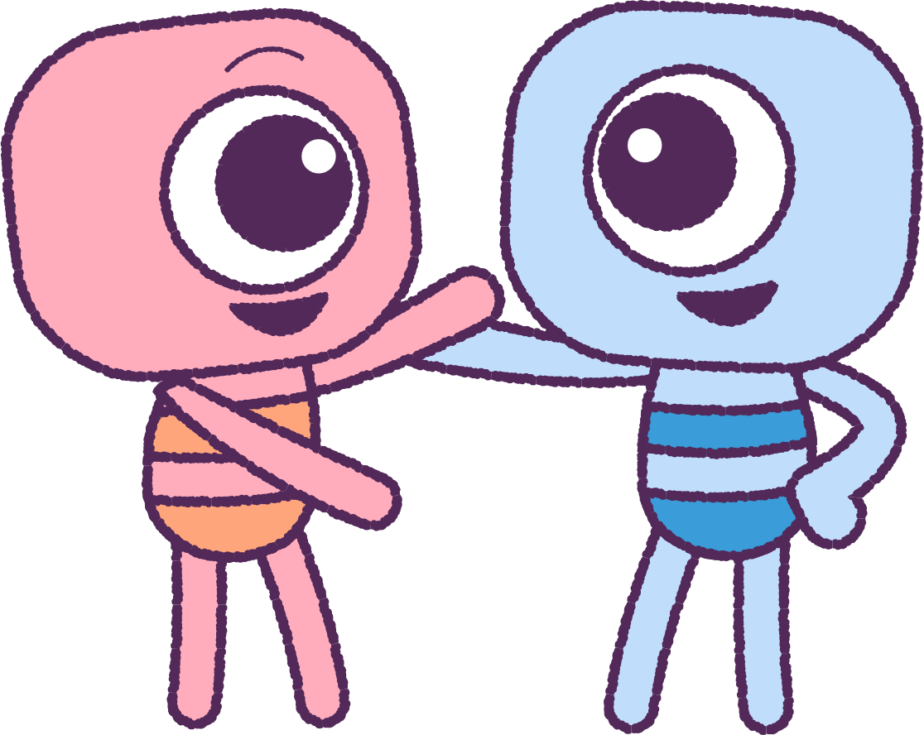
Part 3: Continued
Humans are a social species that like to live with
and be around other people.
Can you list other mammals and animals that are social species?
Think about how they depend on one another for survival. Think about things like:
• Social systems and family structure
• Distribution of food
• Sharing and connecting with other members of the
group or family.
How would a human manage or survive alone?
Think about and discuss the challenges and hardships that would happen if you were alone for a long time.
8

Slide 9
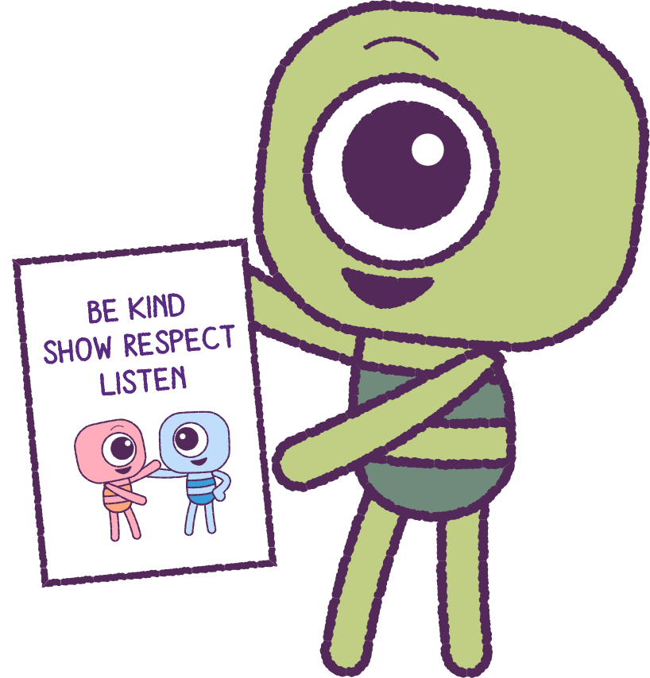
Part 4: Make an infographic
Think about all the ways that people help each other and contribute to one another’s ‘Health’.
• What do you do for others?
• What do you say to others?
• How do you help others?
• Why do you help others?
• What do people need the most?
Think about the physical factors and emotional factors that are important to have good ‘Health’
and Wellbeing.
Create an Infographic Poster to clearly show what you have learnt about what it means to have good ‘Health’ and ‘Wellbeing’.
9

Slide 10
This is the end of Lesson 3.
Great work!

