Slide 1






Professor Shane Pill (PhD) Professor Phillip Slee (PhD)
Associate Professor Deb Agnew (PhD) Dr Amy Wright (PhD)
Jessica Skuza (Research Assistant)

Slide 2
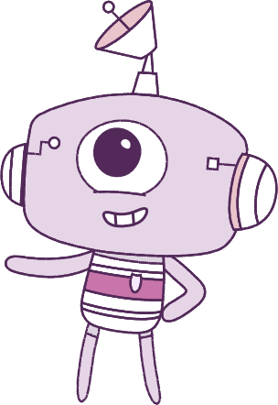




Lesson 4
Lesson 4
Resilience
Self-Concept
Lesson aims:
Lesson aims:
1.
Further develop skills in emotional awareness and regulation to practise demonstrating empathy and promote resilience.
1.
Practise ways to know about your emotions before you act on them.
Describe and demonstrate how respect
and empathy can be expressed to
positively influence relationships.
2.
2.
Learn how different situations can
affect our emotions.
3.
Let’s think about ways to make kind and respectful friendships.
Identify and practise the behaviours
people demonstrate when treating
others in respectful ways.
3.

Slide 3
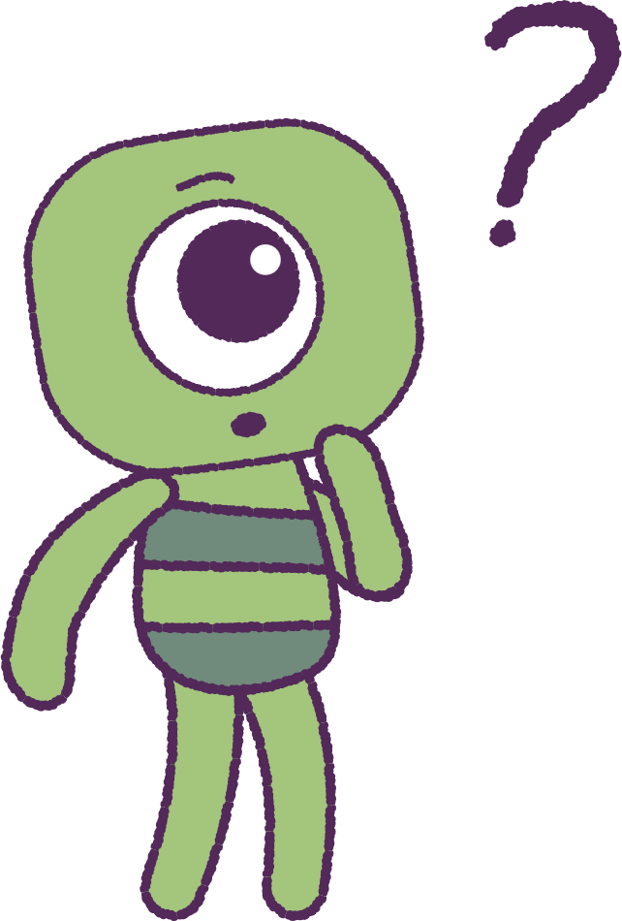

Part 1: Review content from last week
Who can remember what we discussed last lesson?
In our session today, we will talk more about resilience.
Let’s get ready to watch the animation!
3

Slide 4


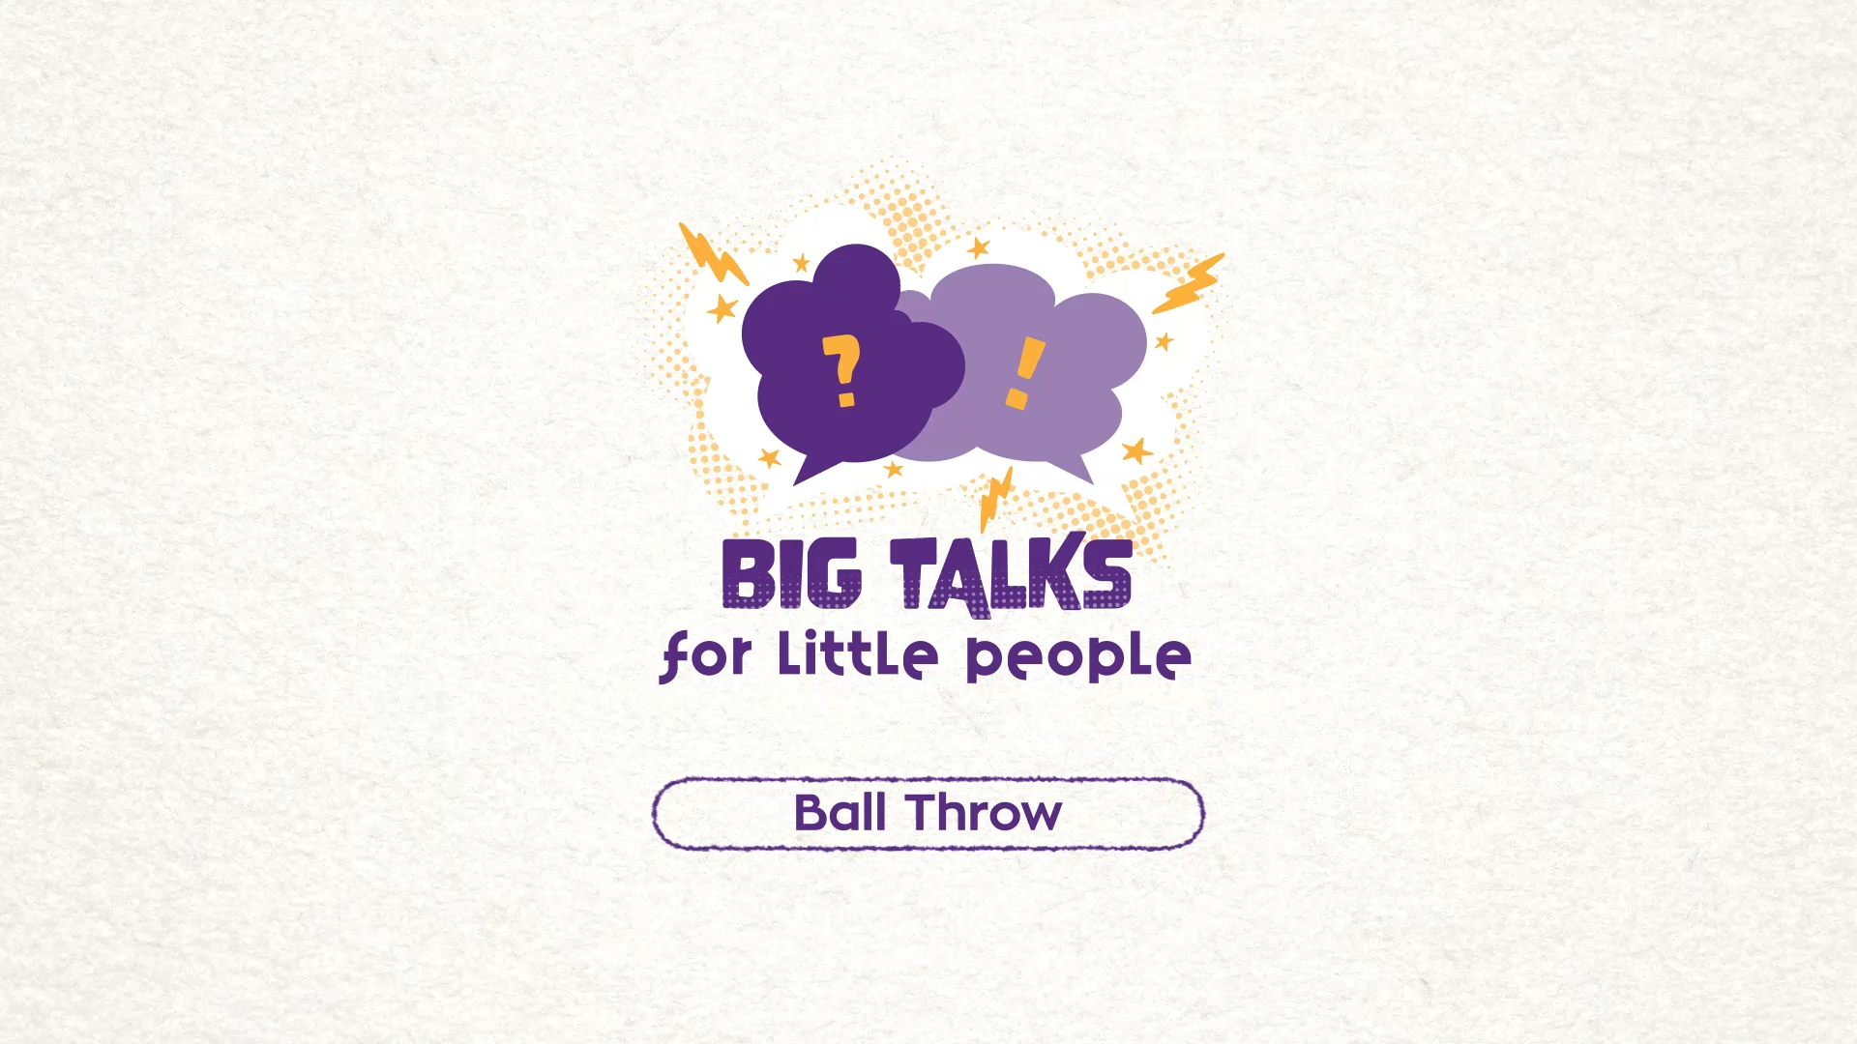

Part 2: Watch the animation
4
Hover your mouse over the video to view play settings. Otherwise, download from the website.

Slide 5
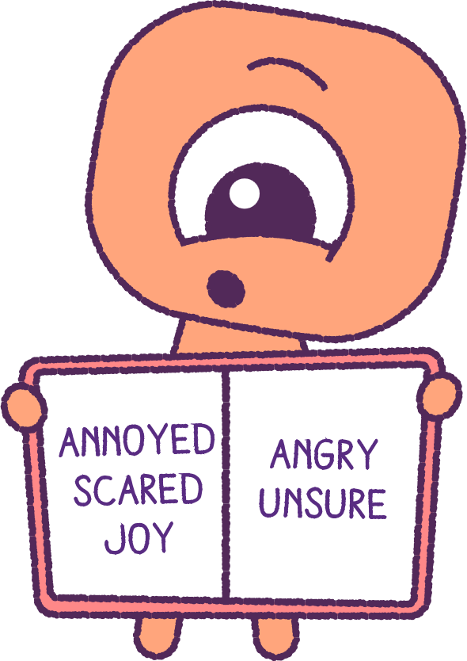
Part 2: Continued
Watch the animation several times.
Note down in your ‘Wellbeing dictionary’,
the emotions and feelings that you can see
and identify.
Compare your list with other classmates
in the class.
5

Slide 6
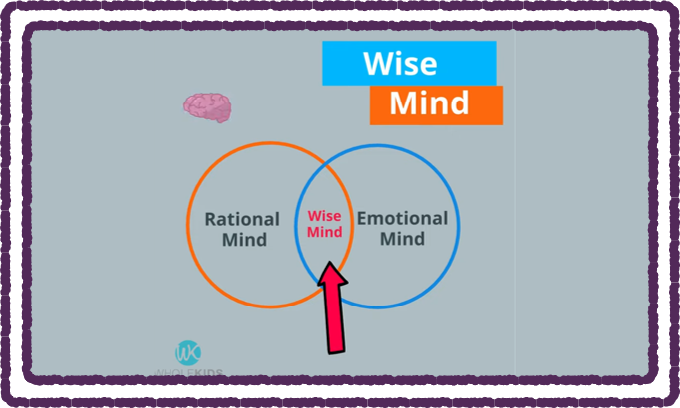
Part 3: Venn Diagram Video
Watch the video ‘Wise Mind’ in the link below.
https://www.youtube.com/watch?v=QHha2e9b9UA
This video talks about our 3 mindsets:
Rational Mind
The decisions based on fact and logic.
Emotional Mind
When our thinking and behaviours come from how we feel. We can feel positive and negative feelings.
Wise mind
The combination of our thinking ‘rational mind’
and our feeling ‘emotional mind’.
6

Slide 7
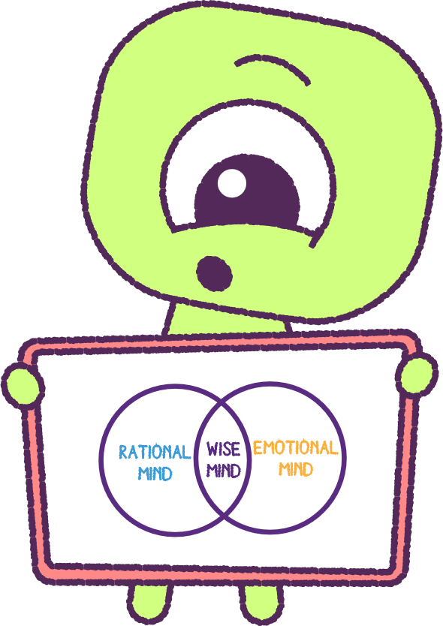
Part 3: Continued
Your teacher will draw a ‘Wise Mind' Venn diagram as
was shown in the ‘Wise Mind’ video.
Think of examples of situations where you would use
your ‘Rational Mind’ and your ‘Emotional Mind’.
Record these examples on your Venn Diagram.
How long does the ‘Emotional’ experience last?
Try to think of some examples of when and where an emotion may pass over quickly. E.g. Someone took a cake from your plate without asking.
Think of some examples of when and where an
emotion may last a much longer time. E.g. You may not have been picked for a sporting event.
7

Slide 8
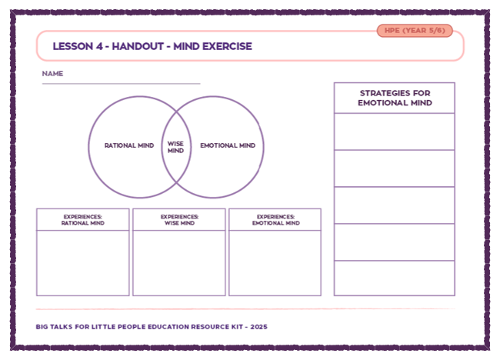
Part 4: Venn Diagram Activity
Your teacher will hand out a ‘Venn Diagram’
activity worksheet.
Record your experiences of when you have used your:
• Rational Mind
• Emotional Mind
• Wise Mind
Record your strategies to help self-regulate
(Calm down, cool off and think about things)
when you are in an ‘Emotional Mind’. E.g.
• Breathe slowly and count - wait for the strong
emotion to pass.
• Talk to someone about how you are feeling.
• Try another activity that you like doing for a while.
8

Slide 9
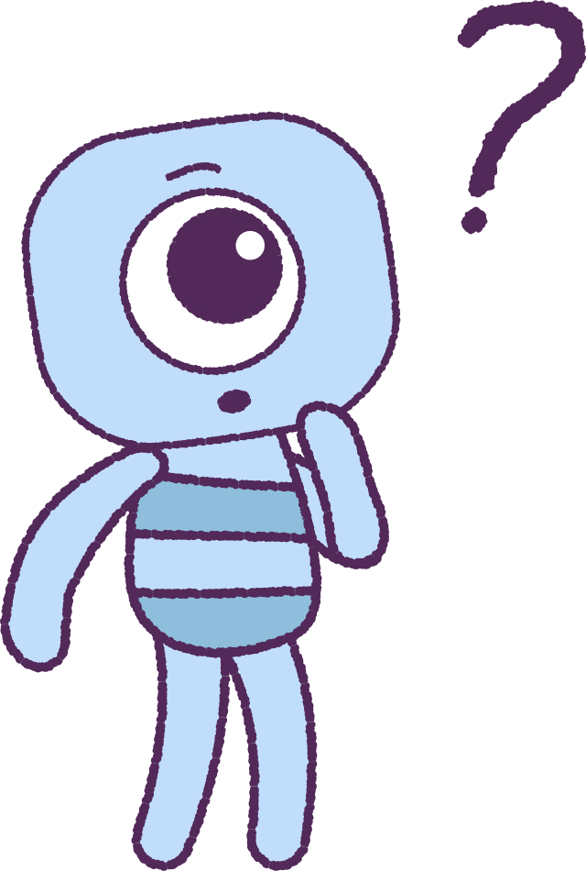
Part 5: Class Discussion
Watch the animation again.
Now discuss as a class how the outcome could have been different for Stalk, if they had used a strategy to manage their feelings.
While listening to the class discussion, write any additional words that come to mind in your wellbeing dictionary.
9

Slide 10
This is the end of Lesson 4.
Great work!

