Slide 1






Professor Shane Pill (PhD) Professor Phillip Slee (PhD)
Associate Professor Deb Agnew (PhD) Dr Amy Wright (PhD)
Jessica Skuza (Research Assistant)

Slide 2
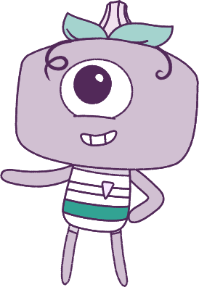




Lesson 5
Lesson 5
Lesson 5
Resilience
Self-Concept
Lesson aims:
Lesson aims:
Lesson aims:
1.
1.
Explore self-awareness of identity and the idea of self-concept to build resilience.
1.
Explore how to build identity,
and cope with various situations.
2.
Explore how identities can be influenced by people and places, and how we can create positive self-identities.
2.
2.
Learn how to strengthen resilience.
3.
3.
Explore the brain’s role in
controlling emotional responses.
3.
Learn how to practice good behaviours that contribute to positive outcomes.
Analyse the influence that choices have on developing personal qualities and identify areas for growth.
4.
4.

Slide 3
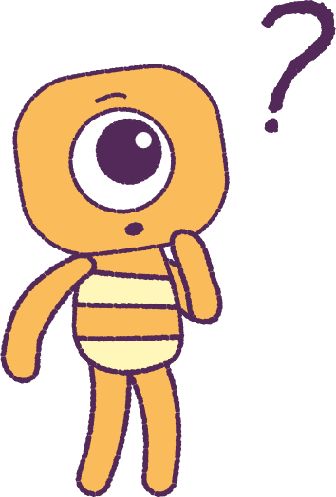

Part 1: Review content from last week
Who can remember what we discussed last lesson?
In our session today, we will talk more about resilience.
Lets get ready to look at the animation!
3

Slide 4


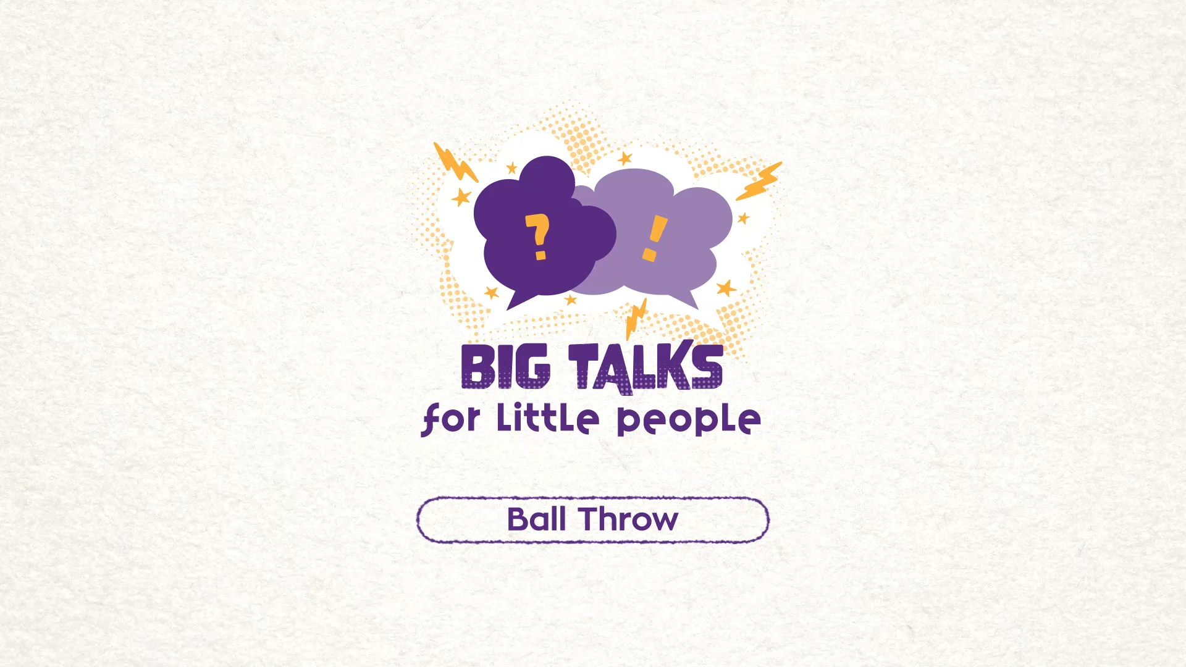

Part 2: Watch the animation
4
Hover your mouse over the video to view play settings. Otherwise, download from the website.

Slide 5
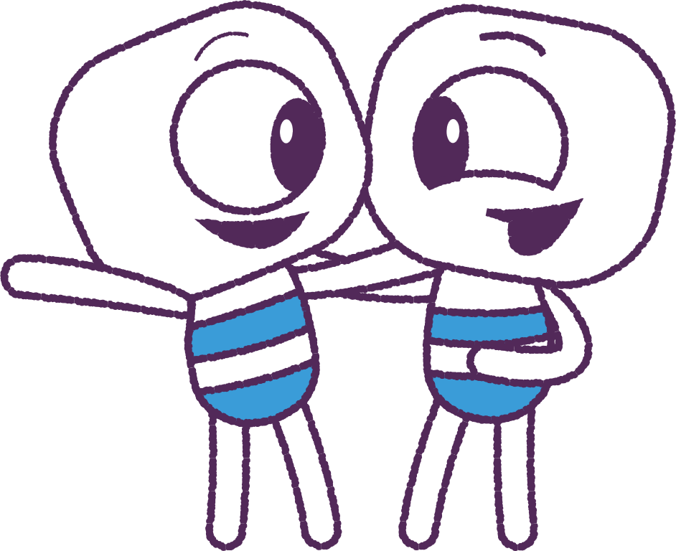
Part 3: Class Discussion
Work in small groups and discuss if there might have
been a better outcome if Stalk had used
their ‘Wise mind’ and acted with ‘resilience’.
How did Stalk’s actions and their ‘Feels’ match
in this story?
Stalk did not stop to think about their emotions,
or how they were treating others.
Did Stalk’s emotions cause them to act badly?
How might Stalk have felt about themselves if they had acted politely, taking turns with Elk to practise?
E.g. Proud, brave, confident, resilient, happy, satisfied?
5

Slide 6

Part 4: Youtube Videos
The Brain Basics videos, developed by ‘Kid’s Helpline’, explain how the brain controls our emotional responses
to stressful situations.
Learn some great tips for controlling emotions!
Brain Basics: Anxiety for Kids: with Lee Constable
https://www.youtube.com/watch?v=eD1wliuHxHI
Brain Basics: Anxiety for Kids (Part 3) : The fight, flight and freeze responses.
https://www.youtube.com/watch?v=8do0Jiscgsk
Brain Basics: Anxiety for Kids (Part 4) : Coping Strategies
https://www.youtube.com/watch?v=PsK3HejhOwc
6

Slide 7
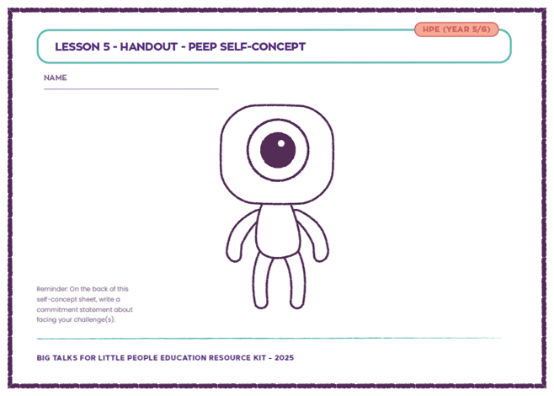
Part 5: Printout Activity
Your teacher will hand out a new ‘Peep’ Self-Concept task sheet.
Add designs to the blank ‘Peep’ to show things about your outer self that physically describe you.
Use the blank spaces on the sheet to describe the things that other people can’t see about you.
E.g.
• Can you describe things about your personality?
• Can you describe things about your thoughts?
• Can you describe things about your likes or fears?
7

Slide 8
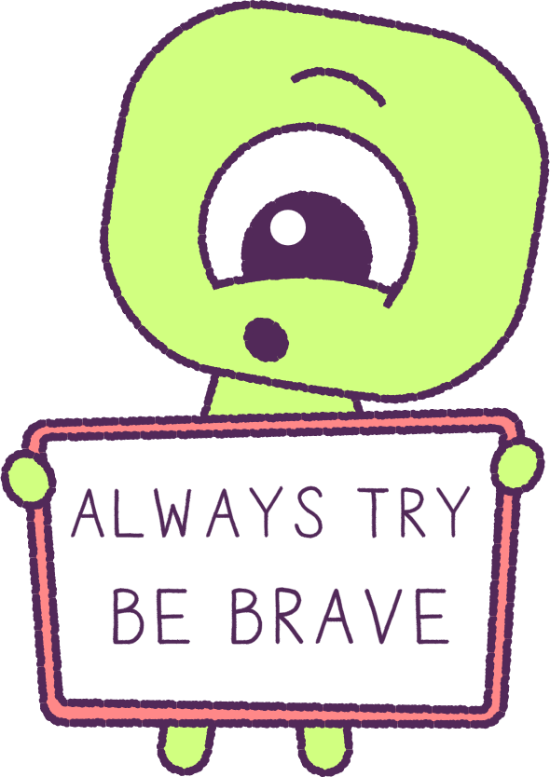
Part 5: Continued
Think about all the things that you have written that
make you a very special and unique person!
On the back of your ‘Self-Concept’ drawing, write a note to yourself about a challenge that you want to overcome.
Think about how your ‘qualities’ (things that make you unique and special) can help you to achieve
that goal.
When we manage our emotions, we can achieve our goals, keep ourselves safe, and keep others around us safe too.
8

Slide 9
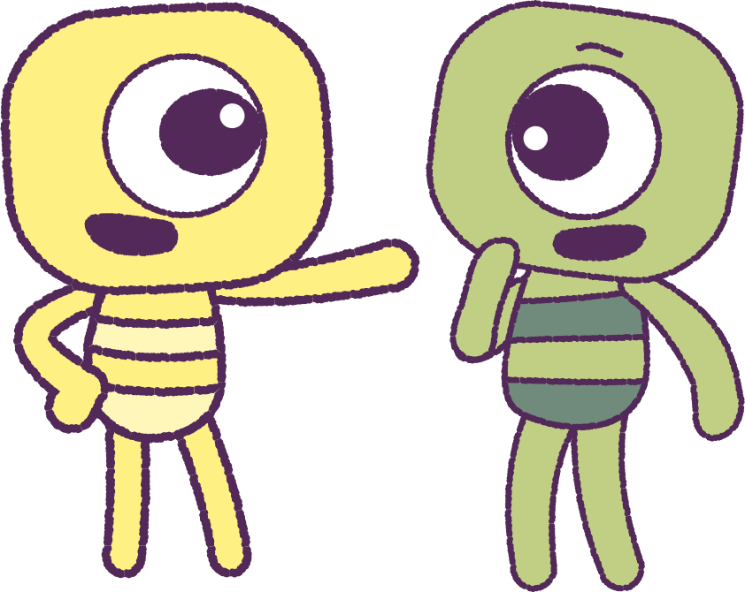
Part 6: Optional Class Activity
As a class, discuss some things that may be holding you back from achieving your personal goal/s.
Think of some strategies that may help you to overcome the things that may be holding you back at this time.
List some ways to be resilient every day.
9

Slide 10
This is the end of Lesson 5.
Great work!

