Slide 1






Professor Shane Pill (PhD) Professor Phillip Slee (PhD)
Associate Professor Deb Agnew (PhD) Dr Amy Wright (PhD)
Jessica Skuza (Research Assistant)

Slide 2
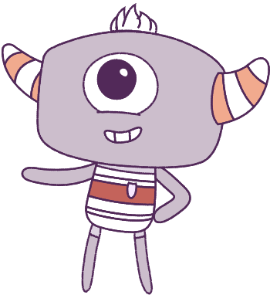




Lesson 6
Self-Concept
Lesson aims:
Discuss relationships and social awareness further, to explore and understand value of empathy.
1.
Develop and understanding around how respect and empathy can be expressed to positively influence relationships.
2.
3.
Enhance capabilities in social awareness and social management.

Slide 3
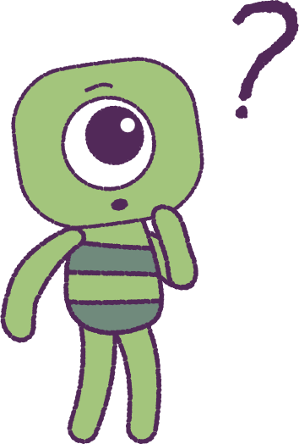

Part 1: Review content from last week
Who can remember what we discussed last lesson?
In our session today, we will talk more about self-concept.
Special note: Your teacher will also handout your “Self-Concept” task sheet from the previous lesson.
3

Slide 4


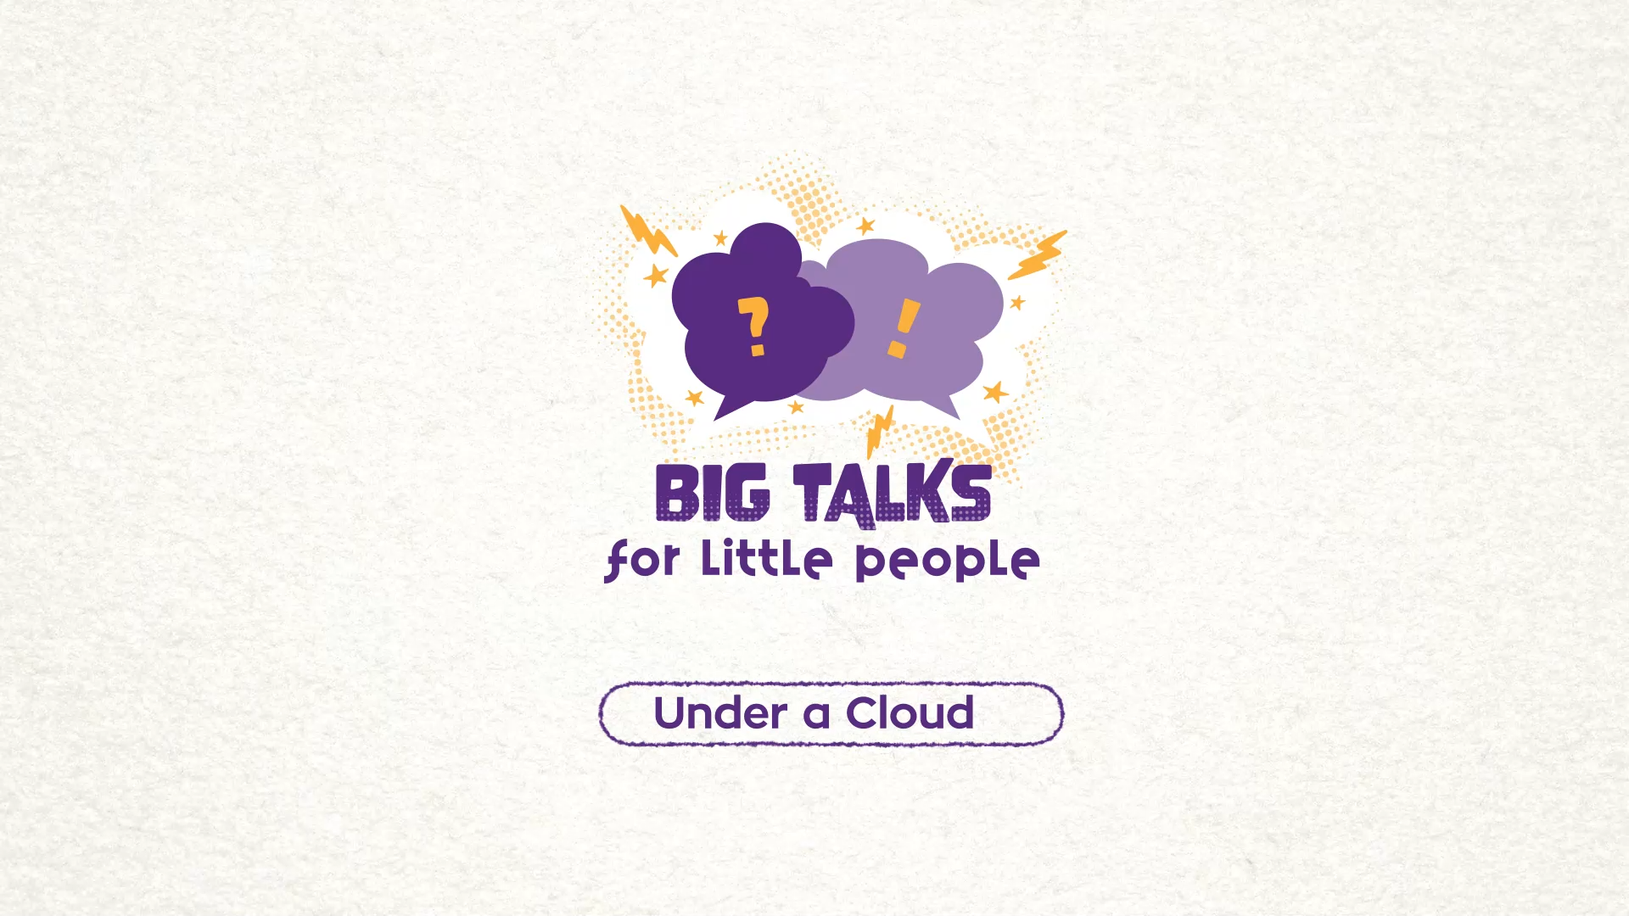

Part 2: Watch the animation
Hover your mouse over the video to view play settings. Otherwise, download from the website.
4

Slide 5
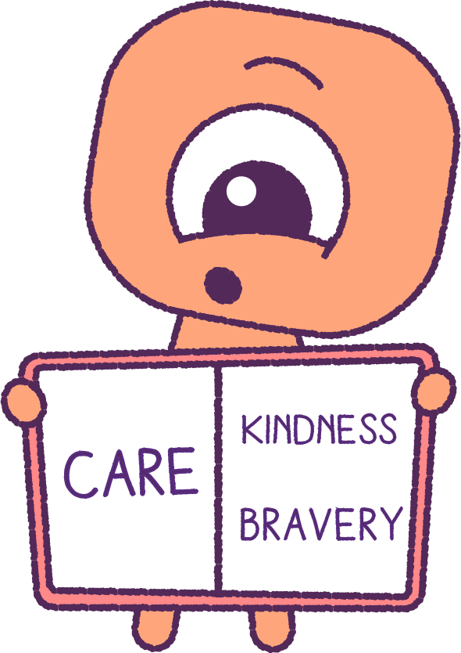
Part 2: Continued
When watching the animation, how many different feelings and emotions can you identify? Record these in your ‘Wellbeing Dictionary’.
As a class discuss:
• What do you think the ‘Peep’ Pan was feeling?
• Why was Pan feeling this way?
• Can you think of a time when you felt like Pan?
• What situations and events created these feelings?
What do you think of the ‘Peep’ Brim’s actions
in the animation? Why did Brim act in this way?
List the feelings, skills, and social values you see Brim demonstrating. (i.e. care, kindness, bravery).
5

Slide 6
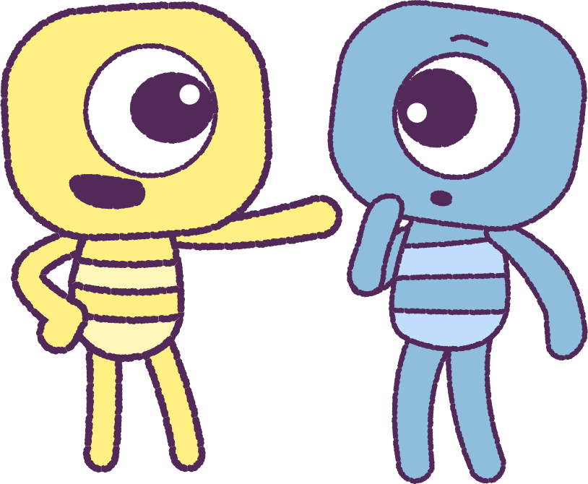
Part 3: Understanding Empathy
Let’s understand what empathy means. The definition of ‘Empathy’ from the Merriem-Webster Dictionary:
“The action of understanding, being aware of, being sensitive to,
and vicariously experiencing the feelings, thoughts and experiences
of another."
We can build ‘empathy’ by trying to understand
and care about the feelings of others.
Have you shown empathy before?
• Share some examples with your class of times
when you have shown ‘Empathy’.
• Explain the outcome of your actions.
• Explain how you were able to understand, help and
comfort the other person.
6

Slide 7
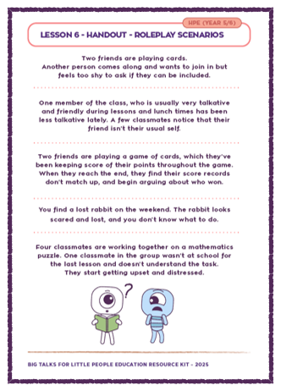
Part 4: Roleplay Scenarios
Your teacher will give you roleplay scenarios.
Form small groups.
When your groups are established, take turns to
act out the different scenarios.
Pause at certain points.
When paused, brainstorm how the actors in the scenarios could use and show empathy.
7

Slide 8
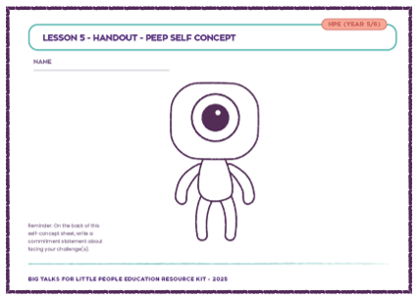
Part 5: Self-Concept Worksheet
Return to your self-concept worksheet from last lesson. How would you like to be treated when you’re feeling sad or upset? Can you explain why?
Why is it important to think of other people’s feelings?
Can you think of ways to be kind to other people?
Make additions to your self-concept worksheet to
include ways that can you can show ‘Empathy’ and
how to care for others.
List the benefits (good things) for friends, family,
school and your wider community, when you show ‘Empathy’ and kindness to others?
Treat others as you would treat a good friend.
8

Slide 9
This is the end of Lesson 6.
Great work!

