Slide 1





Professor Shane Pill (PhD) Professor Phillip Slee (PhD)
Associate Professor Deb Agnew (PhD) Dr Amy Wright (PhD)
Jessica Skuza (Research Assistant)

Slide 2
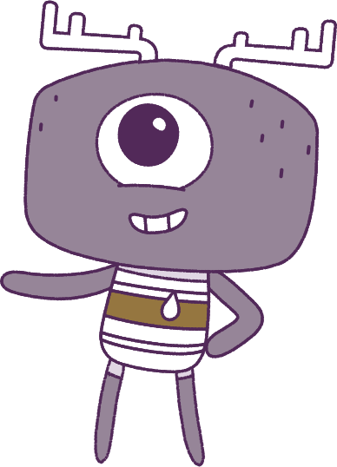




Lesson 7
Self-Concept
Lesson aims:
1.
Understand the importance of seeking help when experiencing strong emotions.
2.
Explore how respect and empathy can be expressed to positively influence relationships.
3.
Apply strategies to manage emotions and analyse how emotional responses influence interactions.
4.
Analyse the influence that choices have on developing personal qualities and identify areas for growth.

Slide 3
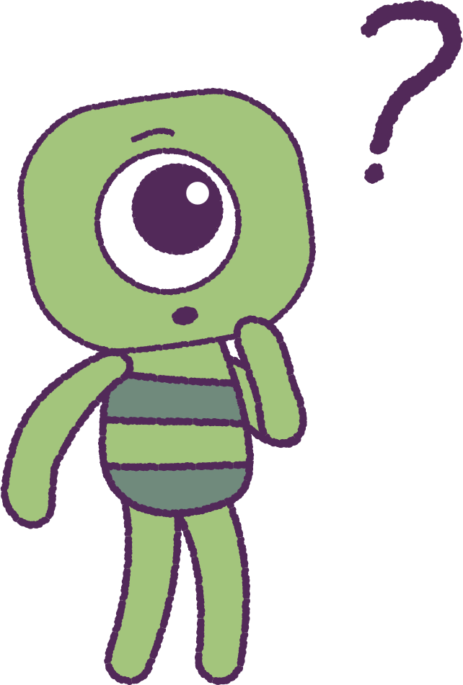

Part 1: Review content from last week
Who can remember what we discussed
last week?
In our session today, we will talk more about self-concept.
To help us complete these activities,
lets get ready to look at the animation!
3

Slide 4


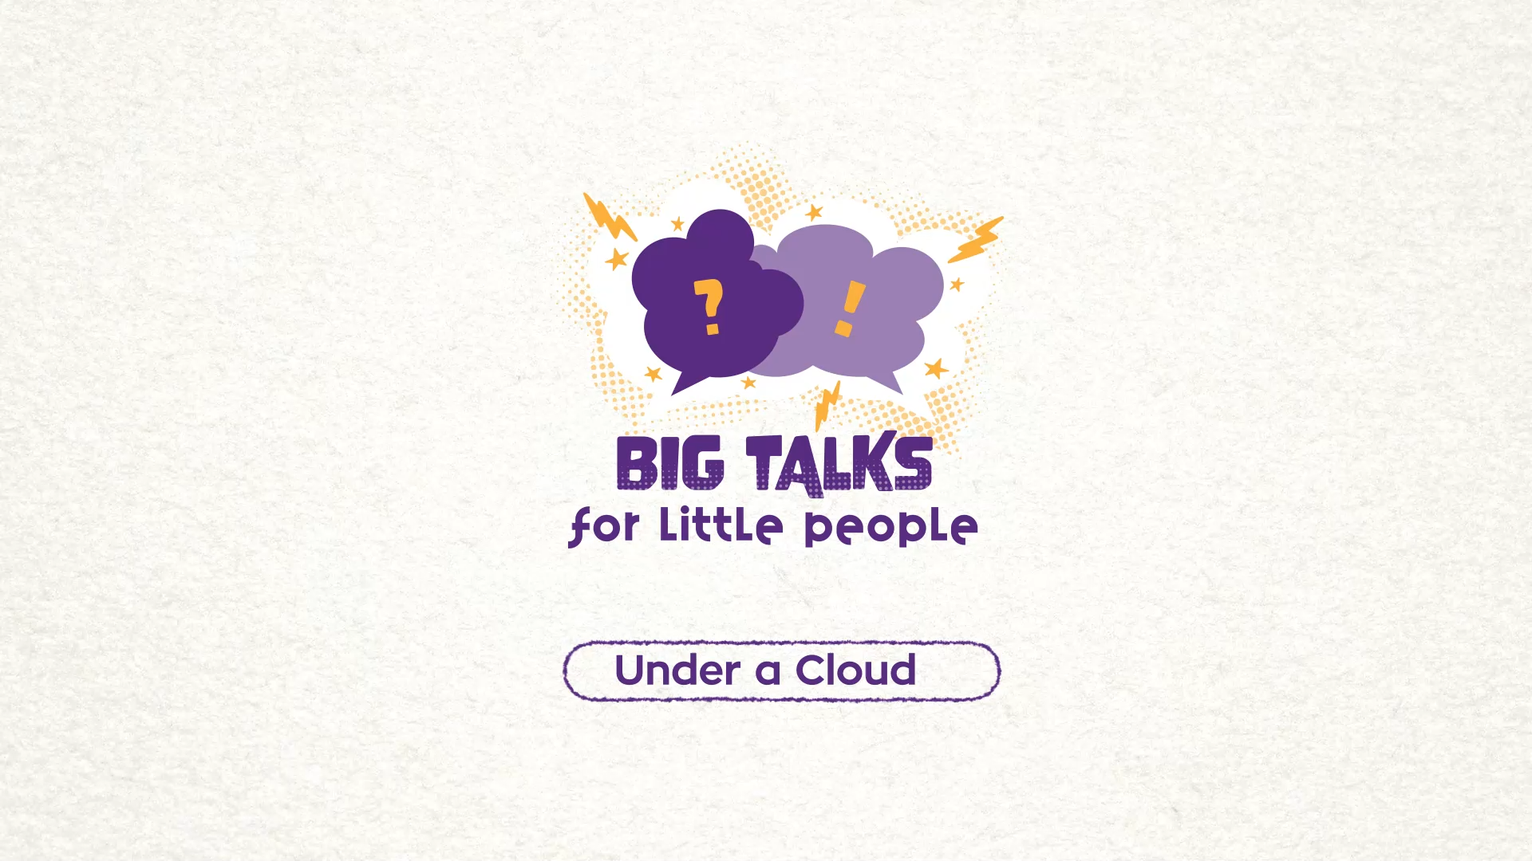

Part 2: Watch an animation
Hover your mouse over the video to view play settings. Otherwise, download from the website.
4

Slide 5
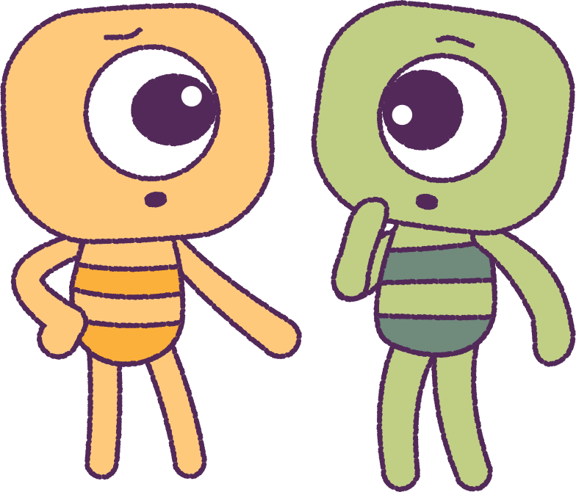
Part 2: Continued
Watch the animation ‘Under a Cloud’ again.
Focus on the ‘Peep’ - Pan, and the ‘Feels’
that change.
Get into groups.
In groups, talk about situations that made you feel sad in the same way, as though you were ‘under a cloud’.
5

Slide 6
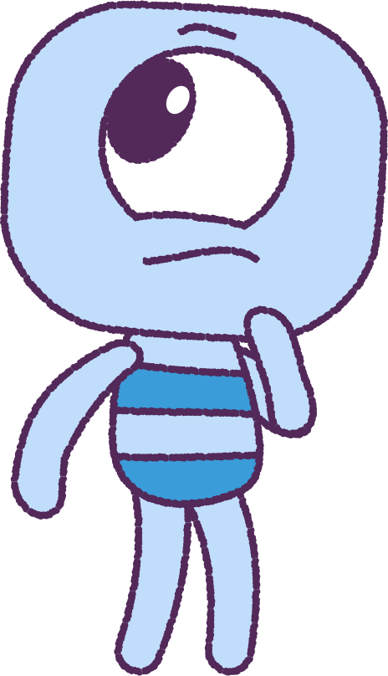
Part 3: Reflecting on Sad Experiences
Return to your workspace and write some notes about a time that you felt like Pan.
• Did other people know that you felt this way?
• Was there anyone to help you through the situation?
• If so, how did the other person help you?
Sadness is a normal emotion.
Everyone feels sadness sometimes.
You can learn ways to help manage your sadness.
A friend or trusted adult can help you.
6

Slide 7
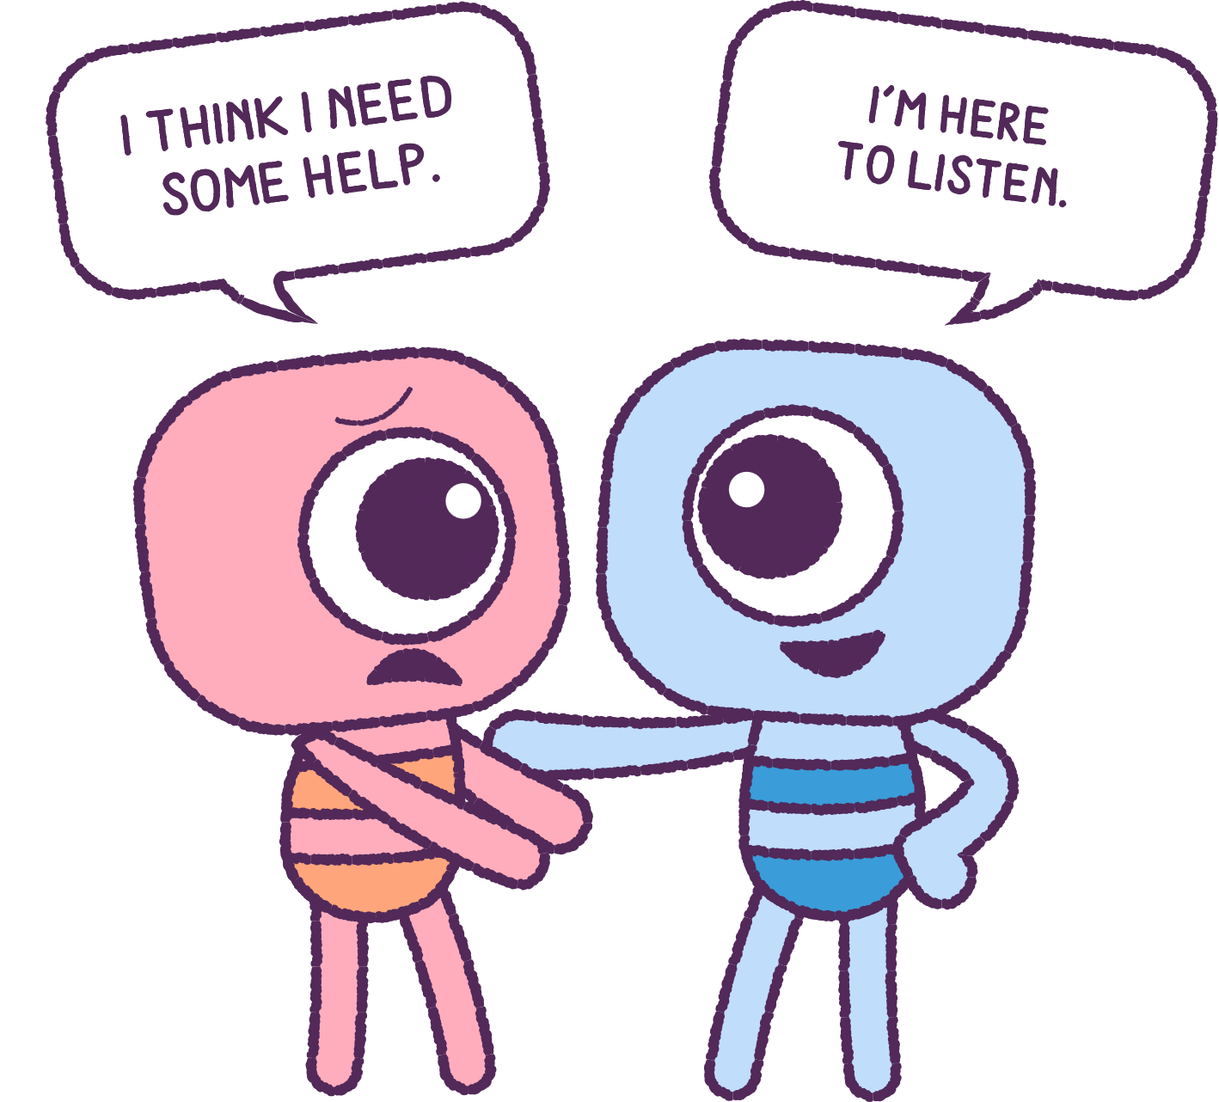
Part 4: Seeking Help for Sadness
Discuss some strategies and phrases for asking for help and make a list. You could try:
• “I have a problem, and I don’t know what to do.”
• “I need to talk to someone about what is going on.”
• “Can I make a time to talk to you? - I need help.”
• “I need to talk to you about something important.”
When you are feeling sad, it is important to
ask for help from a friend or a trusted adult.
On the classroom whiteboard, list the benefits of
seeking help and support from a friend.
In another column, list the benefits of seeking help
and support from a parent or another trusted adult.
7

Slide 8
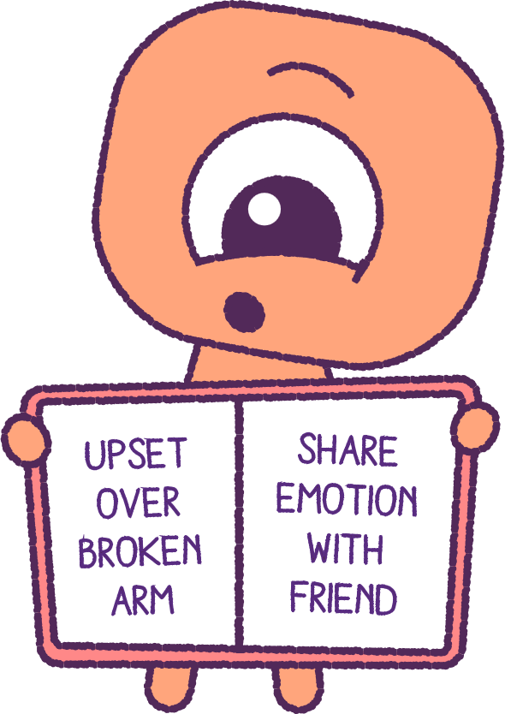
Part 5: Continue Reflection
To conclude, return to your workspace.
In a notebook, write about any other past experiences when you have felt sad.
Write about the ways in which you could have asked for help or sought support.
8

Slide 9
This is the end of Lesson 7.
Great work!

