Slide 1

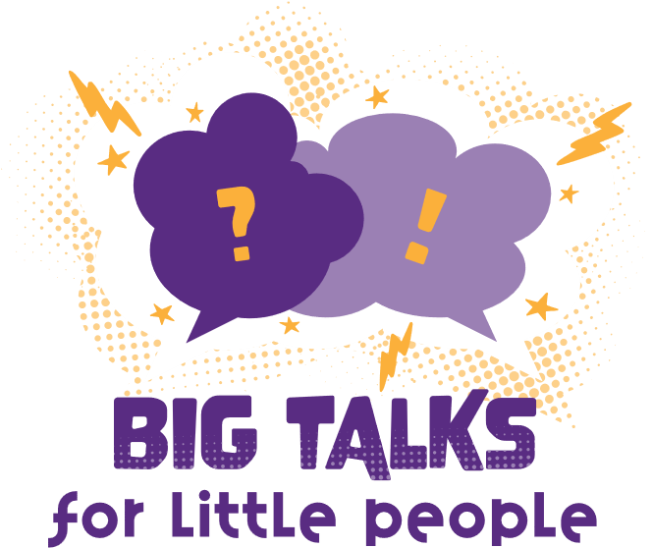



Professor Shane Pill (PhD) Professor Phillip Slee (PhD)
Associate Professor Deb Agnew (PhD) Dr Amy Wright (PhD)
Jessica Skuza (Research Assistant)

Slide 2
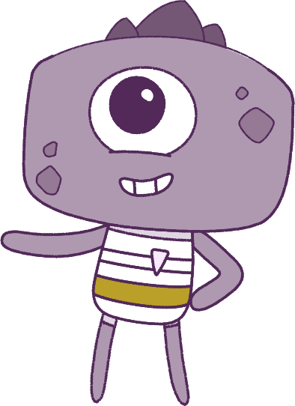




Lesson 8
Lesson 8
Conflict-Management
Resilience
Lesson aims:
Lesson aims:
1.
Explore strategies to identify, respond to and protect from cyberbullying attempts.
1.
Practise keeping calm in difficult situations.
Analyse and practise protective behaviours and help-seeking strategies that can be used in a range of online and offline situations.
2.
2.
Learn how situations can change your emotions.
Understand digital literacy, digital safety and wellbeing; and how to manage online safety.
3.
Learn about how to keep safe, look for help, and what makes others special.
3.

Slide 3
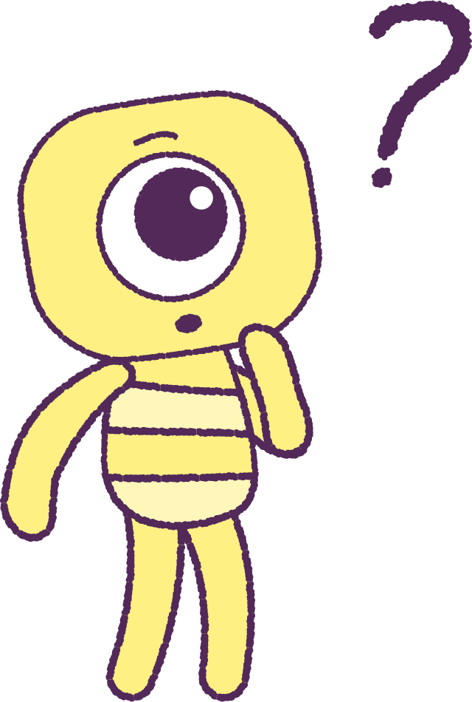

Part 1: Review content from last week
Who can remember what we discussed
last week?
In our session today, we will talk more about conflict-management.
3

Slide 4
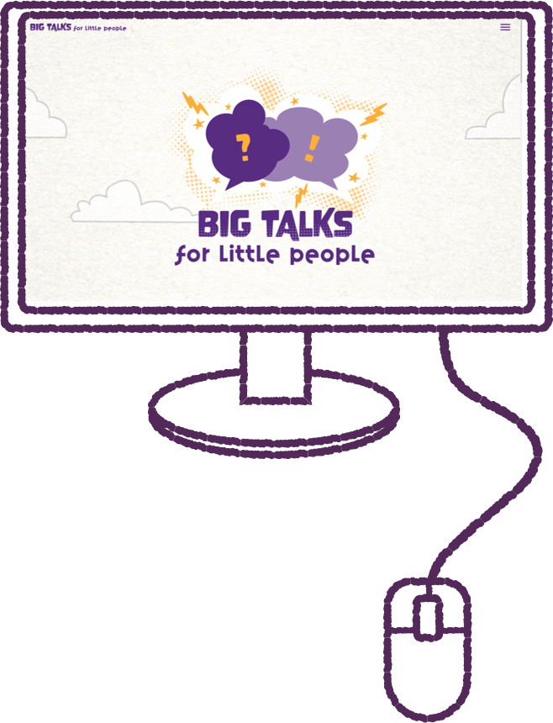
Part 2: Discuss Online Experiences
What kind of platforms do you use on the internet?
If you are not familiar with the platforms, your teacher will explain what they are, and what they are used for.
Create a list of the platforms you access.
Also discuss and record this as a class.
(E.g. TikTok, Instagram, YouTube, Discord).
Discuss negative comments you have noticed online.
Comments may even target a celebrity or influencer figure, and be picking on the way they look or the things they say.
Anybody who puts content on the internet can receive unkind comments from strangers … even people who are very famous!
2021
4
2021
Test
Test
4
4

Slide 5
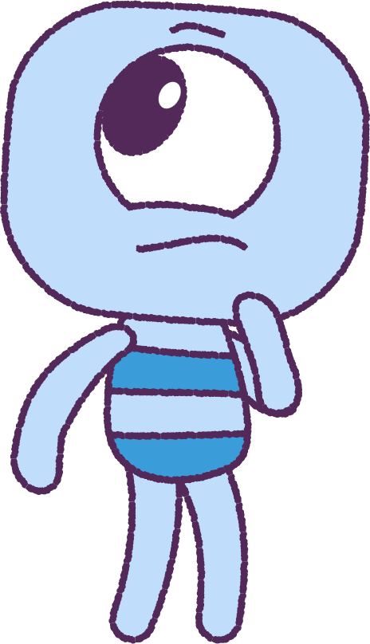
Part 3: Watch “Three Steps”
Watch the ‘Three Steps’ animation. (On the next slide).
In your ‘wellbeing dictionary’, write about how Crown
is reacting to the online content. Write the emotions
and feelings that Crown is having, while watching.
Watch the animation again. Discuss how you felt
after seeing what Crown had experienced?
Trying to feel and understand what someone else is feeling, is called having ‘Empathy’.
Discuss if you have seen people in the real life, act
and speak online, like they do in the animation.
Discuss if you have seen or heard something online from someone that you thought was a friend, and that you thought was normal, but it was in fact inappropriate, hurtful or harmful.
2021
5
2021
Test
Test
5
5

Slide 6


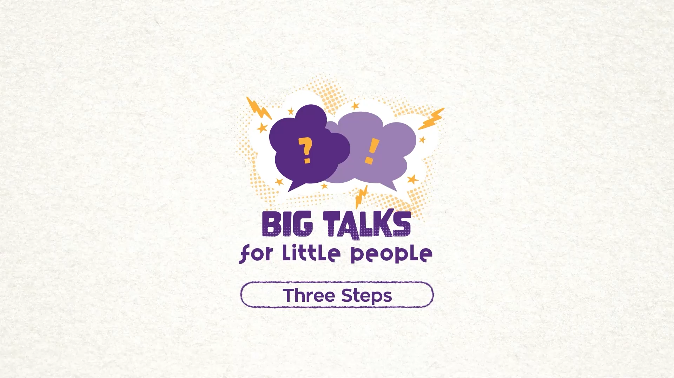

Part 3: Watch the animation
6
Hover your mouse over the video to view play settings. Otherwise, download from the website.

Slide 7
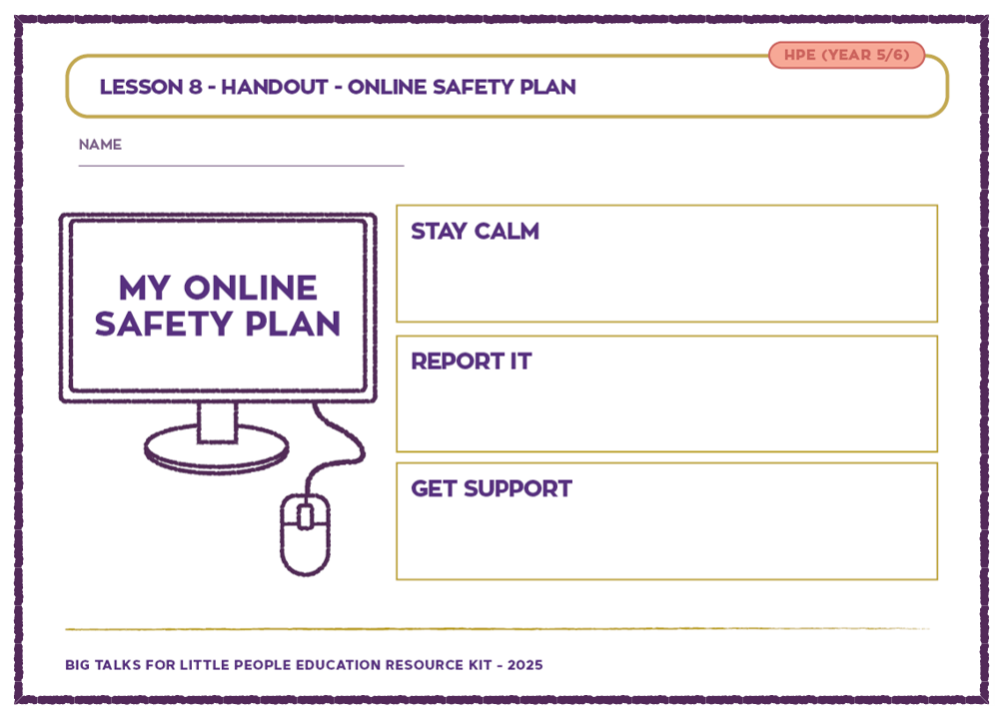
Part 4: Online Safety Plan
Nemours KidsHealth Website:
“Cyberbullying is the use of technology to harass,
threaten, target or embarrass another person.
Online threats and mean, aggressive and rude texts, tweets and messages all count…. So does posting personal information, pictures or video, designed to hurt or embarrass someone else.”
Your teacher will give you an ‘Online Safety Plan’ worksheet.
Make up your own individual strategies (good action plans and ideas) for responding to cyberbullying.
Write clear actions and plans for each of the three sections: ‘Stay calm’, ‘Report it’, ‘Get support’.
2021
7
2021
Test
Test
7
7

Slide 8
This is the end of Lesson 8.
Great work!

