Slide 1





Professor Shane Pill (PhD) Professor Phillip Slee (PhD)
Associate Professor Deb Agnew (PhD) Dr Amy Wright (PhD)
Jessica Skuza (Research Assistant)

Slide 2
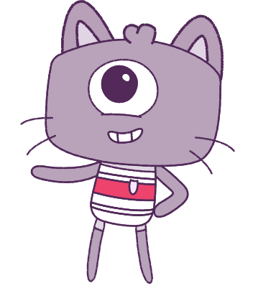




Lesson 9
Lesson 9
Conflict-Management
Resilience
Lesson aims:
Lesson aims:
Continue to build strategies against cyberbullying. Explore conflict management online and offline.
1.
1.
Learn how to control our emotions, make smart decisions, and treat others kindly.
Analyse and practise protective behaviours and help-seeking strategies that can be used in a range of online and offline situations.
2.
2.
Learn about how to keep safe, look for help,
3.
Analyse the influence that choices have on developing personal qualities and identify areas for growth.
3.
Describe the things that make us and others special.

Slide 3
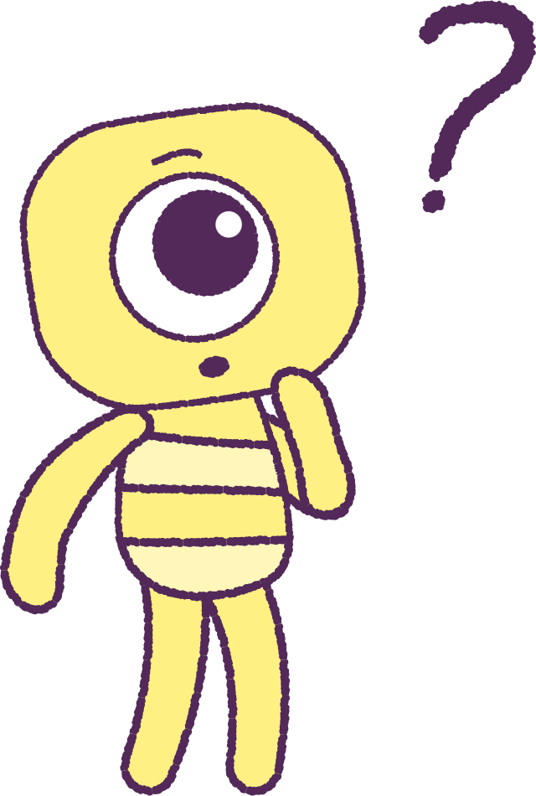

Part 1: Review content from last week
Who can remember what we discussed
last week?
In our session today, we will talk more about conflict-management.
Lets get ready to look at the animation!
3

Slide 4


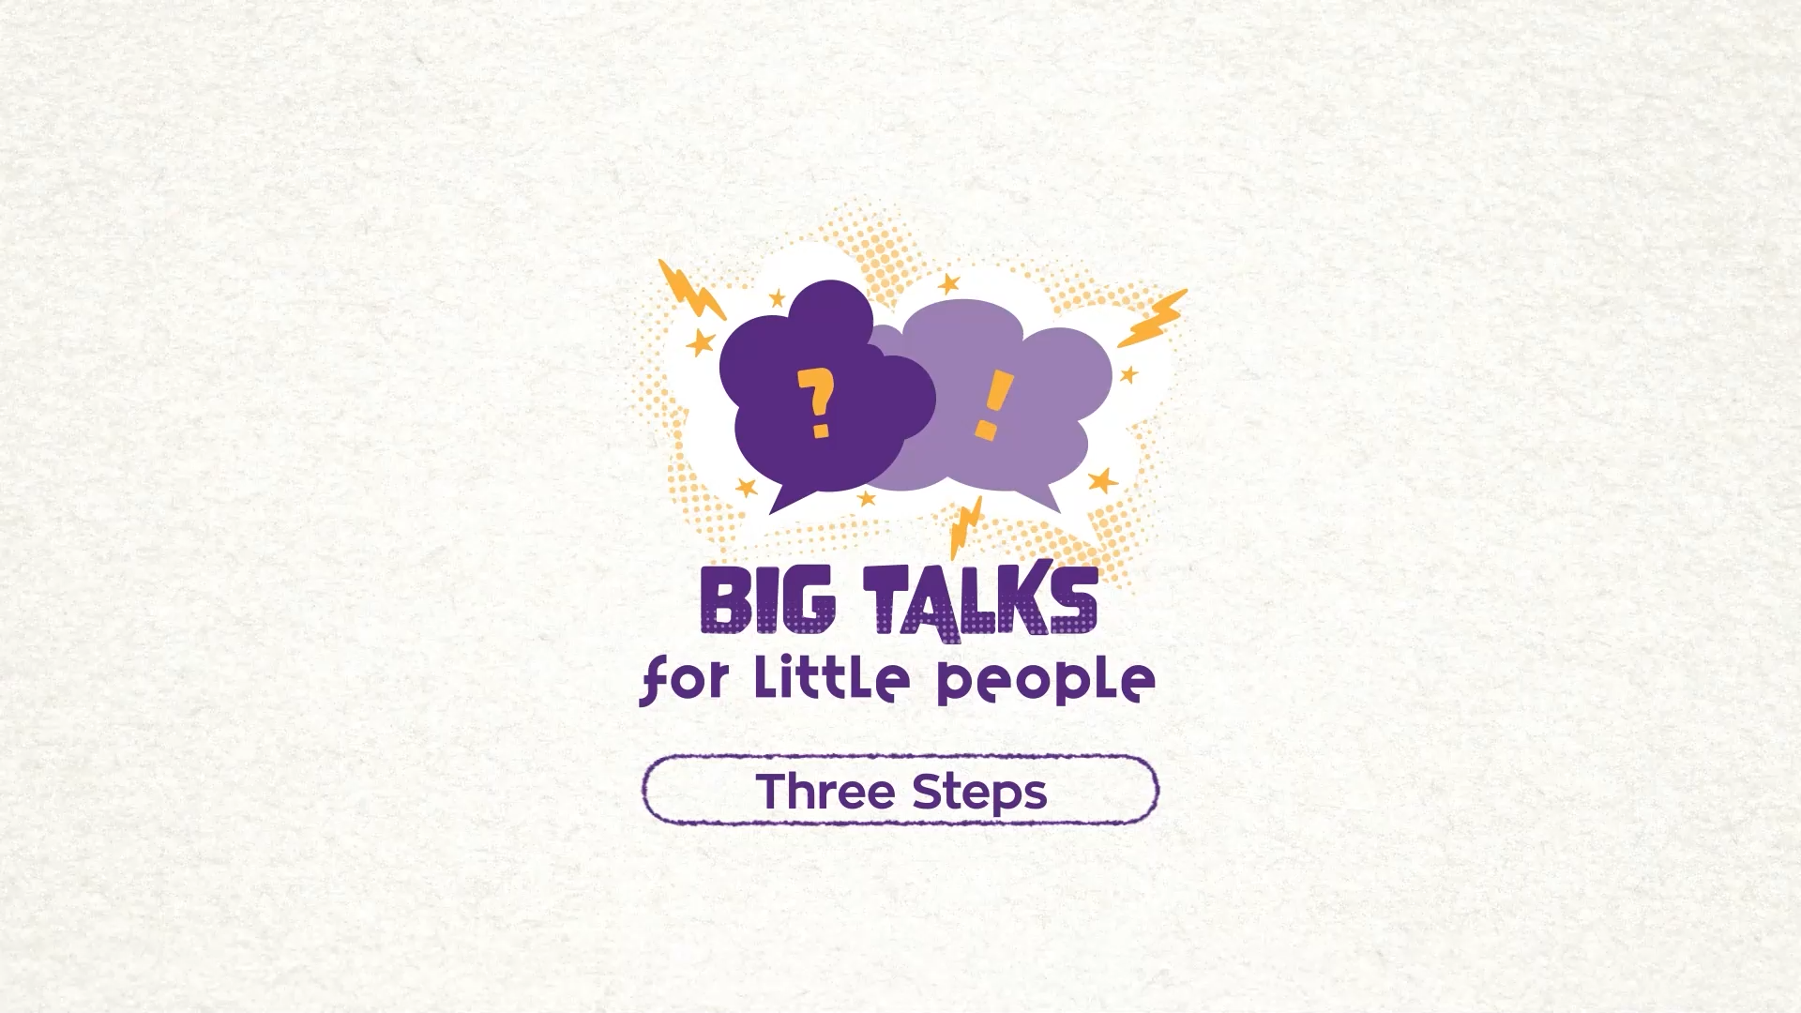

Part 1: Continued
Hover your mouse over the video to view play settings. Otherwise, download from the website.
4

Slide 5
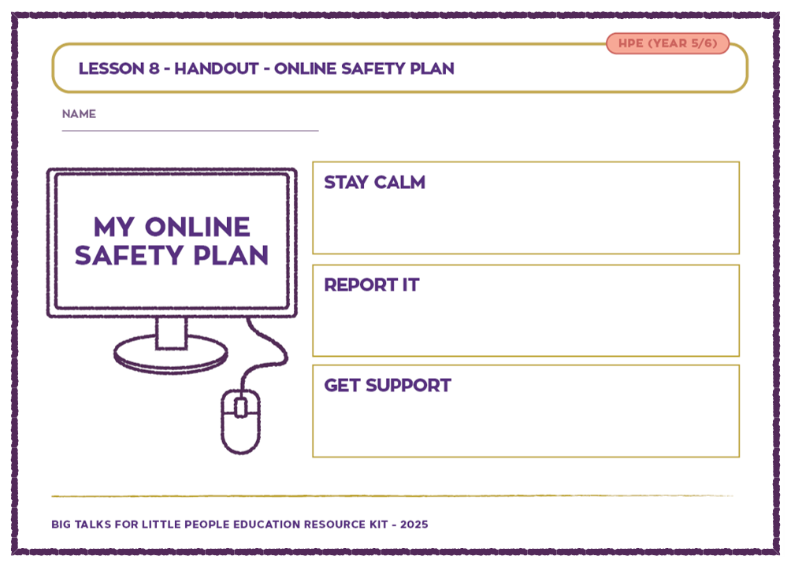
Part 2: Revisit Online Safety Plan
Revisiting your ‘Online Safety Plan’ from the previous lesson. What would you do if you saw a friend being excluded, bullied, or treated poorly online?
There are 3 different ways that we can respond to a conflict or fight.
• AVOID
• ATTACK
• PROBLEM SOLVE
What do you think these words mean when talking about a conflict or a difficult emotional situation?
• AVOID – someone may not want to get involved.
• ATTACK- someone may react strongly, without thinking
about the consequences of their actions.
• PROBLEM SOLVE – Someone may use their ‘Wise Mind’ to
think about a solution to the problem, before they act!
2021
5
2021
Test
Test
5
5

Slide 6
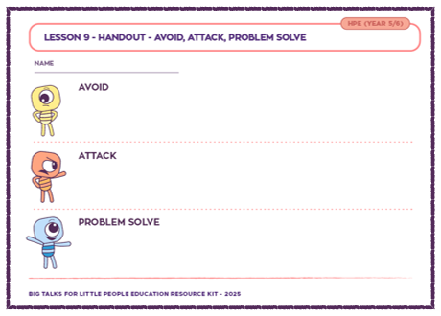
Part 3: Roleplay Scenarios
There are different responses to conflict. These include:
Avoid, Attack, and Problem Solve.
As a class, let’s roleplay the scenarios below with an additional character to react.
First in avoidance, second in attack, and lastly to problem solve.
1) Two friends take an embarrassing picture of their friend,
are laughing and post it online.
2) One student is sent a screenshot of a private message
where one friend shared a secret with someone they
trusted.
3) Four friends are playing an online game, two of them
keeping ‘kicking’ one person out of the game.
4) Two friends are looking at another friend’s social media
account and notice a few people have been leaving
mean comments.
2021
6
2021
Test
Test
6
6

Slide 7
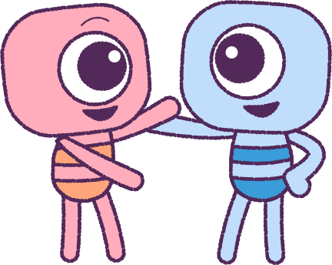
Part 3: Continued
Swap out the volunteers in your plays, so that others get a turn if they wish to.
You can also have a director who yells out ‘Action!’
and ‘Cut’ when your story is finished.
The audience may suggest other ways in which characters might show avoidance, attacking and problem-solving behaviours.
When you use a different method from the Avoid, Attack, Problem Solve list to approach a problem, there will be different outcome for each situation. Some outcomes may be good, and some may not be good.
Think about which strategy you would rather use,
so you will have a better chance of a good outcome.
2021
7
2021
Test
Test
7
7

Slide 8
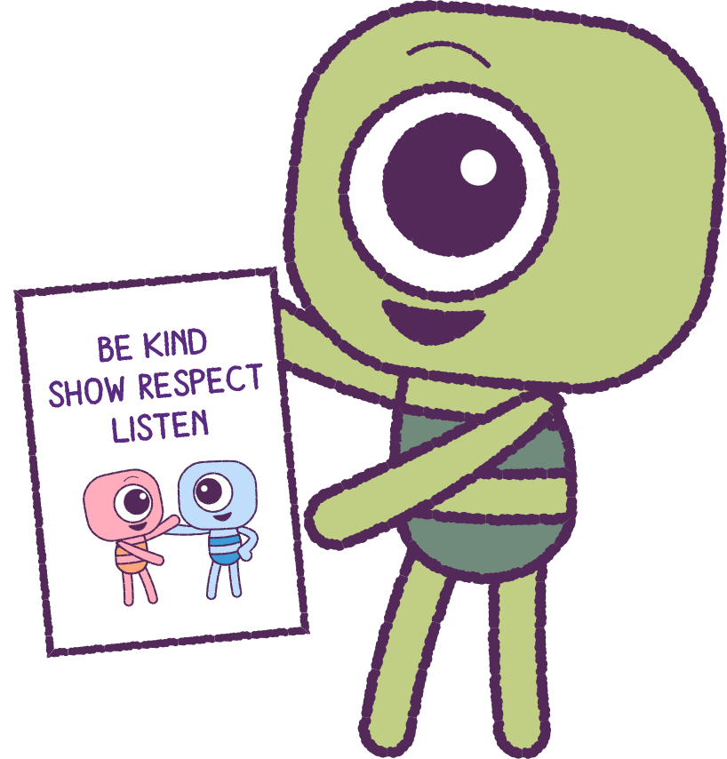
Part 4: Class Discussion and Poster
Develop a classroom strategy poster to help solve
conflicts and arguments. Use the below as a guide.
1. STOP. CALM DOWN, COOL OFF
Notice pain, body reaction.
2. SAY WHAT’S BOTHERING YOU
Don’t blame, attack, use put-downs or negative body language.
3. EACH PERSON REPEATS WHAT THE OTHER PERSON SAID
This brings understanding and empathy.
4.TAKE RESPONSIBILITY
What can each person do to improve things in the future?
5. BRAINSTORM SOLUTION
Find one that satisfies all parties.
6. AFFIRM, FORGIVE OR THANK
Acknowledge the effort made to overcome the natural
tendency to fight or withdraw.
2021
8
2021
Test
Test
8
8

Slide 9
This is the end of Lesson 9.
Great work!

