Slide 1





Professor Shane Pill (PhD) Professor Phillip Slee (PhD)
Associate Professor Deb Agnew (PhD) Dr Amy Wright (PhD)
Jessica Skuza (Research Assistant)

Slide 2
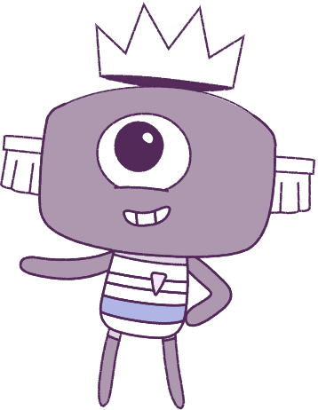




Lesson 10
Assessment & Conclusion
Lesson aims:
1.
Review the various types
of feelings and emotions.
Create a “3D Peep”, showing their understanding of strategies to help cope with feelings and motions.
2.
3.
Optional: Post-surveys.

Slide 3
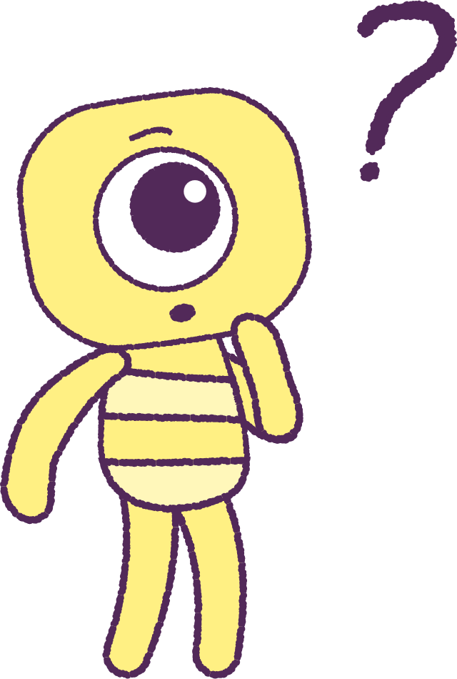

Part 1: Review content from last week
Who can remember what we discussed
last week?
In our session today, we will talk more about what we have learnt in general.
3

Slide 4
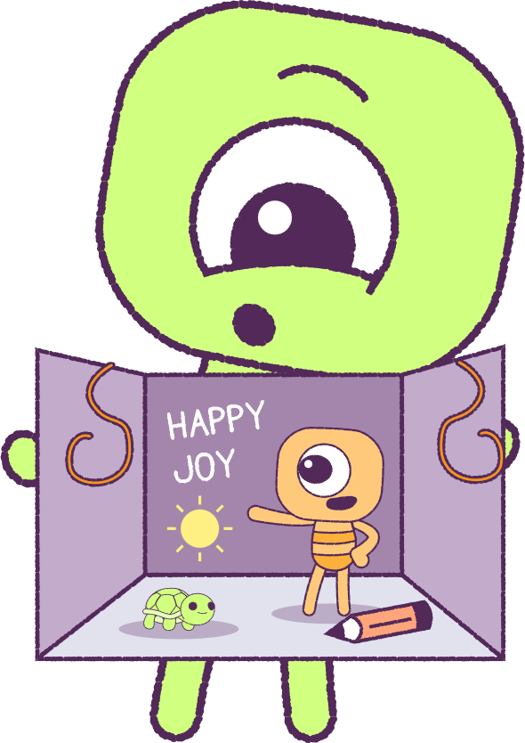
Part 2: 3D Peep Diorama
Use your imagination to create a hand-made 3D model or digital Peep of your choice that represents you (e.g. using recycled or craft materials, Microsoft PowerPoint or Canva). Think about how you would like it to look, what emotions, personal values and personal attributes that you would like to show, and what environment your Peep would like to be in. E.g.
Respect: You are kind and polite to others.
Empathy You understand things from other people’s point of view.
Inclusion You include others where you can.
Optional: Create a voice file to go with the digital picture,
that describes the special things about you, helps to explain how you have created your Peep, and why you have included those special things in your Peep.
2021
4
2021
Test
Test
4
4

Slide 5

Part 3: Student post-survey
(OPTIONAL)
This optional post-survey will ask questions about how you think and feel.
Please have students visit the below website link:
www.caper.com.au
And click on:
“HPE Module – Student Surveys Years 5-6”.
It is important that you answer the questions as honestly as possible as the information will be used to help understand the well-being of young people.
This pre-survey will take a minimum of 15 minutes
2021
5
2021
Test
Test
5
5

Slide 6
Part 4: Teacher post-survey
(OPTIONAL)
This optional post-survey will ask questions about how the HPE program went.
Please visit the below website link:
www.caper.com.au
And click on:
“Teacher Implementation Index”.
It is important that you answer the questions as honestly as possible as the information will be used to help understand the well-being of young people.
This pre-survey will take a minimum of 15 minutes
2021
6
2021
Test
Test
6
6

Slide 7
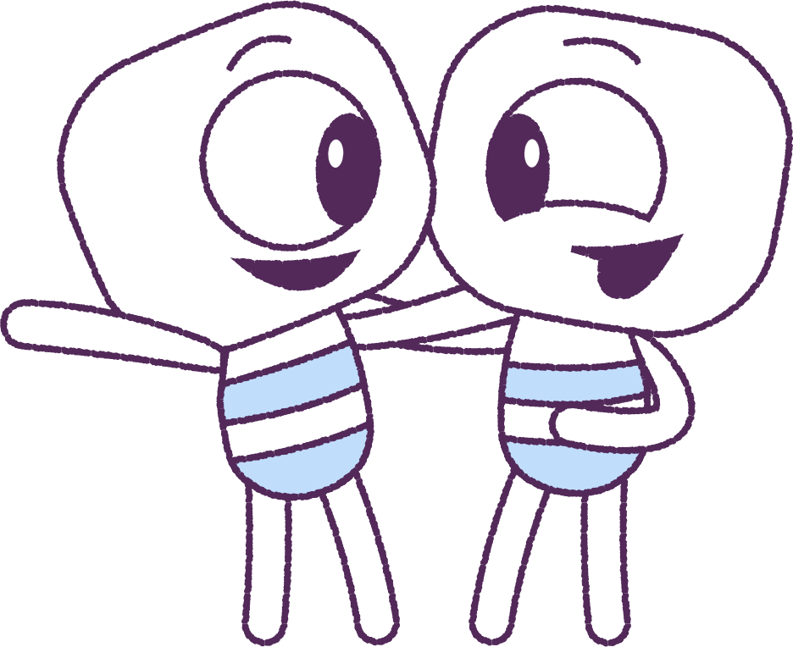
Conclusion
Recognise the good and bad things that other
people do and feel, which makes you a stronger,
more confident person.
Remember strategies (good plans) to help you
manage your feelings and emotions.
You can STOP. CALM DOWN. COOL OFF.
Be respectful to others by:
• ‘Talking with kindness’
• ‘Acting with kindness’
• ‘Playing with kindness’
TREAT OTHERS AS YOU WOULD TREAT A GOOD FRIEND!
2021
7
2021
Test
Test
7
7

Slide 8
This is the end of Lesson 10.
Great work!

